Slide 1
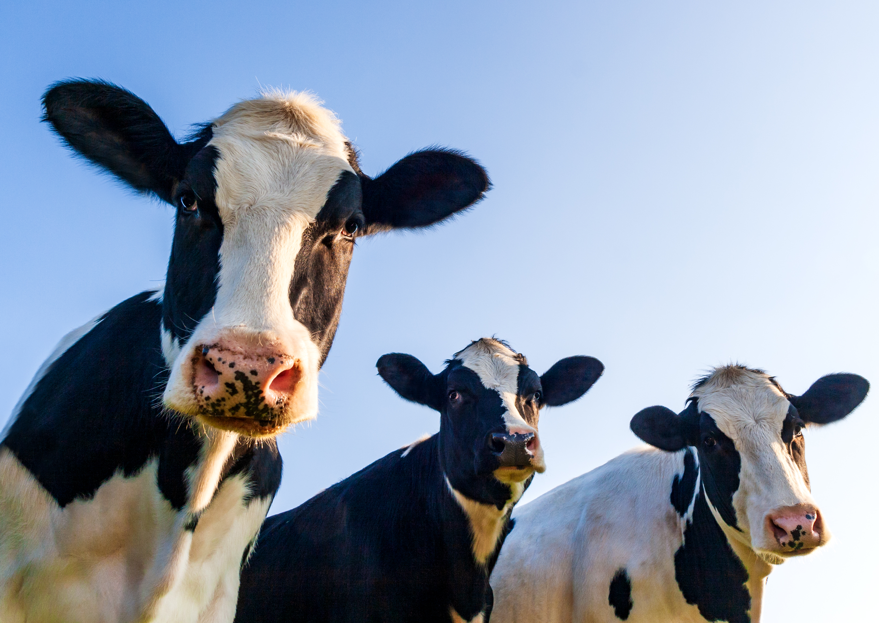
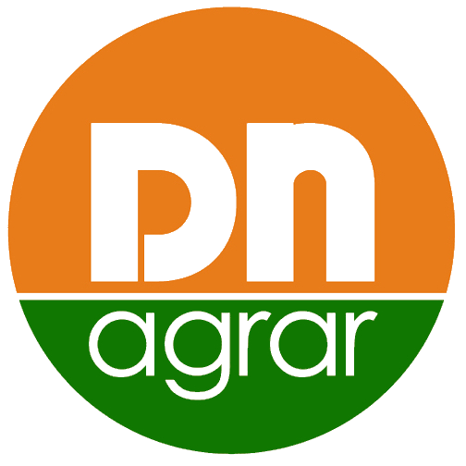
DN AGRAR Group
OGMS APRIL 2024

Slide 2




CONTENT
ABOUT DN AGRAR & THE MARKET
DN AGRAR RESULTS 2023
DN AGRAR PROJECTS & FINANCIAL PROJECTIONS
DN AGRAR BUDGET 2024

Slide 3
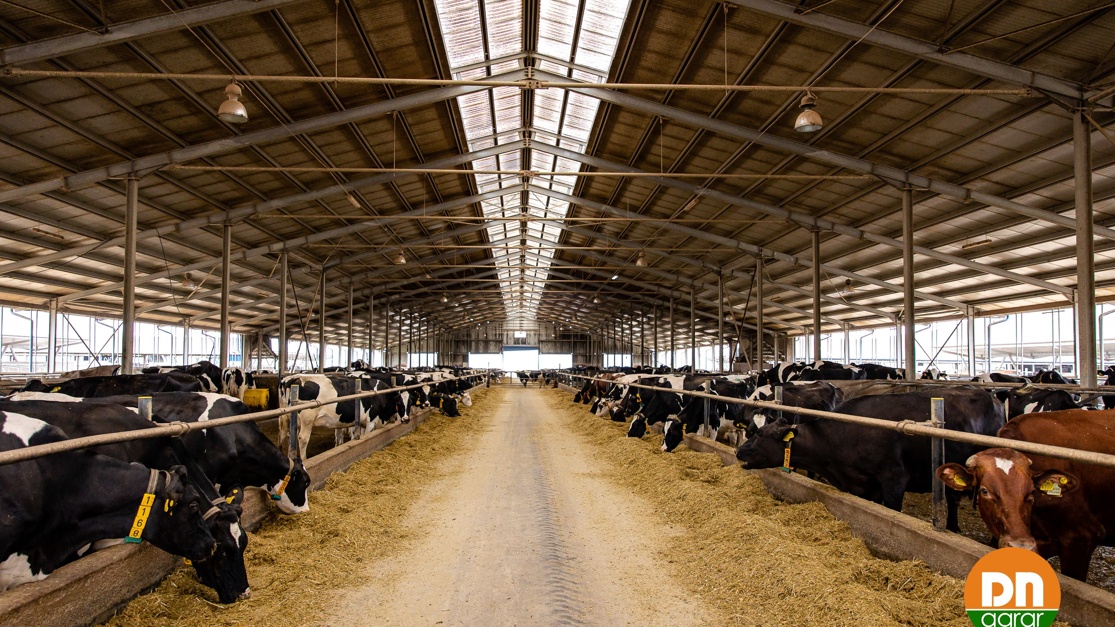
ABOUT
DN AGRAR
& THE MARKET

Slide 4
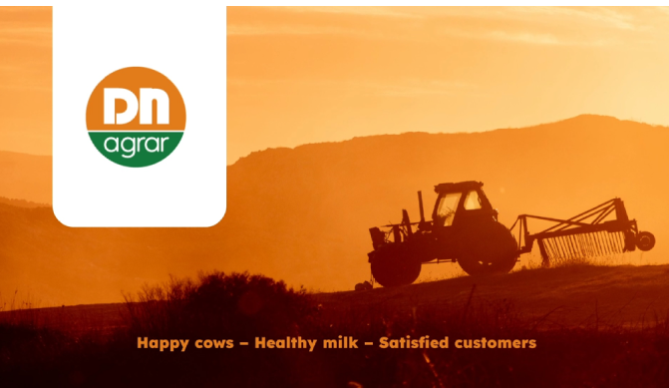
DN AGRAR INVESTMENT PROPOSITION
Leading milk producers in Europe and the largest integrated zootechnical farm in Romania, with cow milk production and vegetable production.
Market
Position
Focus on sustainable, regenerative agriculture practices that maximize productivity, reduce environmental impact, and ensure long-term profitability.
Sustainable
Agriculture
Strategy
Tripled its business since listing.
To double the business by 2027 supported by operation efficiencies and the development of a new farm.
Milk production at the end of 2027: 300,000 liters/day
Target 2028: production of over 100 million liters of milk delivered annually
Track
Record
~ 60 million liters of milk delivered annually.
Notes:
With a clear vision for expansion and development, DN AGRAR aims to capitalize on emerging opportunities in the agricultural market while mitigating risks through prudent financial management and strategic planning

Slide 5

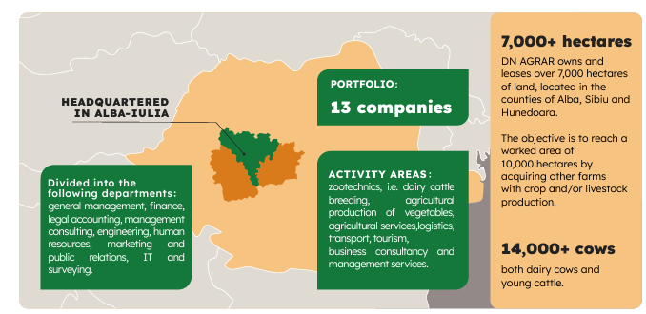


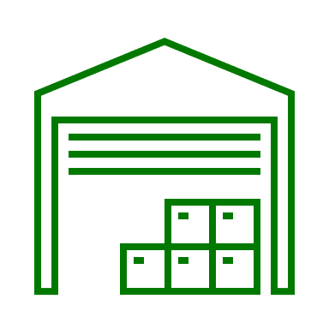




DN AGRAR TODAY
Zootechnics
Vegetal agriculture production
Agricultural services
Logistics
Transport
Tourism
Business and management consulting services
5
5

Slide 6

DN AGRAR FARMS TODAY
APOLD FARM
CUT FARM
Over 4,800 dairy cattle & young stock
70,000 liters/day
400 cows milked/hour
2,100 dairy cattle
50,000 liters/day
300 cows milked/hour
LACTO AGRAR FARM
PRODLACT FARM
4,000 dairy cattle & young stock
63,000 liters/day
350 cows milked/hour
Over 3,300 young stock animals
Raising young cattle for Apold and Cut farms

Slide 7
KEY DIFFERENTIATORS OF DN AGRAR
Romanian cost price – Western Europe selling price
High volume of milk
Constant quality
Minimal use of chemical fertilizers
Animals monitored 24/7 by our veterinary teams
Circular agriculture
Investing in the most modern equipment on the market
Automatization & Digitalization
Experienced personnel
Constant growth – organically and through acquisitions
Transparency and predictability
Quarterly reporting
Experienced Management team
Notes:
The amount of raw milk imported by processing units decreased in January 2023 compared to
the previous month by 13.2%.

Slide 8
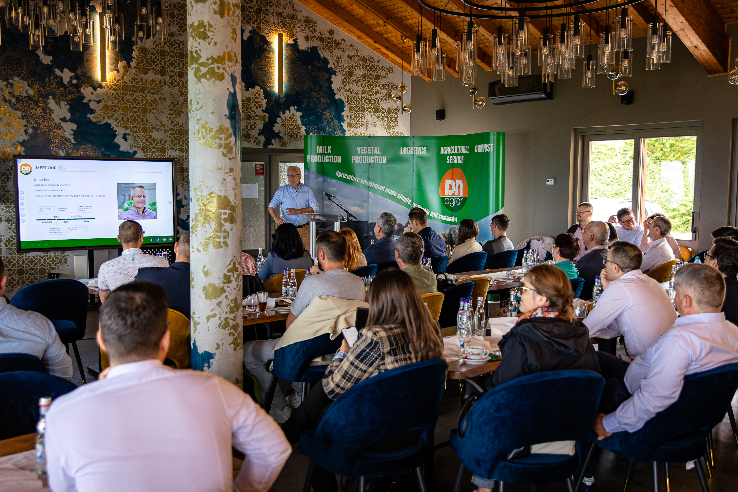
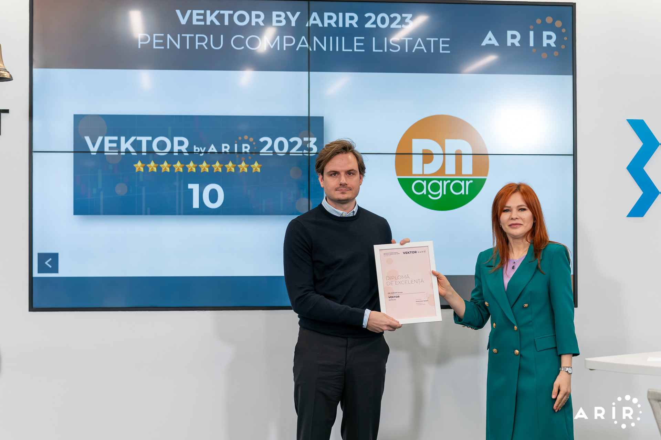
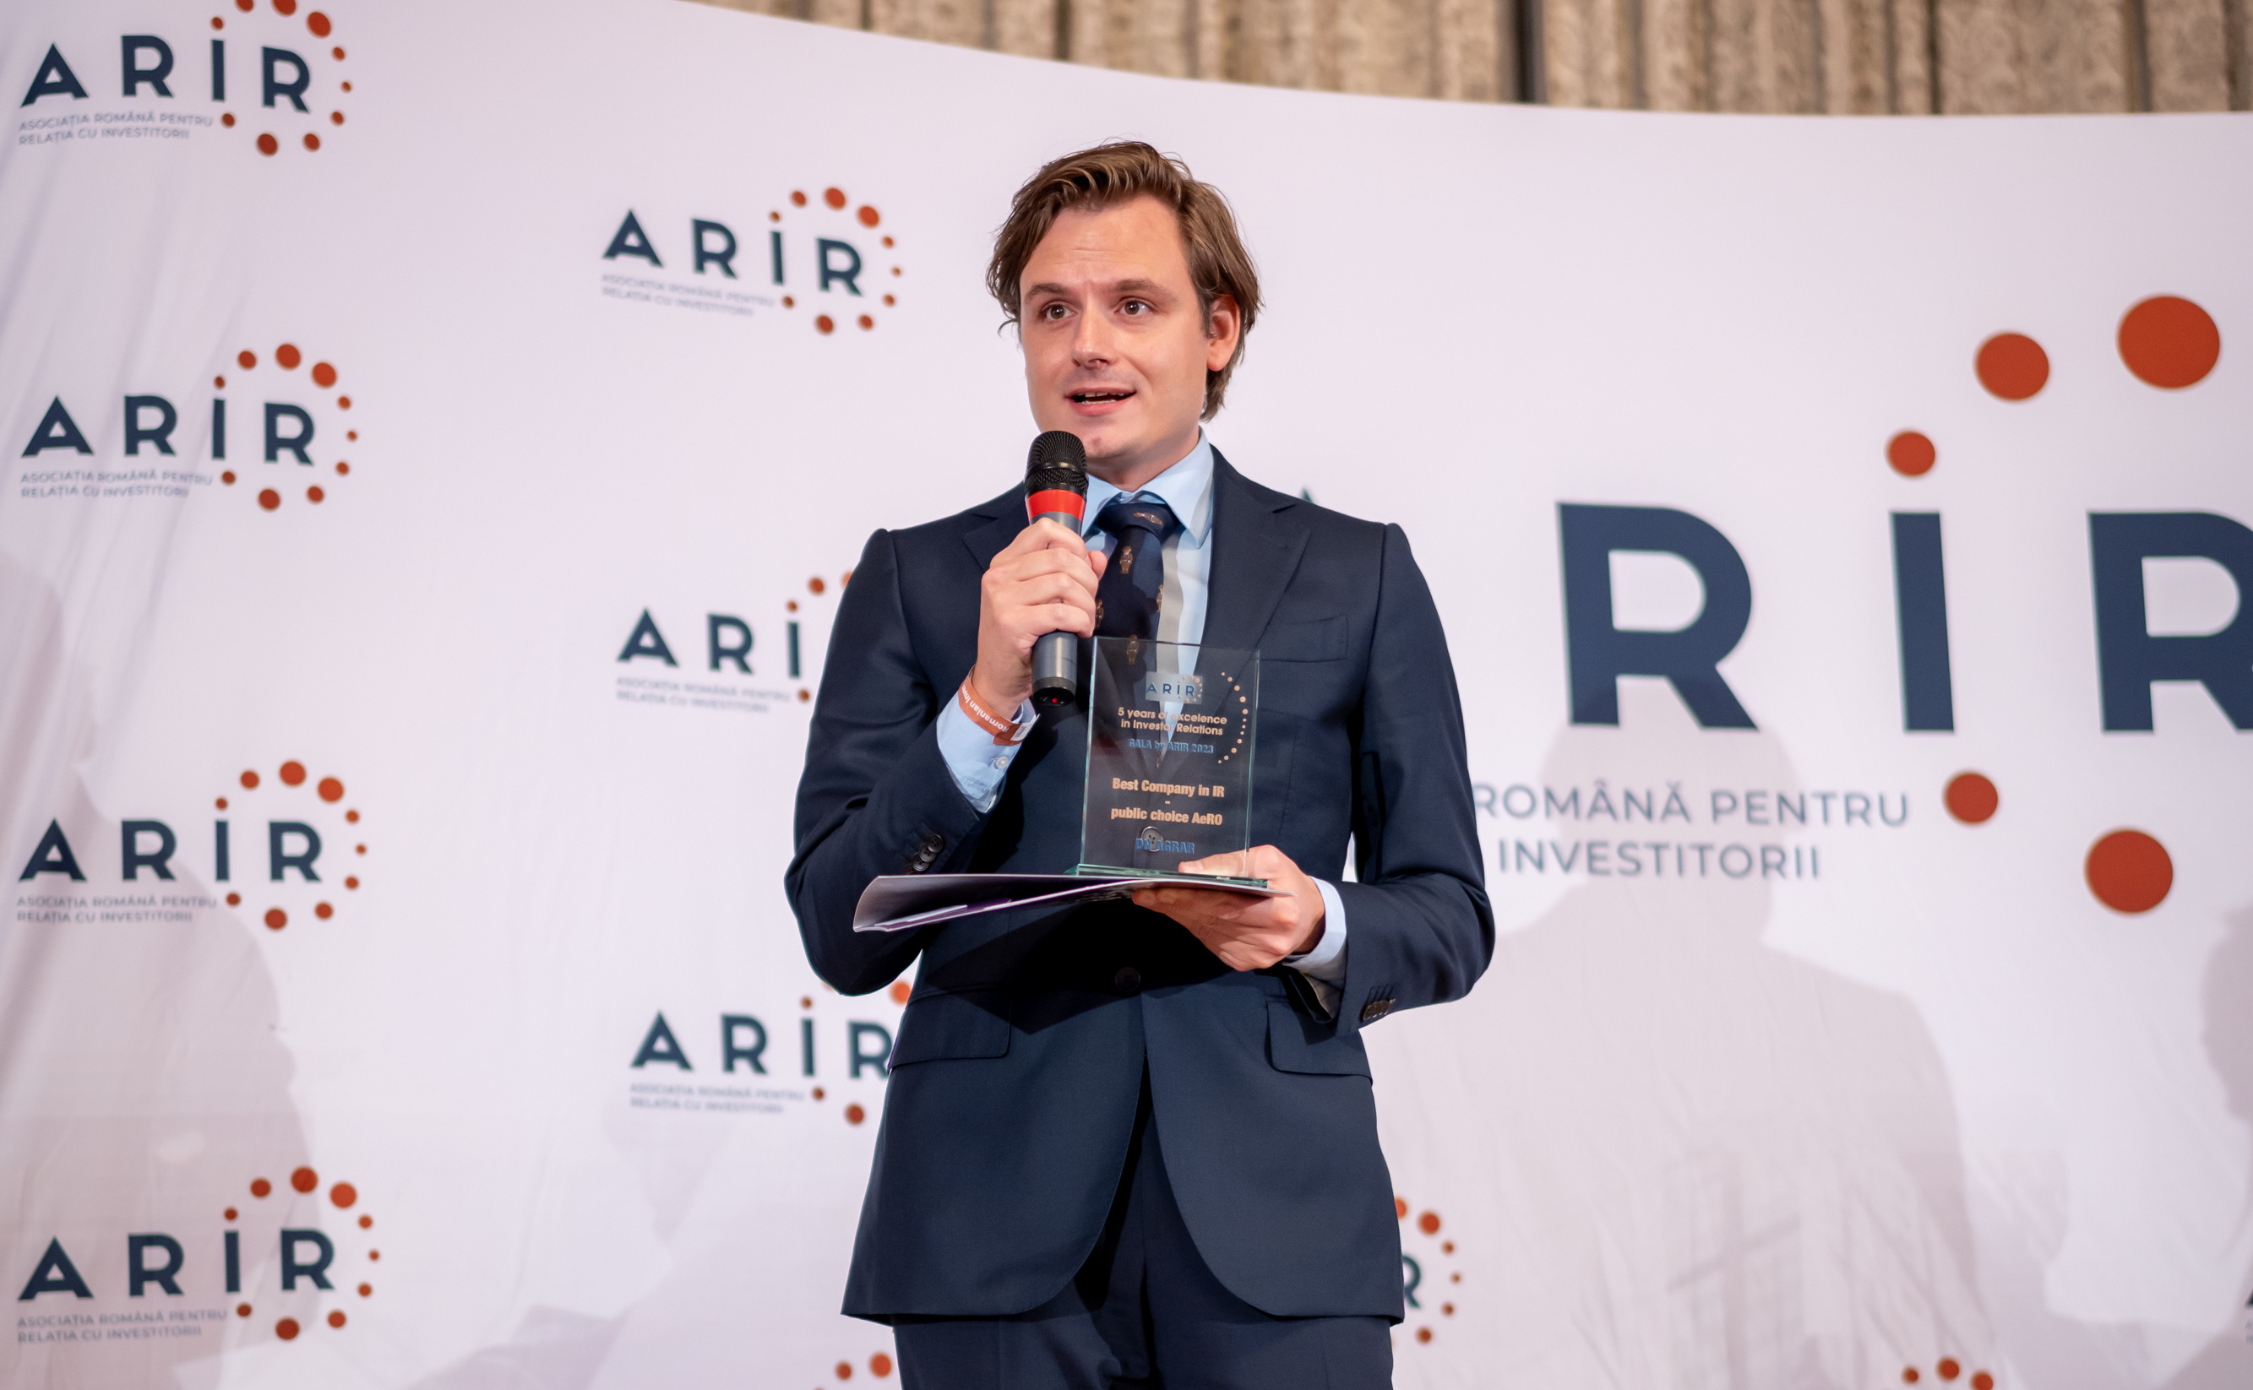
DN AGRAR IN THE CAPITAL MARKET
Listed on the Bucharest Stock Exchange, AeRO market since February 2, 2022
+24.81% (YTD) share price performance, +75.82% in 2023
Shares included in the BETAeRO and MSCI Frontier Small Cap and MSCI Romania Small Cap indices
Over 2.300 investors (+150% in the last year)
Market-Making services provided by BRK Financial Group
First Investors’ Day organized in June 2023
Over 60 investors present in Alba, to see the farms
Analysts covering the share
Prime Transaction – December 18, updated target price 1.6922 RON
Prime Transaction – November 22, target price 1.5954 RON
BRK Financial Group – June 30, target price 0.91 RON
Recognition
Best Company in IR – AeRO Market, awarded by ARIR after being voted by individual investors
8.5 at first VEKTOR by ARIR 2022 evaluation
10 in the second VEKTOR by ARIR 2023 evaluation

Slide 9
MARKET EVOLUTION AND TRENDS
Key highlights of the Romanian milk market
Key highlights of the European milk market
6.2% increase in the quantity of milk collected in 2023, one of the highest growth rates in the European Union
21% decrease in imported raw milk, following a 3-year period of growth (2020-2022) NSI Romania, provisional data for 2023.
Over the past 10 years (2014-2023), the quantity of collected milk increased by 21%, while imported milk rose by 48.8%.
The dairy market has been volatile, consumption has remained robust, albeit with some notable changes in consumer preferences and behavior
The volumes collected at the European level are similar to those in 2022
The average price of raw milk in 2023 decreased by 6.4% compared to 2022
*source: insse.ro, agrointel.ro, ec.europa.eu/eurostat.

Slide 10



FRAGMENTATION OF THE ROMANIAN MARKET
“FRIESLAND CAMPINA” (Napolact)
“OLYMPUS”
Collected approx. 300,000 liters/day (2022)
Collects milk from over 1,100 farmers
who milk 20,000 cows
Collected approx. 650,000 liters/day
Collects milk from over 1,300 farmers (2021)
“DANONE”
“LACTALIS”
Collected approx. 150,000 liters/day (2022)
Collects milk from 24 direct supplier farms and
1 collection center that collects milk from 200 small farmers
Collected approx. 685,000 liters/day (2022)

Slide 11
DN AGRAR
RESULTS 2023

Slide 12

KEY PERFORMANCE INDICATORS IN 2023
TURNOVER
NET PROFIT
EBITDA
RON 150.88 mil.
+0.06%
Vs FY 2022
RON 22.67 mil.
+62.64%
Vs FY 2022
RON 53.97 mil.
+24.53%
Vs FY 2022
NET ASSETS
TOTAL ASSETS
EQUITY
RON 231.26 mil.
+32.35%
Vs 31.12.2022
RON 307.94 mil.
+31.29%
Vs 31.12.2022
RON 133.33 mil.
+67.38%
Vs 31.12.2022
12

Slide 13
KEY FACTORS INFLUENCING FINANCIAL RESULTS IN 2023
Expenses related
to revaluation
differences
Higher production
cost for crop
Increase in income from operating subsidies
The subsidy income had a positive impact in 2023 compared to previous years, it's important to mention that the subsidies received for 2023 are based on the number of animals owned by the company in 2018. Had the subsidies been calculated on the number of animals owned in 2023, the estimated revenues that DN AGRAR could have received would have been higher by RON 1,257,000.
Increased expenditure on rendering compared to the previous year
In the 4th quarter of 2023, DN AGRAR farms underwent a revaluation of fixed assets. Expenses related to revaluation differences amounted to RON 482,724, primarily stemming from the revaluation of agricultural land.
In Q4 2023, crop production costs rose, leading to higher lease-in-kind expenses paid to agricultural landowners in products like corn and wheat. These increased costs also affected milk production expenses, negatively impacting the profitability of the livestock business line by RON 4.26 million.
The acquisition of DN Agrar Apold farm resulted in a Goodwill of RON 5,000,000, due to the difference between the acquisition value of shares and the revalued asset value, with a depreciation period of 5 years. The company will record an additional depreciation of RON 1,000,000 per year for the next 4 years, similar to 2023. Negative difference of RON 877,749 due to herd restructuring after restocking with young animals. Increase in depreciation expenses and disposal of fixed assets recorded in the financial year 2023.
Unrealized
profit on
feed stock
In the 4th quarter of 2023 at the level of intra-group transactions for feed stocks, was not considered realized profit the amount for feed stocks of RON 700,000. This will be reflected in the consolidated financial statements in the year 2024 when the feed stocks will be released for consumption.
Changes in
the strategy
for the growth
of the young
cattle herd
In the year 2023 there was a change related to the livestock management at the DN AGRAR Group. This change consisted in moving the young cattle from the DN Agrar Prodlact farm to the DN Agrar Apold farm leading to a decrease in the profitability of the Apold farm by approximately RON 3,77 million, the largest part of this amount impacted the 4th quarter of 2023. The impact will be gradually recovered in the coming years from lower depreciation expense assets that will go into milk production as well as from income that will be recorded from the production of tangible fixed assets.

Slide 14

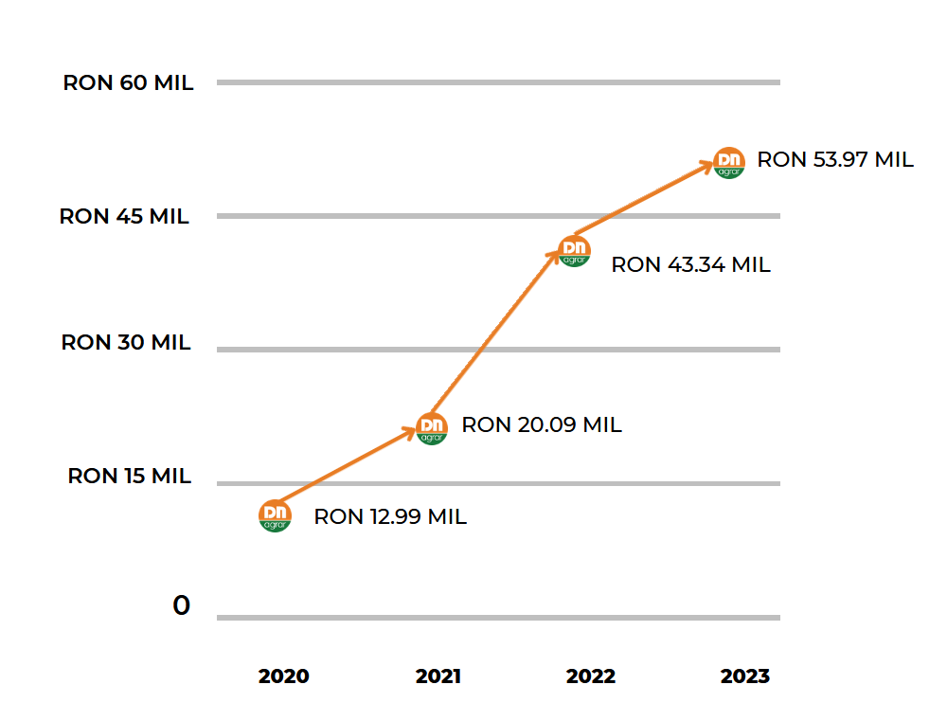
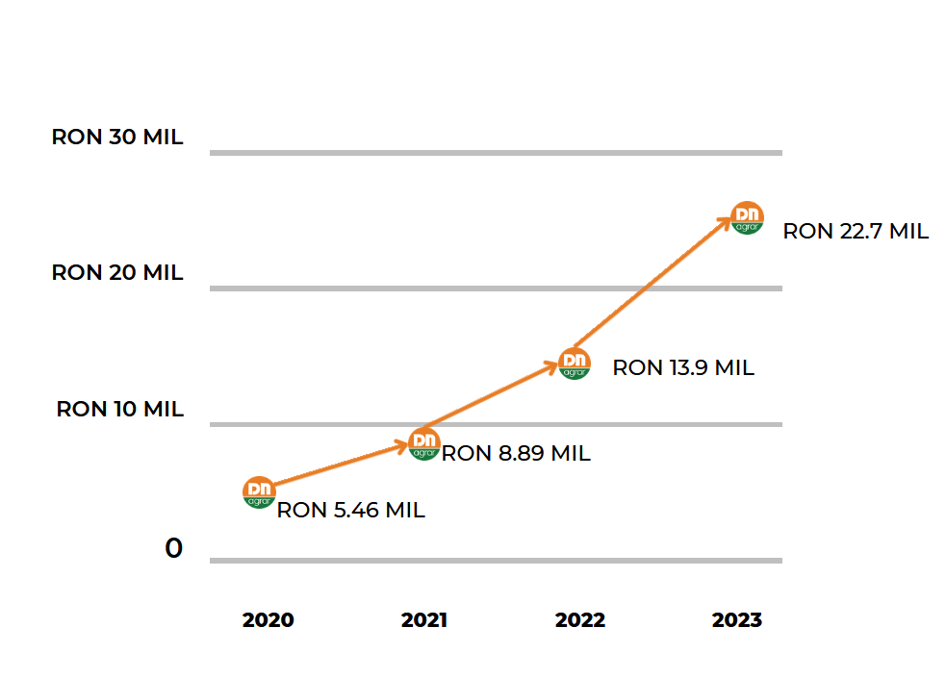
KEY PERFORMANCE INDICATORS EVOLUTION
EVOLUTION NET PROFIT
EVOLUTION EBITDA
14
14

Slide 15
KEY PERFORMANCE INDICATORS
KEY PERFORMANCE INDICATORS (RON) | 31/12/2023 | 31/12/2022 | 31/12/2021 | 31/12/2020
TURNOVER | 150,886,163 | 150,789,463 | 46,951,665 | 38,220,407
NET PROFIT | 22,672,945 | 13,940,230 | 8,888,910 | 5,464,045
NET ASSETS | 231,264,711 | 174,740,878 | 104,983,616 | 57,260,284
TOTAL ASSETS | 307,944,974 | 234,555,704 | 146,975,768 | 80,690,944
EBITDA | 53,978,555 | 43,344,722 | 20,091,765 | 12,989,414
EQUITY | 133,339,798 | 79,661,430 | 10,606,282 | 36,100

Slide 16
THE BALANCE SHEET
BALANCE SHEET INDICATORS (RON) | 31/12/2023 | 31/12/2022 | 31/12/2021 | 31/12/2020
FIXED ASSETS - TOTAL | 212,141,058 | 160,654,419 | 96,416,465 | 57,557,888
CURRENT ASSETS - TOTAL | 94,362,606 | 72,472,451 | 49,426,260 | 22,362,883
DEFERRED EXPENSES | 1,441,310 | 1,428,834 | 1,133,043 | 770,173
TOTAL ASSETS | 307,944,974 | 234,555,704 | 146,975,768 | 80,690,944
DEBTS: AMOUNTS TO BE PAID WITHIN UP TO ONE YEAR | 76,397,539 | 59,675,569 | 41,793,980 | 23,430,660
DEBTS: AMOUNTS TO BE PAID IN MORE THAN ONE YEAR | 95,954,744 | 92,906,479 | 39,325,133 | 27,273,458
PROVISIONS | 385,892 | 305,969 | 200,465 | 142,636
DEFERRED REVENUES | 1,867,001 | 2,006,257 | 198,172 | -
DEBT - TOTAL | 172,352,283 | 152,582,048 | 81,119,113 | 50,704,118
EQUITY – TOTAL | 133,339,798 | 79,661,430 | 65,458,018 | 29,844,190
TOTAL EQUITY AND DEBT | 307,944,974 | 234,555,704 | 146,975,768 | 80,690,944

Slide 17
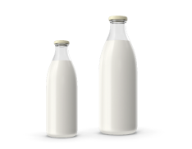

MILK PRODUCTION EVOLUTION
DN AGRAR - Monthly Evolution of the Quantity of Milk Delivered in 2024 (3M) vs 2023 vs 2022
🐄 In 2023 the quantity of milk delivered increased by 14% compared to 2022.
🐄 In the first quarter of 2024, DN registered over 18% advance in the amount of milk delivered, compared to the same period last year.
🐄 Continuing the positive trend from January 2024, DN AGRAR exceeded the threshold of 5 million liters delivered monthly in Q1 2024.
18% increase
in Q1 2024 vs Q1 2023

Slide 18
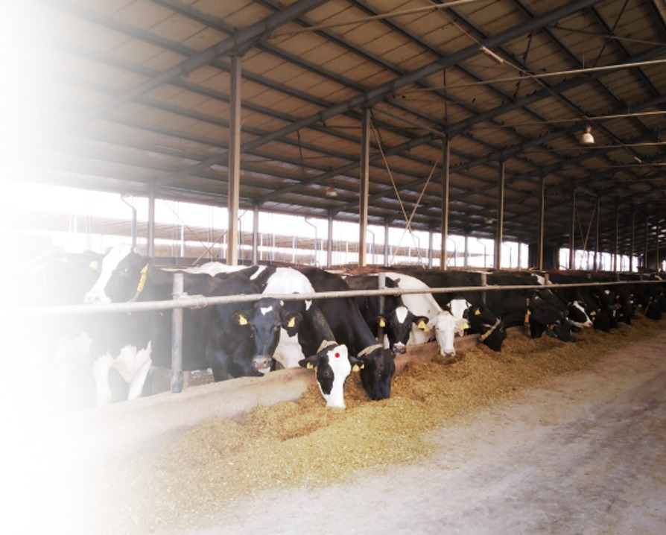
DN AGRAR PROJECTS & FINANCIAL PROJECTIONS

Slide 19
OUR STRATEGY FOR THE PERIOD 2024-2027
Since the beginning of DN AGRAR's operations in Romania, starting from 2008, we made major investments totalling approximately 100 million euros. In recent years, the company has undergone a rapid process of consolidation and expansion, which included the acquisition of two farms (DN AGRAR Apold and Lacto Agrar) to achieve a leading position.
Doubling our Business in 2024-2027
Digitization & Automation
Diversification of Activities
Emissions Reduction & Circular Agriculture
The New Straja Farm
Compost Factory
New Farm Acquisitions
Installation of Robots on Farms
Digitization of the Administrative and Financial-Accounting Department
Production of Liquefied or Compressed Biogas
Compost Factory
Solar Panels on Farm Buildings' Roofs
Photovoltaic Park near the Apold Farm
Compost Factory
Utilization of No-tillage Technology
The reduction of impact on the environment through crop rotation strategy

Slide 20
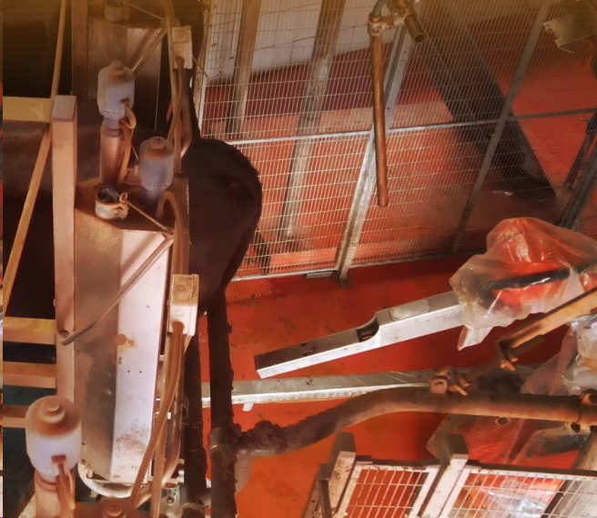
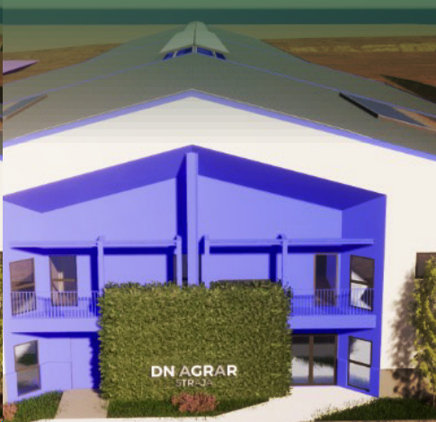
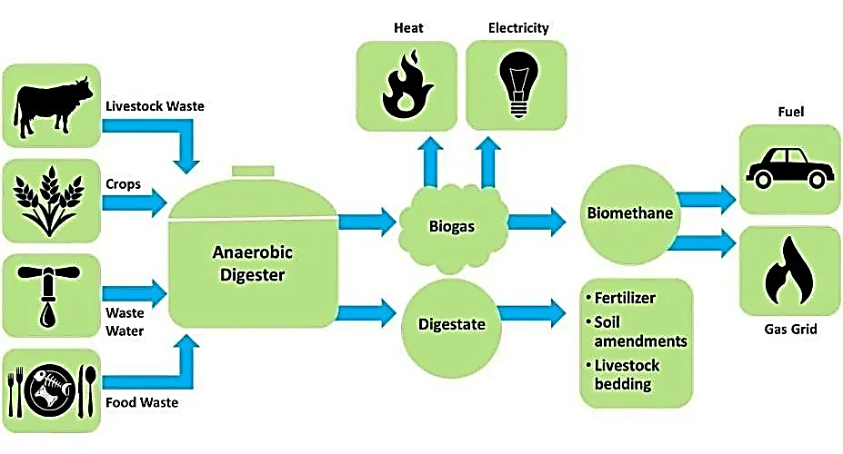
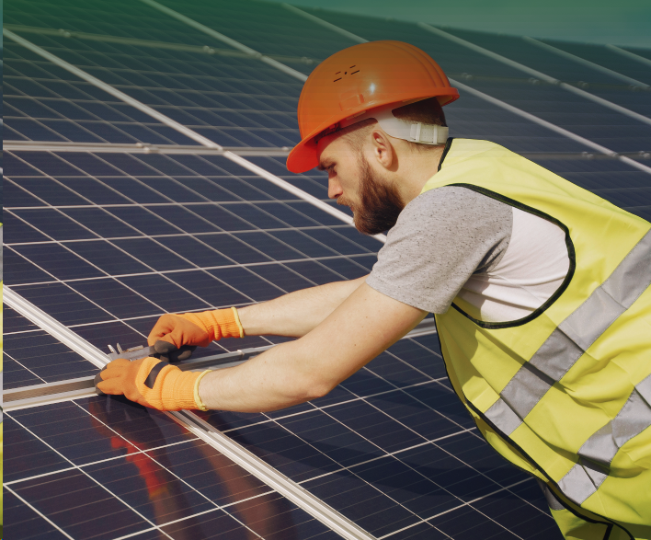
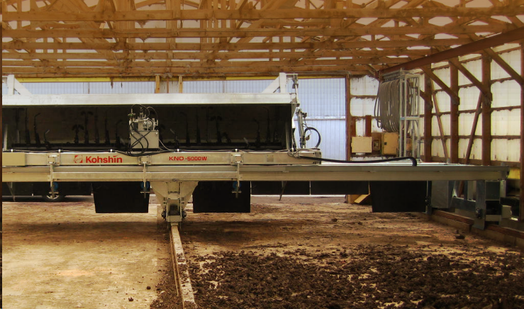
CURRENT PROJECTS AND PERSPECTIVES
Production of Liquefied
or Compressed Biogas
By using manure from own farms in biogas production,
DN AGRAR will reduce its carbon emissions by 90%.
Robots for farms
Installation of 2nd robot
for the milking parlors of
the DN AGRAR Cut and
Lacto Agrar farms.
Straja project
In the first part of 2024, we will start the construction phase for the first milking parlour, and in September 2024, we expect to start milk production at the Straja farm with 600 dairy cows, and gradually increase the number of dairy cows to 900, by the end of 2024.
Compost Factory Construction
In 2023, we completed the first 3 phases of this project, with the completion of the construction of the composting building, where we will place the composting unit.
Solar panels on the roof of the buildings of the DN AGRAR Apold, DN AGRAR Cut and Lacto Agrar farms.

Slide 21
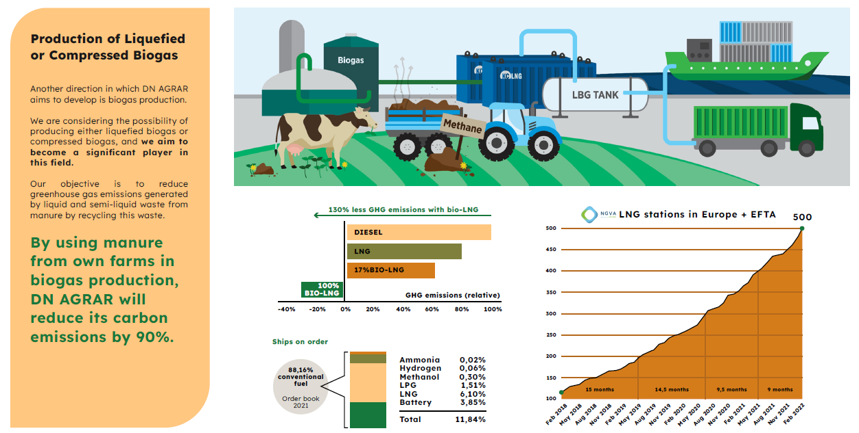
CURRENT PROJECTS AND PERSPECTIVES

Slide 22

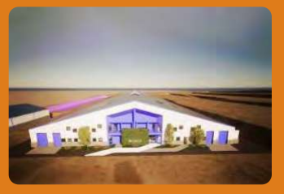
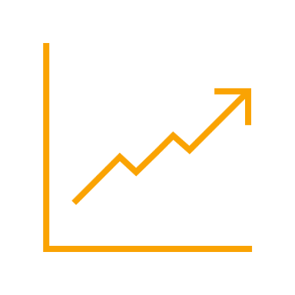
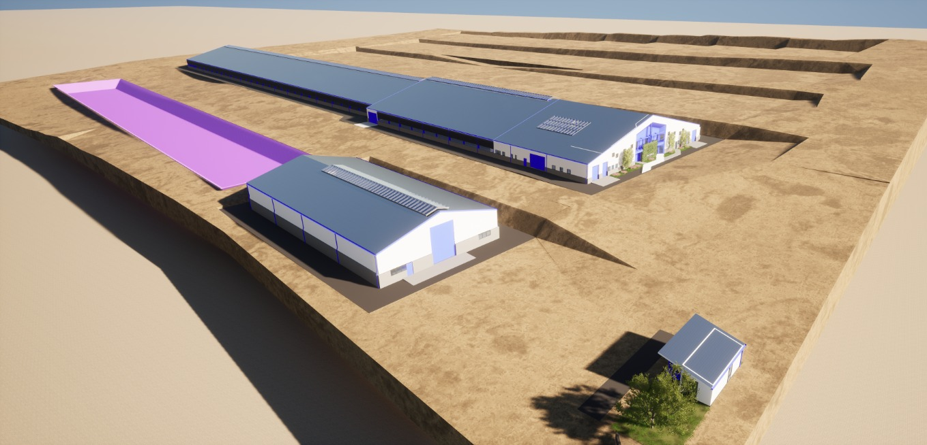

STRAJA PROJECT
Project planned to be completed in 2027
Capacity of 5,000 cows (3,800 dairy cows & 1,200 young stock)
Timeline
2024: Construction works start, approx. 1,000 cows in production
2025: Approx. 1,700 cows in production & pregnancy
2026: Approx. 3,400 cows in production & pregnancy
2027: Approx. 4,000 cows in production & pregnancy
Impact
Straja Project will be an engine to our company’s growth, being estimated to double DN AGRAR’s business
Financing
A credit facility of 9.2 million euros to develop the farm, for equipment and the purchase of animals.
For this project, DN AGRAR will provide 20.78% by own sources.

Slide 23
DN AGRAR DAIRY FARMS 2027/2028
OVER 300.000 LITERS PER DAY
THE 4 DAIRY FARMS WILL PRODUCE OVER 100 MILLION LITERS OF MILK ANNUALLY
A HERD OF APPROX 20.000 DAIRY COWS AND YOUNG STOCK

Slide 24
DN AGRAR FARMS 2027/2028
STRAJA FARM
Acquisition FARM
3,800 dairy cattle
1,200 young stock
100,000 liters/day
600 cows milked/hour
………. dairy cattle
……….liters/day
………. cows milked/hour
APOLD FARM
CUT FARM
Over 4,800 dairy cattle + young stock
100,000 liters/day
400 cows milked/hour
2,100 dairy cattle
50,000 liters/day
300 cows milked/hour
LACTO AGRAR FARM
PRODLACT FARM
4,000 dairy cattle + young stock
63,000 liters/day
350 cows milked/hour
Over 3,300 young stock animals
Raising young cattle for Apold and Cut farms

Slide 25
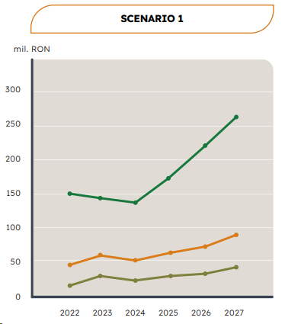
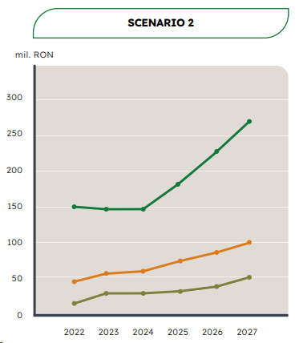
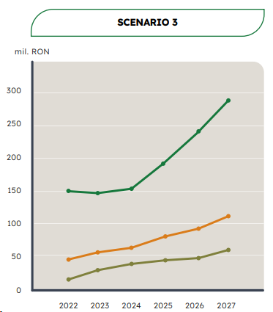
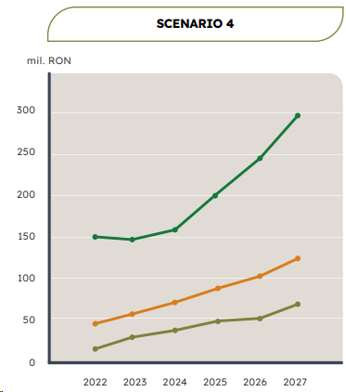
WORKING SCENARIOS until 2027
Net Profit
Net Turnover
EBITDA
The selling price of milk is considered to be close to 2023's lowest selling price.
The milk price at the average price level we achieved from the sale of production in November 2023.
The price of milk is considered to be at the level of the annual average at which we sold milk in 2023.
Takes into account a positive evolution in the milk price, higher than the average selling price in 2023, but at a significantly lower level than the sales price from the first quarter of 2023.

Slide 26
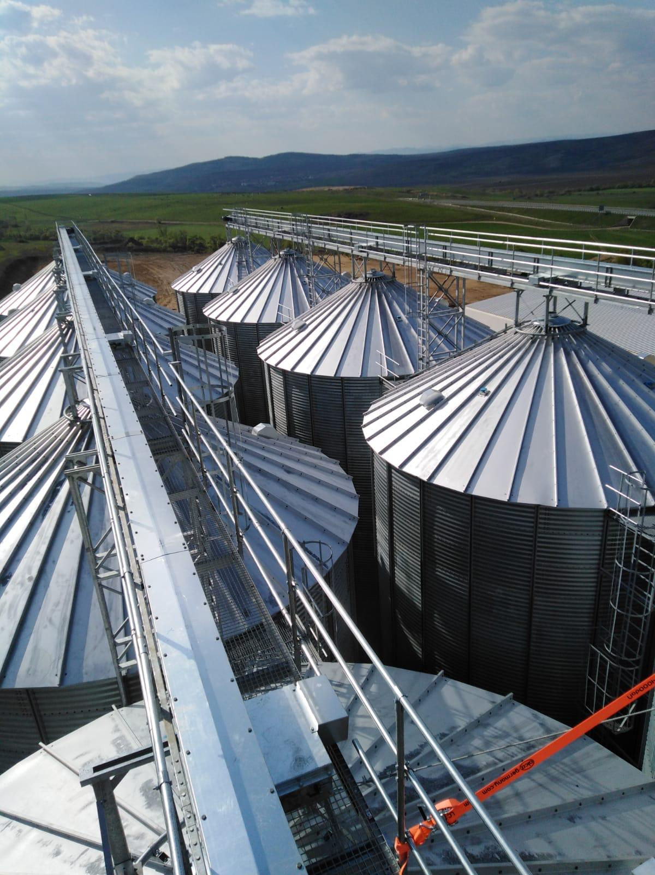
DN AGRAR BUDGET 2024

Slide 27

BUDGET 2024: FORECASTING AND OUTLOOK
OPERATING INCOME FROM SUBSIDIES
RON 25 mil.
-7.84%
Vs 31.12.2023
NET PROFIT
RON 30.07 mil.
+32.66%
Vs 31.12.2023
OPERATING INCOME
RON 237.76 mil.
+1.29%
Vs 31.12.2023
OPERATING EXPENSES
RON 194.58 mil.
-2.80%
Vs 31.12.2023
TURNOVER
RON 153.25 mil.
+1.57%
Vs 31.12.2023

Slide 28
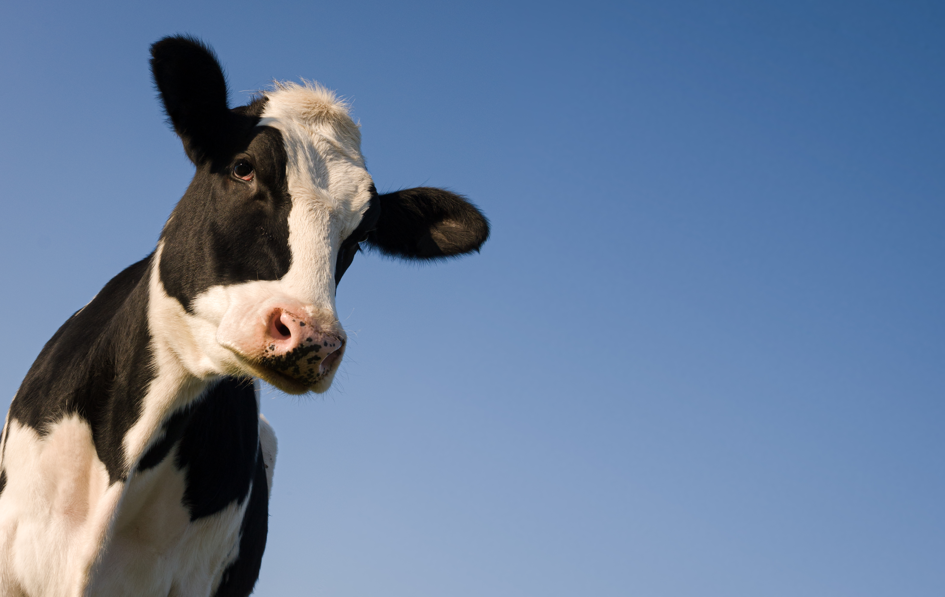
CONTACT INVESTOR RELATIONS
Peter de Boer,
BoD Member & Investor Relations Manager
investors@dn-agrar.eu , +40 258 818114

