Slide 1
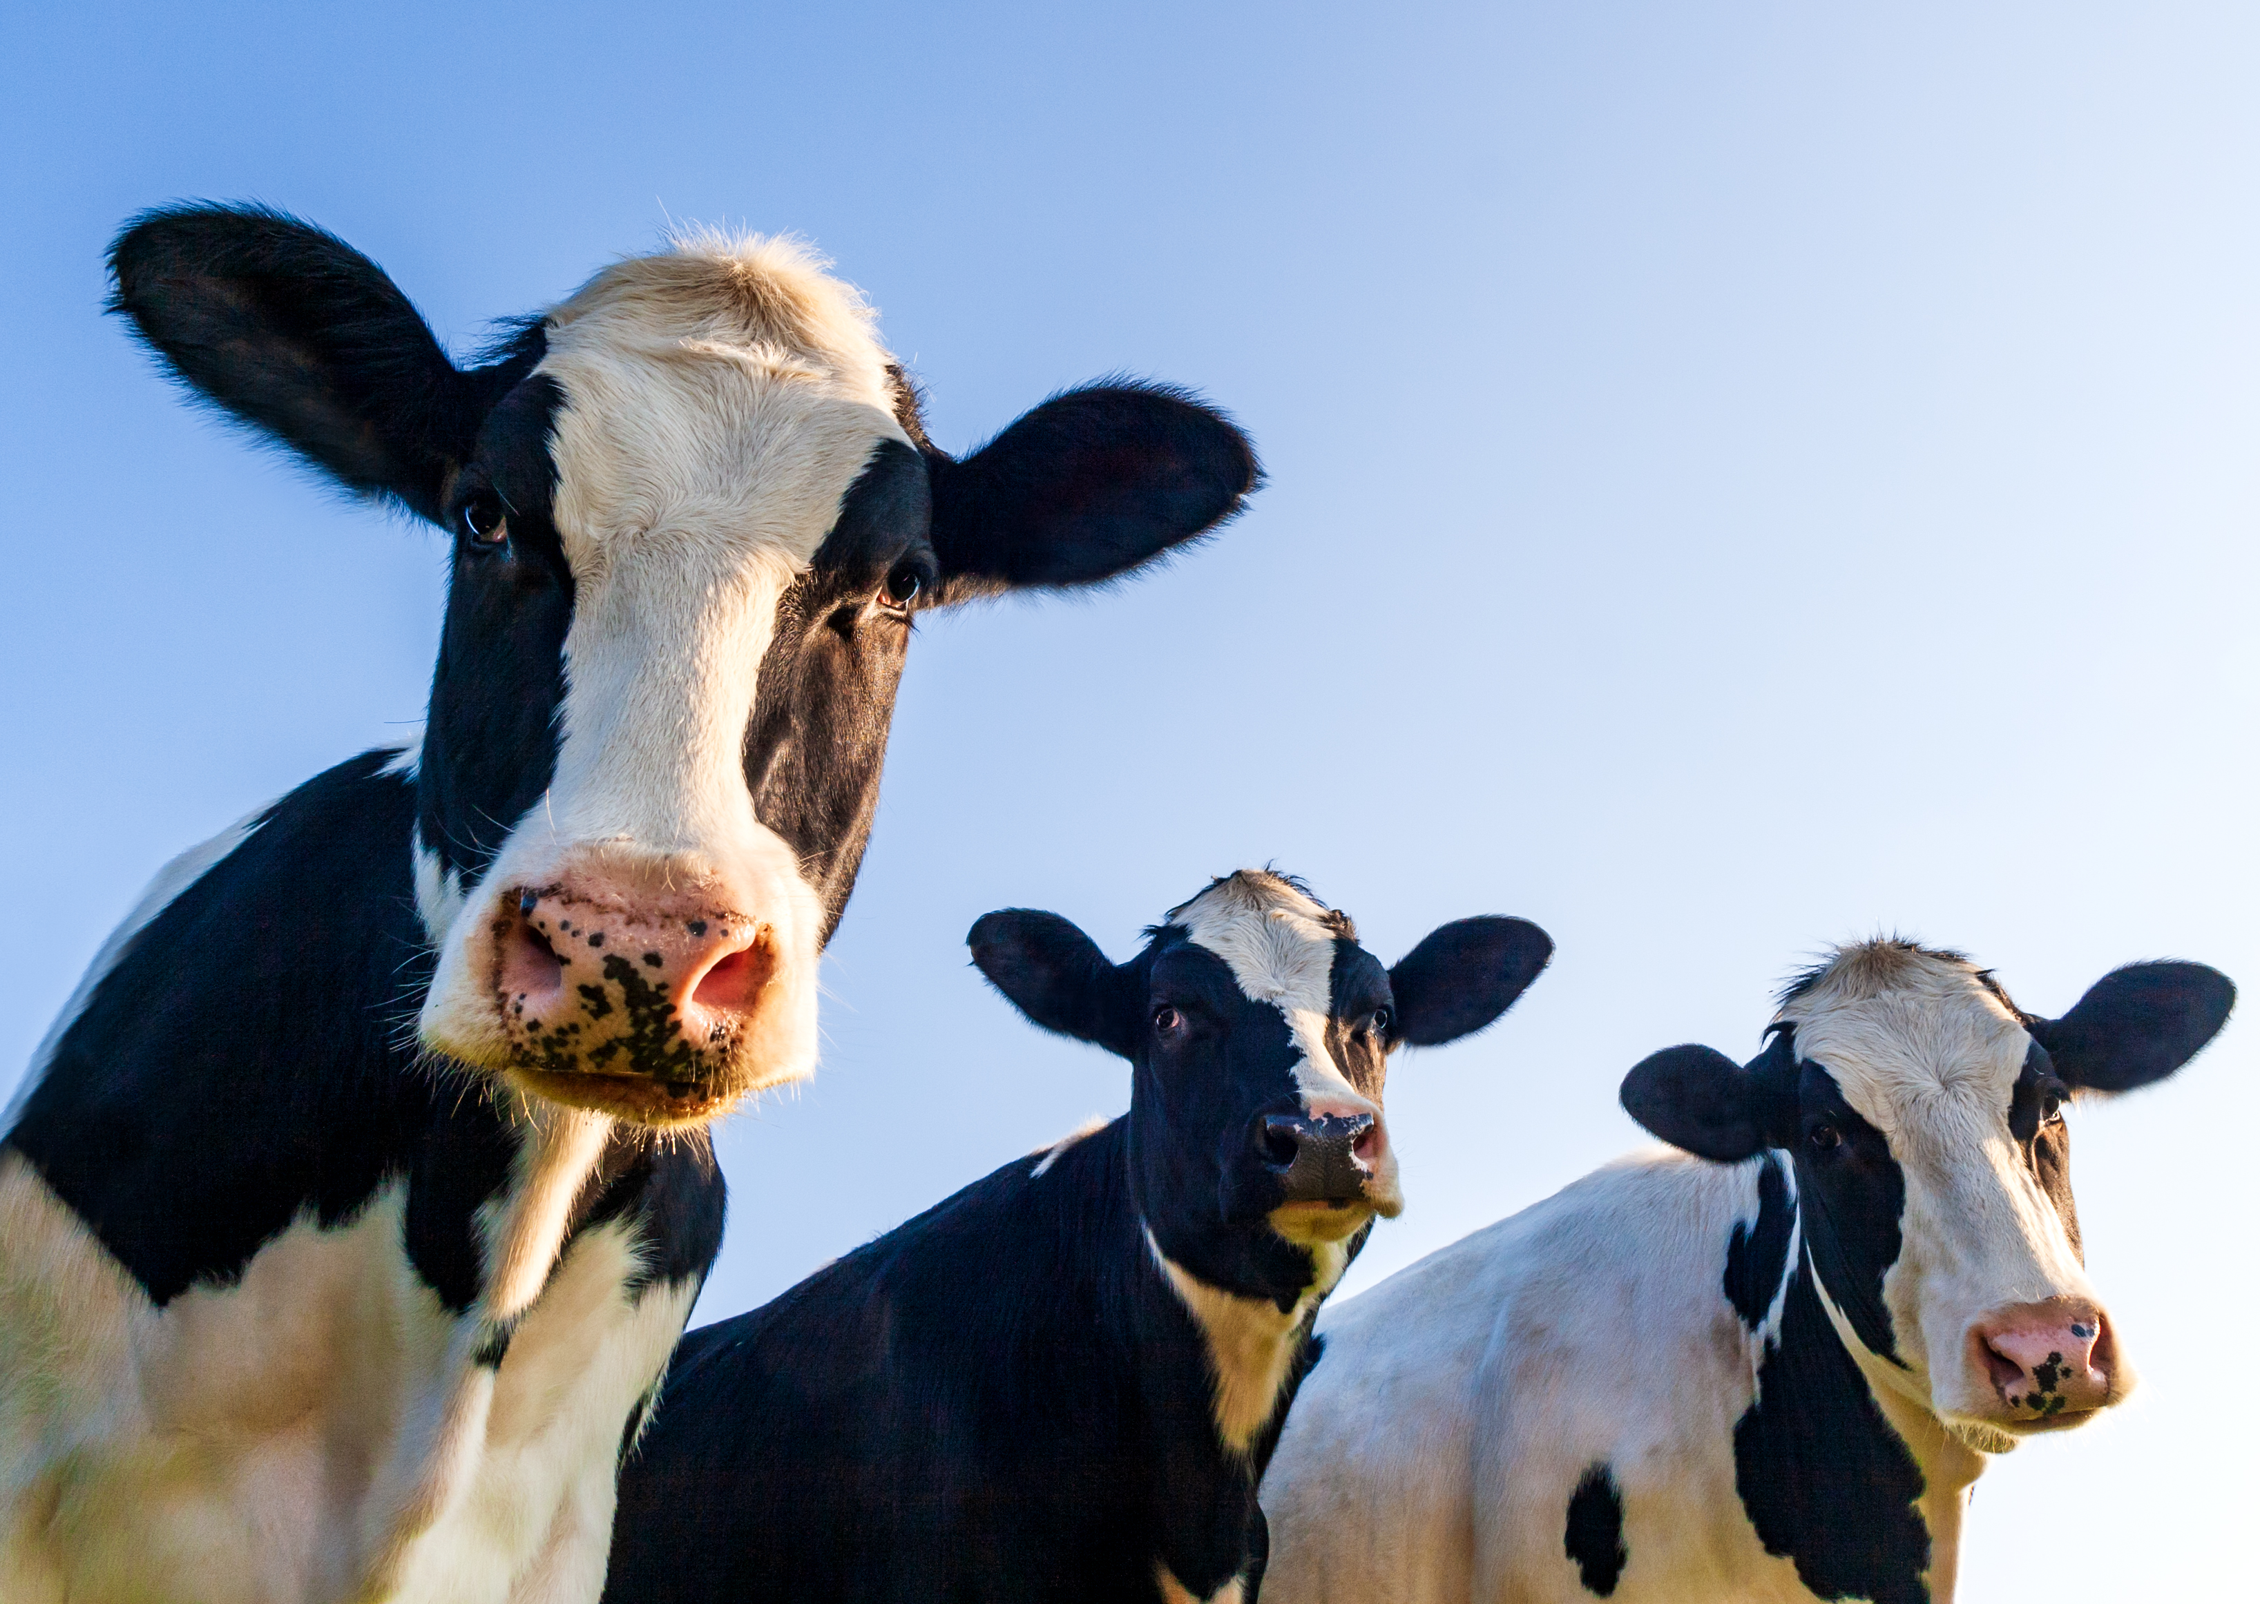
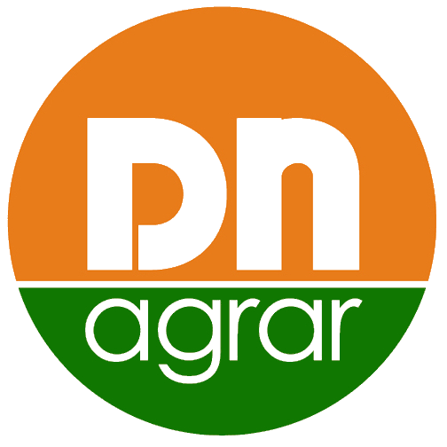
DN AGRAR Group
EGMS MARCH 2024

Slide 2



CONTENT
AGENDA
CURRENT SITUATION DN FARMS
STRAJA PROJECT

Slide 3

DN AGRAR FARMS TODAY
CUT FARM
APOLD FARM
2,100 dairy cattle
50,000 liters/day
300 cows milked/hour
Over 4,800 dairy cattle + young stock
70,000 liters/day
400 cows milked/hour
LACTO AGRAR FARM
PRODLACT FARM
4,000 dairy cattle + young stock
63,000 liters/day
350 cows milked/hour
Over 3,300 young stock animals
Raising young cattle for Apold and Cut farms

Slide 4
DN AGRAR FARMS 2027/2028
STRAJA FARM
Acquisition FARM 1-2
3,800 dairy cattle
1,200 young stock
100,000 liters/day
600 cows milked/hour
………. dairy cattle
……….liters/day
………. cows milked/hour
APOLD FARM
CUT FARM
Over 4,800 dairy cattle + young stock
100,000 liters/day
400 cows milked/hour
2,100 dairy cattle
50,000 liters/day
300 cows milked/hour
LACTO AGRAR FARM
PRODLACT FARM
4,000 dairy cattle + young stock
63,000 liters/day
350 cows milked/hour
Over 3,300 young stock animals
Raising young cattle for Apold and Cut farms

Slide 5
DN AGRAR DAIRY FARMS 2027/2028
OVER 300.000 LITERS PER DAY
THE 4 DAIRY FARMS WILL PRODUCE OVER 100 MILLION LITERS OF MILK ANNUALLY
A HERD OF APPROX 20.000 DAIRY COWS AND YOUNG STOCK

Slide 6
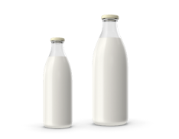

MILK PRODUCTION EVOLUTION
DN AGRAR - Monthly Evolution of the Quantity of Milk Delivered in 2024 (2M) vs 2023 vs 2022
🐄 In February 2024 the quantity of milk delivered increased by 24% compared to February 2023.
🐄 Continuing the positive trend from January 2024, DN AGRAR exceeded the threshold of 5 million liters delivered monthly in February 2024, as well.
🐄In the first 2 months of the 2024, DN registered a 19% advance in the amount of milk delivered compared to the same period last year.
24% increase
in Feb. 2024 vs Feb. 2023

Slide 7
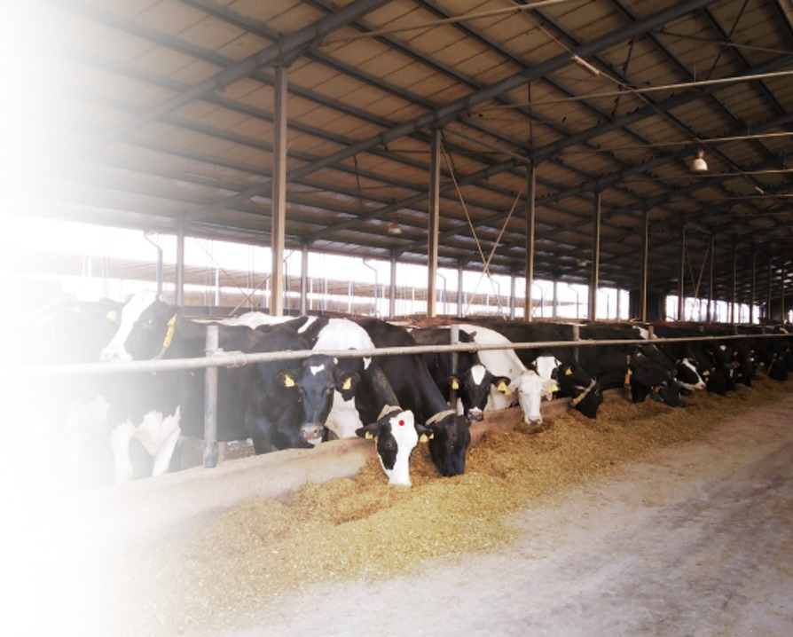
STRAJA PROJECT
3.800 DAIRY COWS
1.200 YOUNG STOCK
2 MILKING ROTORS

Slide 8
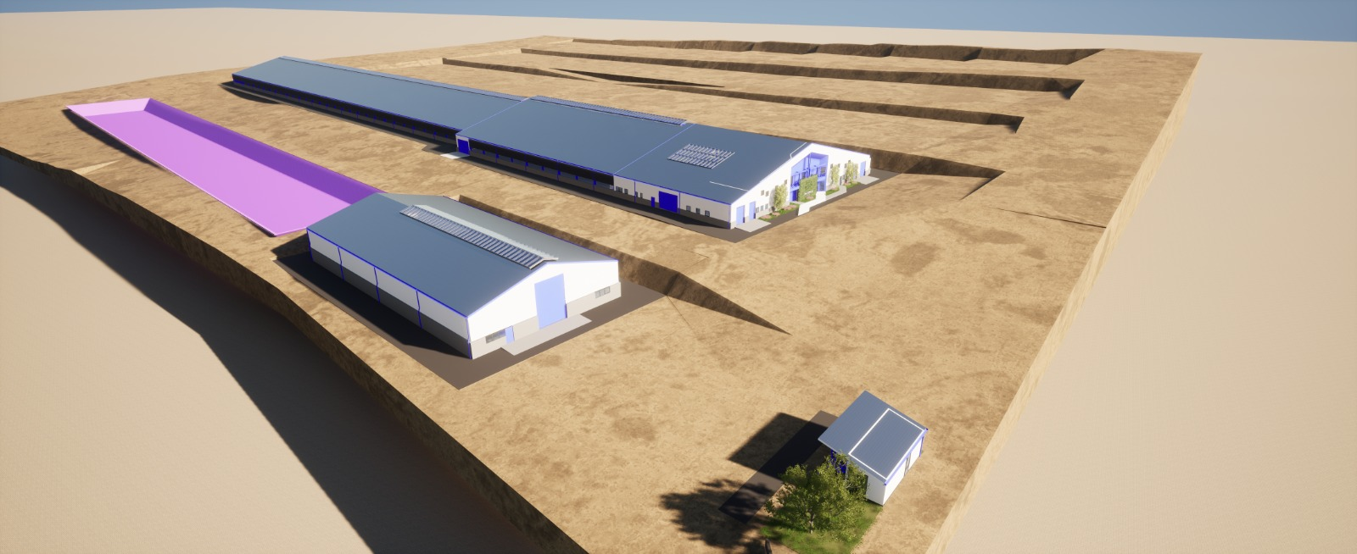
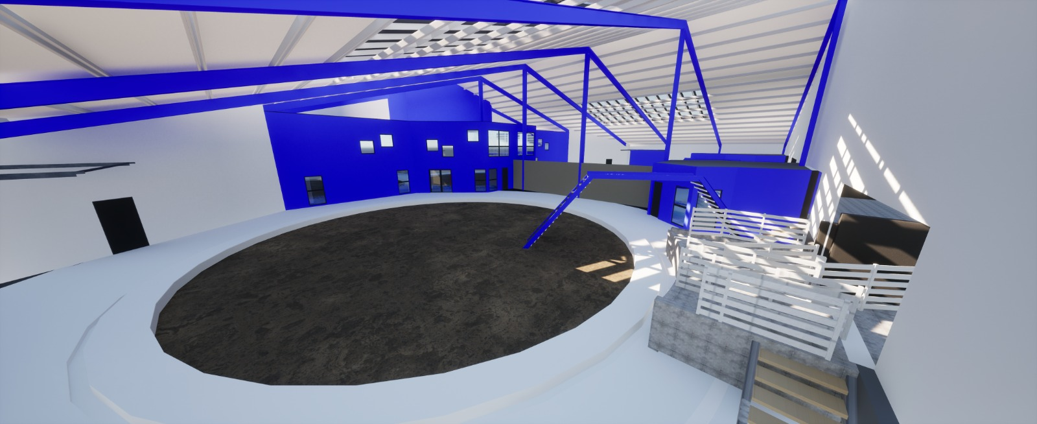
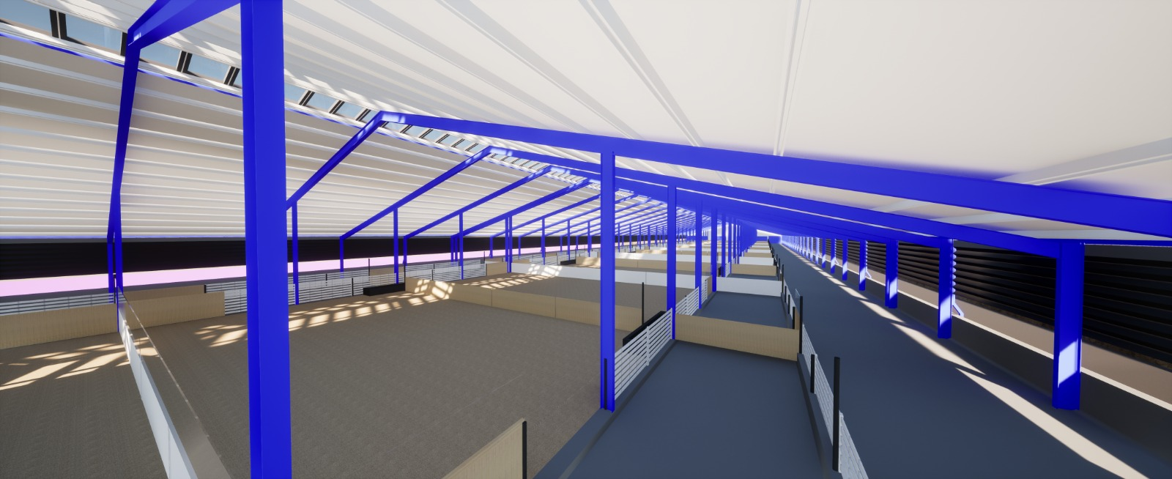
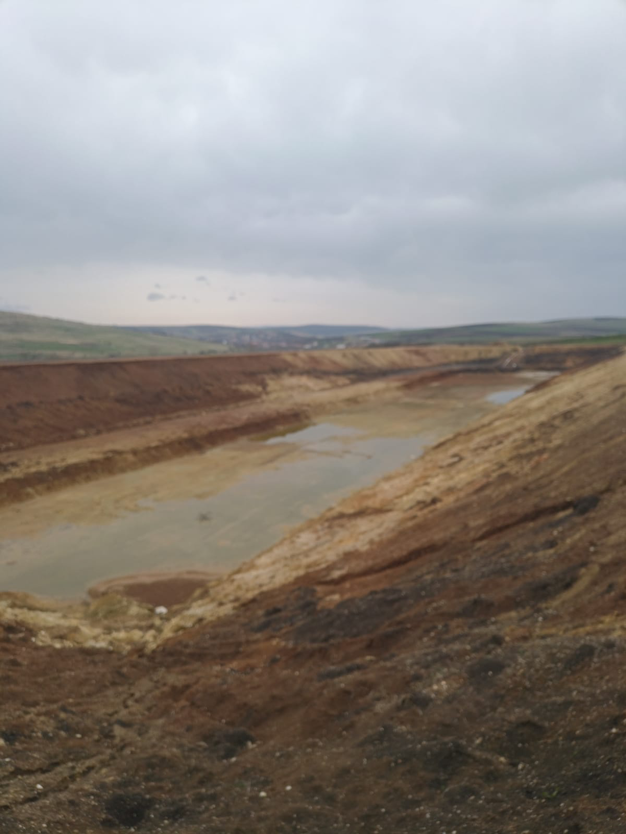
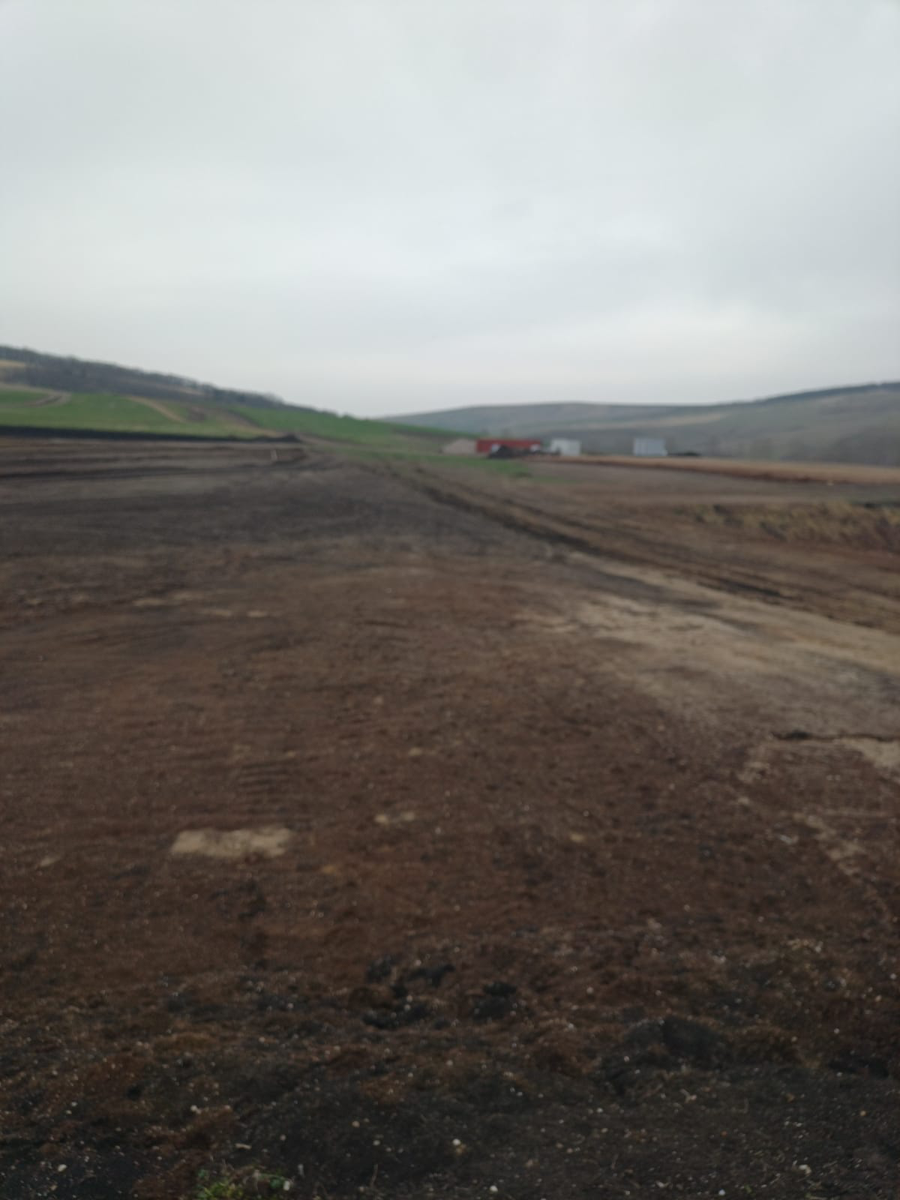
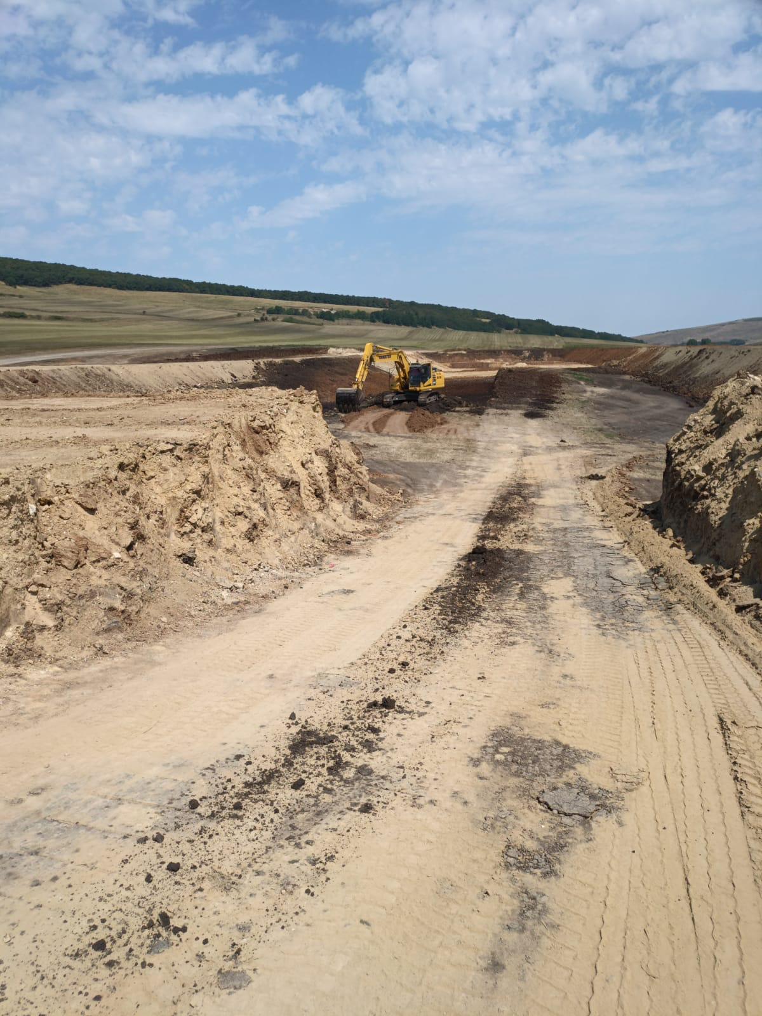
STRAJA PROJECT

Slide 9
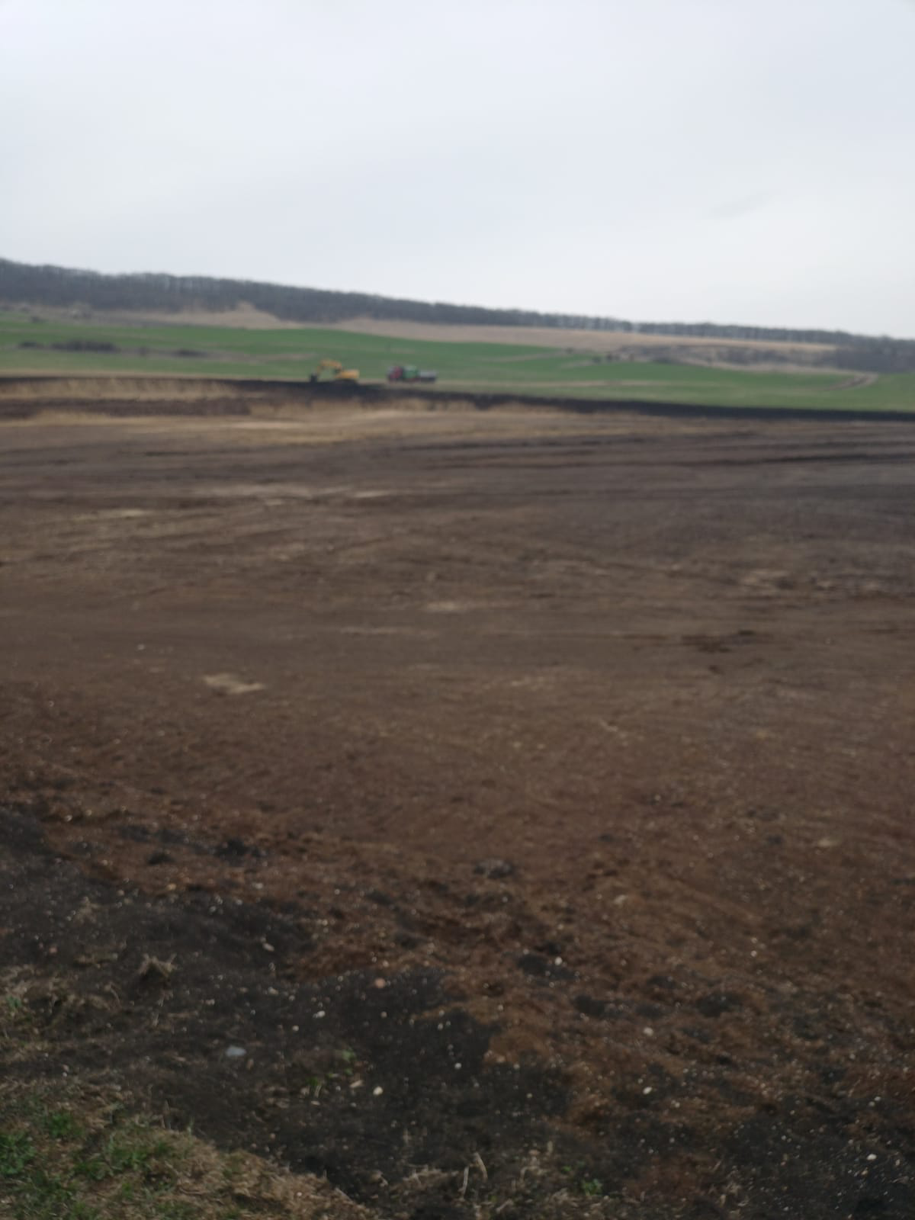
STRAJA PROJECT

Slide 10

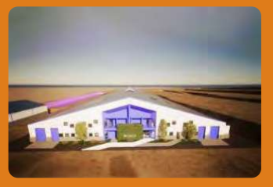
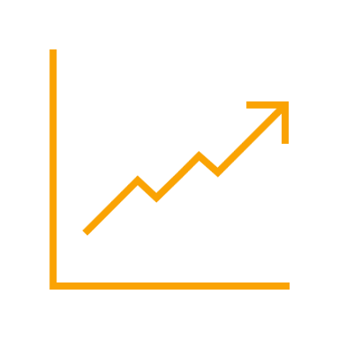

STRAJA PROJECT
Project planned to be completed in 2027
Capacity of 5,000 cows (3,800 dairy cows & 1,200 young stock)
Timeline
2024: Construction works start, approx. 1,000 cows in production
2025: Approx. 1,700 cows in production + pregnancy
2026: Approx. 3,400 cows in production + pregnancy
2027: Approx. 4,000 cows in production + pregnancy
Impact
Straja Project will be an engine to our company’s growth, being estimated
to double DN AGRAR’s business
Financing
The project will be funded through a bank loan.

Slide 11
Why ING and EXIM
  History
  Diversification
  Financing from ING was over 23 million euro
  Removal of pledge AM Advies shares

Slide 12
STRAJA BUDGET

Slide 13
STRAJA PROJECT PHASE 1
DN AGRAR will access a credit facility of 9.2 million euros from Exim Banca Românească SA to develop the farm, for equipment and the purchase of animals.
Additionally, for this project, DN AGRAR will provide 20.78% by own sources.
The financing of the project and related conditions are subject to the approval of the shareholders.

Slide 14
STRAJA PROJECT FINANCING PHASE 1
INVESTMENT LOAN 9.27 MILLION EURO
DN CONTRIBUTION 1.9 MILLION EURO
TOTAL 11.2 MILLION EURO
Actual investment phase 1 is: 8.770.000 EURO
1.800 DAIRY COWS with a total value of 2.430.000 EURO will be purchased from the other DN AGRAR FARMS
After the operational start of the Straja farm with 600-700 dairy cows the farm will increase its herd every month with approx. 100 dairy cows up to 3.800 by the end of 2027
The purchase price of 1.350 euro per cow that the other DN farms will receive, during phase 1, from Straja will be used to decrease the loans to ING and EXIM with 2.430.000 EURO

Slide 15
STRAJA PROJECT FINANCING PHASE 2
DN AGRAR GROUP 2.838.000 EURO
DAIRY COWS PURCHASED FROM DN FARMS 2.700.000 EURO
TOTAL 5.538.000 EURO
The purchase price received by the DN FARMS of PRODLACT, CUT and APOLD, in phase 2, will remain in these companies.

Slide 16
STRAJA ING – EXIM

Slide 17
QUESTIONS & COMING EVENTS
18th of March - ZF Capital Markets Summit
29th of March – Publication of GMS materials
8-10th of April – Raiffeisen Conference, Zurs Austria
29th of April - GMS
30th of April - Publication of 2023 Annual Report

Slide 18
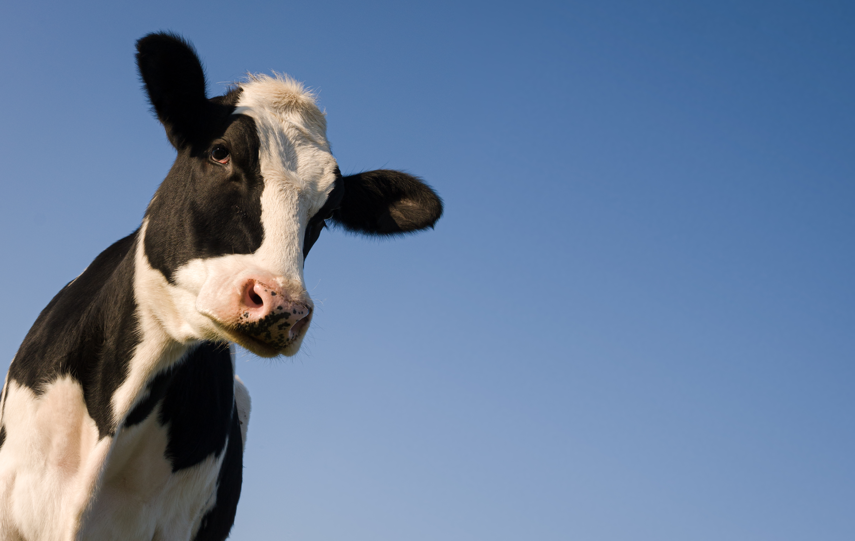
CONTACT INVESTOR RELATIONS
Peter de Boer,
BoD Member & Investor Relations Manager
investors@dn-agrar.eu , +40 258 818114

