Slide 1
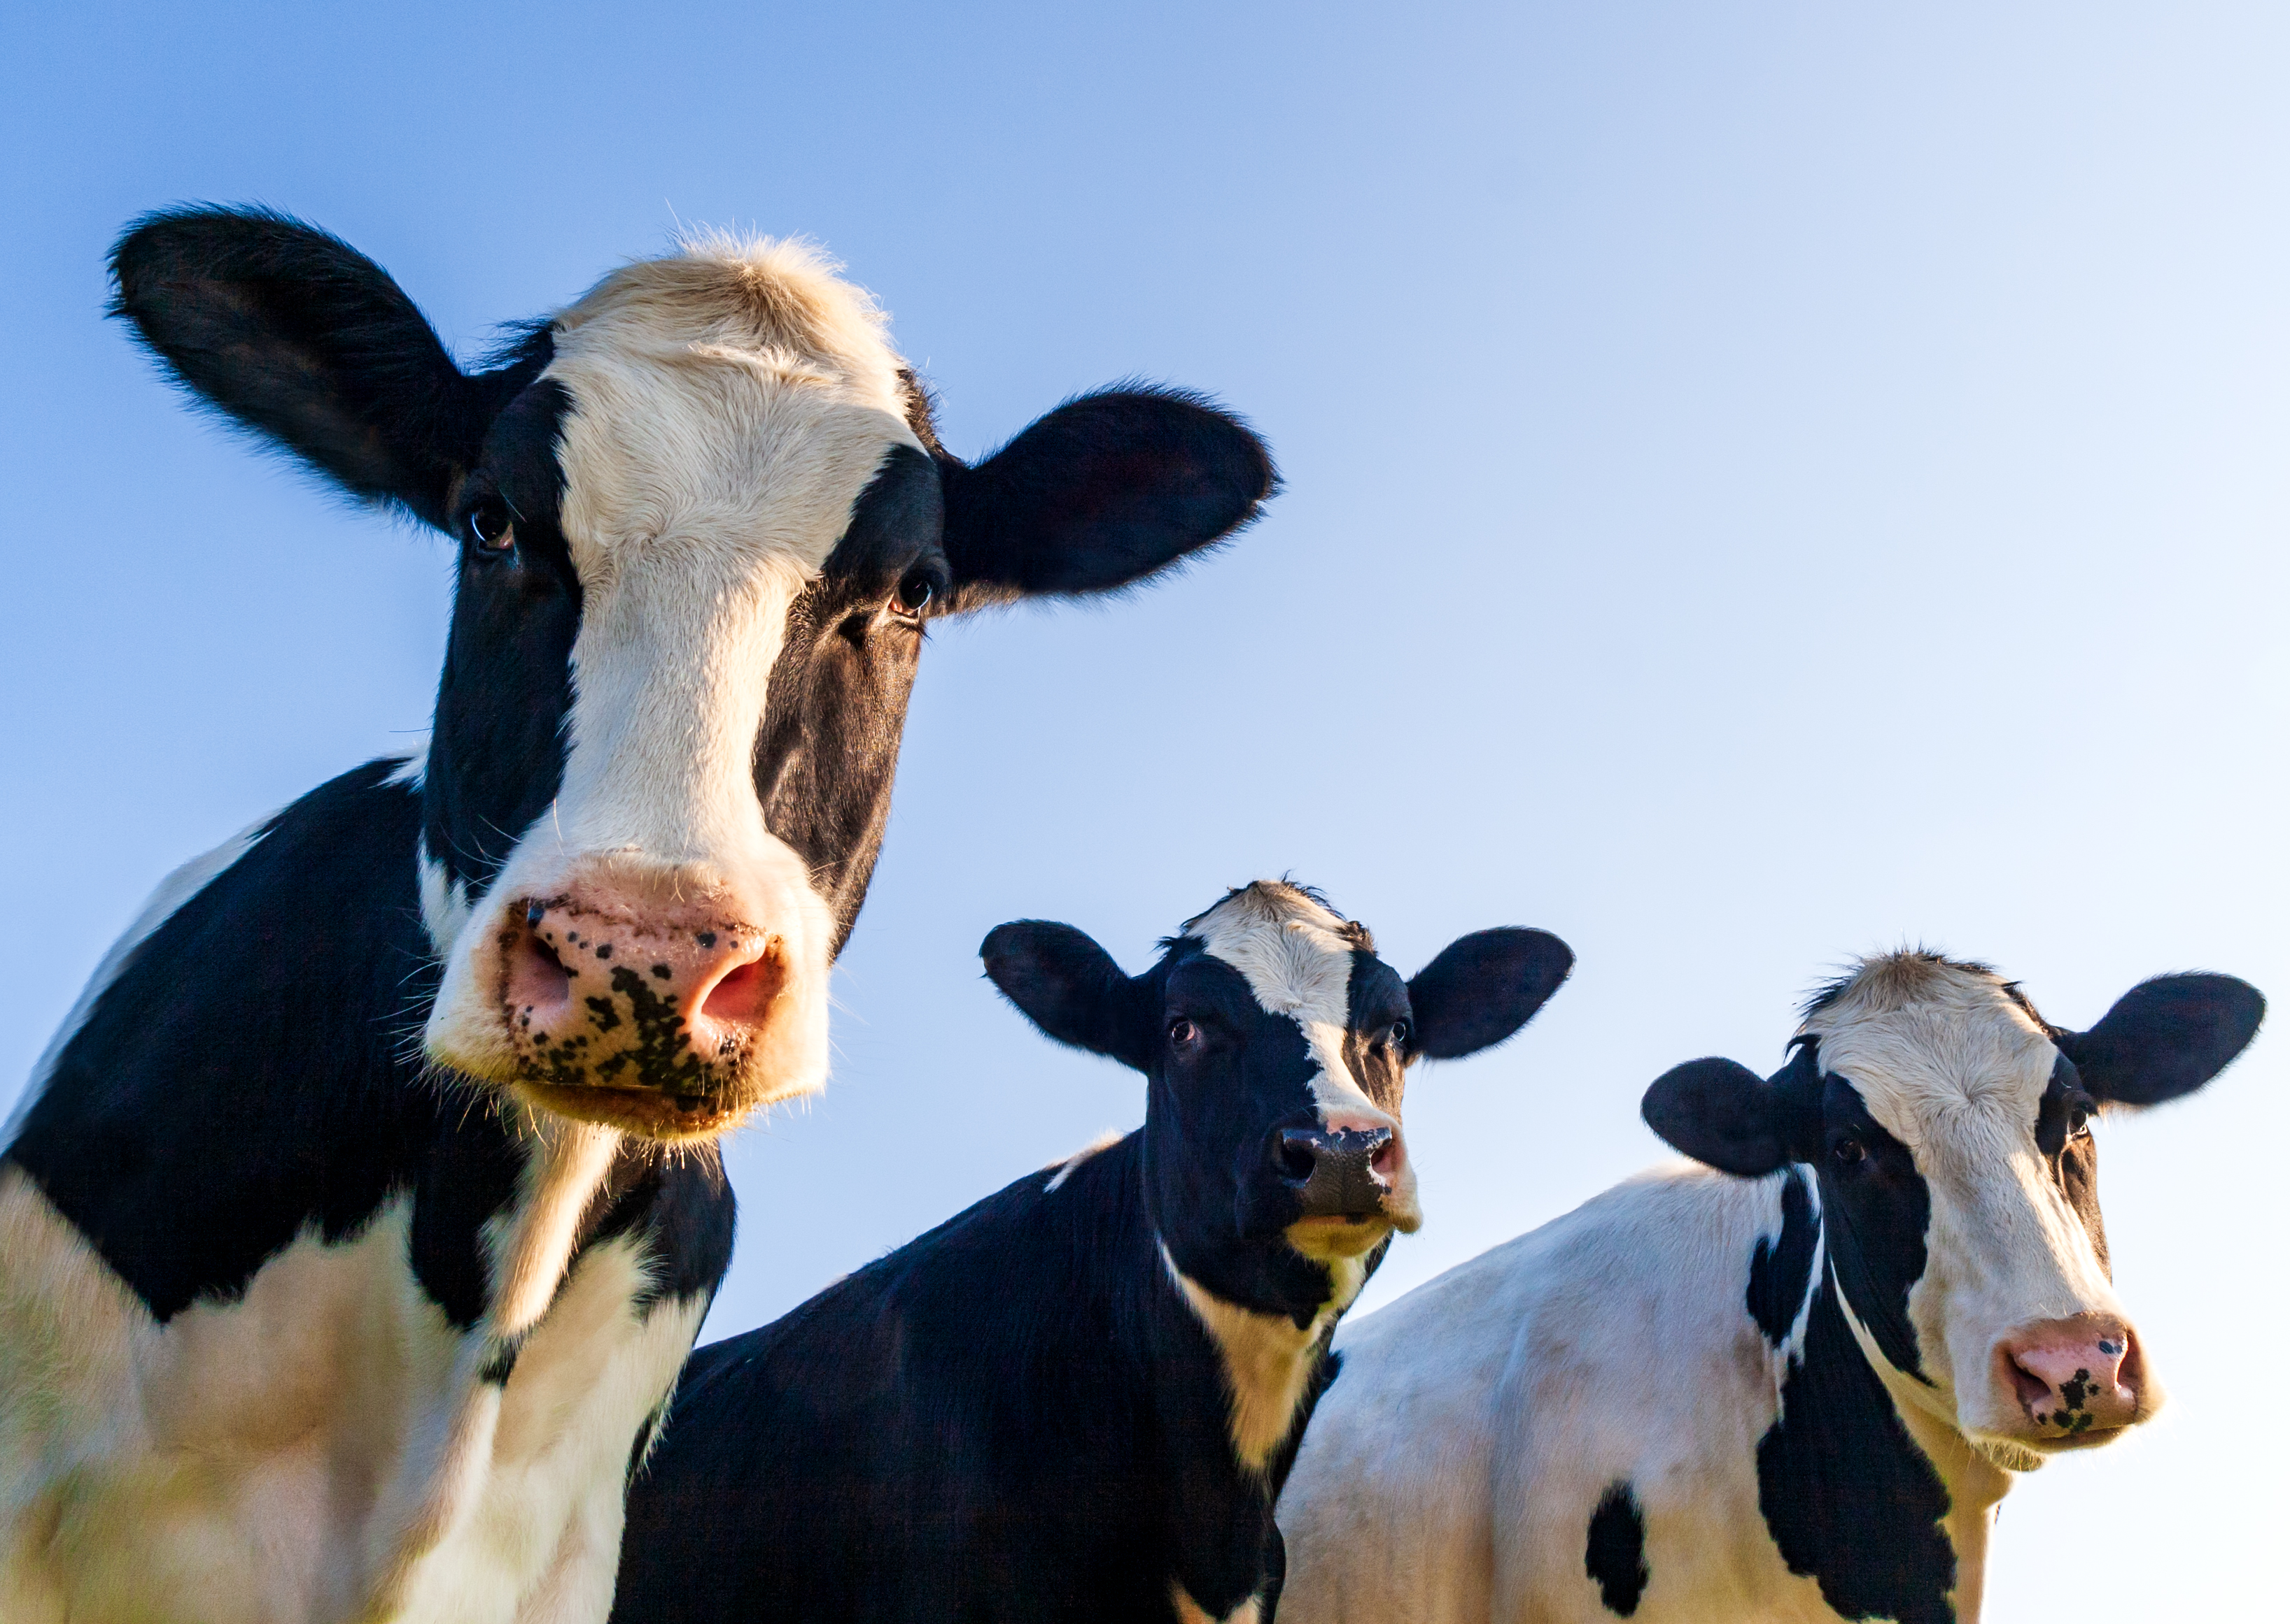
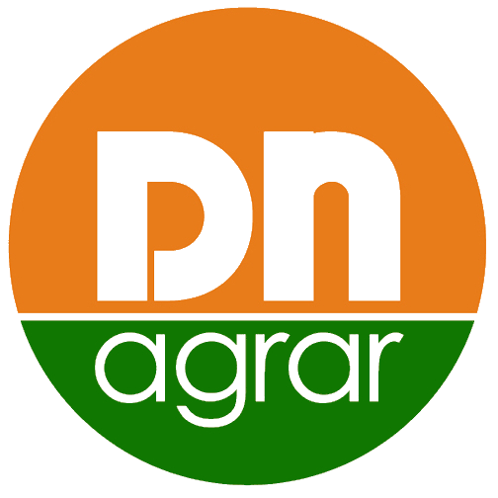
DN AGRAR’s
Management Team
Presentation Financial Results
1st half of 2025
- August 28th, 2025 -

Slide 2
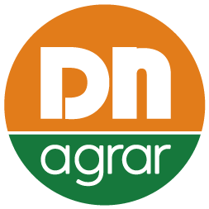



CONTENT
1
ABOUT DN AGRAR
2
6M 2025 FINANCIAL RESULTS
3
CAPITAL MARKET JOURNEY
4
OPERATIONAL ACTIVITY
5
CURRENT PROJECTS
6
OUTLOOK & 2025 -2030 STRATEGY

Slide 3






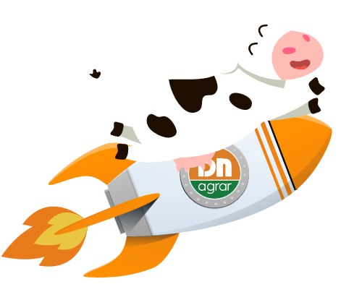
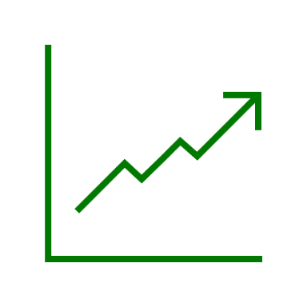


DN AGRAR - A SUSTAINABLE VISION SINCE 2008
THE FOUR SCENARIOS:
16,000+ heads dairy cows as well as young cattle
THE LARGEST MILK PRODUCER IN THE E.U.
10,000+ hectares of worked land (7,000+ inside the group, and the rest outside the group)
5 farms & 1 compost factory
Founded by Jan G. de Boer in 2008
Established crops:
Maize
Triticale
Alfalfa
Wheat
Barley
Rye
Listed on the AeRO market of the Bucharest Stock Exchange on February 2nd, 2022
Shares were included in the BETAeRO index since September 2022 and starting from March 2024 in the MSCI Frontier Small Cap and MSCI Romania Small Cap indices

Slide 4
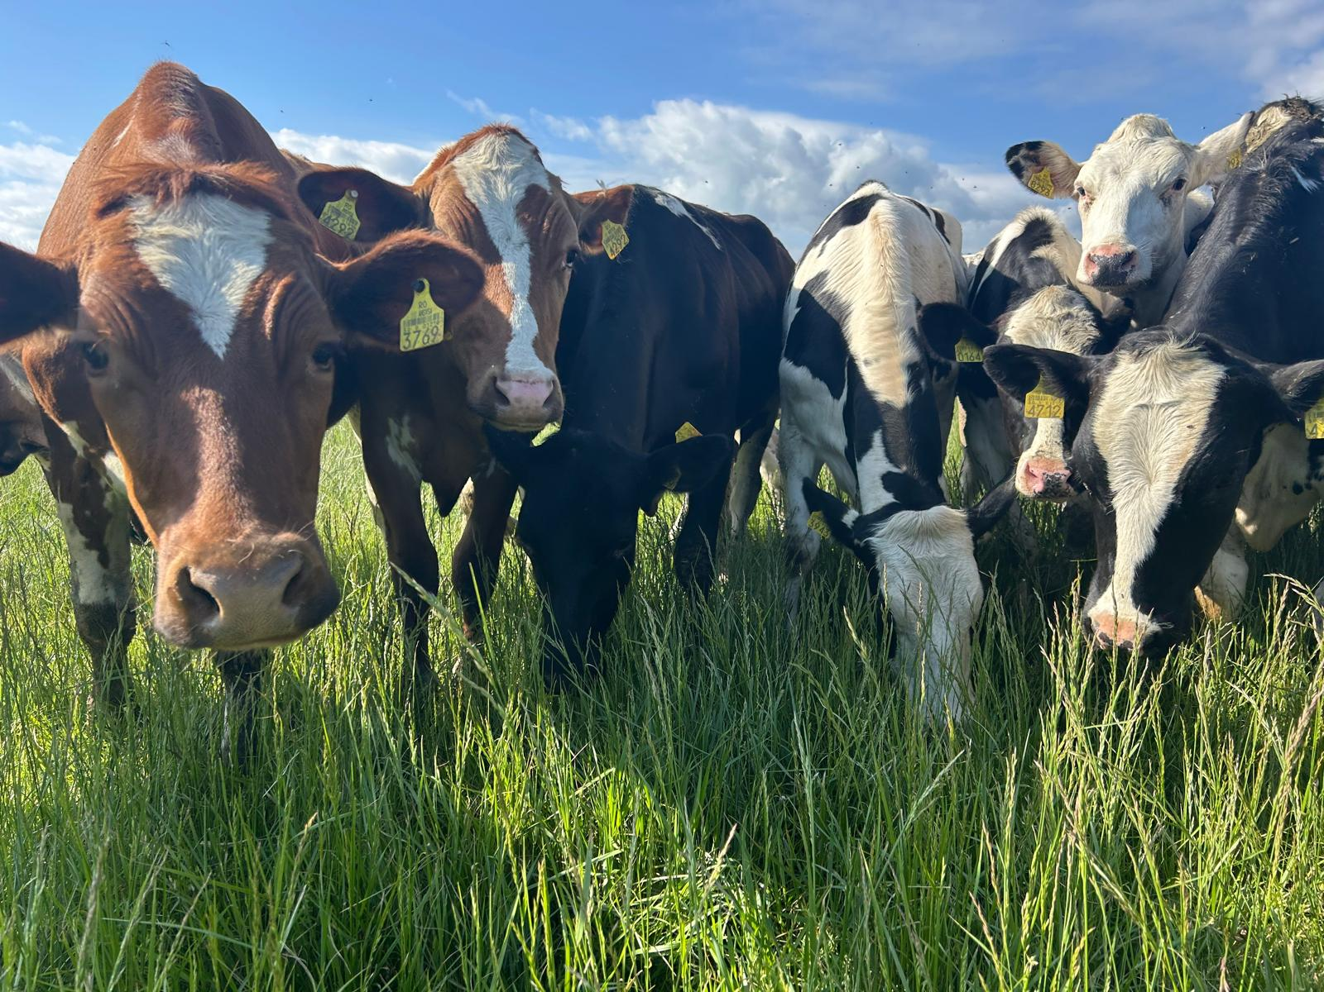
DN AGRAR - AN OUTSTANDING GROWTH STORY
Tripled the business since listing
Consistent Growth in EBITDA
34 million liters of milk delivered in H1 2025
Track
Record
Focus on sustainable, regenerative agriculture practices that maximize productivity, reduce environmental impact, and ensure long-term profitability.
Sustainable
Agriculture
One of the leading integrated agrifood company in Romania
The largest dairy milk producer in E.U.
Market
Position

Slide 5

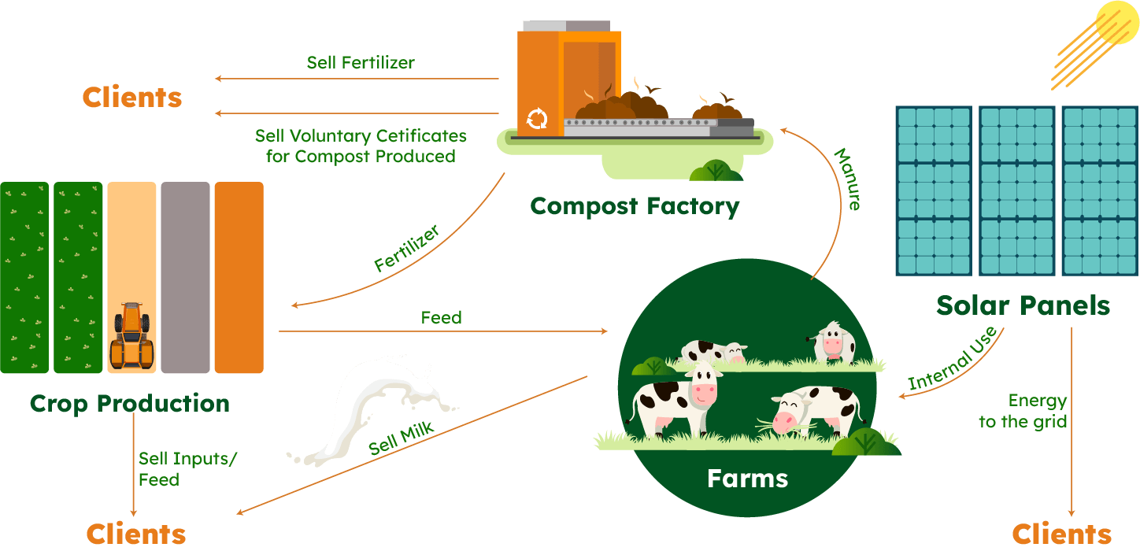

INTEGRATED BUSINESS MODEL – TODAY

Slide 6
CONTENT
1
ABOUT DN AGRAR
2
6M 2025 FINANCIAL RESULTS
3
CAPITAL MARKET JOURNEY
4
OPERATIONAL ACTIVITY
5
CURRENT PROJECTS
6
OUTLOOK & 2025 -2030 STRATEGY

Slide 7
RECORD RESULTS IN H1 2025, TURNOVER +21.6%, NET PROFIT +80%
THE FOUR SCENARIOS:
TURNOVER
NET ASSETS
RON 101.25 mil.
+21.62%
vs H1 2024
RON 317.04 mil.
+14.30%
vs 31.12.2024
NET PROFIT
TOTAL ASSETS
RON 27.18 mil.
+80.25%
vs H1 2024
RON 392.69 mil.
+8.58%
vs 31.12.2024
EBITDA
EQUITY
RON 49.38 mil.
+42.13%
vs H1 2024
RON 192.41 mil.
+16.63%
vs 31.12.2024

Slide 8


FACTORS THAT INFLUENCED THE H1 2025 RESULTS
Increase in turnover by 22%
Income from subsidies increased by 30%
Personnel expenses advanced by 27%
The increase in accounting depreciation by 13%
Increase in raw materials, consumables and utilities expenses by 5%
Agricultural equipment purchases of ~RON 6 million led to a 28% rise in leasing liabilities
Investments of RON 32 million in key projects
The increase in other operating expenses by 7%
The financial loss of RON 6 million
The increase in corporate income tax by 51%

Slide 9
CONTINOUS FINANCIAL GROWTH PERFORMANCE
TURNOVER, mil. RON
EBITDA, mil. RON
NET PROFIT, mil. RON

Slide 10
FINANCIAL RESULTS HIGHLIGHTS in H1 2025
In the first half of 2025, operating revenues amounted to RON 159 million, a 20% increase compared to the same period of last year.
Operating expenses increased by 10% in the first half of 2025 compared to the same period in 2024, reaching RON 120 million.
The increase in operating expenses was also Influenced by the evolution of expenses for raw materials and consumables, which recorded an increase of 5% in 2025, reaching the value of RON 67 million.
Expenses related to value adjustments on tangible and intangible assets also had an impact on operating expenses. These amounted RON 14 million, with an increase up to 13% compared to the same period last year, a development correlated with an 11% increase in the fixed assets.
PROFIT AND LOSS ACCOUNT (RON) | 30/06/2025 | 30/06/2024 | ∆%
OPERATING INCOME – TOTAL | 158,719,177 | 131,737,012 | 20.48%
OPERATING EXPENSES – TOTAL | 119,750,382 | 109,139,557 | 9.72%
OPERATING PROFIT OR LOSS | 38,968,795 | 22,597,455 | 72.45%
FINANCIAL INCOME – TOTAL | 209,831 | 722,747 | (70.97)%
FINANCIAL EXPENSES – TOTAL | 6,495,772 | 4,592,687 | 41.44%
FINANCIAL PROFIT OR LOSS | (6,285,941) | (3,869,940) | (62.43)%
GROSS PROFIT OR LOSS | 32,682,854 | 18,727,515 | 74.52%
NET PROFIT OR LOSS | 27,178,169 | 15,077,972 | 80.25%

Slide 11
THE MAIN ELEMENTS OF THE BALANCE SHEET
BALANCE SHEET INDICATORS (RON) | 30/06/2025 | 31/12/2024 | ∆%
FIXED ASSETS - TOTAL | 270,095,463 | 243,511,009 | 10.92%
CURRENT ASSETS - TOTAL | 119,363,001 | 115,784,991 | 3.09%
DEFERRED EXPENSES | 3,230,269 | 2,369,930 | 36.30%
TOTAL ASSETS | 392,688,734 | 361,665,930 | 8.58%
DEBTS: AMOUNTS TO BE PAID WITHIN UP TO ONE YEAR | 75,507,681 | 84,138,725 | (10.26)%
DEBTS: AMOUNTS TO BE PAID IN MORE THAN ONE YEAR | 123,080,532 | 110,433,346 | 11.45%
PROVISIONS | 34,164 | 386,046 | (91.15)%
DEFERRED REVENUES | 1,658,119 | 1,727,746 | (4.03)%
DEBT - TOTAL | 198,588,213 | 194,572,071 | 2.06%
EQUITY - TOTAL | 192,408,238 | 164,980,067 | 16.63%
TOTAL EQUITY AND DEBT | 392,688,734 | 361,665,930 | 8.58%
Equity increased by 17% compared to December 31st, 2024, reaching RON 192 million, this increase being determined by the recording of a net profit of RON 27 million at the end of June 2025.
Long-term liabilities increased by 11% compared to the end of 2024, reaching a balance of RON 123 million at the end of June, following the investments made.
The provisions for the first half of 2025 decreased by 91% compared to the end of 2024, reaching RON 34 thousand, reflecting the efficiency with which the company managed employee vacation leave.

Slide 12
CONTENT
1
ABOUT DN AGRAR
2
6M 2025 FINANCIAL RESULTS
3
CAPITAL MARKET JOURNEY
4
OPERATIONAL ACTIVITY
5
CURRENT PROJECTS
6
OUTLOOK & 2025 -2030 STRATEGY

Slide 13


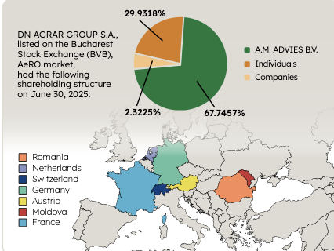
DN AGRAR IN THE CAPITAL MARKET
Included in indices
BETAeRO
MSCI Frontier Small Cap
MSCI Romania Small Cap
The company with the largest weight in the BETAeRO index at the end of H1 2025
Number of Shareholders
Investment
in CUT 2 Farm
3,100 shareholders
19% increase in the number of shareholders vs H1 2024
CAPITALIZATION
Shareholding Structure
RON 276.82 MIL.
Recognition
EUR 54.52 MIL.
Score of 10 in the VEKTOR by ARIR evaluation
for the 2nd consecutive year
DN AGRAR has been nominated for IR Magazine Europe Awards 2024
Awards in 2024 at ARIR Gala
Best IR Department
Best Annual Report
Best Company Representative in the Capital Market
Best ESG Performance & Communication
30.06.2025
+4.82%
vs. 28.06.2024
NUMBER OF SHARES
159.094.224

Slide 14
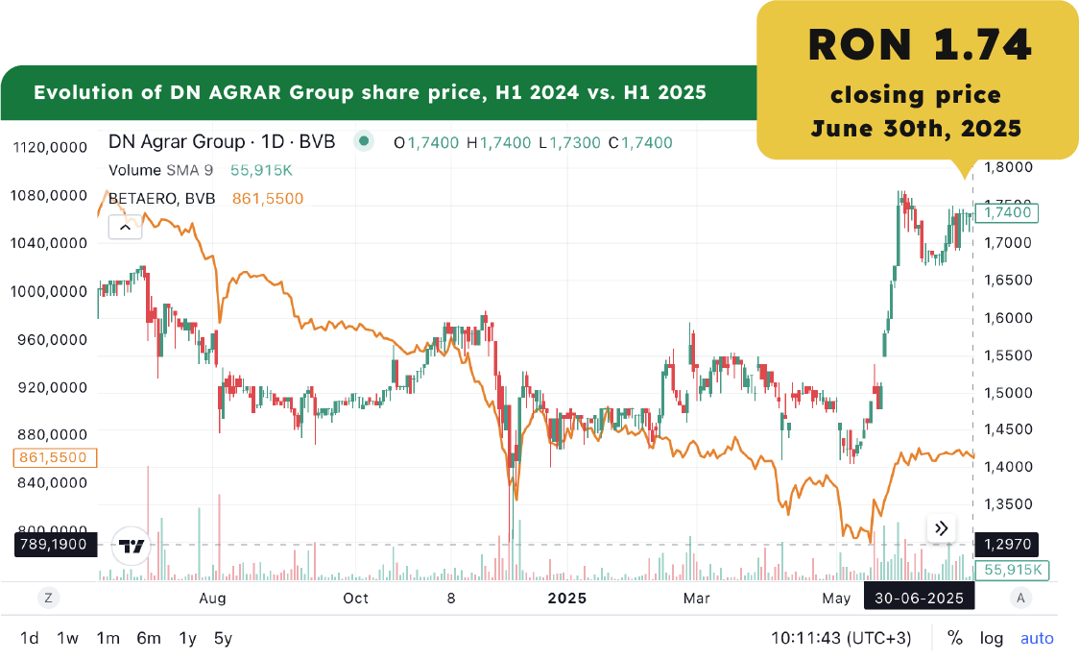
STRONG PERFORMANCE IN THE CAPITAL MARKET

Slide 15

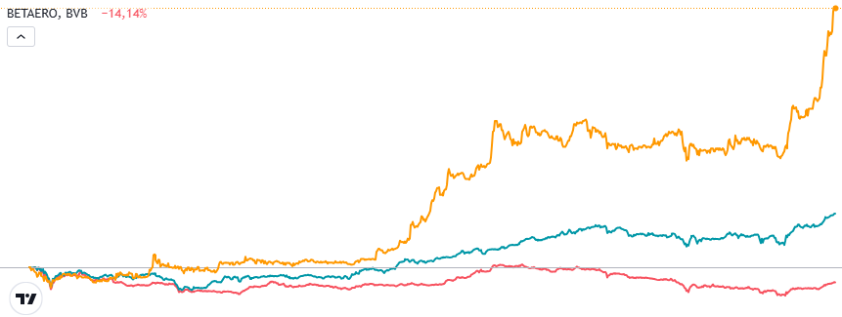
DN AGRAR's SHARES OUTPERFORMING THE MARKET
EVOLUTION SINCE LISTING
DN AGRAR
+109%
DN AGRAR
+63%
DN AGRAR
+244%
Listed on the AeRO market of the Bucharest Stock Exchange on February 2, 2022.
BET
+21%
BET
+51%
BETAeRO
+6%
BETAeRO
-14%
Feb. 2022
Dec. 2024
July 2025

Slide 16
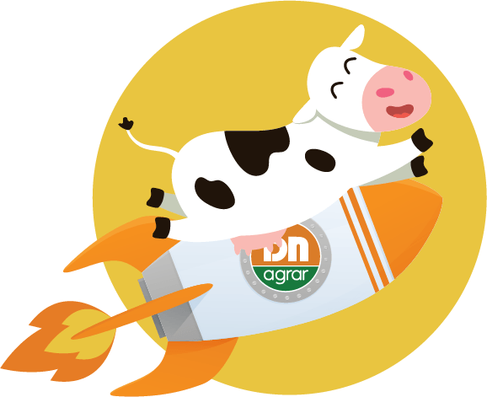


OUR PATH TO MAIN MARKET
DN AGRAR GROUP
sets course for
Main Market upgrade
Main Market of BVB
Decision to be made at the end of 2025
IFRS Reporting starting from 2026

Slide 17
CONTENT
1
ABOUT DN AGRAR
2
6M 2025 FINANCIAL RESULTS
3
CAPITAL MARKET JOURNEY
4
OPERATIONAL ACTIVITY
5
CURRENT PROJECTS
6
OUTLOOK & 2025 -2030 STRATEGY

Slide 18
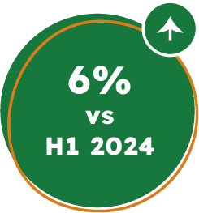
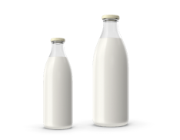
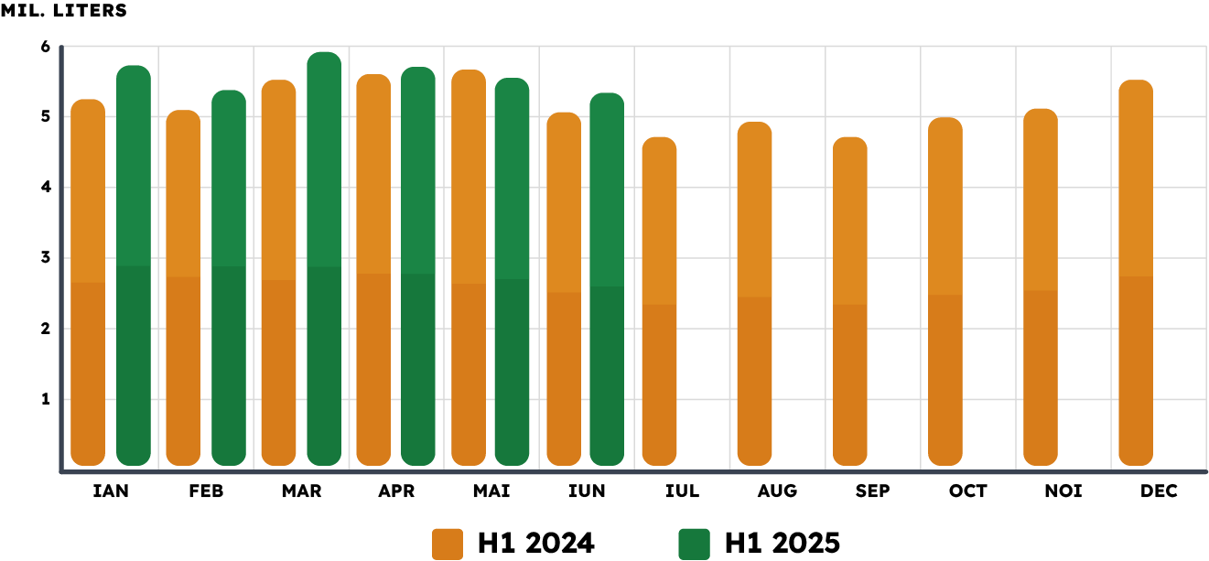
CONSISTENT GROWTH IN MILK DELIVERIES
34 million liters of milk
were delivered in H1 2025
🐄 In H1 2025 the company recorded an increase of approximately 6% in the quantity of milk delivered, compared to the first half of 2024, reaching a total volume of 34 million liters.
🐄 Following the upward trend in the milk delivered, DN AGRAR recorded solid production growth, bringing us close to the milestone of 6 million liters, on average, per month.
🐄 This positive trend is also due to the strong dynamics of the livestock, which exceeded 16,000 heads at the end of June 2025, marking an 11% increase compared to H1 2024.

Slide 19
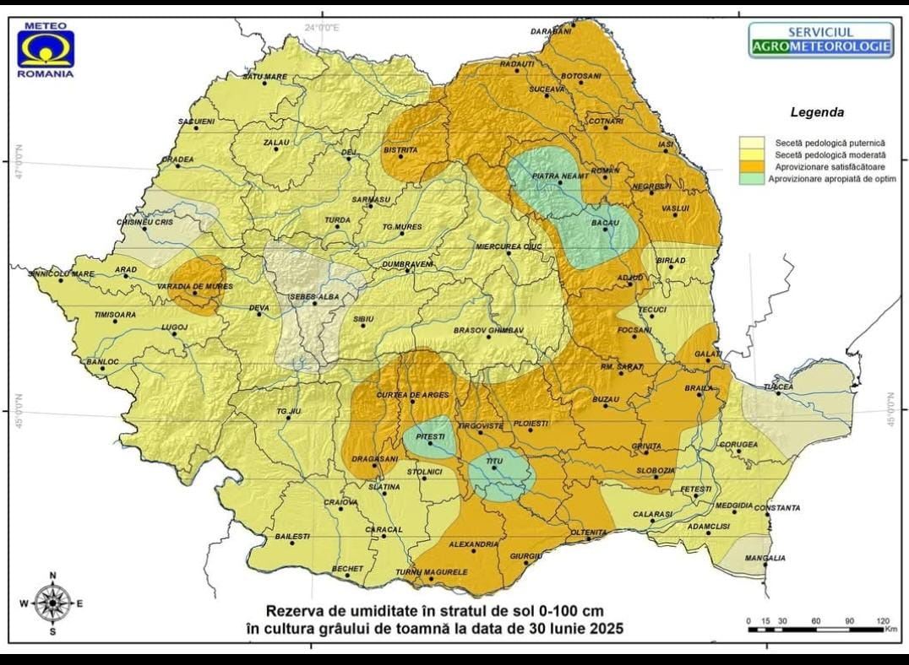
DN AGRAR CEREAL PRODUCTION EVOLUTION
🌱 The soil moisture map (0-100cm), published by the National Institute of Meteorology and Hydrology on June 30th, 2025, confirms the severity of the situation in the agricultural sector.
🌱 As we were in an area affected by severe pedological drought, this year's challenging climatic conditions, have impacted the domestic agricultural production of fodder.
Month | 2024 | 2025
Jan | 37 | 8
Feb | 72 | 0
Mar | 43 | 36
Apr | 64 | 0
May | 98 | 105
Jun | 129 | 14
Total | 443 | 163

Slide 20
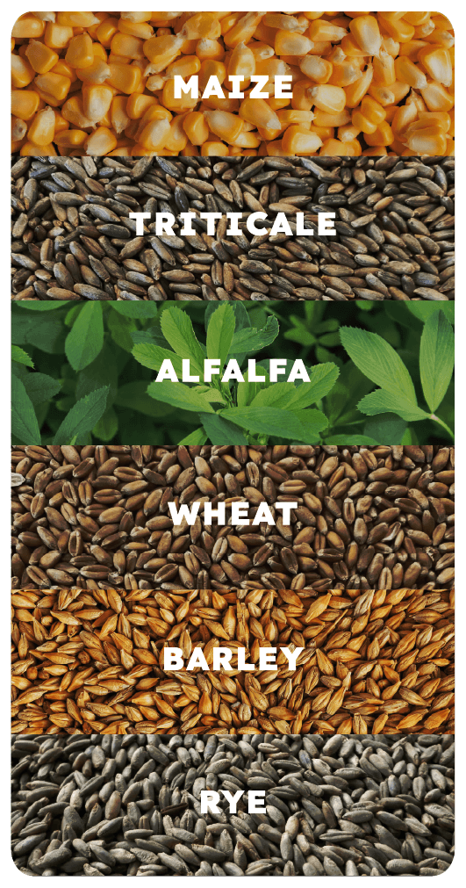
DN AGRAR CEREAL PRODUCTION – CROP YIELDS
🌱 As a result, in order to meet our internal feed requirements, we had to purchase fodder from the market, at additional costs.
To mitigate the financial impact, our team acted proactively by securing the fodder supply, thereby ensuring a consistent and high-quality feed stock for our animals.
Crop | 2024 | 2025
Triticale silage (to/ha) | 31.01 | 21.4
Wheat grain (to/ha) | 5.2 | 5.2
Lucerne silage (to/ha) | 20.41 | 7.3*
Corn silage (to/ha) | 31.5 | 15–20**
*current production for lucerne crop, we will have 1 more harvest.
**estimated production for the corn silage crop; harvest is currently in progress.

Slide 21
CONTENT
1
ABOUT DN AGRAR
2
6M 2025 FINANCIAL RESULTS
3
CAPITAL MARKET JOURNEY
4
OPERATIONAL ACTIVITY
5
CURRENT PROJECTS
6
OUTLOOK & 2025 -2030 STRATEGY

Slide 22

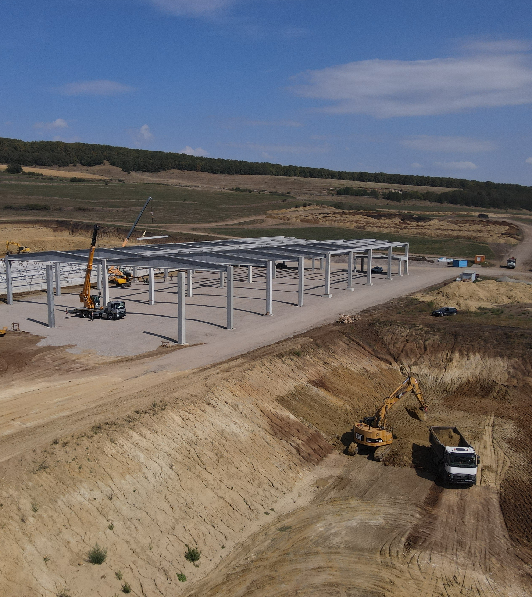
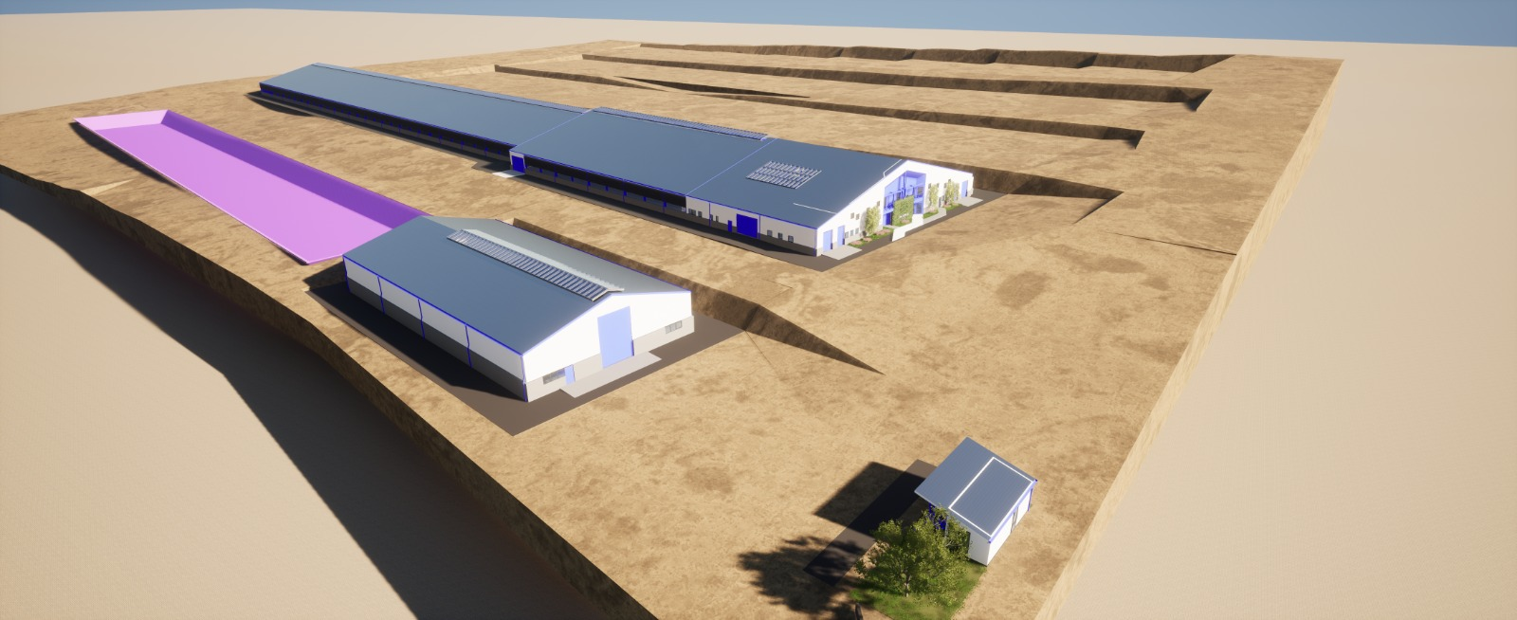

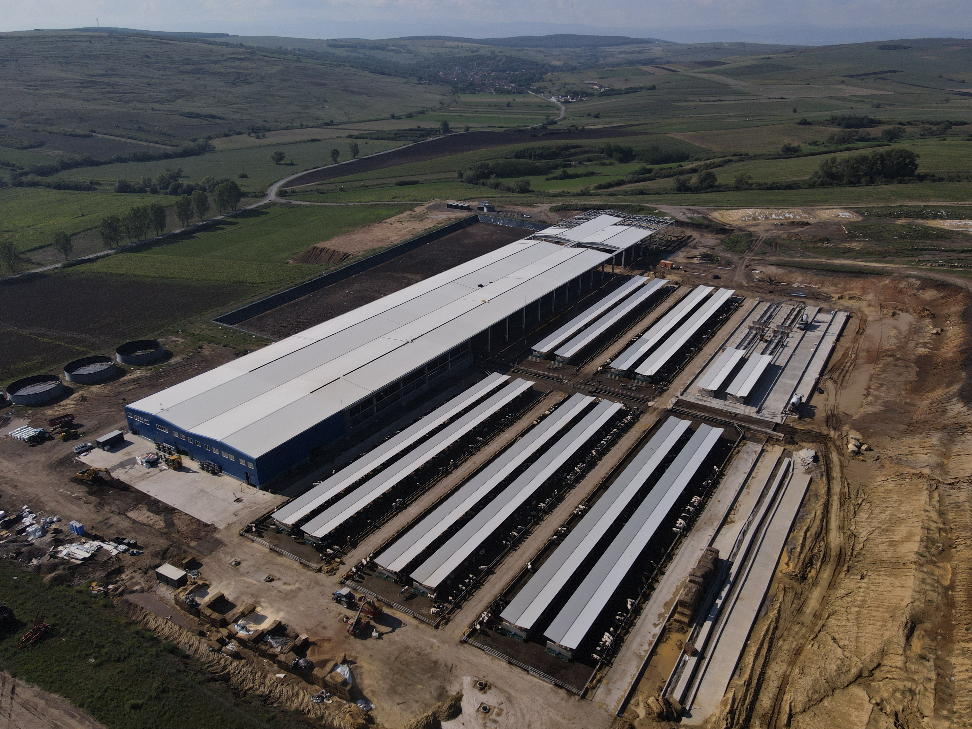
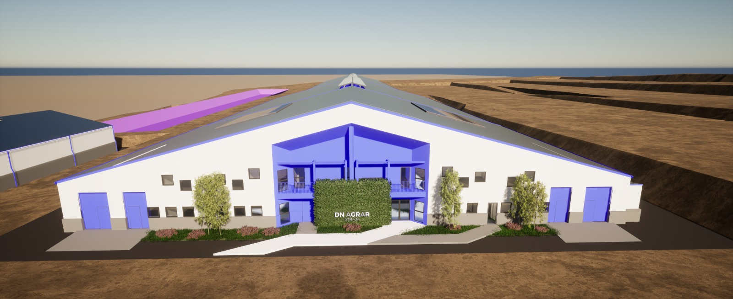
STRAJA FARM - A SIGNIFICANT EXPANSION IN PRODUCTION
Key Highlights
2025
2027
Started in 2023, and planned to be completed in 2027.
Capacity of 5,000 cows (4,000 dairy cows and 1,000 young stock).
Financed through credit facility and own sources.
Gradual increase of the dairy cow herd, reaching 1,800 heads by the end of August 2025.
Plans to install industrial robots at the Straja farm in Q3 2025.
Beg. March – Start milk production
End of august 2025
1,800 cows
Robots to be installed in Q3
End of 2027
5,000 cows (4,000 dairy cows and 1,000 young stock)
The foundation works were completed
Part of the main hall, finalized
Waste storage lagoon, finalized
Approx. 3,400 cows in production & pregnancy
2024
2026

Slide 23
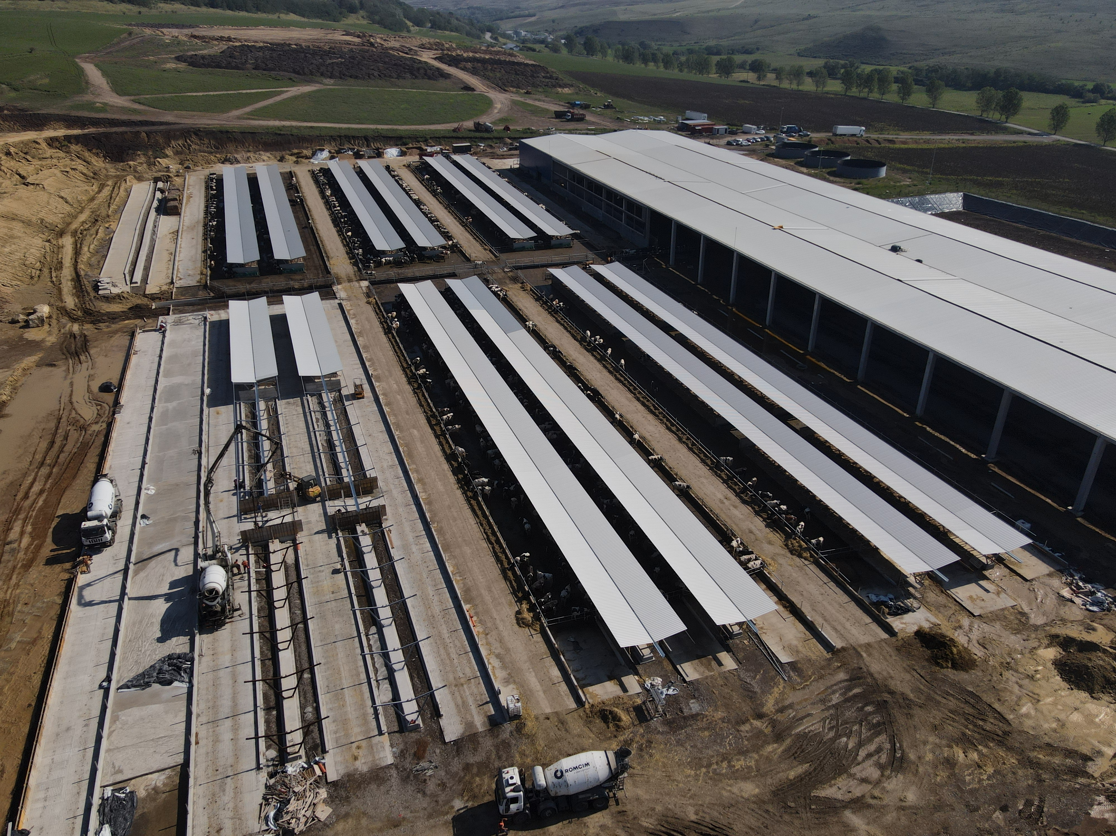
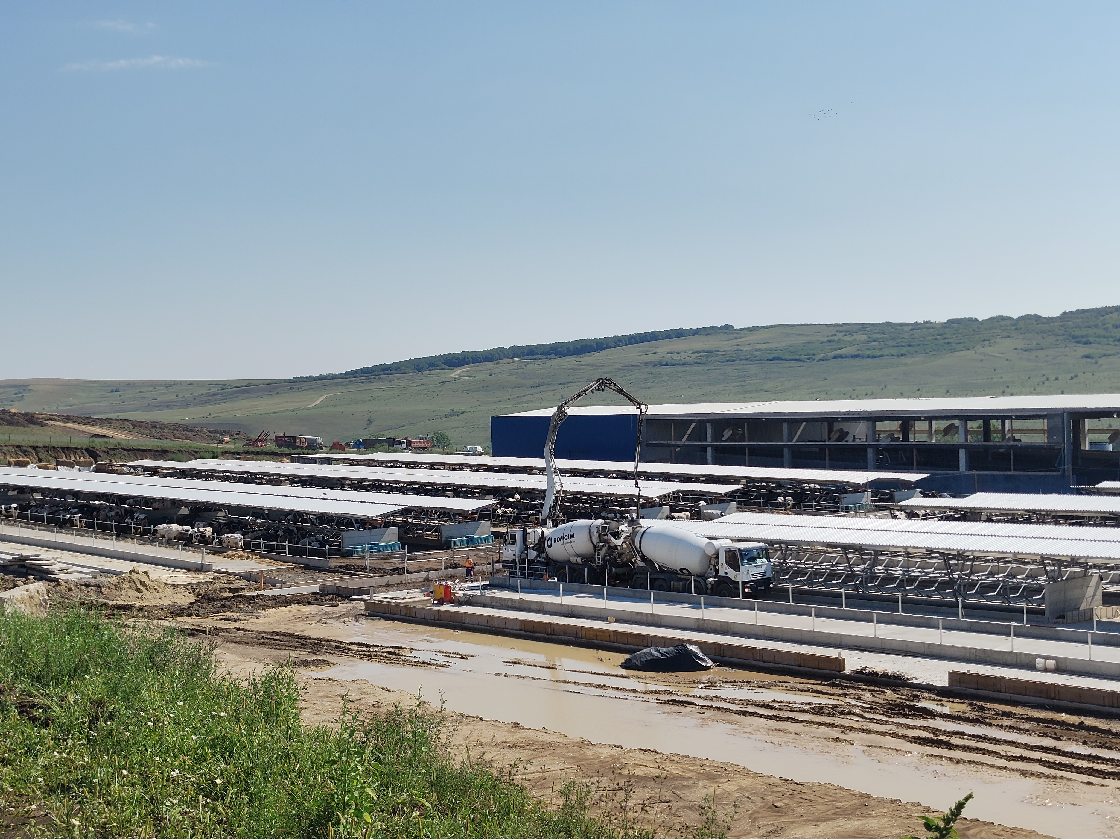
STRAJA PROJECT CURRENT STATUS

Slide 24
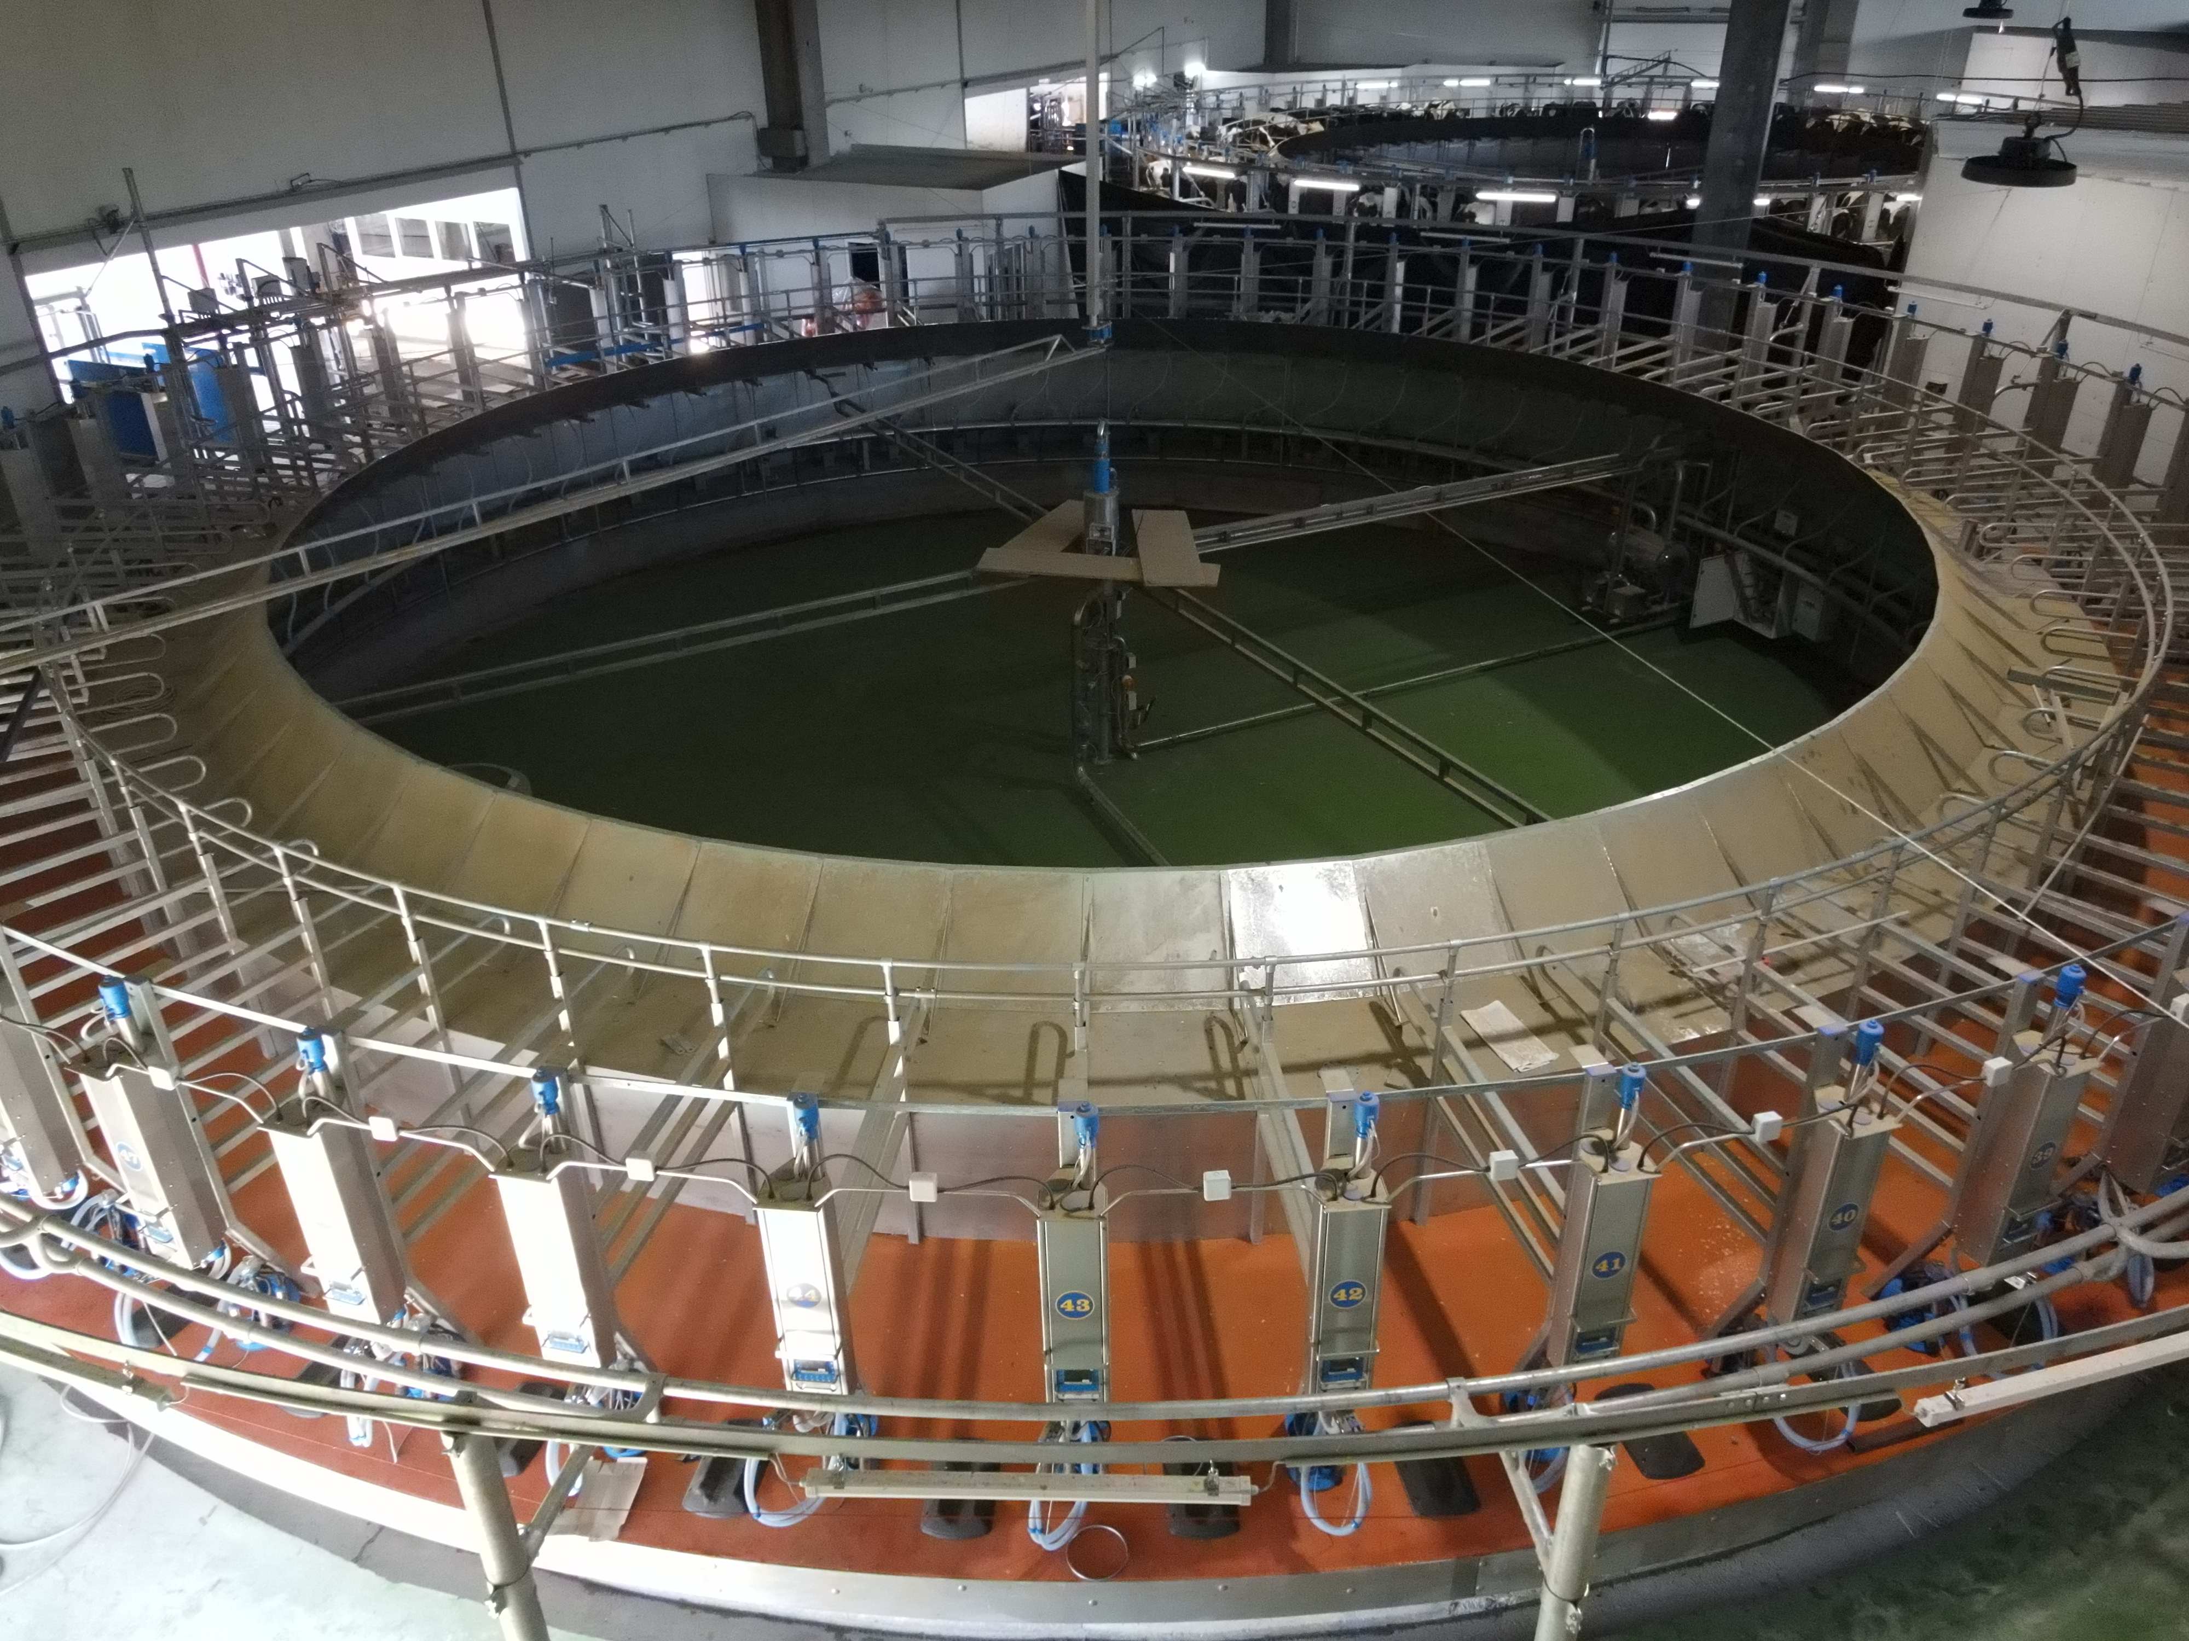
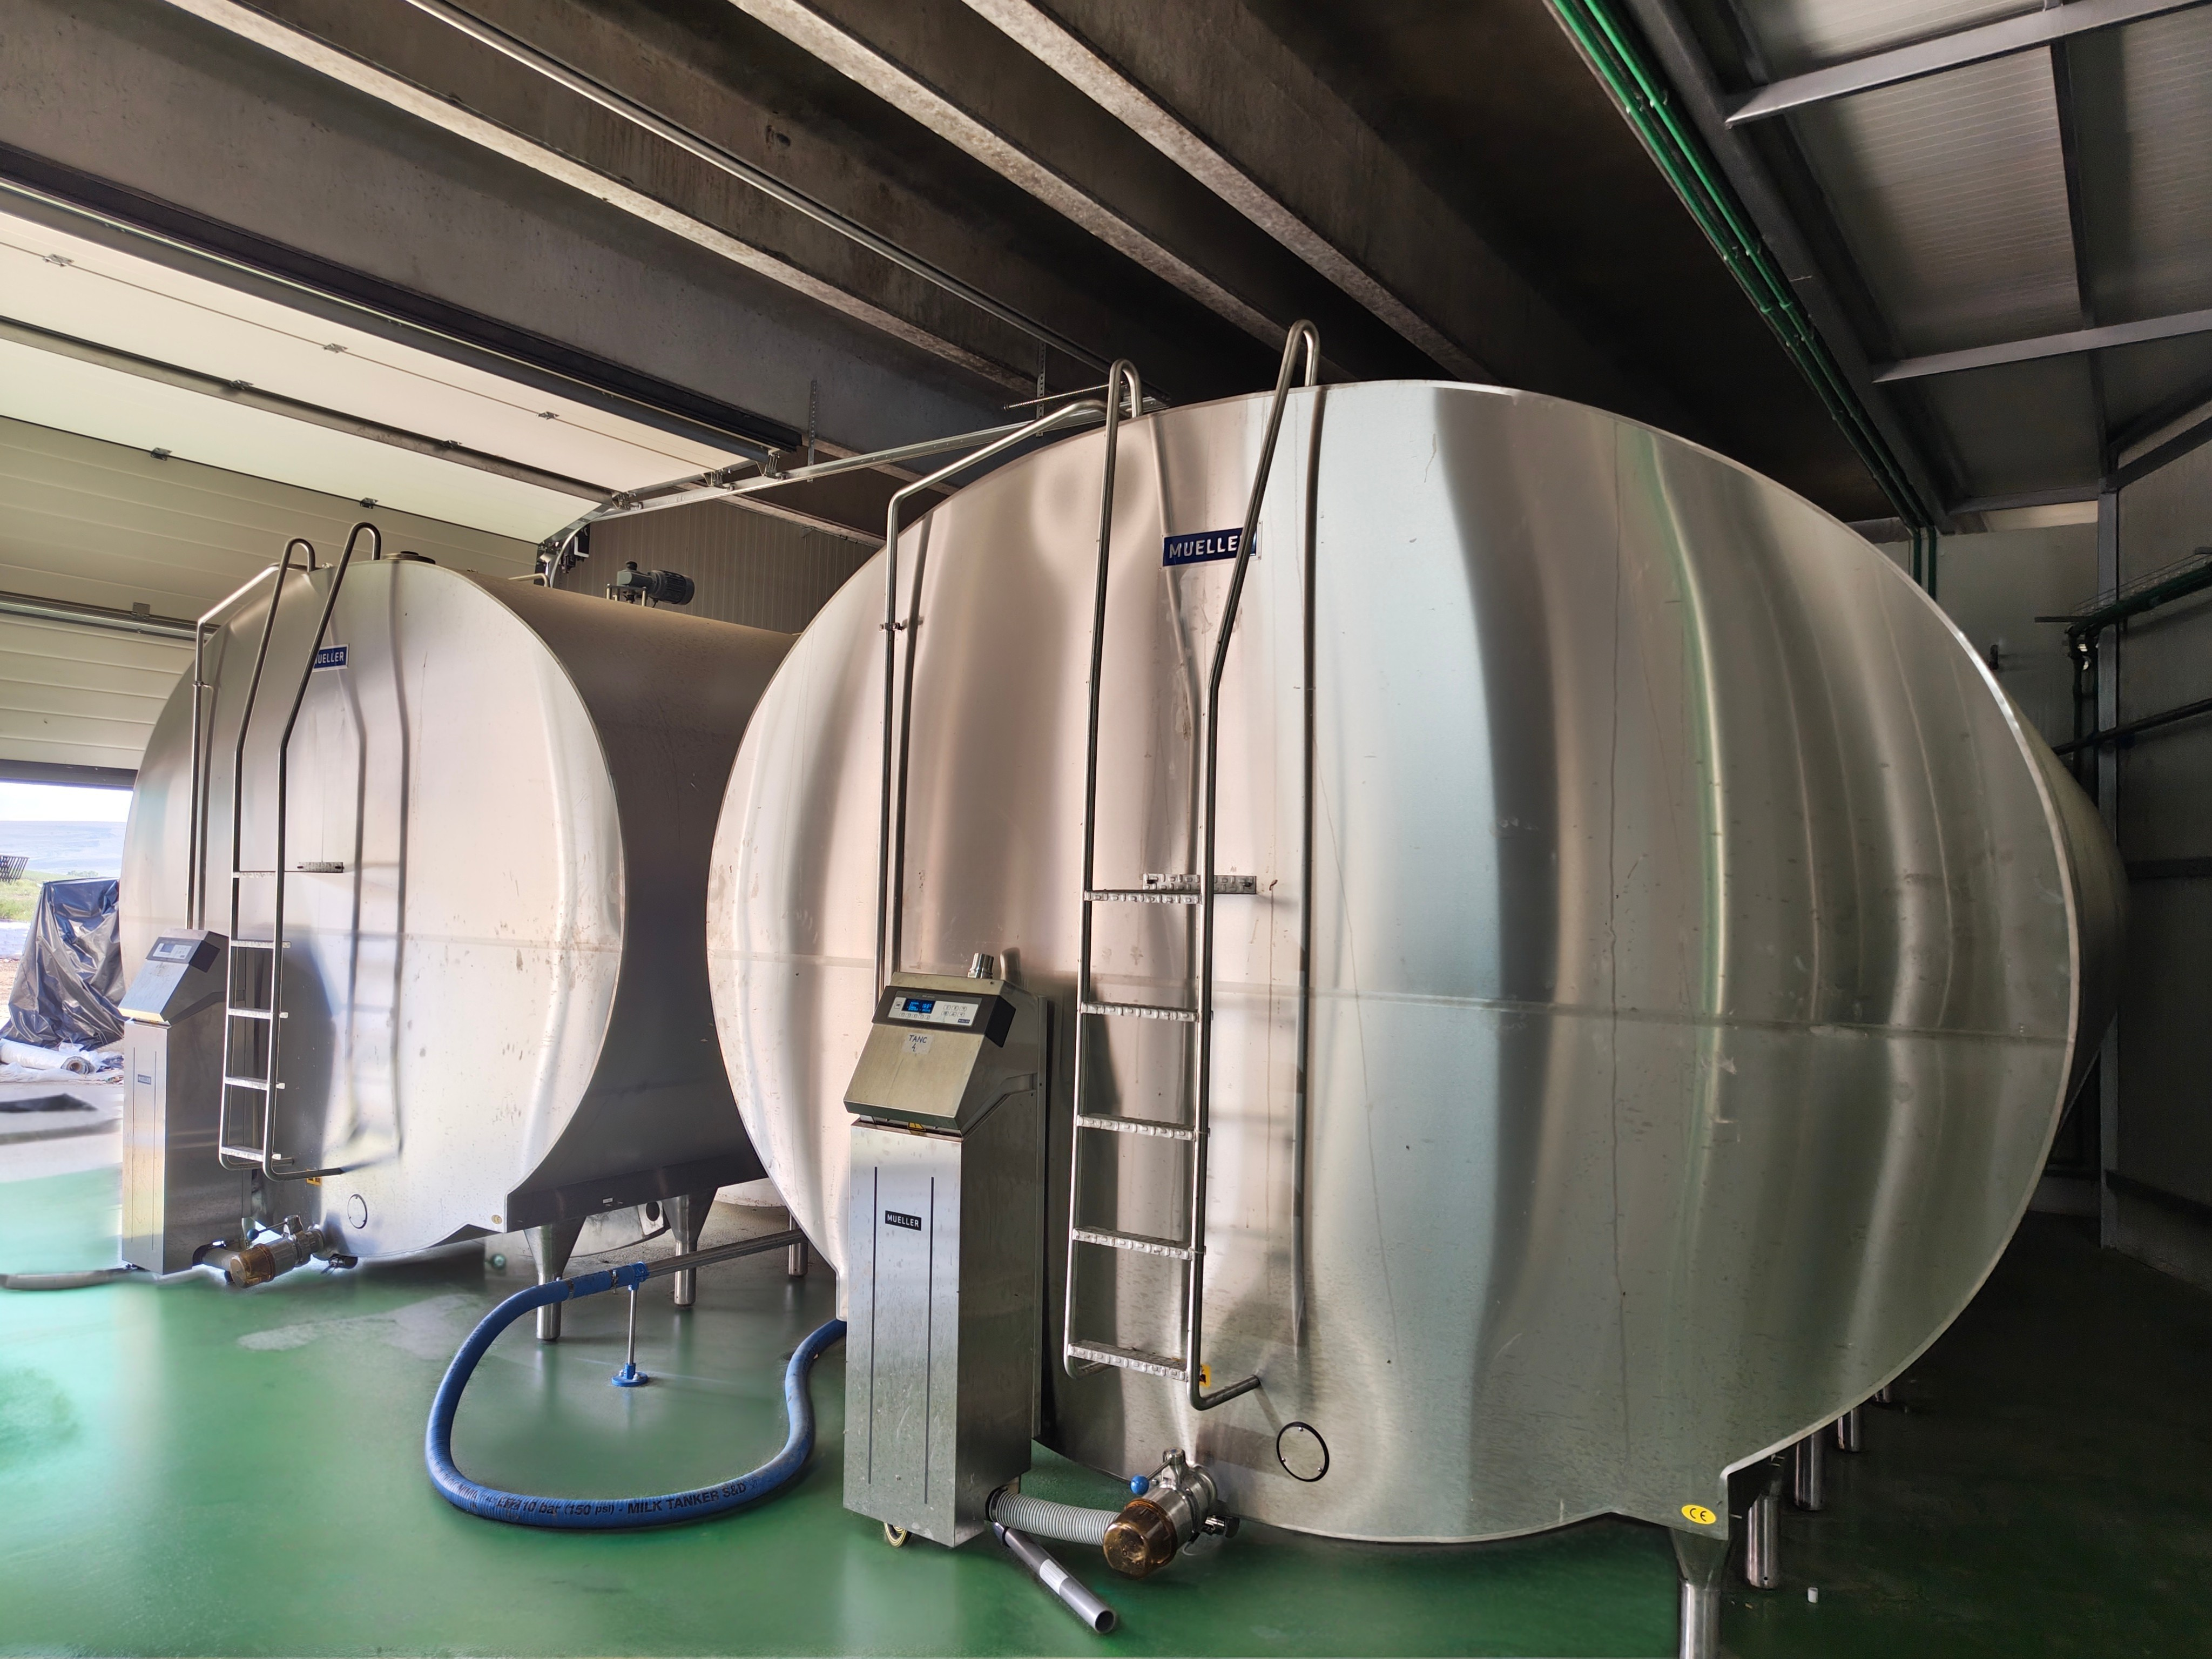
STRAJA PROJECT CURRENT STATUS

Slide 25
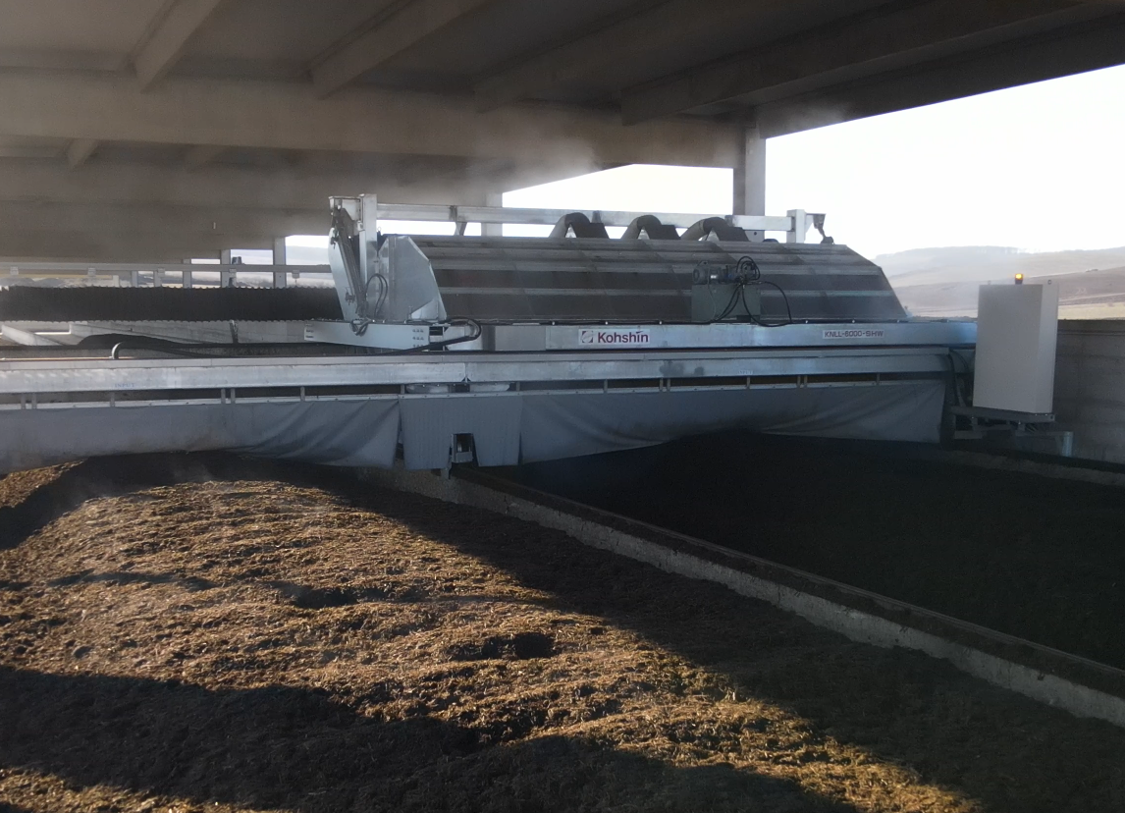


COMPOST FACTORY TO STRENGTHEN THE CIRCULAR ECONOMIC MODEL
Operational Highlights
The Apold compost factory is performing as planned, with a production of approximately 1,500 tons of compost
The Lacto Agrar compost factory is currently being developed
21,000 tons of manure processed annually
Increasing the production capacity of organic fertilizer to over 14,000 tons, with the installation of the 2nd factory in Lacto Agrar
Use the organic fertilizers produced for internal needs and to sell outside the Group
2 compost factories
The project addresses two major challenges:
efficient manure management and
improved soil fertility
contribution to the
reduction of greenhouse
gas emissions
Integrated organic waste management system
Further Developments
Currently in the final stages of the certification process with Ecocert and anticipate that this process will be completed soon.
Process of obtaining voluntary carbon certification for the produced compost initiated. The first carbon credits will be obtained by the end of 2026
Build the sales channel to develop the business line
Advance with the certification process to achieve the international "Gold Standard" accreditation for carbon credit

Slide 26
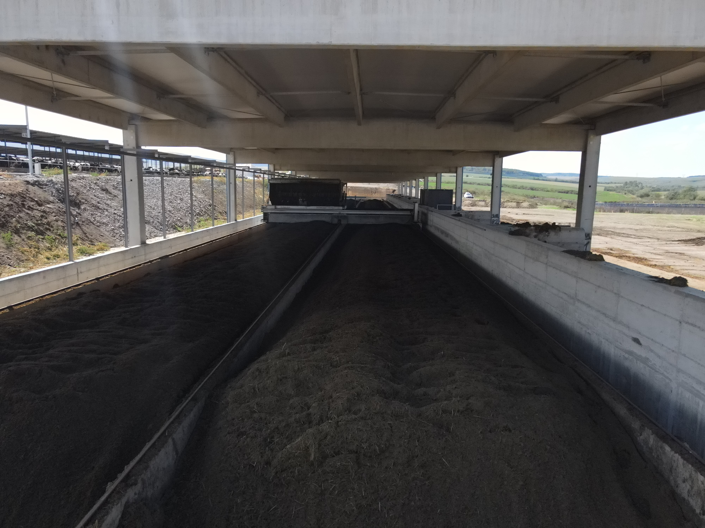
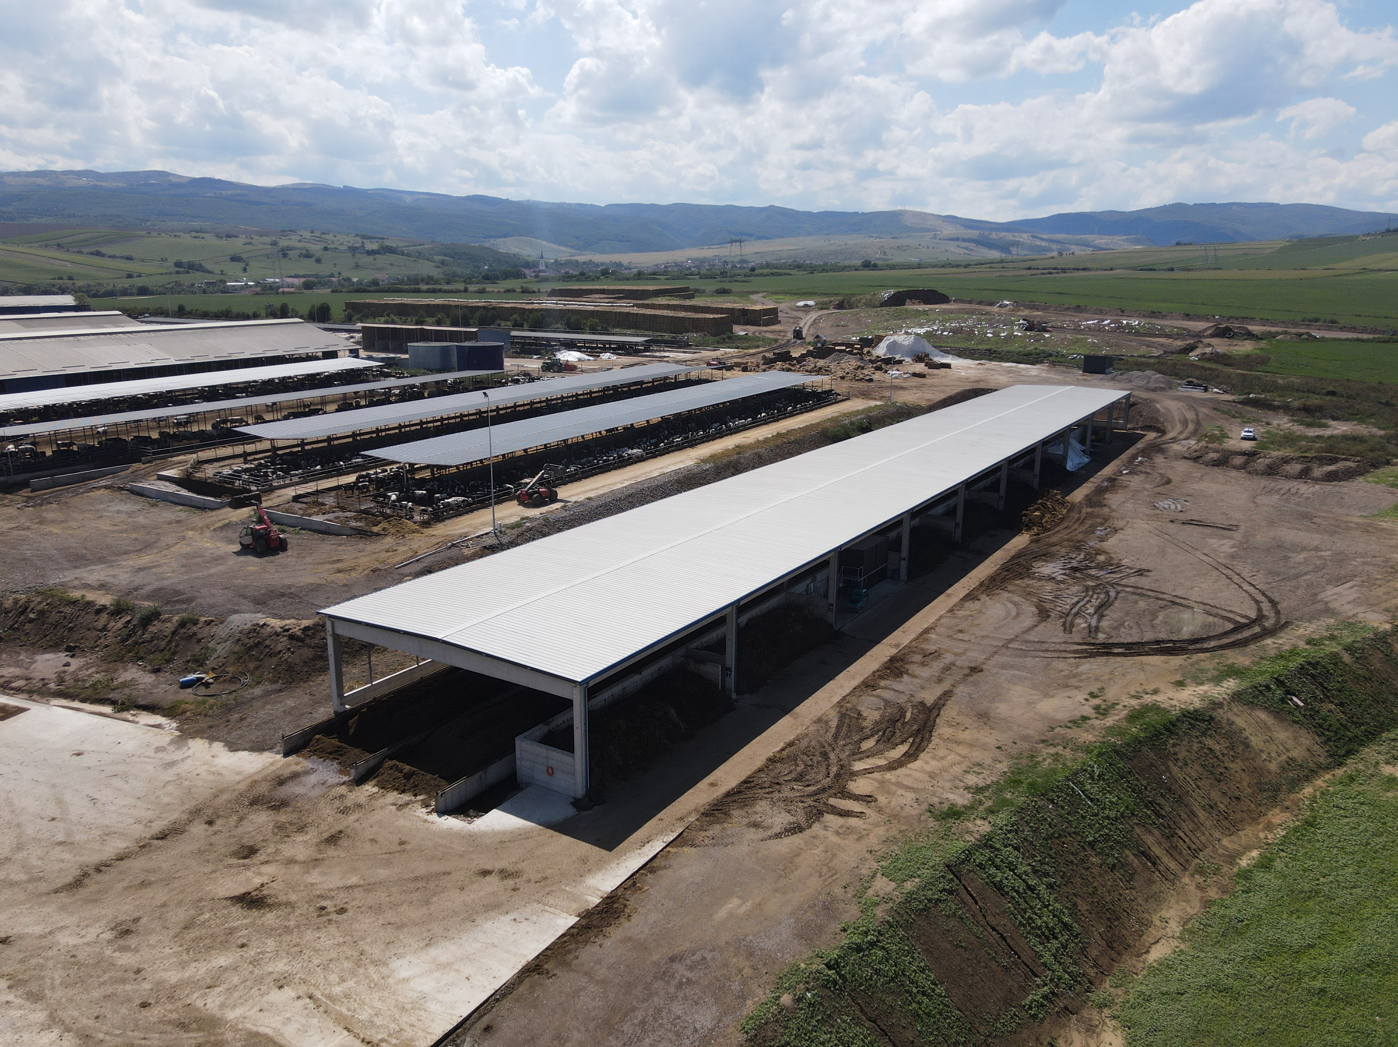
APOLD COMPOST FACTORY

Slide 27
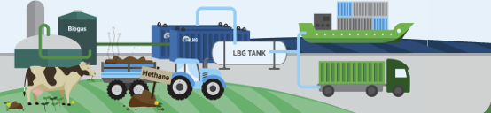
BIOMETHANE PRODUCTION FOR AN INTEGRATED SUSTAINABLE STRATEGY
Operational Highlights
Production facility with a total capacity of up to 15-20 MW.
DN AGRAR will supply the raw material for the biomethane production and transportation.
BSOG Energy will develop the production facility.
Cooperation agreement for the largest biomethane production facility in Romania with BSOG Energy
Further Developments
This project aligns with DN AGRAR’s mission
to lead sustainable agriculture.
The partnership with BSOG Energy reached a new stage with land secured and permitting in progress.
Project execution is expected to take over 2 years from the signing of the final agreement.
The overall investment in the facility is estimated to around EUR 30 million.
Based on a 15-year contract, the expected yearly revenues for DN AGRAR will be approximatively EUR 3.5 million.
By implementing biomethane, composting, and solar panel sustainability projects, DN AGRAR aims to significantly reduce its carbon footprint, leading to a reduction of approximately 90% in emissions, and supporting the company’s goal to achieve near net-zero emissions by 2030.
Current status

Slide 28
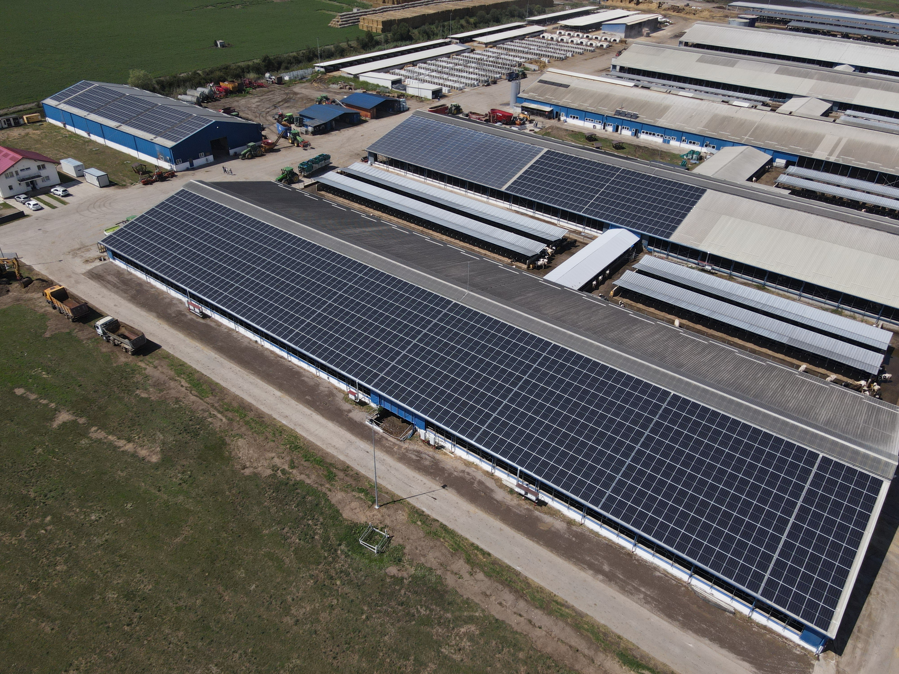
GREEN ENERGY - SOLAR PANELS PROJECT
DN AGRAR strengthens its energy strategy with new investments
Solar panel installation on the roofs of DN AGRAR farms was completed
APOLD
farm
An EUR 1.7 million project for the installation of solar panels on the buildings of Apold, Lacto Agrar, and Cut farms, with funding approved earlier this year.
60% funded through the National Recovery and Resilience Plan (PNRR).
The project has a total capacity of 2,218 kW.
The installation of the panels has been completed, and in the second phase, the farms were also equipped with energy storage systems (batteries) to maximize efficiency.
The main goal is reducing the carbon footprint and securing a renewable energy source for the company’s internal operations.

Slide 29
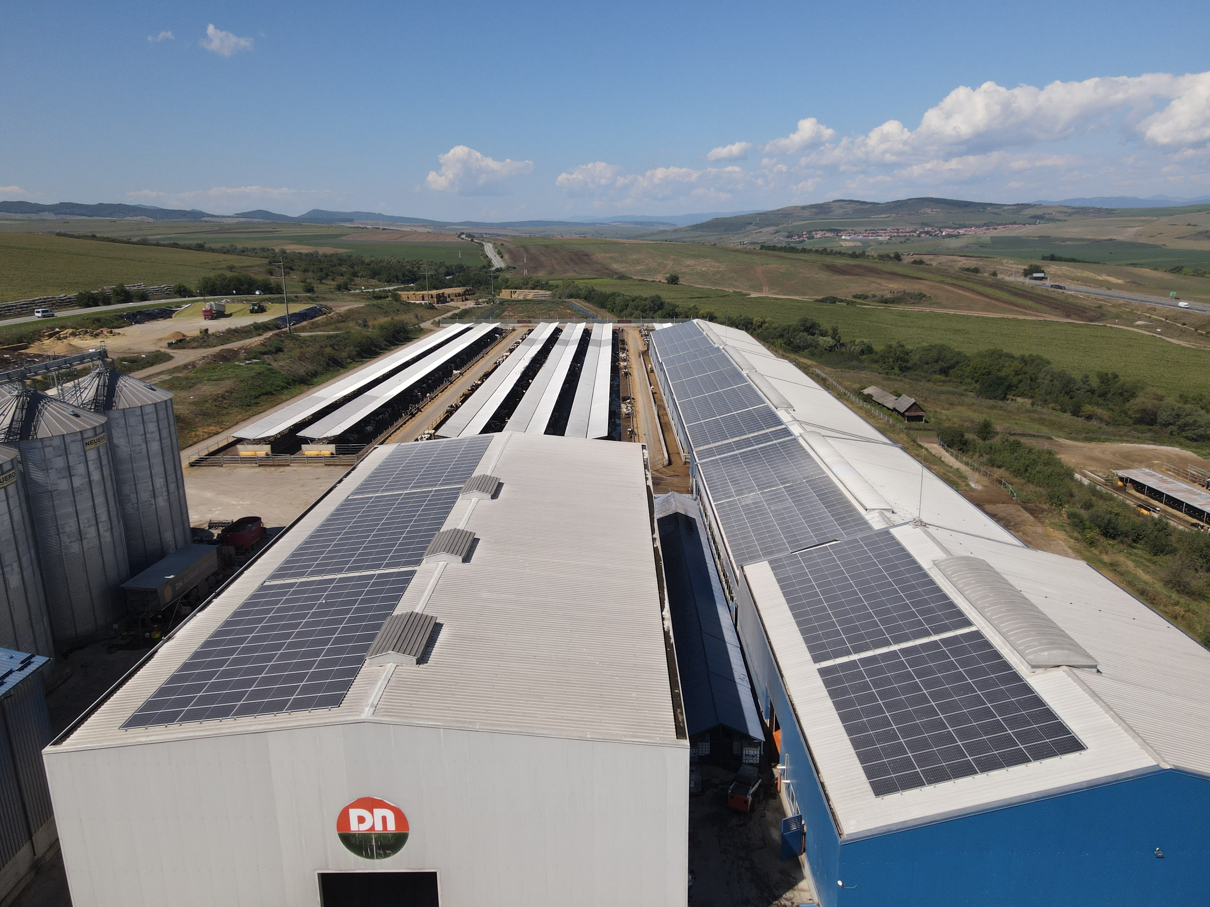
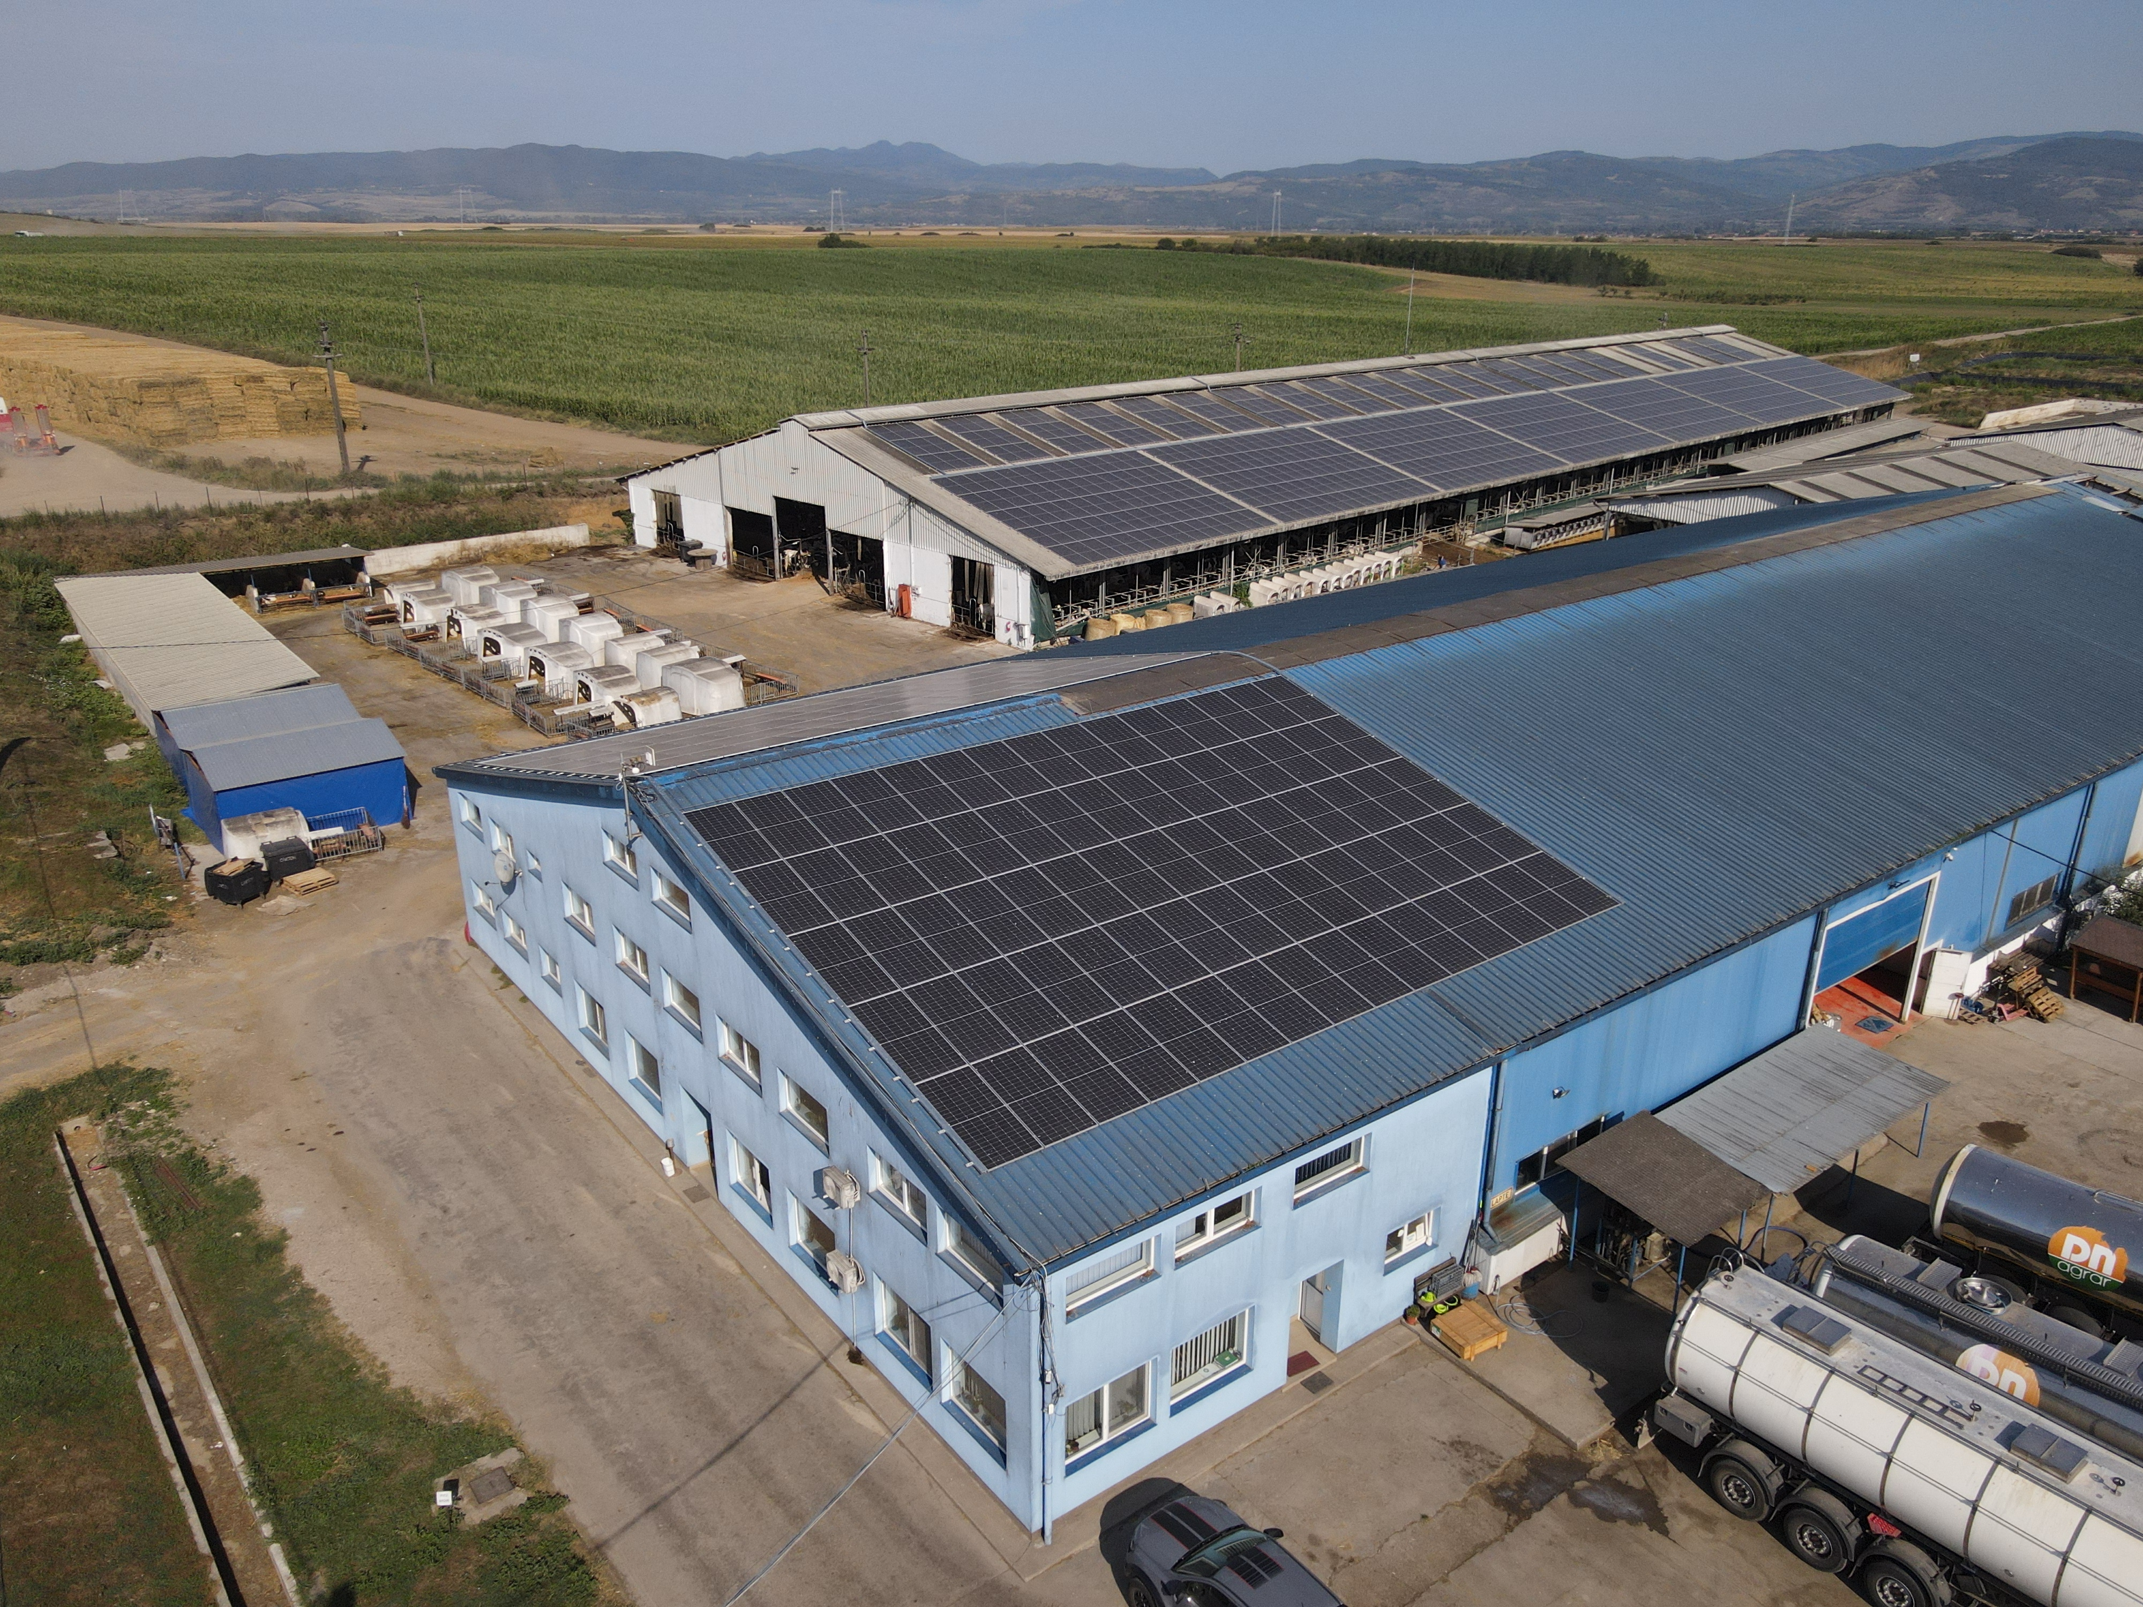
SOLAR PANEL PROJECT CURRENT STATUS
CUT
farm
LACTO AGRAR
farm

Slide 30
CONTENT
1
ABOUT DN AGRAR
2
6M 2025 FINANCIAL RESULTS
3
CAPITAL MARKET JOURNEY
4
OPERATIONAL ACTIVITY
5
CURRENT PROJECTS
6
OUTLOOK & 2025 -2030 STRATEGY

Slide 31
H2 2025 OUTLOOK
Financial Highlights
Operational Highlights
Q3 began with higher feed costs resulting from the unfavorable climate and significantly lower harvest yields, thus pressure on margins is expected.
While this additional cost burden will partly be offset by relatively favorable market prices for cereals and rapeseed, the overall effect in Q3 will still be slightly negative for margins.
In Q4, the impact of the drought will become even more visible as production costs for cereals are recalculated.
The lower in-house production of crops translates in higher costs for feed as more external purchases are required to supplement the reduced in-house production.
Milk volumes are expected to remain at elevated levels in both Q3 and Q4, due to herd expansion and productivity gains, supporting further revenue growth.
On the agriculture side, in certain areas, harvests were reduced to almost half of the tons per hectare compared to last year.
DN AGRAR maintains a positive outlook for the second half of 2025 despite the significant challenges posed by adverse climate conditions.

Slide 32
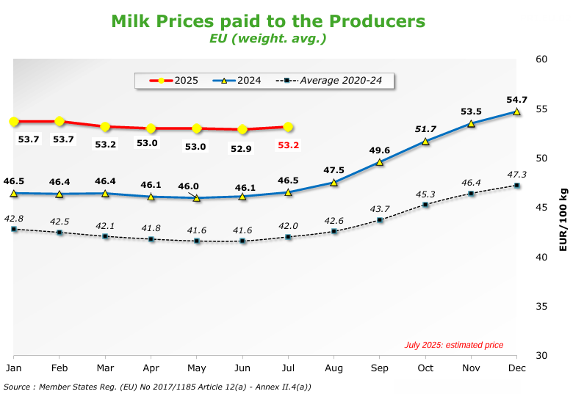
EUROPEAN MILK MARKET
May 2025 vs. to May 2024
as of June 2025
*Source: https://agriculture.ec.europa.eu/

Slide 33
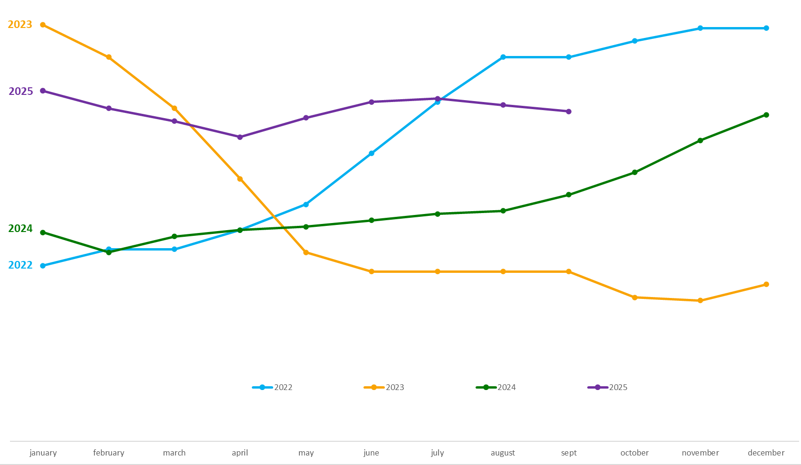
DINAMYCS OF THE MILK PRICE EVOLUTION
THE FOUR SCENARIOS:
Although the milk price experienced
a decline in the first quarter of 2025,
it remained substantially above the levels seen in Q1 2024.
In Q2 2025, the price continued to increase following an upward pace.
The market environment remains favorable and DN AGRAR anticipates for
Q3 an average milk price higher than in the same quarter of 2024.
For Q4, the milk price is projected to remain stable and above last year’s levels.

Slide 34
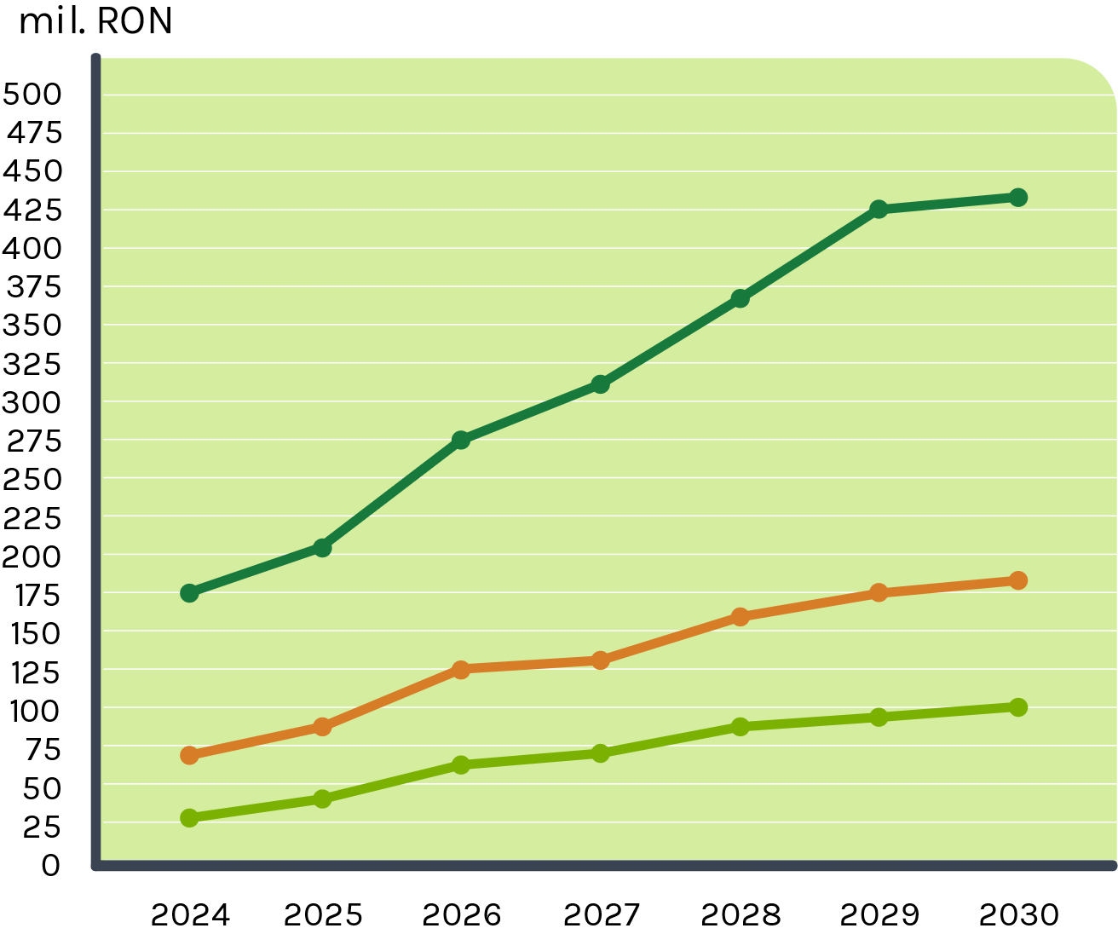

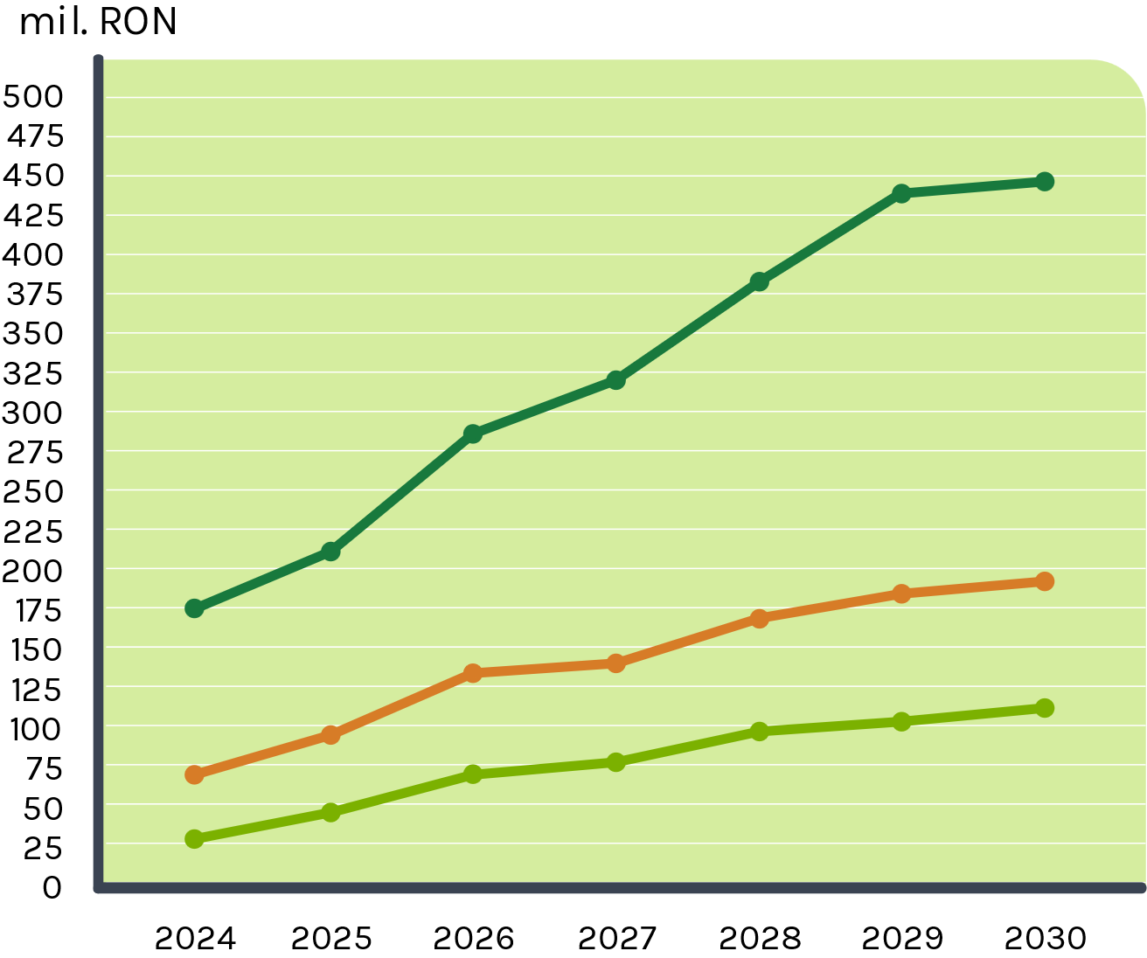
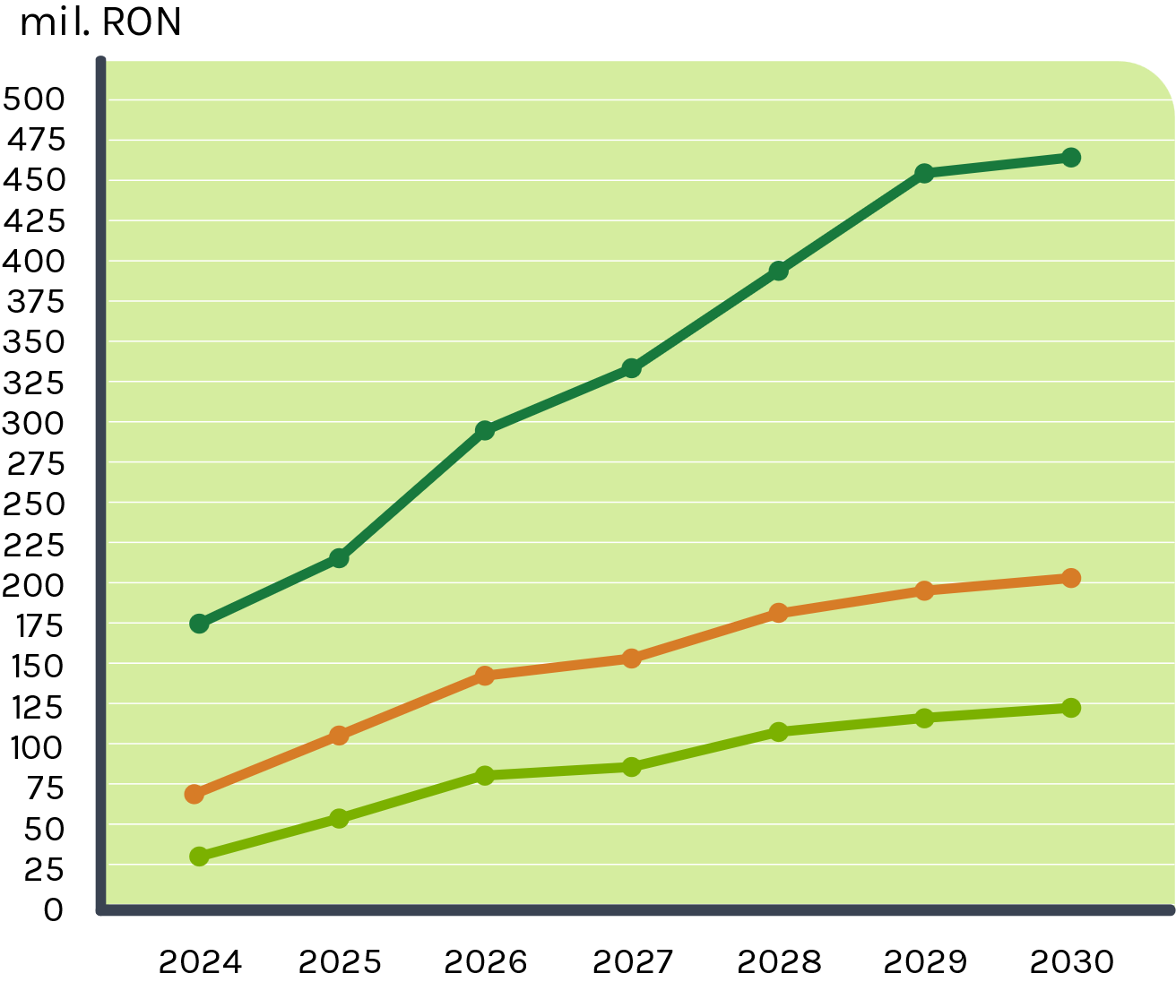

THE FOUR SCENARIOS by 2030
SCENARIO 1 - the milk price is considered based on the average milk price in 2023.
SCENARIO 2 - the milk price is considered based on the average milk price in 2024.
SCENARIO 3
- the milk price is considered based on the average milk price at the end of 2024.
SCENARIO 4 - the milk price is considered based on the average milk price in 2025, until now.

Slide 35
DN AGRAR
Strategy for 2030:
A Vision for
Growth,
Innovation,
and Value Creation
BUSINESS SEGMENTS:
1
MILK Production
2
COMPOST
3
4
VERTICAL FARMING
Production for
wheatgrass
GREEN ENERGY
5
ALTERNATIVES for
VALORIZING MILK
6
GREENHOUSES
Double EBITDA by 2030
150 - 200 million liters
of milk annually

Slide 36
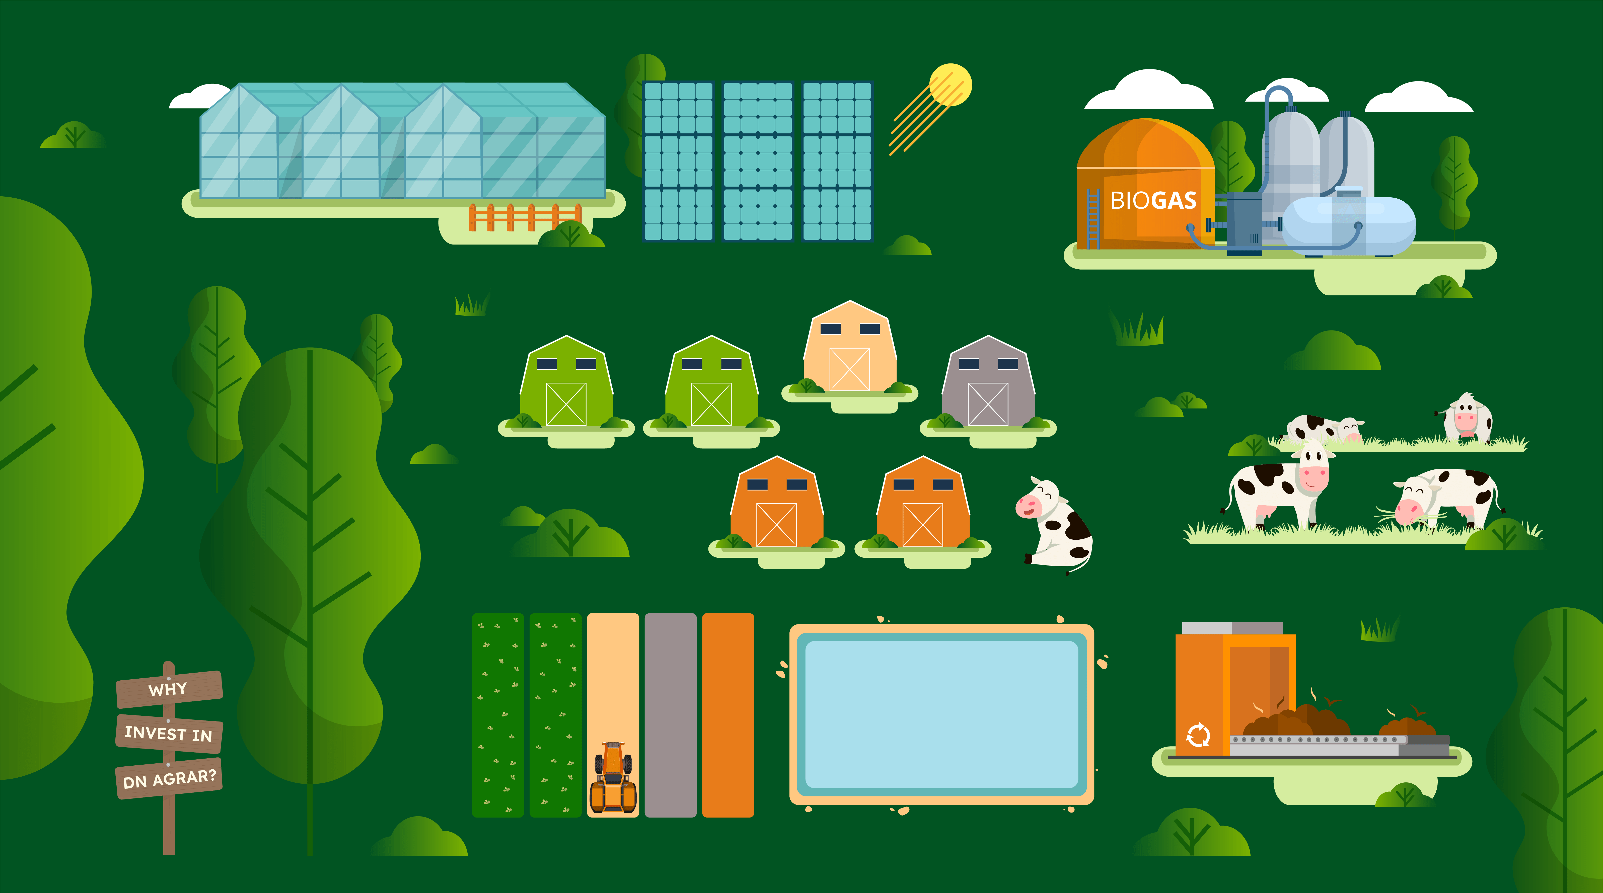

STRATEGIC TIMELINE 2025 - 2030
Vertical Integration
& diversification
Vertical Farming (Cut 1) Compost (Cut 1)
Laguna (Apold)
Cut 2 Farm (Construction)
Infrastructure Consolidation
& Agritech Expansion
Cut 2 Farm (Animal Acquisition)
Vertical Farming (Cut 2)
Compost (Cut 2)
Laguna (Straja - Ohaba)
Straja 2 Farm (Potential Construction)
Market Penetration
& Final Vertical Integration
Greenhouses (Phase 2) Vertical Farming (Apold)
2 Composting Units (Straja)
2025
2027
2029
2026
2028
2030
Foundation Year
Straja Farm Phase 1 Compost (Vaidei) Solar Panels
Biogas Entry & Operational Scaling
Straja 1 Farm Completed
Biogas Facilty (end of 2027)
Cut 2 Farm (Milking Infrastructure) Solar Panels (Expansion)
Laguna (Cut 2)
Greenhouse
consumer – oriented
Greenhouses (Phase 1) Vertical Farming (Vaidei)

Slide 37
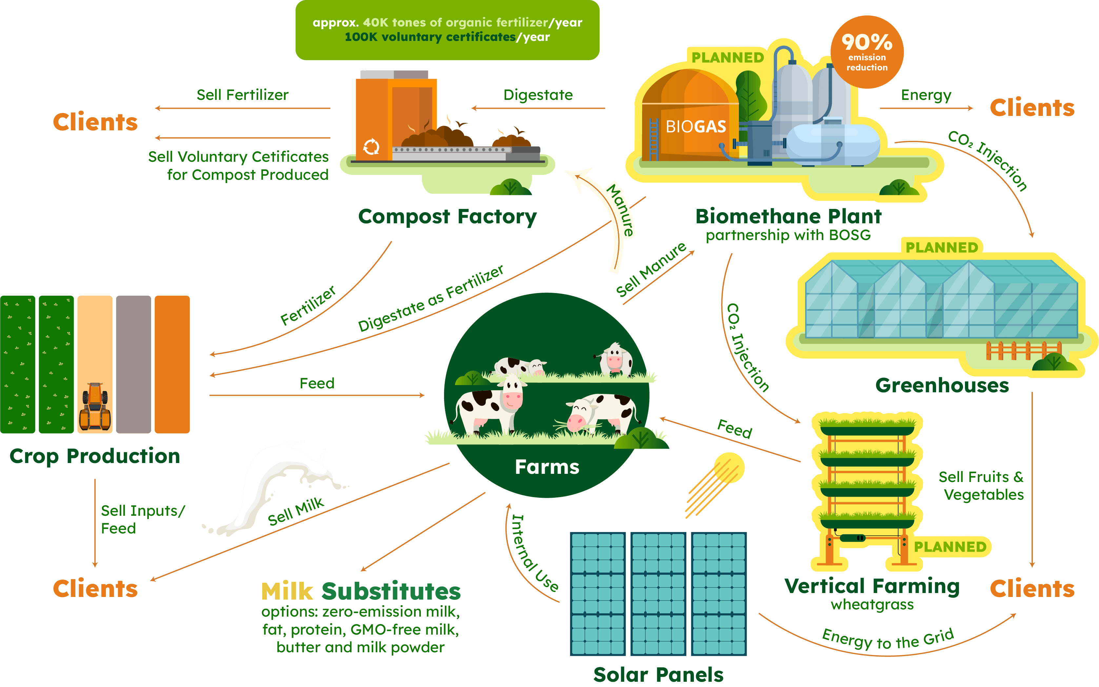
INTEGRATED BUSINESS MODEL – IN 2030

Slide 38


DN AGRAR’S INVESTOR DAY
September 19th, 2025
09:30 – 10:00 – Welcome Coffee & Registration & Meet DN AGRAR’s management team
10:00 – 11:30 – DN AGRAR’s Strategy 2025 – 2030: business segments, diversification & vision, capital
market roadmap
11:30 – 12:10 – Panel Innovation & partnerships
🔸 Kohshin (Japan): Organic fertilizer production & market potential
Speaker: Mr. Hugo Katsumi Higo - Area Manager Kohshin Japan
Speaker: Mr. Cezar Păun - CEO Kohshin Europe
🔸 Logiqs (Netherlands): First large-scale wheatgrass facility in Europe
Speaker: Mr. Gert-Jan van Staalduinen
🔸 DN AGRAR (Romania): First to field - company’s strategic adoption of global agri-innovations
12:10 – 12:30 – ING’s outlook on the agri-food economy and regional competitiveness
12:30 – 13:15 – Site Visit: Straja Farm, the newest farm of the Group
13:15 – 14:15 – Networking Lunch
14:15 – 14:35 – DN & BSOG Biomethane project and its strategic value
14:35 – 15:15 – DN AGRAR’s Project pipeline 2025 -2030: first integrated Agri-Cluster and plans for
greenhouse cluster development
Speaker: Yorick Debruin, Phd – Director of Wageningen Metropolitan
Food Clusters
15:15 – 16:15 – Conclusions and Q&A
16:30 – 18:30 – Optional Site Visits
– Location 1 – CUT 1 Farm & CUT 2 cluster location
– Location 2 – Apold Farm & DN AGRAR’s first organic fertilizer factory

Slide 39
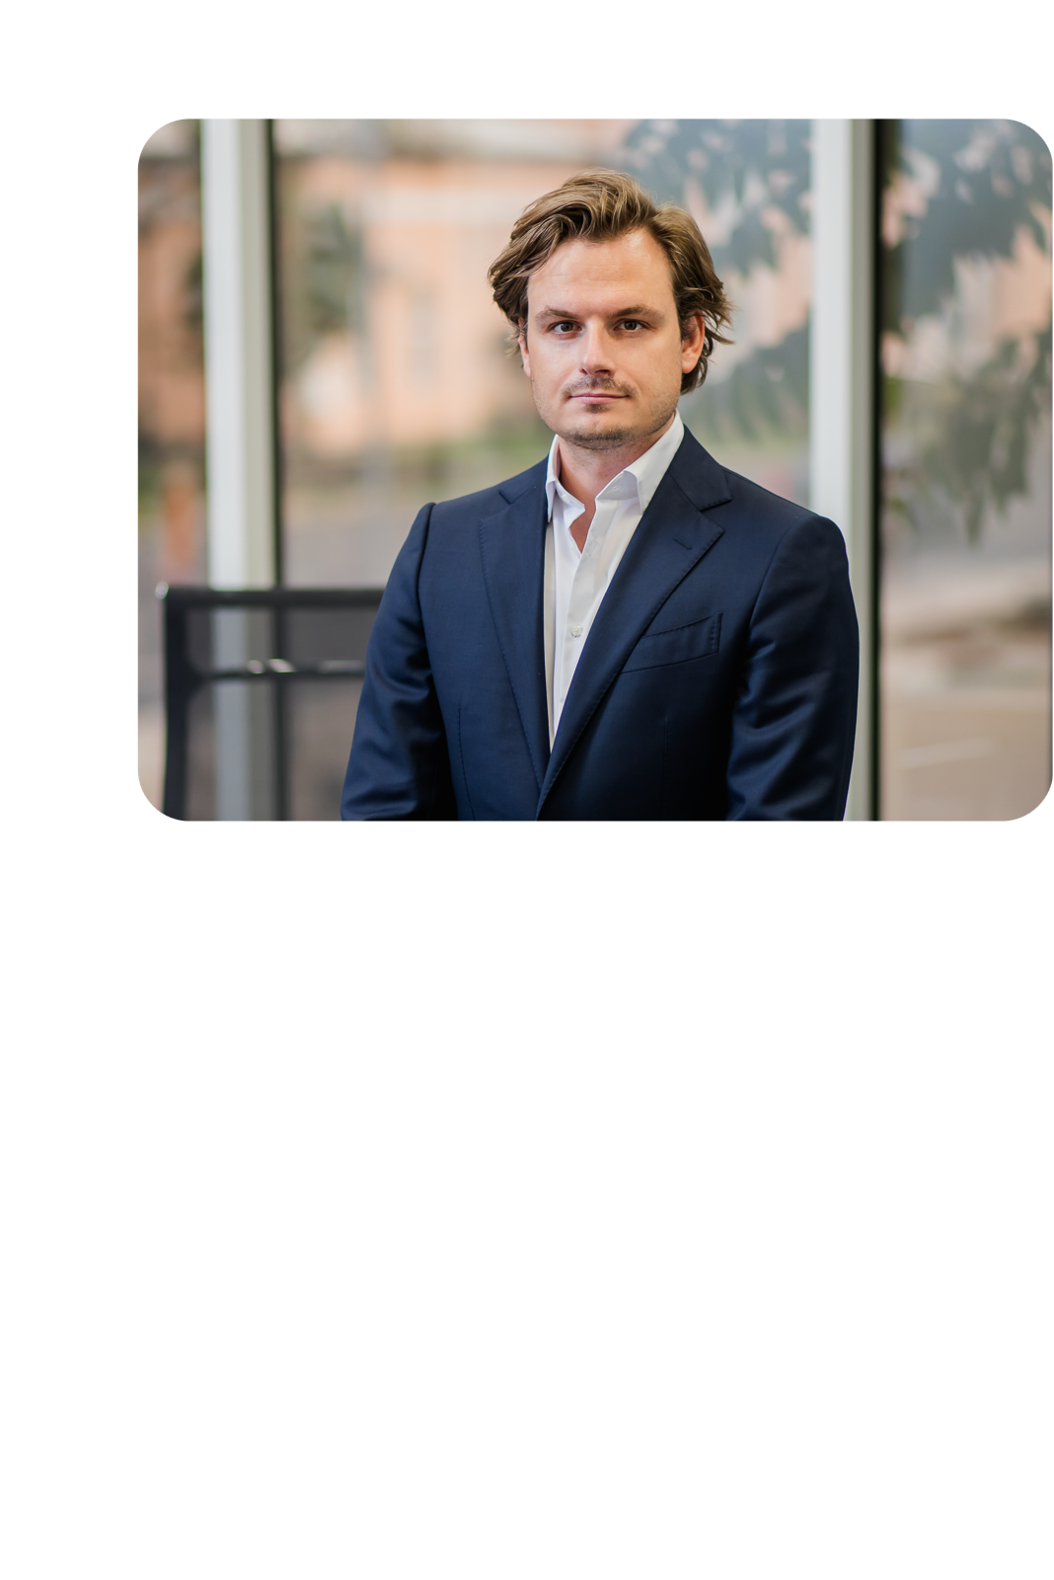
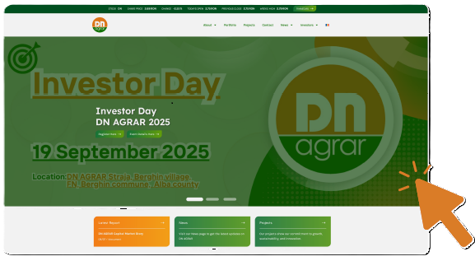
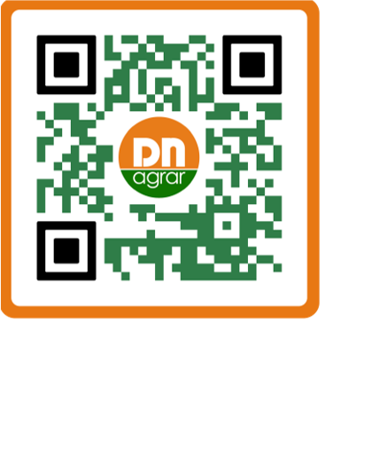
CONTACT
Website: www.dn-agrar.eu
On the DN AGRAR company website, you can find press releases, financial reports, annual reports, presentations, the financial calendar, and other relevant information for shareholders, accessible through the Euroland interactive tool.
How do you contact us?
Peter de Boer, CEO & BoD Member
DN AGRAR Group
Visit our page and
subscribe to our newsletter
to keep up to date with our work.
General information
Piața Iuliu Maniu Street, No. 1, Alba-Iulia Alba County, Romania
(+)40 258 818 114
(+)40 258 818 115
office@dn-agrar.eu
investors@dn-agrar.eu

Slide 41
QUESTIONS
This conference is on 28th august so 2/3 of Q3 already passed. In which of the 4 presented scenarios is DN now?
Have you noticed the activity of investment funds in recent weeks?
When is DN AGRAR expected to be listed on the main market?
Could you present three scenarios for revenue growth over the next 10 years (CAGR): base, pessimistic, and optimistic?

