Slide 1
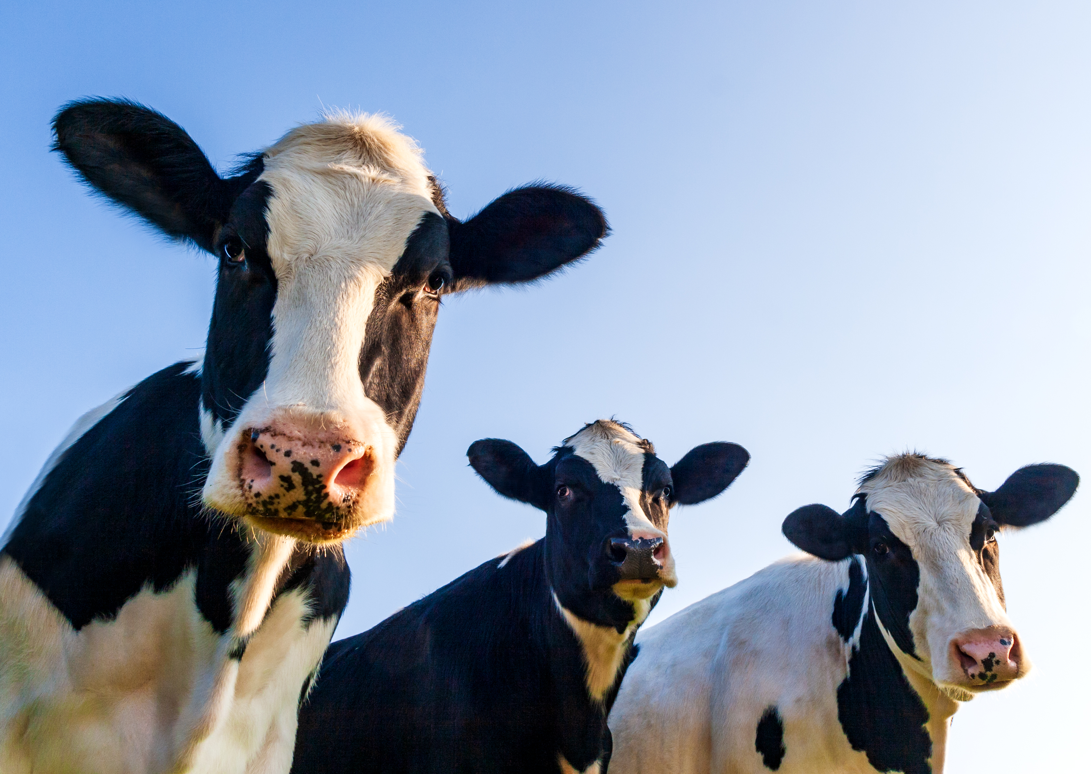
DN AGRAR’s
Management Team
Presentation Financial Results
Q1 2025
- May 26th, 2025 -

Slide 2
CONTENT
ABOUT DN AGRAR
Q1 2025 FINANCIAL RESULTS & CAPITAL MARKET ACTIVITY
OPERATIONAL ACTIVITY & OUTLOOK
DN AGRAR CURRENT PROJECTS UPDATE

Slide 3
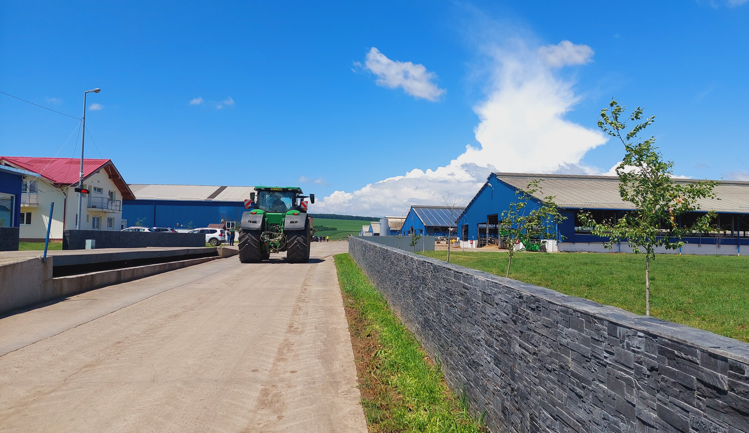
ABOUT
DN AGRAR

Slide 4
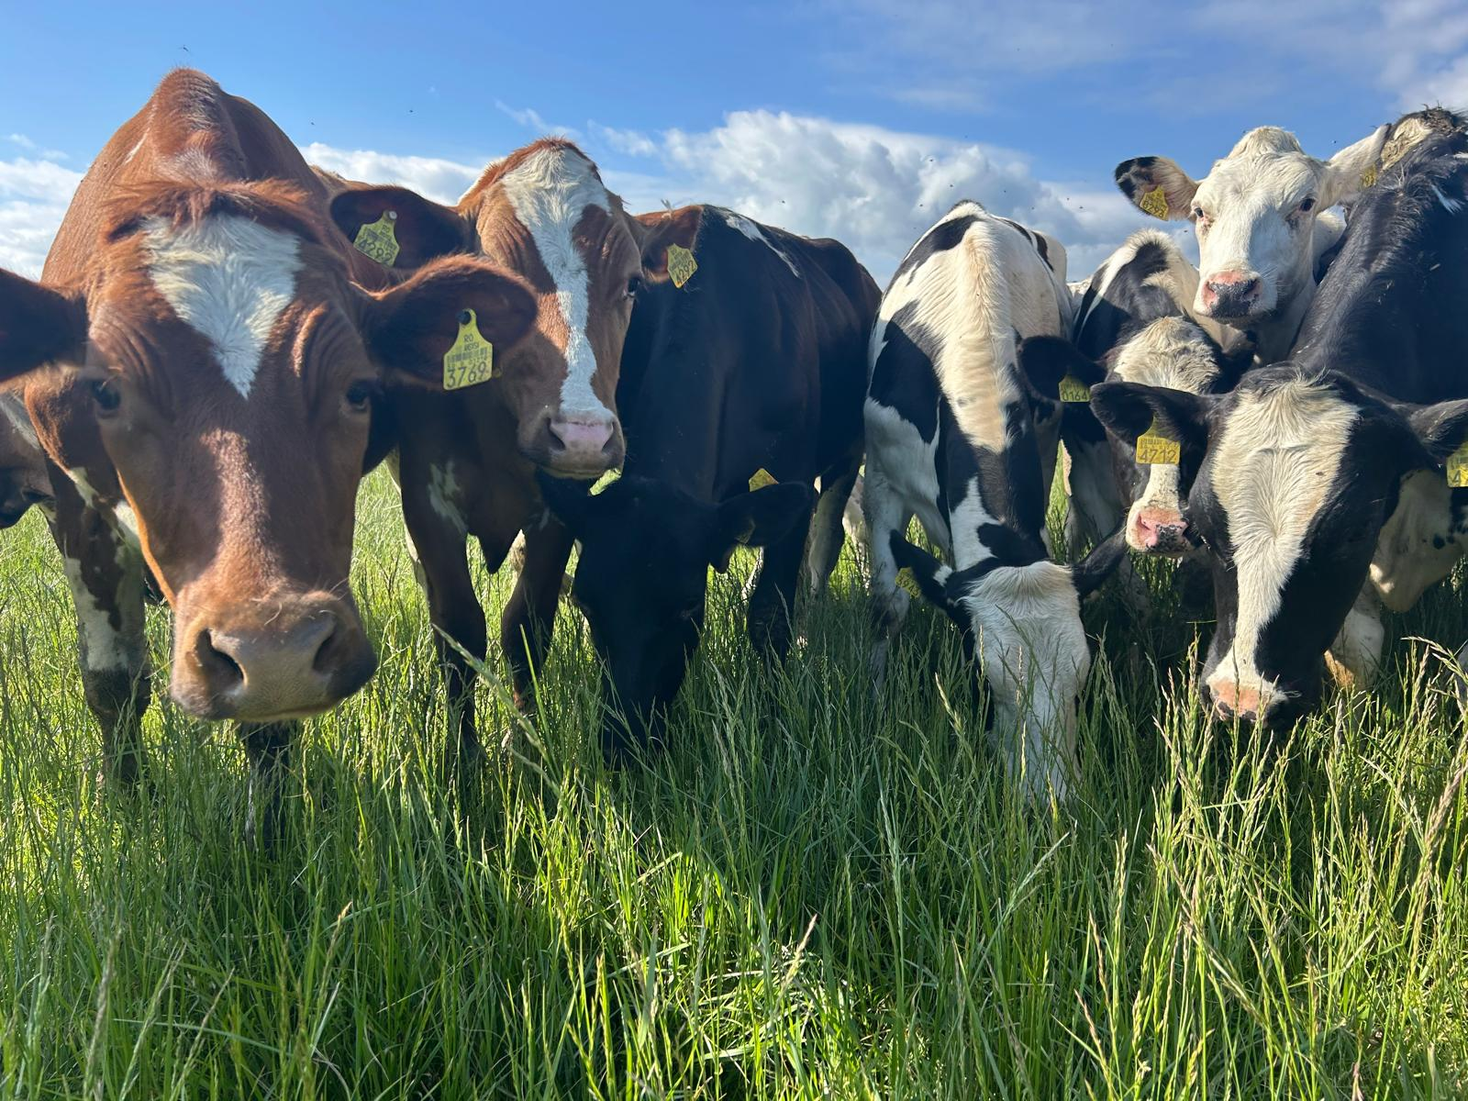
DN AGRAR - AN OUTSTANDING GROWTH STORY
Tripled the business since listing
Consistent Growth in EBITDA
Approx. 17 million liters of milk delivered in Q1 2025.
Track
Record
Focus on sustainable, regenerative agriculture practices that maximize productivity, reduce environmental impact, and ensure long-term profitability.
Sustainable
Agriculture
One of Europe’s leading milk producers and the largest integrated zootechnical farm in Romania, with cow milk production and vegetable production.
Market
Position
4

Slide 5
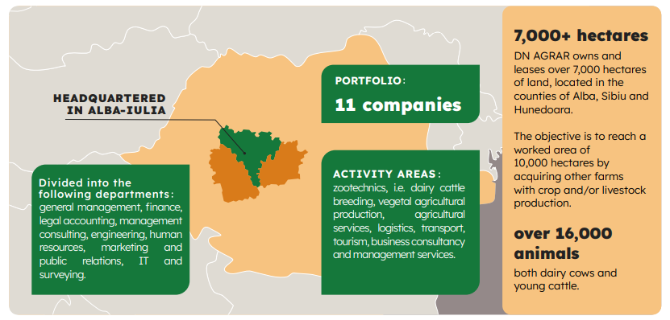
DN AGRAR ACTIVITY – INTEGRATED DAIRY PRODUCTION
Zootechnics
Vegetal agricultural production
Agricultural services
Logistics
Transport
Tourism
Business and management consulting services

Slide 6
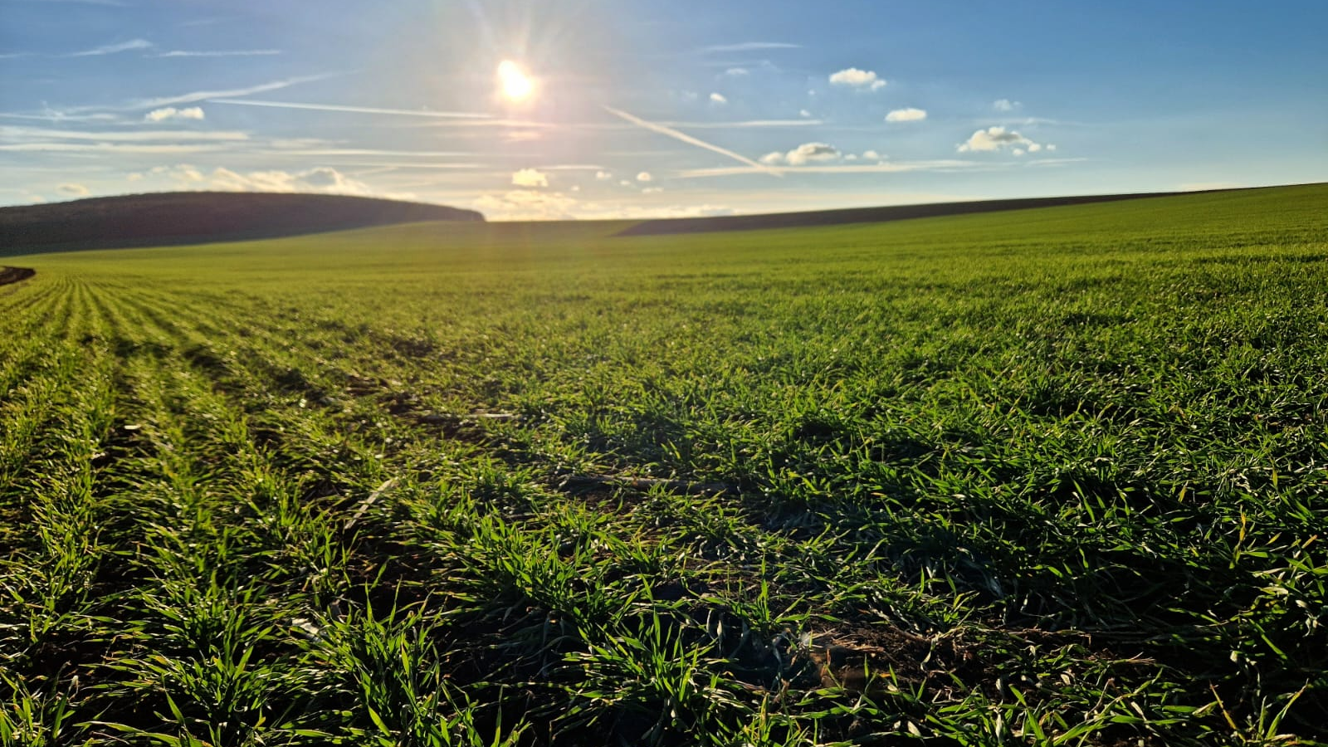
Q1 2025
FINANCIAL RESULTS &
CAPITAL MARKET ACTIVITY

Slide 7
RECORD RESULTS IN Q1 2025, TURNOVER +26.8%, NET PROFIT +78%
TURNOVER
NET ASSETS
RON 51.09 mil.
+26.84%
vs Q1 2024
RON 296.87 mil.
+7.02%
vs 31.12.2024
NET PROFIT
TOTAL ASSETS
RON 14.06 mil.
+78.28%
vs Q1 2024
RON 380.23 mil.
+5.13%
vs 31.12.2024
EBITDA
EQUITY
RON 25.54 mil.
+44.00%
vs Q1 2024
RON 179.14 mil.
+8.59%
vs 31.12.2024

Slide 8
FACTORS THAT INFLUENCED THE Q1 2025 RESULTS
Increase in turnover by 27%
Decrease in production costs for crops by 10%.
Income from subsidies increased by RON 1 million
The increase in depreciation by 11%
Increase in raw materials, consumables and utilities
by 6% expenses
The increase of personnel expenses by 28%
The evolution of investments
The increase in operating expenses by 20%
The increase in corporate income tax by 70%
8

Slide 9
CONTINOUS FINANCIAL GROWTH PERFORMANCE
TURNOVER, mil. RON
EBITDA, mil. RON
NET PROFIT, mil. RON

Slide 10
FINANCIAL RESULTS HIGHLIGHTS in Q1 2025
PROFIT AND LOSS ACCOUNT (RON) | 31/03/2025 | 31/03/2024 | ∆%
OPERATING INCOME – TOTAL | 73,428,08 | 60,152,441 | 22.07%
OPERATING EXPENSES – TOTAL | 54,358,447 | 48,559,094 | 11.94%
OPERATING PROFIT OR LOSS | 19,069,641 | 11,593,346 | 64.49%
FINANCIAL INCOME – TOTAL | 89,446 | 260,094 | (65.61)%
FINANCIAL EXPENSES – TOTAL | 1,823,410 | 2,034,111 | (10.36)%
FINANCIAL PROFIT OR LOSS | (1,733,964) | (1,774,017) | (2.26)%
GROSS PROFIT OR LOSS | 17,335,677 | 9.819.329 | 76.55%
GROUP NET PROFIT OR LOSS | 14,065,292 | 7,889,460 | 78.28%
In the first quarter of 2025, operating revenues amounted to RON 73 million, a 22% increase compared to the same period of last year.
Operating expenses increased by 12% in the first quarter of 2025 compared to the same period in 2024, reaching RON 54 million.
The main contribution came from the expenses related to value adjustments for tangible and intangible assets, which amounted to RON 7 million, a 12% increase compared to the same period of last year.
Revenues from production sold grew by 27%, reaching RON 51 million, compared to the first quarter of 2024.

Slide 11
THE MAIN ELEMENTS OF THE BALANCE SHEET
Equity increased by 9% compared to December 31, 2024, reaching RON 179 million, with this increase being driven by the recording of a net profit of RON 14 million as of March 31, 2025.
Long-term liabilities increased by 5% compared to the end of 2024, so as of March 31, 2025, the balance of long-term liabilities reached RON 116 million.
The provisions for the first quarter of 2025 decreased by 70% compared to the end of 2024, reaching RON 114 thousand.
Compared to the end of 2024, there was an increase in long-term loans contracted from Exim Bank by RON 4 million, or 8%, as a result of the withdrawals made from the EUR 9.2 million loan contracted in April 2024 for the construction project of the DN AGRAR Straja farm.
BALANCE SHEET INDICATORS (RON) | 31/03/2025 | 31/12/2024 | ∆%
FIXED ASSETS - TOTAL | 256,599,371 | 243,511,009 | 5.37%
CURRENT ASSETS - TOTAL | 120,615,925 | 115,784,991 | 4.17%
DEFERRED EXPENSES | 3,019,652 | 2,369,930 | 27.42%
TOTAL ASSETS | 380,234,948 | 361,665,930 | 5.13%
DEBTS: AMOUNTS TO BE PAID WITHIN UP TO ONE YEAR | 83,223,972 | 84,138,725 | (1.09)%
DEBTS: AMOUNTS TO BE PAID IN MORE THAN ONE YEAR | 116,058,465 | 110,433,346 | 5.09%
PROVISIONS | 114,220 | 386,046 | (70.41)%
DEFERRED REVENUES | 1,692,932 | 1,727,746 | (2.01)%
DEBT - TOTAL | 199,282,437 | 194,572,071 | 2.42%
EQUITY - TOTAL | 179,145,359 | 164,980,067 | 8.59%
TOTAL EQUITY AND DEBT | 380,234,948 | 361,665,930 | 5.13%

Slide 12
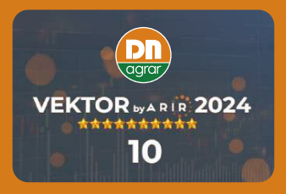
ACTIVITY IN THE CAPITAL MARKET RECOGNIZED INTERNATIONALLY
Listed on the Bucharest Stock Exchange, AeRO market since February 2, 2022
Market capitalization of EUR ~50 mil, liquidity ranks among the highest on the AeRO market, surpassing even companies listed on the Main Market.
The company with the largest weight in the BETAeRO index at the end of Q1 2025.
Shares included in the MSCI Frontier Small Cap and MSCI Romania Small Cap indices
DN AGRAR obtained the score 10 at VEKTOR by ARIR
for the 2nd consecutive year
DN AGRAR was nominated in 3 categories at the
Business Review Awards Gala
Recognition

Slide 13
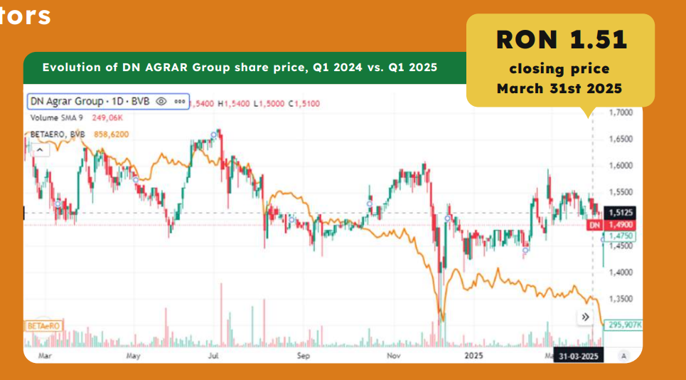
STRONG PERFORMANCE IN THE CAPITAL MARKET
Strong Share Performance
The share price performance compared to the listing has doubled.*
+3.07% share price performance in Q1 2025.
Shareholders Evolution
2,300
shareholders
3,000
shareholders
31.03.2024
31.03.2025
30% increase in the number of shareholders
*considering the closing price from 31.03.2025
**31.05.2025 vs 31.03.2024

Slide 14
OPERATIONAL
ACTIVITY & OUTLOOK

Slide 15
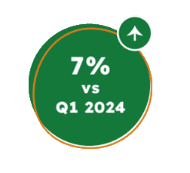
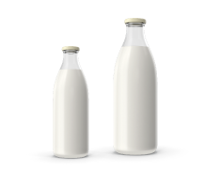
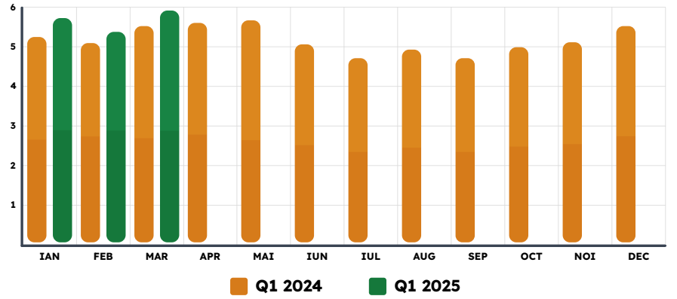
CONSISTENT GROWTH IN MILK DELIVERIES
~ 17 million liters of milk
were delivered in Q1 2025
🐄 Regarding DN AGRAR’s milk production activity, in Q1 2025 the company reported an increase of approximately 7% in the quantity of milk delivered, compared to the first quarter of 2024, reaching a total volume of approximately 17 million liters.
🐄 Following the upward trend, in March the volume of milk delivered increased by approx. 8%, approaching the threshold of 6 million liters of milk delivered.
🐄 This performance was supported by investments in increasing livestock by approximately 11%, exceeding 16,000 heads at the end of March 2025.
15

Slide 16
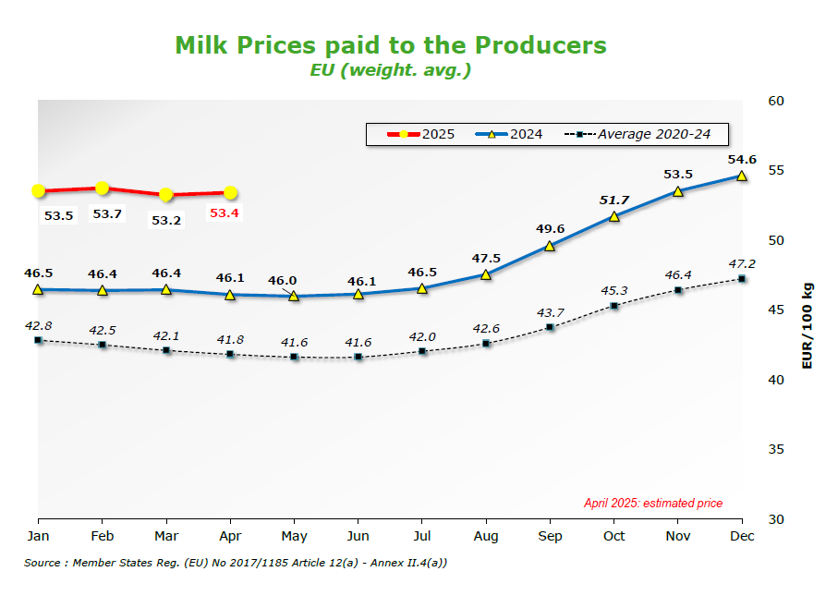
EUROPEAN MILK MARKET IN Q1 2025
Amount of milk collected at the regional
level, %
Feb 2025 vs. to Feb 2024
as of March 2025
*Source: https://agriculture.ec.europa.eu/

Slide 17
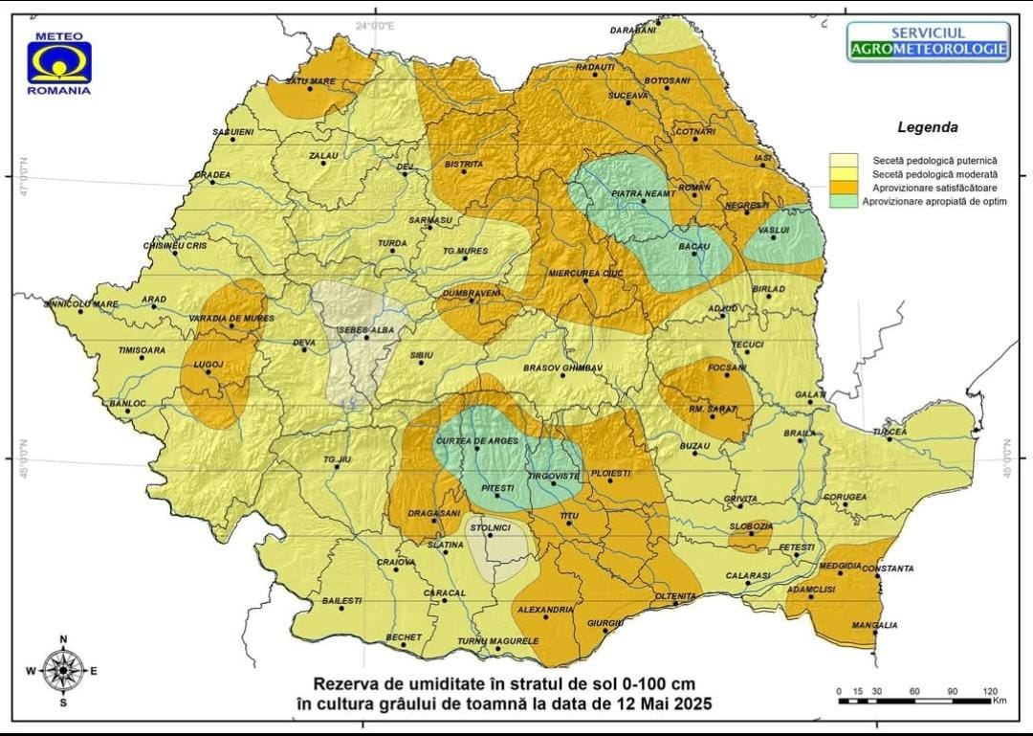
DN AGRAR CEREAL PRODUCTION EVOLUTION
🌱 The soil moisture map (0-100cm), published by the National Institute of Meteorology and Hydrology on May 12th, 2025, confirms the severity of the situation in the agricultural sector.
🌱 As shown in the map below, we are in an area affected by severe pedological drought.
🌱 A prolonged drought could drastically reduce yields.
🌱 Consequently, anticipating these unfavorable conditions, in 2025 we will be forced to purchase fodder from the market, which will generate significant additional costs, with a considerable financial impact both this year and next year.

Slide 18
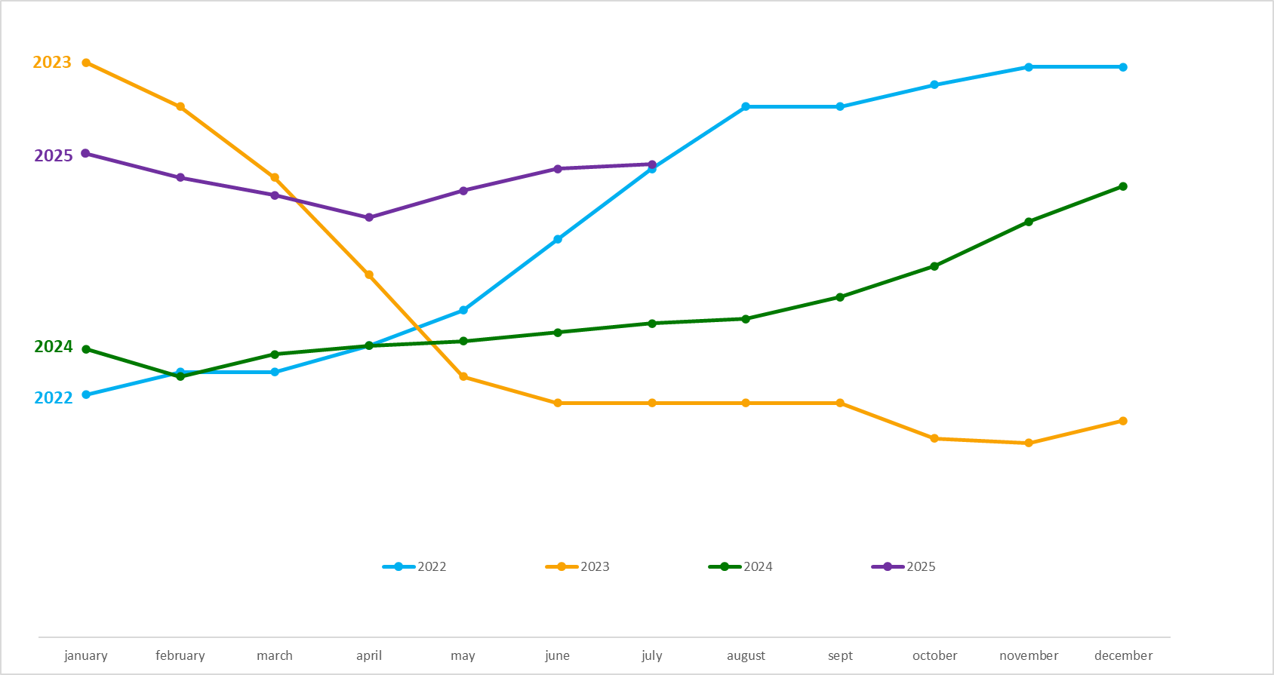
Q2 2025 OUTLOOK ON MILK PRICE EVOLUTION
DN’s milk price evolution
Although the milk price experienced a decline in the first quarter of 2025, it remained substantially above the levels seen in Q1 2024.
Furthermore, for Q2 2025, the price continues to increase, following an upward pace.

Slide 19
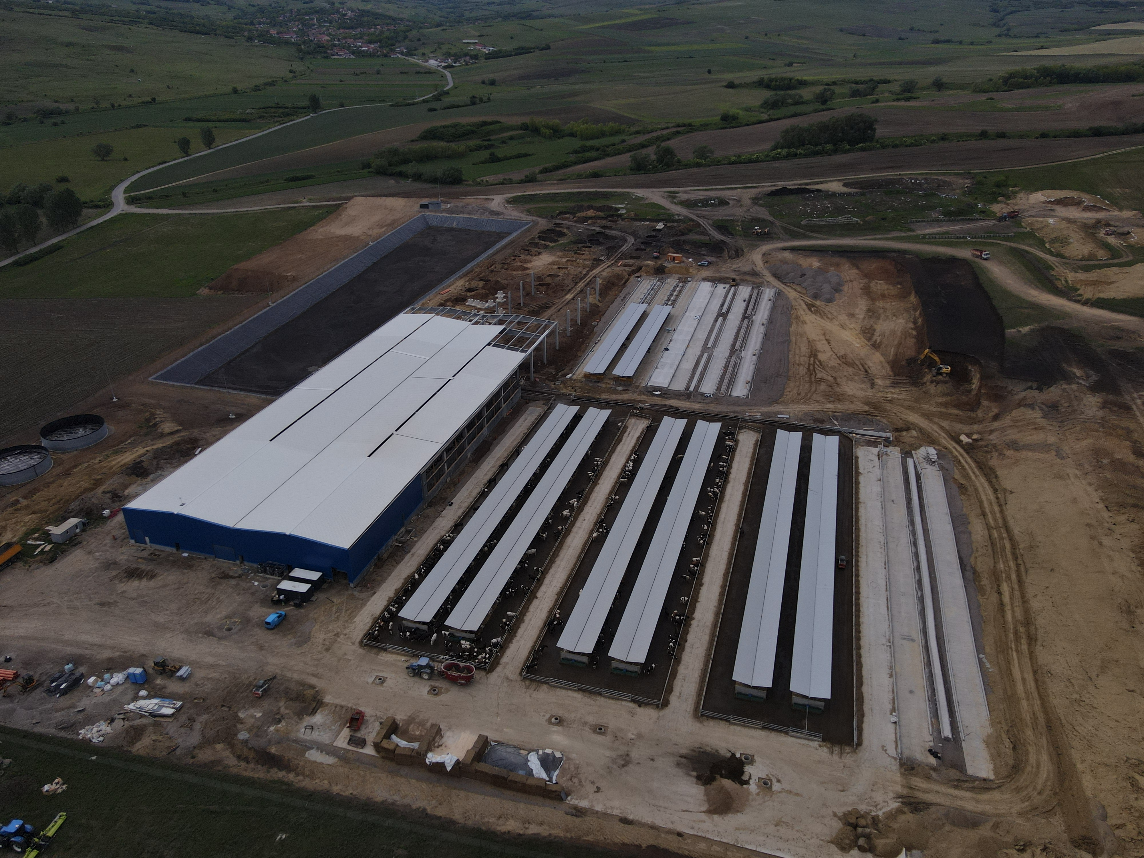
DN AGRAR
CURRENT PROJECTS UPDATE

Slide 20
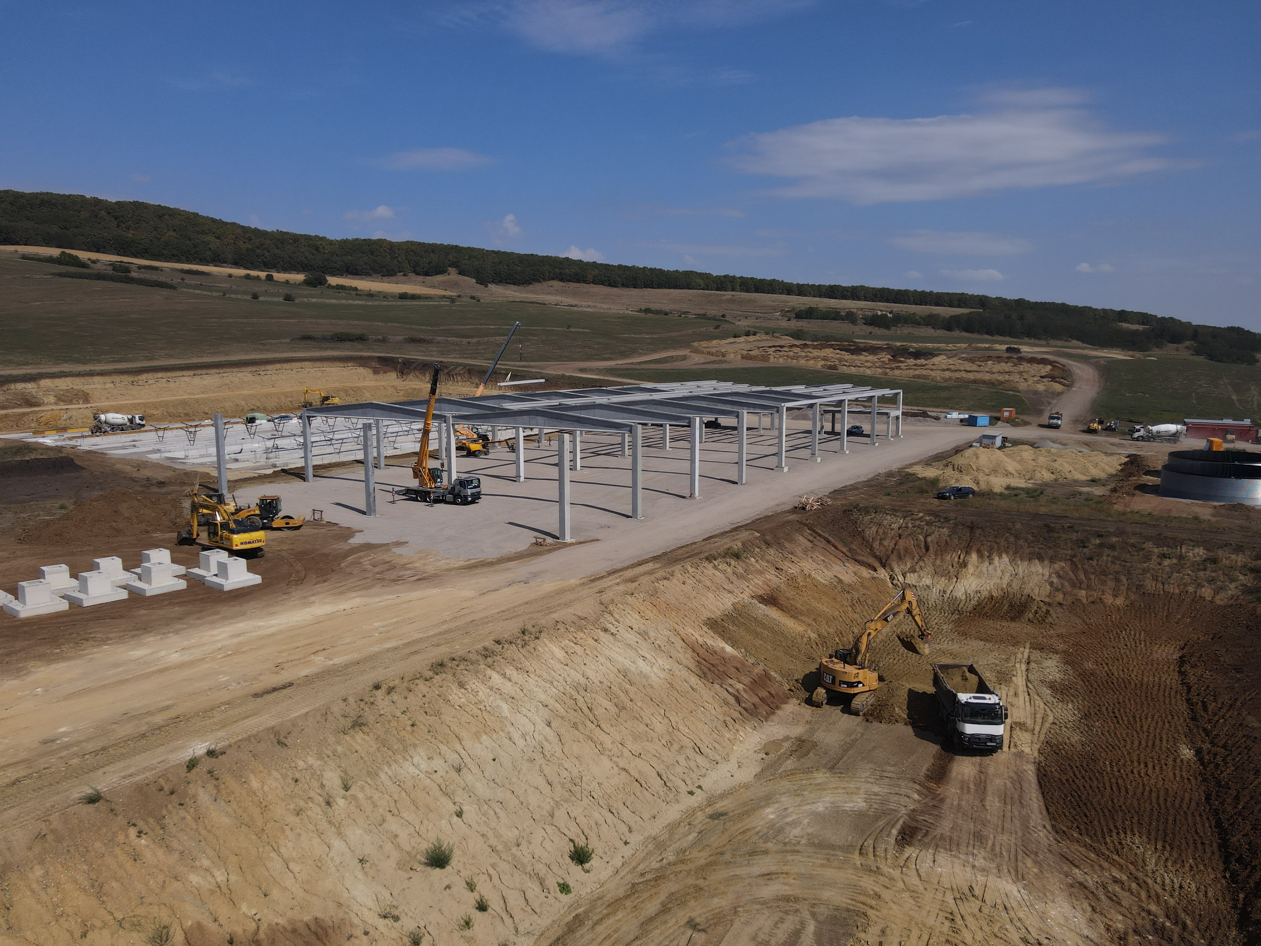
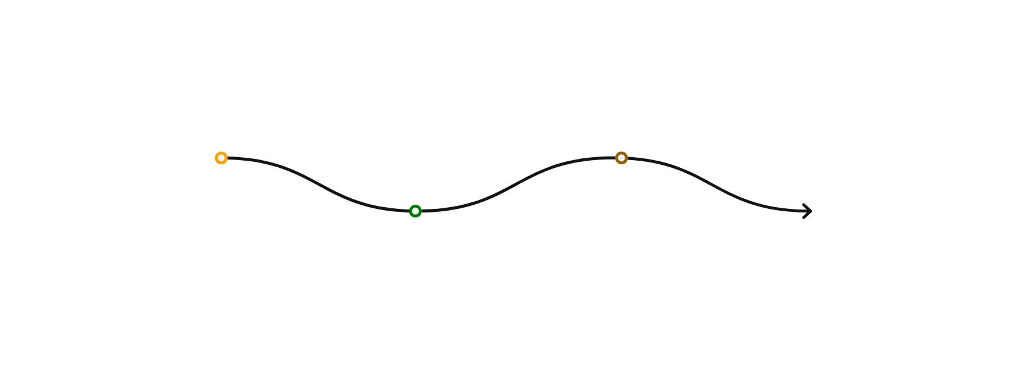
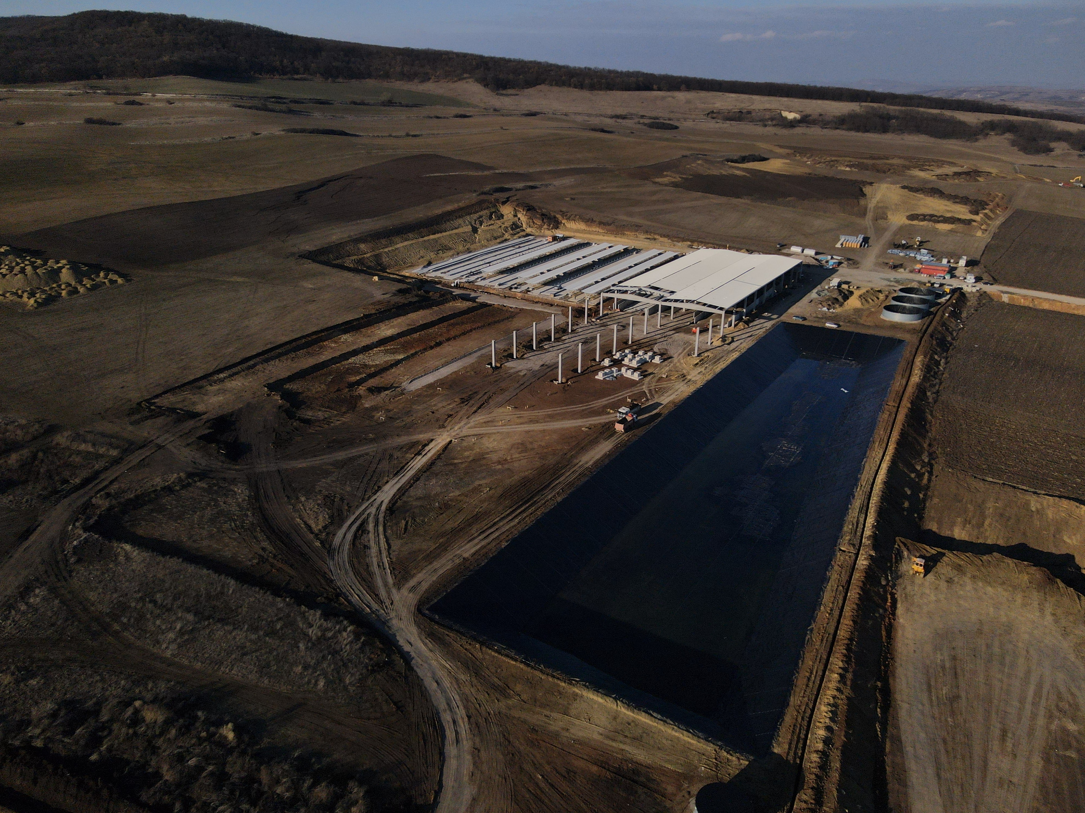
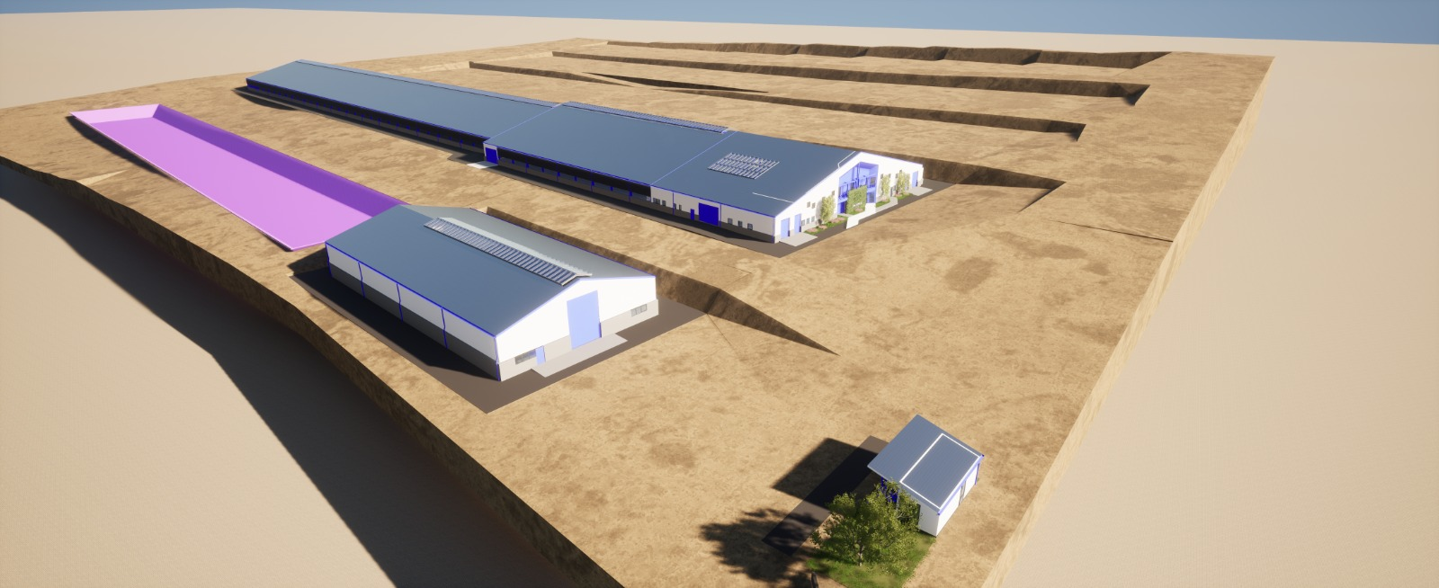
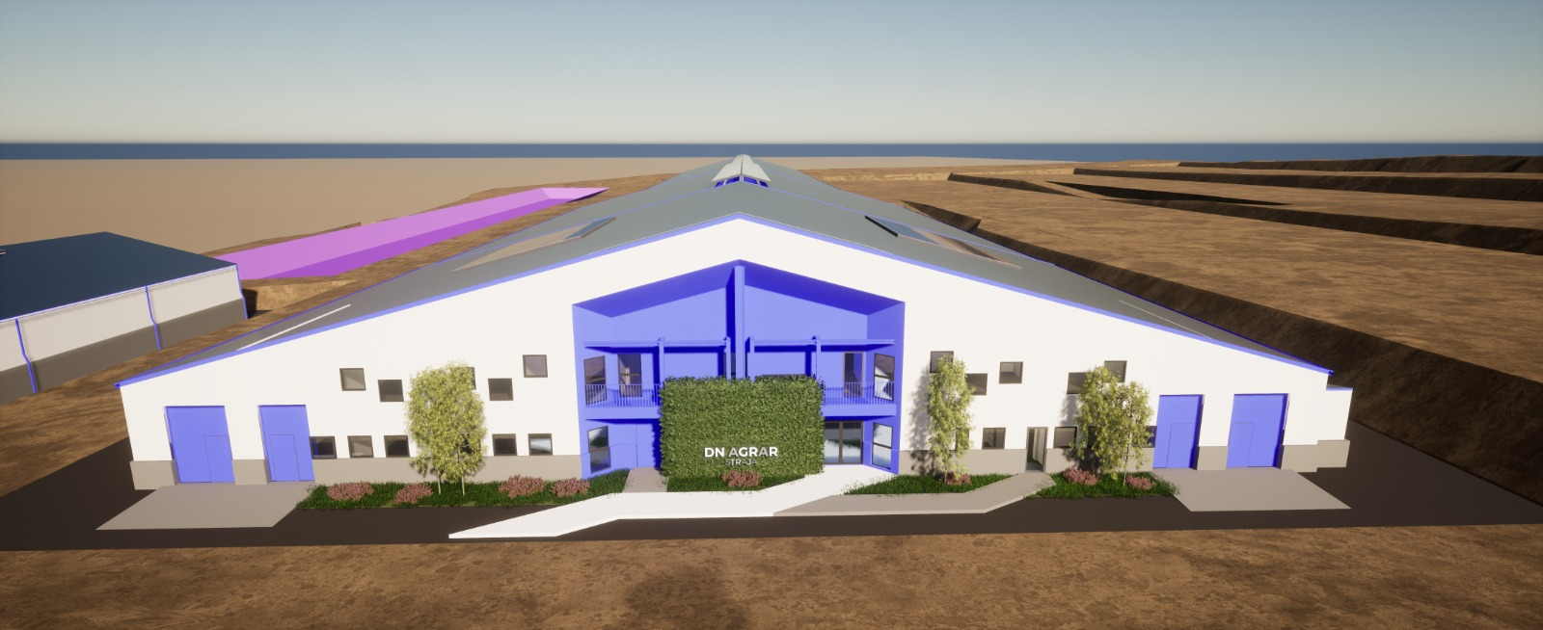
STRAJA PROJECT - A SIGNIFICANT EXPANSION IN PRODUCTION
Key Highlights
2024:
The foundation works were completed
Part of the main hall, finalized
Waste storage lagoon, finalized
Started in 2023, and planned to be completed in 2027.
Capacity of 5,000 cows (4,000 dairy cows and 1,000 young stock).
Financed through credit facility and own sources.
The Straja farm has been operational since March 2025, and at the time of the inauguration, it was equiped to house a total of 1,100 dairy cows.
Gradual increase of the dairy cow herd, reaching 1,800 heads by the end of 2025.
The completion of the second milking hall, a step that enabled the inauguration of operations at the Straja farm in March 2025.
2025:
Beg. March – Start milk production
End of April – finalizing the 2nd milking parlor
End of 2025: 1,800 cows
2026:
Approx. 3,400 cows in production & pregnancy
Robots to be installed
End of 2027: 5,000 cows

Slide 21
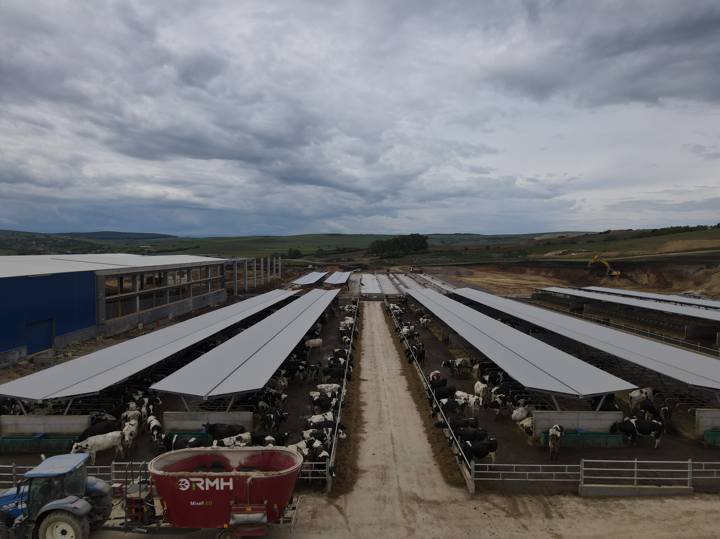
STRAJA PROJECT CURRENT STATUS

Slide 22
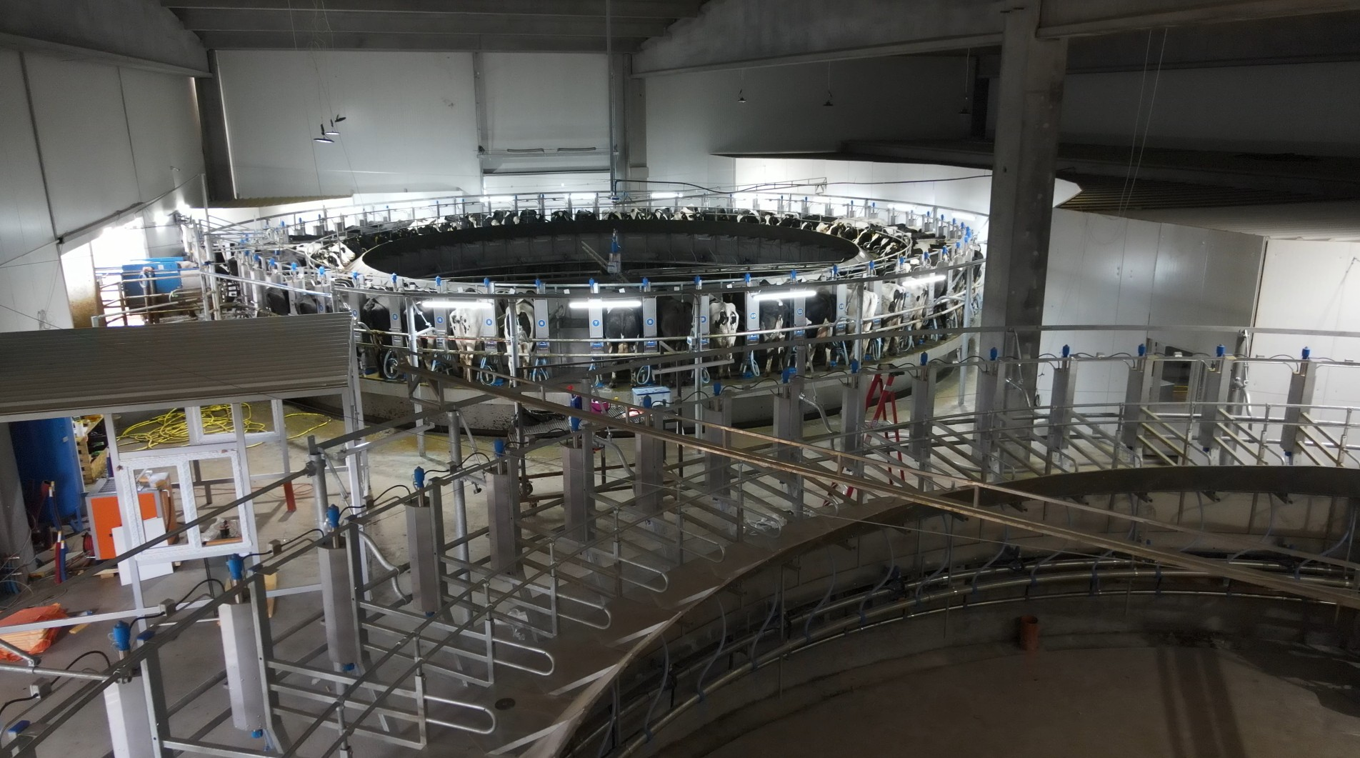
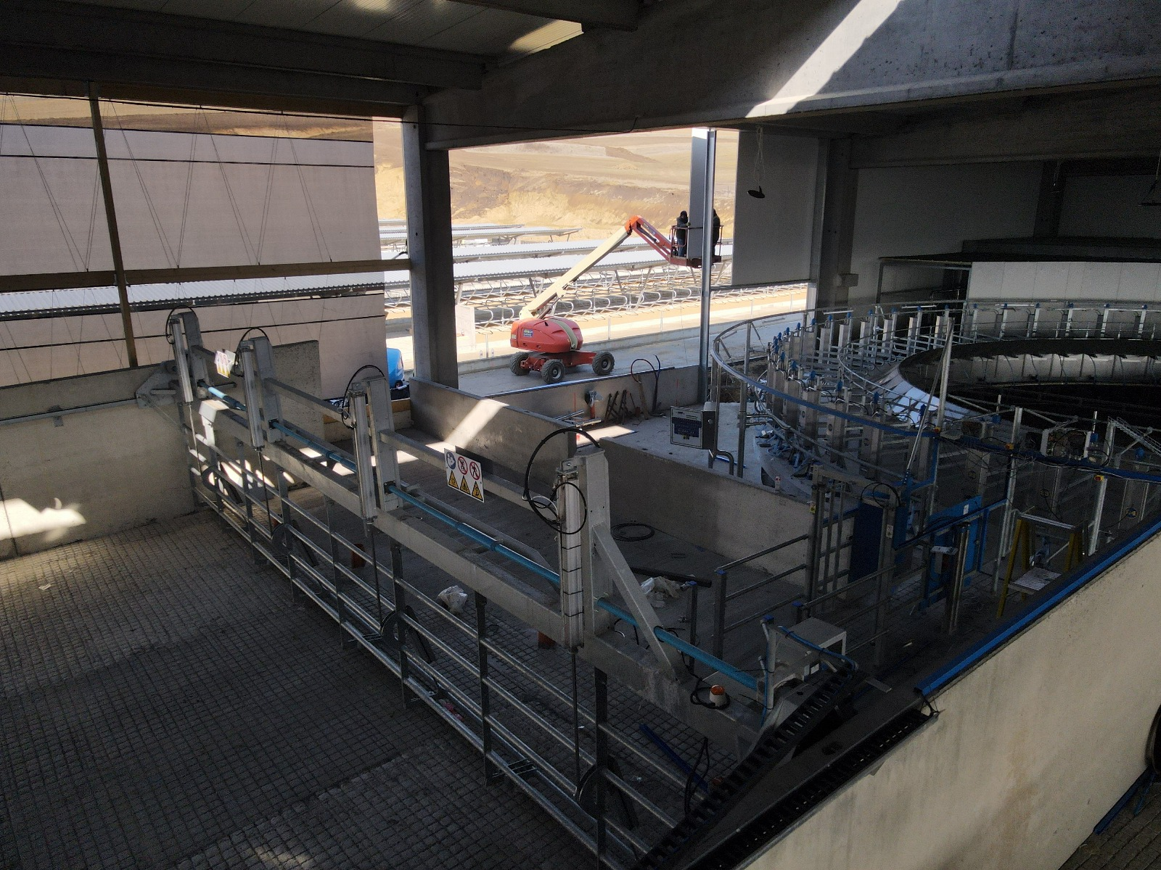
STRAJA PROJECT CURRENT STATUS

Slide 23
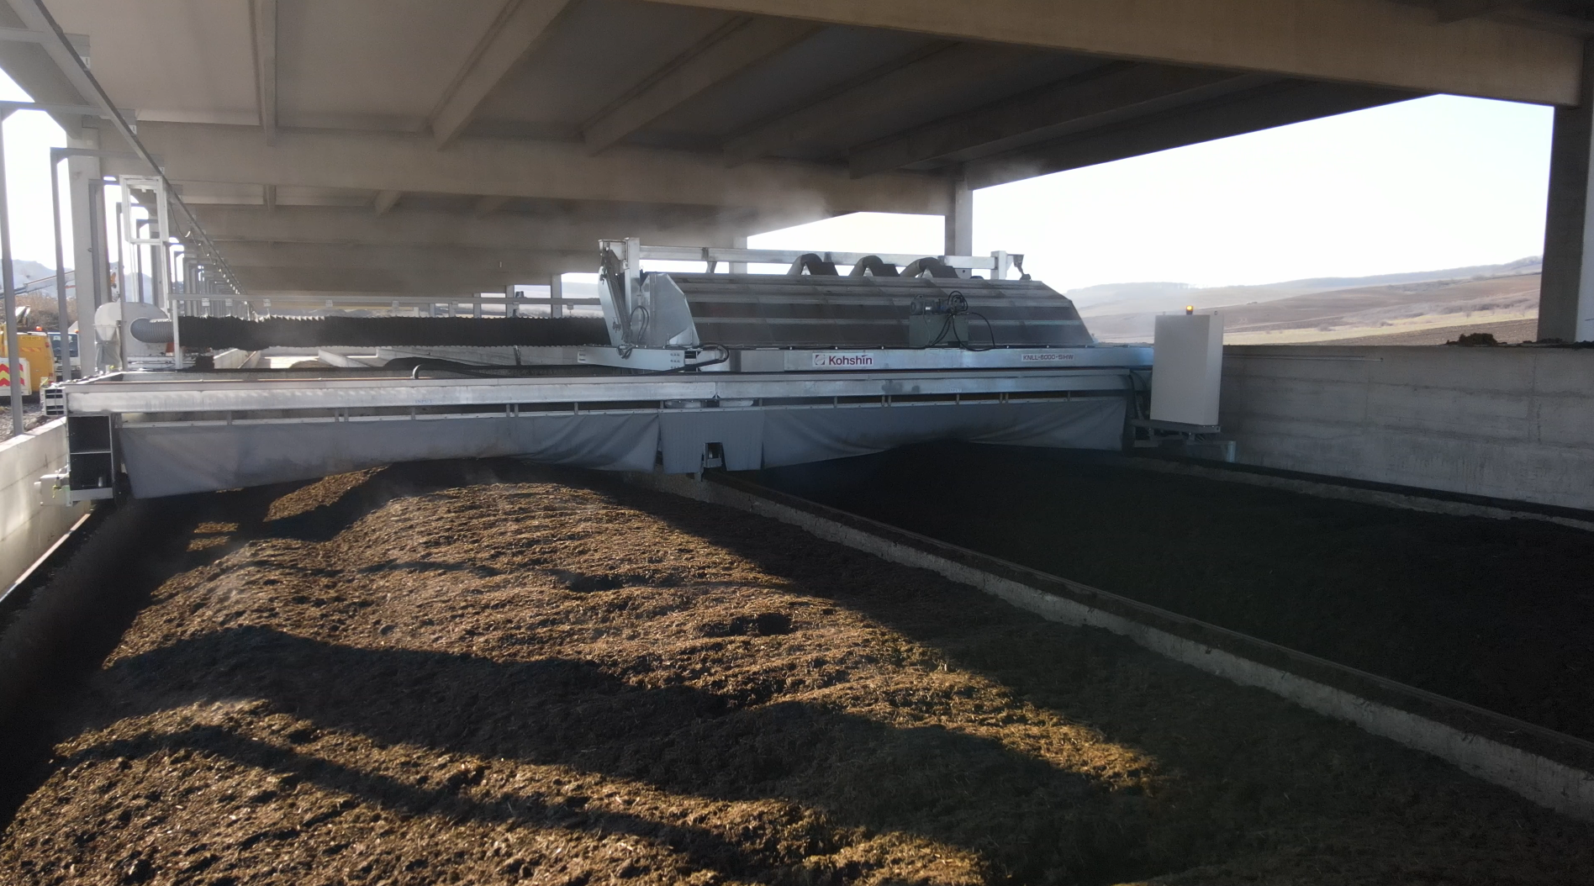
COMPOST FACTORY TO STRENGTHEN THE CIRCULAR ECONOMIC MODEL
Operational Highlights
Integrated organic waste management system
Operations started in November 2024
21,000 tons of manure processed annually
Production of over 7,000 tons of organic fertilizer
Use the organic fertilizers produced for internal needs and to sell outside the Group
The process of certifying fertilizers as organic typically takes 3 - 6 months
Investment of EUR 1.8 million
The Apold compost factory is performing as planned
The project addresses two major challenges:
1. efficient manure management and improved soil fertility
2. contribution to the reduction of greenhouse gas emissions
Further Developments
In parallel with the start of operations, the process of obtaining voluntary carbon certification for the produced compost has been initiated
It is estimated that by the end of 2026, the first carbon credits will be obtained
Build the sales channel to develop the business line
Advance with the certification process to achieve the international "Gold Standard" accreditation for carbon credit
23

Slide 24
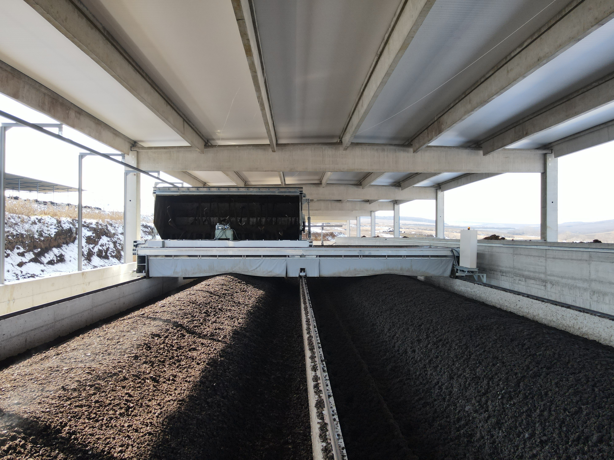
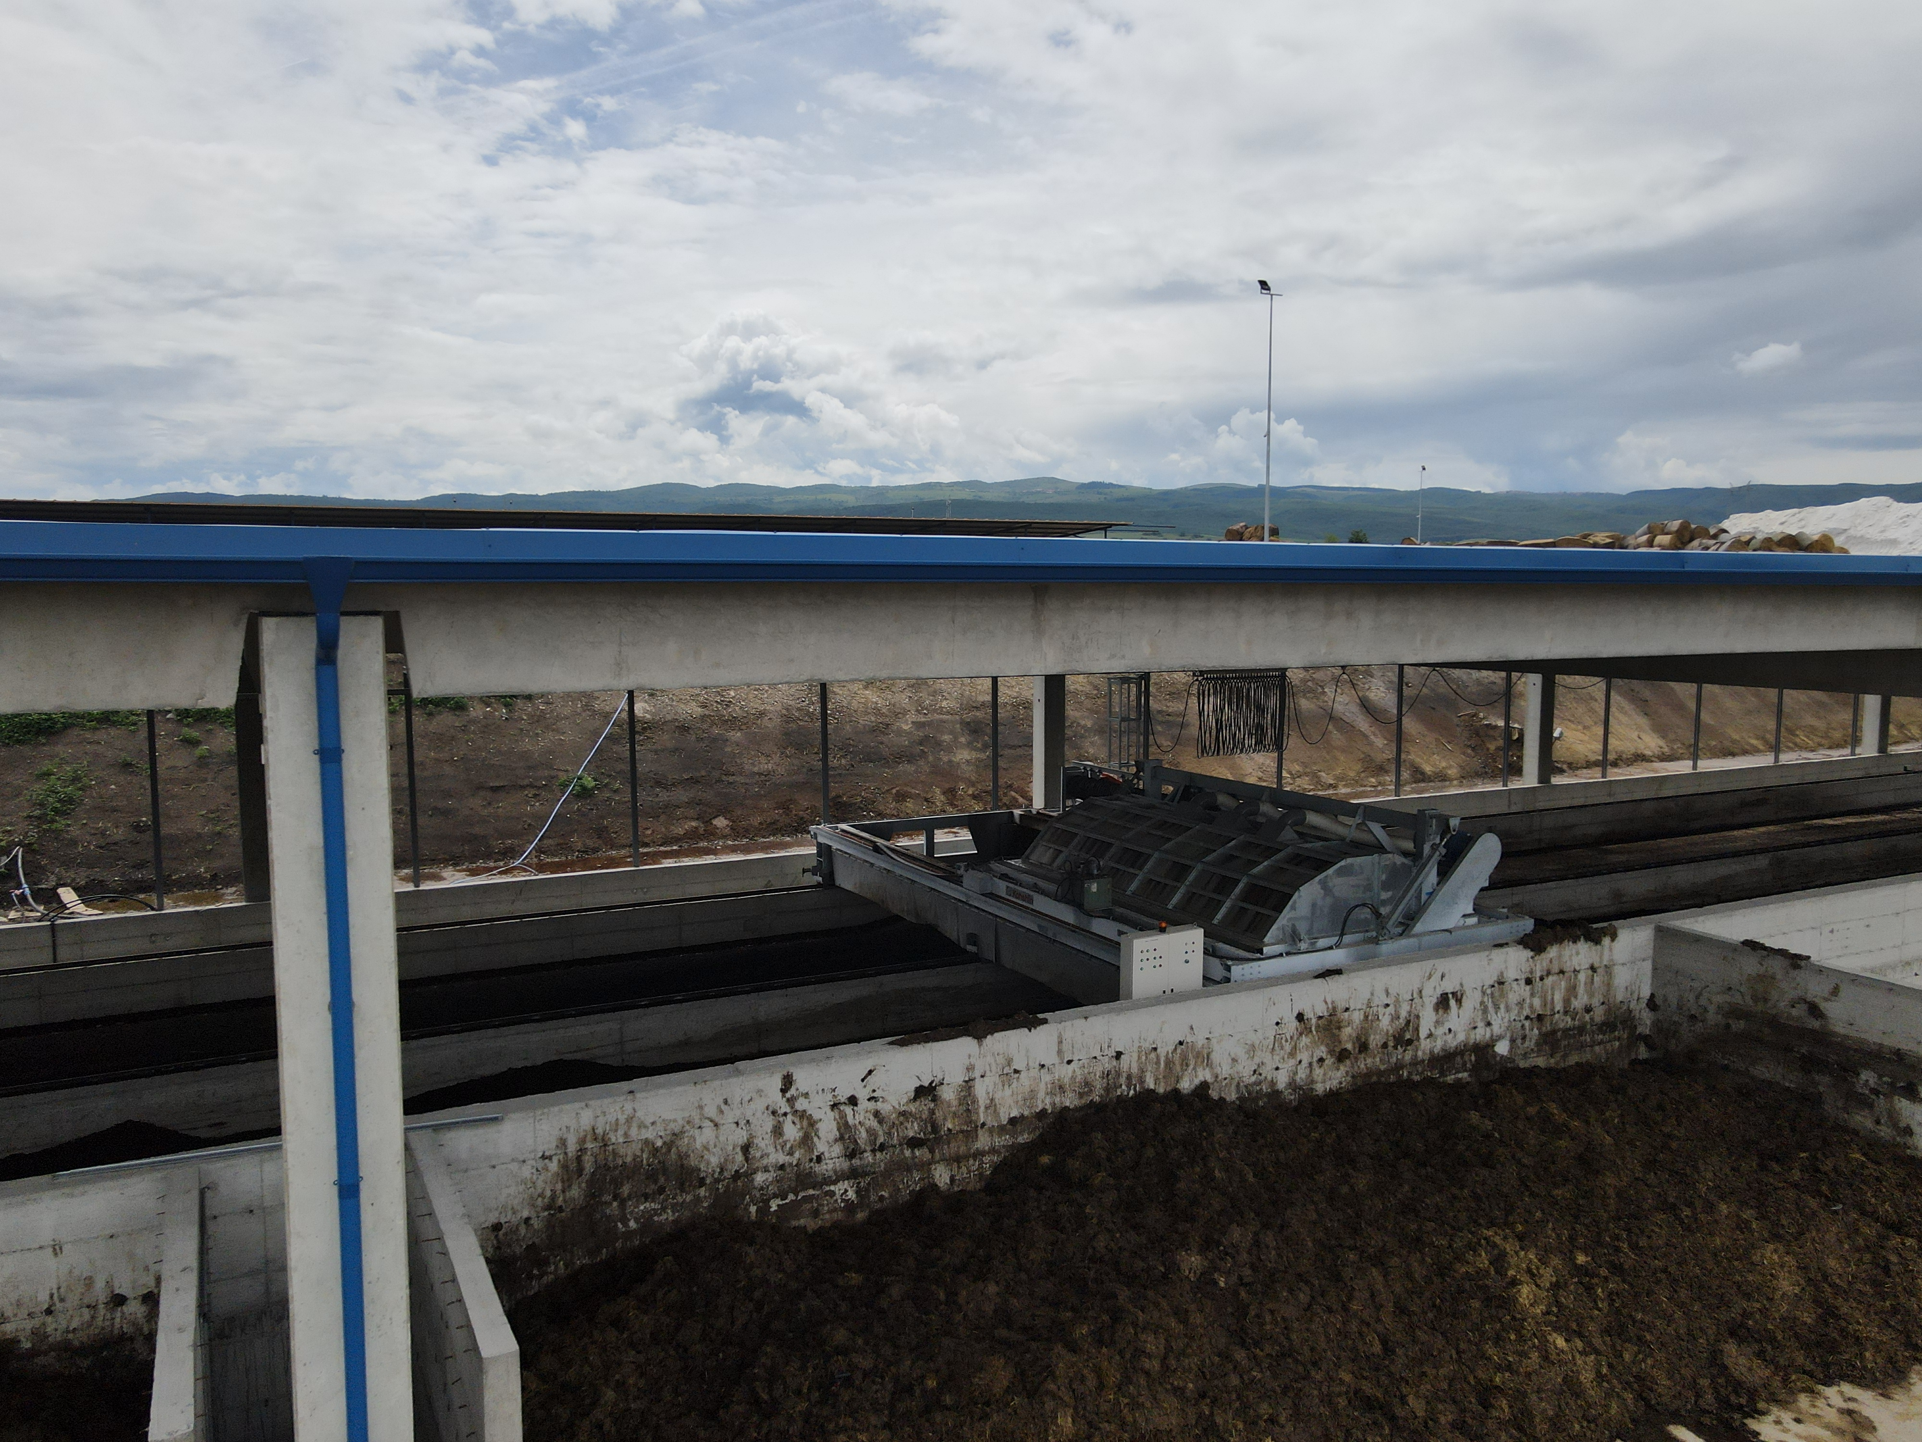
APOLD COMPOST FACTORY

Slide 25
BIOMETHANE PRODUCTION FOR AN INTEGRATED SUSTAINABLE STRATEGY
Operational Highlights
Production facility with a total capacity of up to 15-20 MW.
DN AGRAR will supply the raw material for the biomethane production and transportation.
BSOG Energy will develop the production facility.
Cooperation agreement for the largest biomethane production facility in Romania with BSOG Energy
This project aligns with DN AGRAR’s mission
to lead sustainable agriculture.
Further Developments
Project execution is expected to take over 2 years from the signing of the final agreement.
The overall investment in the facility is estimated to around EUR 30 million.
Based on a 15-year contract of approx. 50 million EURO, the expected yearly revenues for DN AGRAR will be between EUR 3 - 3.5 million.
By implementing biomethane, composting, and solar panel sustainability projects, DN AGRAR aims to significantly reduce its carbon footprint, leading to a reduction of approximately 90% in emissions, and supporting the company’s goal to achieve near net-zero emissions by 2030.
Project initiated at the beginning of 2024
25

Slide 26
STATUS OF CURRENT PROJECTS
Automation and Energy Diversification
Obtaining voluntary certification
for the compost produced
In parallel with the start-up of the compost plant, we have embarked on an ambitious project to obtain voluntary certification for the compost produced.
This process will be carried out in a 5-year period.
After 2 years, the certificates can be traded.
Obtaining voluntary
carbon reduction
Allowances
The project aims to cover a significant area of land, and contracts
will be signed for the land
included in the program to achieve this goal.
Estimates indicate a carbon reduction of
approximately 5,000 tons of carbon emissions per year, a remarkable performance achieved through the
implementation of modern technologies and sustainable
farming practices.
In 2025, the produced fertilizer will be used both for testing and optimizing the certification as organic fertilizer, as well as to selling it outside the group.

Slide 27
NEW STRATEGIC INVESTMENTS PLANNED FOR 2025
DN AGRAR shareholders have approved the new investments planned for this year
New Compost Factory at Lacto Agrar Farm
Solar panels with an installed capacity of 2,218 kW
Investment of EUR 1.7 million
Investment of approx. EUR 1.7 million
Second composting unit within the Group
Start in 2025, operational by Q4 2025
Annual capacity: 7,000 tons of organic fertilizer
Total production increase to 14,000 tons annually from 2026
Organic certification and carbon emissions reduction (32,000 carbon credits annually)
The investment aims to install solar panels on the rooftops of farms located at Apold, Lacto Agrar, and Cut (DN AGRAR Service).
The project was approved by DN AGRAR’s shareholders in March, and the necessary permits have already been obtained.
The installation of solar panels will begin in the second quarter of the year with the systems providing a total installed capacity of 2,218 kW.
In the second phase, the farms will also be equipped with storage batteries to enhance further the efficiency brought
We estimate that through this project we will become completely energy independent for our Lacto Agrar, Cut and Apold farms.
These projects will be financed through a combination of European funds and bank loans.

Slide 28
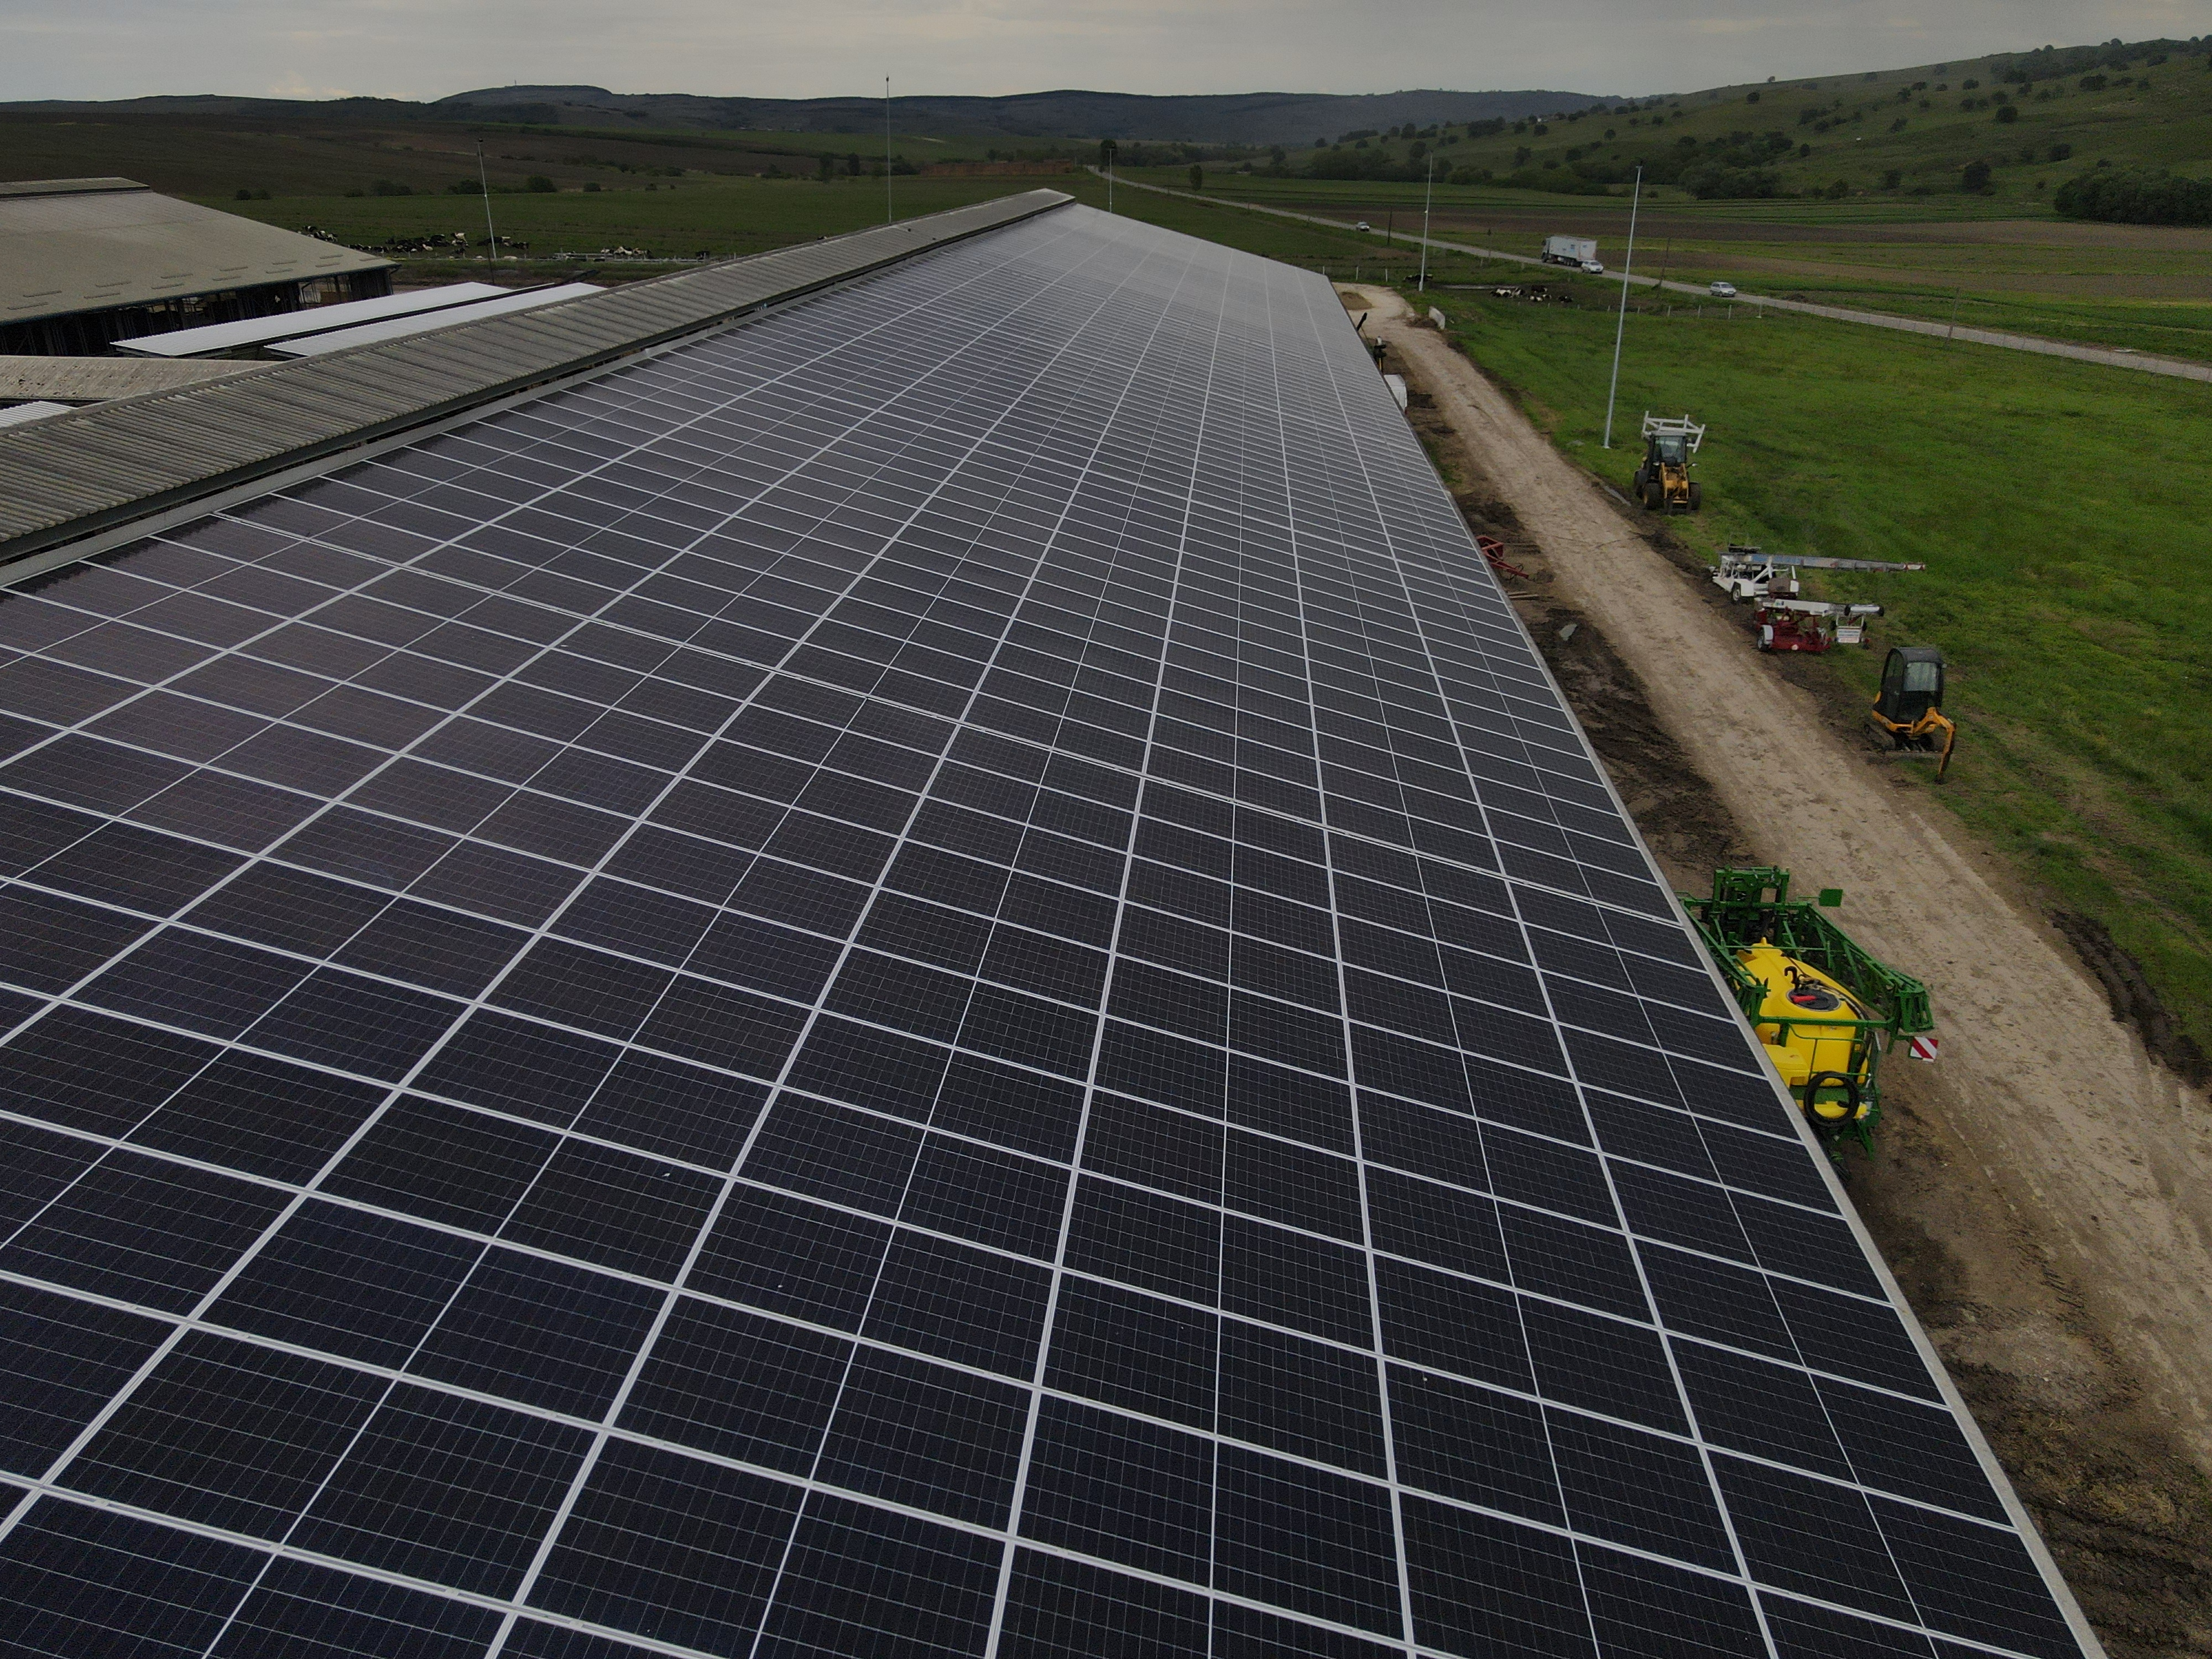
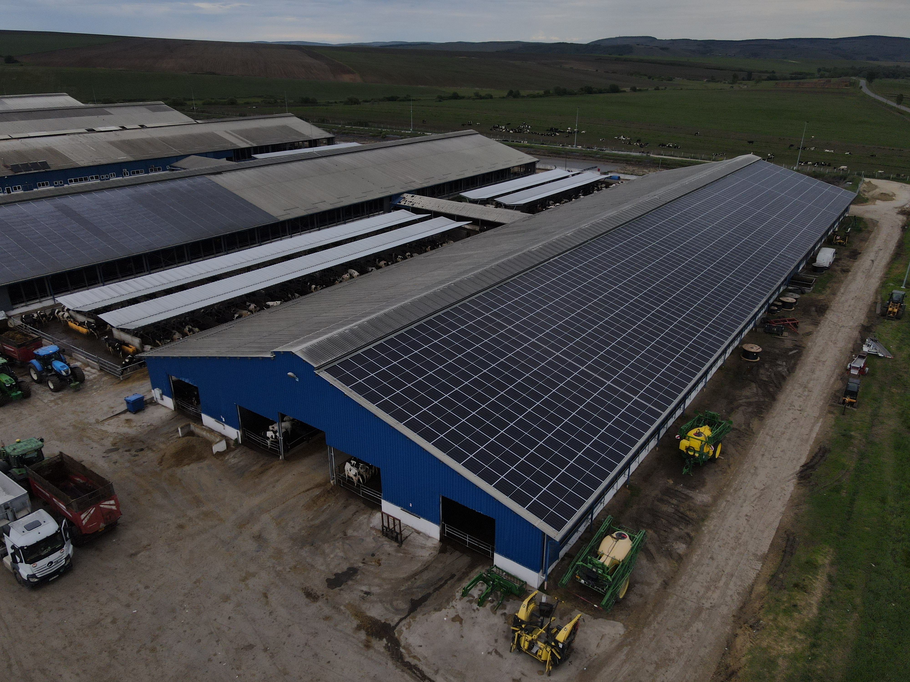
SOLAR PANEL PROJECT CURRENT STATUS

Slide 29
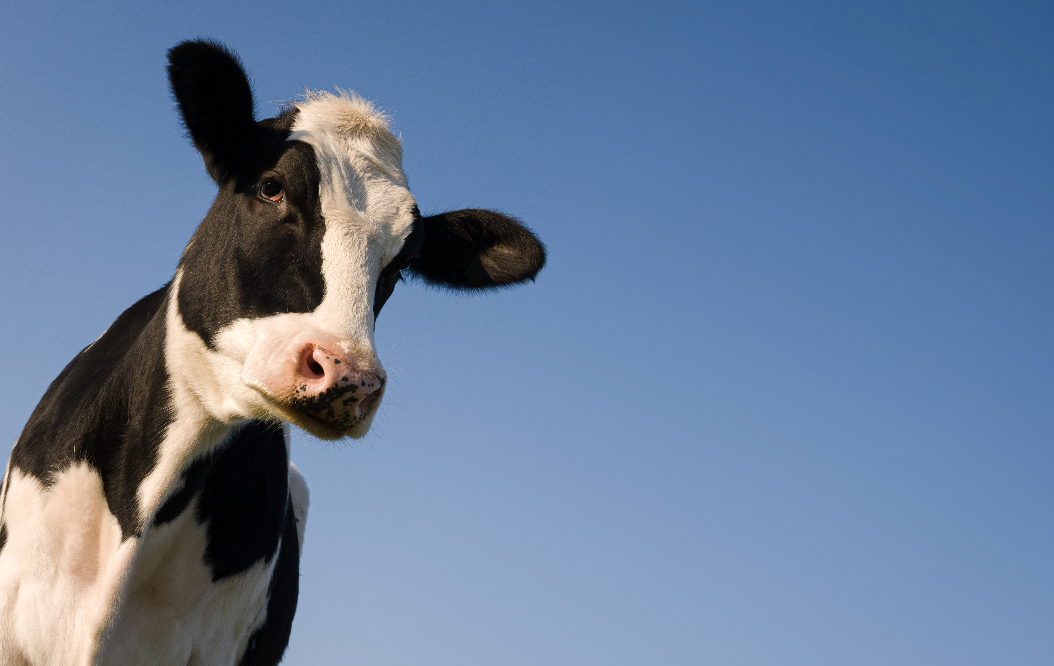
CONTACT INVESTOR RELATIONS
Peter de Boer,
CEO & BoD Member
investors@dn-agrar.eu , +40 258 818114

Slide 30
QUESTIONS
Straja project status?
What are the main strategic directions through which DN AGRAR intends to increase its margins and strengthen its position?
When are dividends paid?
Congratulations on the way you are developing your business! Do you plan to enter the milk processing segment as well?
Why no composting plants at the farms Cut, Prodlact and Straja? Why no solar panels at the farms Prodlact and Straja?
When do you aim to move to the main category of the BVB?
What are the risks and opportunities once the Presidential Elections are completed and the future Government is formed?"

