Slide 1
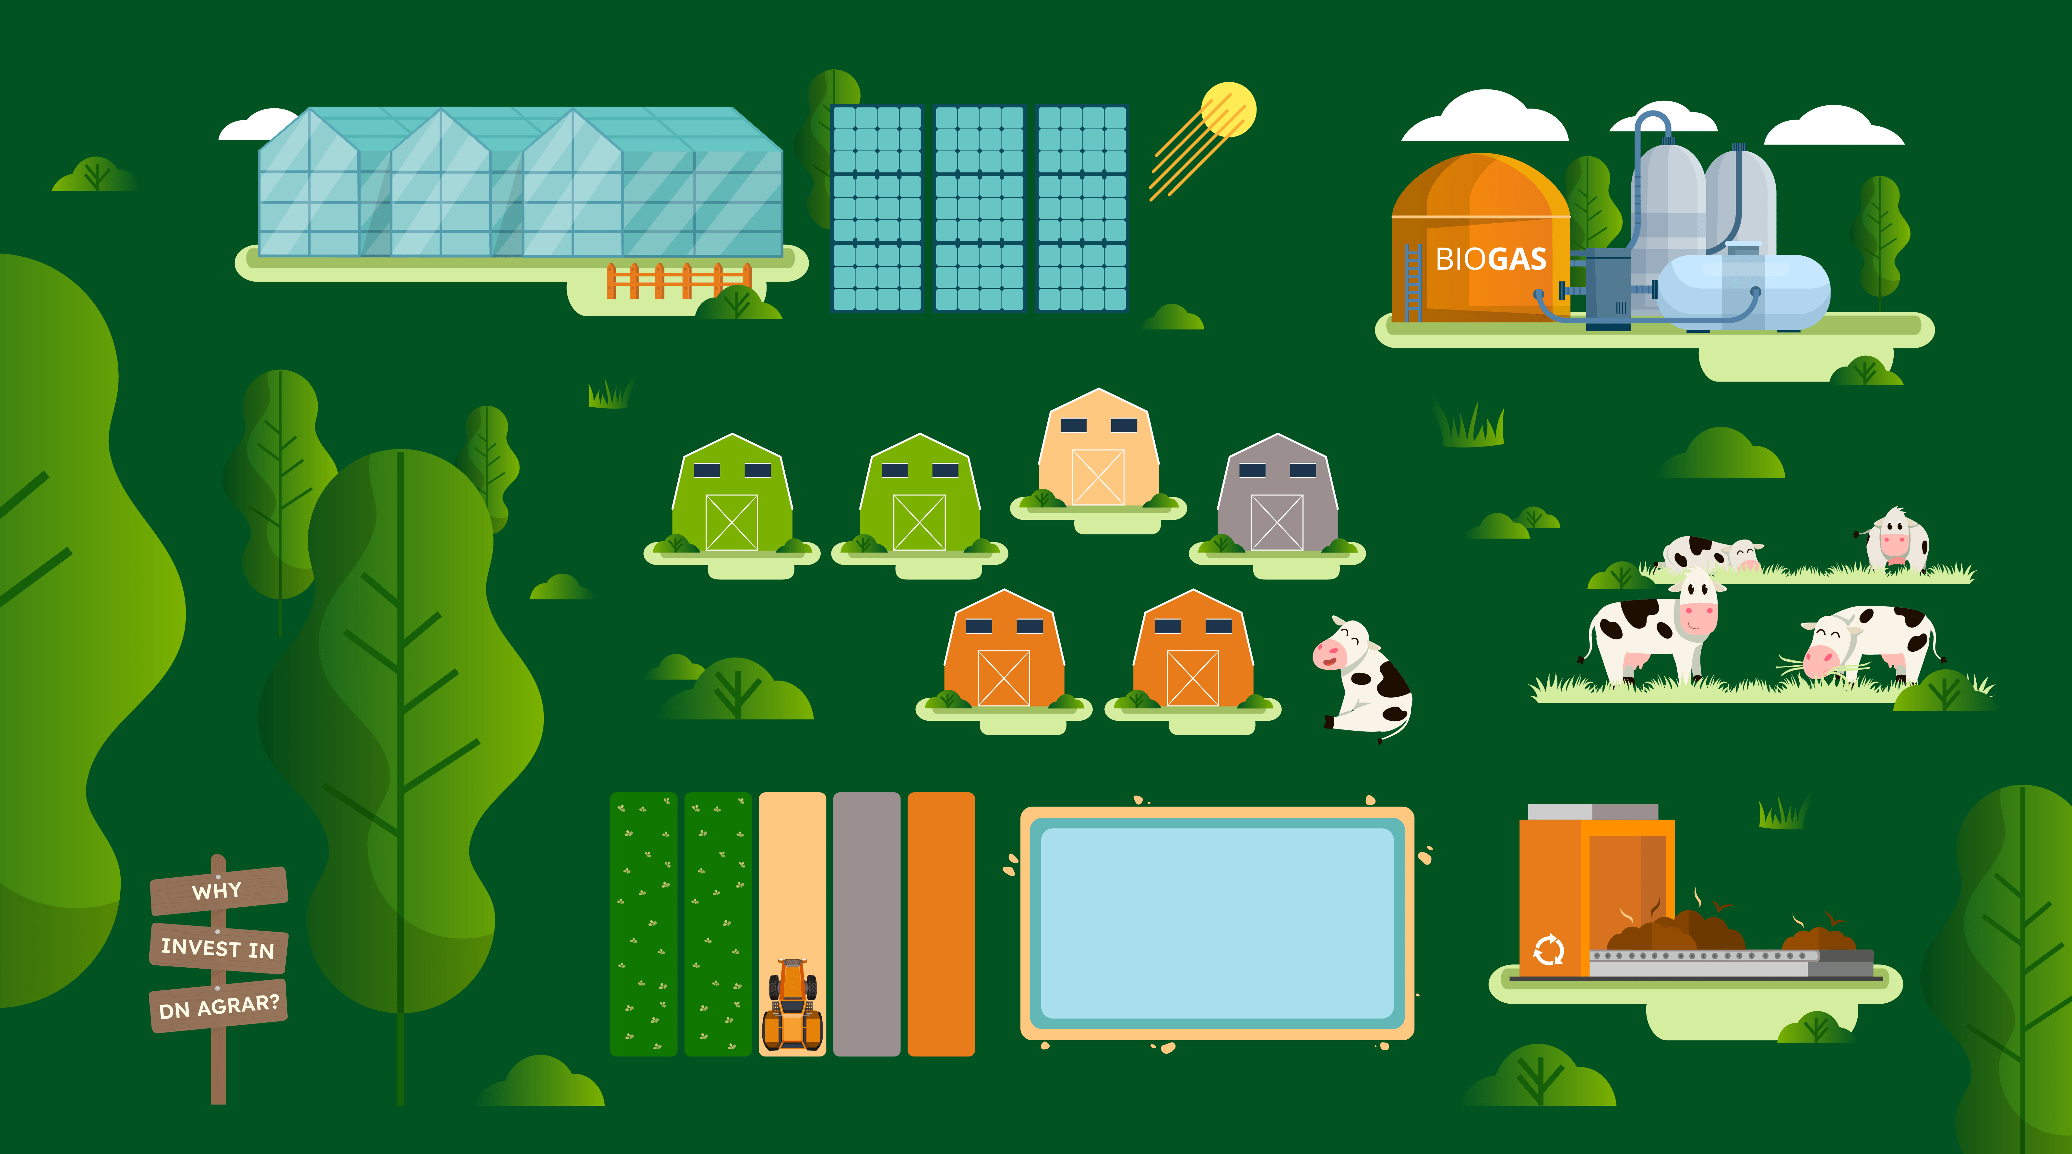
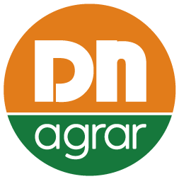
STRATEGY 2025 - 2030

Slide 2
Disclaimer - Strategic Outlook 2025–2030
This presentation outlines DN AGRAR's Strategic Vision for the period 2025-2030, including four financial scenarios intended to provide insight into the management team's current outlook and ambitions for the company’s development.
The purpose of this strategic overview is to transparently communicate DN AGRAR’s medium-to-long-term direction, priorities, and investment considerations, as envisioned by the management team at the time of presentation.
It is important to note that this strategic plan, including the financial scenarios and investment goals, does not constitute a commitment or guarantee that all objectives will be fully realized or implemented.
The strategy represents a forward-looking vision that is inherently subject to risks, uncertainties, and evolving market conditions.
Assumptions underpinning the scenarios may be impacted by a range of external factors, including but not limited to macroeconomic developments, agricultural market dynamics, climate conditions, political shifts, and legislative or regulatory changes in Romania and globally.
DN AGRAR is committed to maintaining an agile and adaptive strategic approach. The strategy will be reviewed on a regular basis and formally updated at least once per year to ensure alignment with emerging trends, stakeholder interests, and the broader operating environment.
We emphasize that the ongoing monitoring and refinement of our strategic direction is essential to safeguarding the long-term interests of our investors and all stakeholders, while striving to maximize sustainable value creation.
Investors are advised to interpret this document as a dynamic framework subject to ongoing evaluation rather than a definitive roadmap.

Slide 3
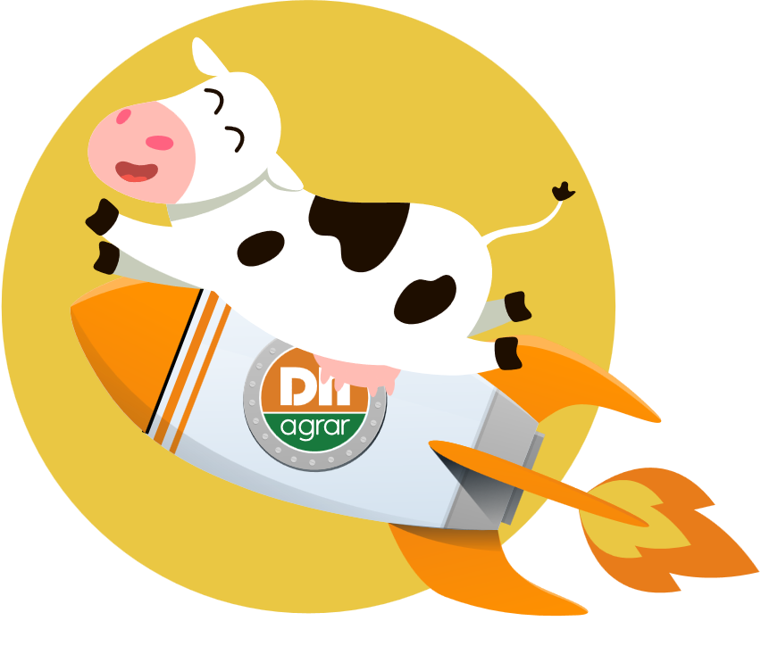
DN AGRAR Group Unveils Ambitious
Strategy for 2030:
PAVING
THE WAY
FOR GROWTH
VALUE
CREATION
INNOVATION

Slide 4
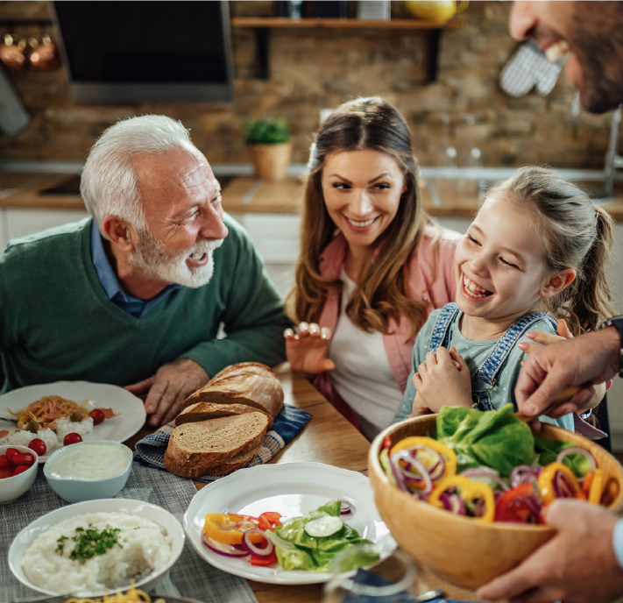
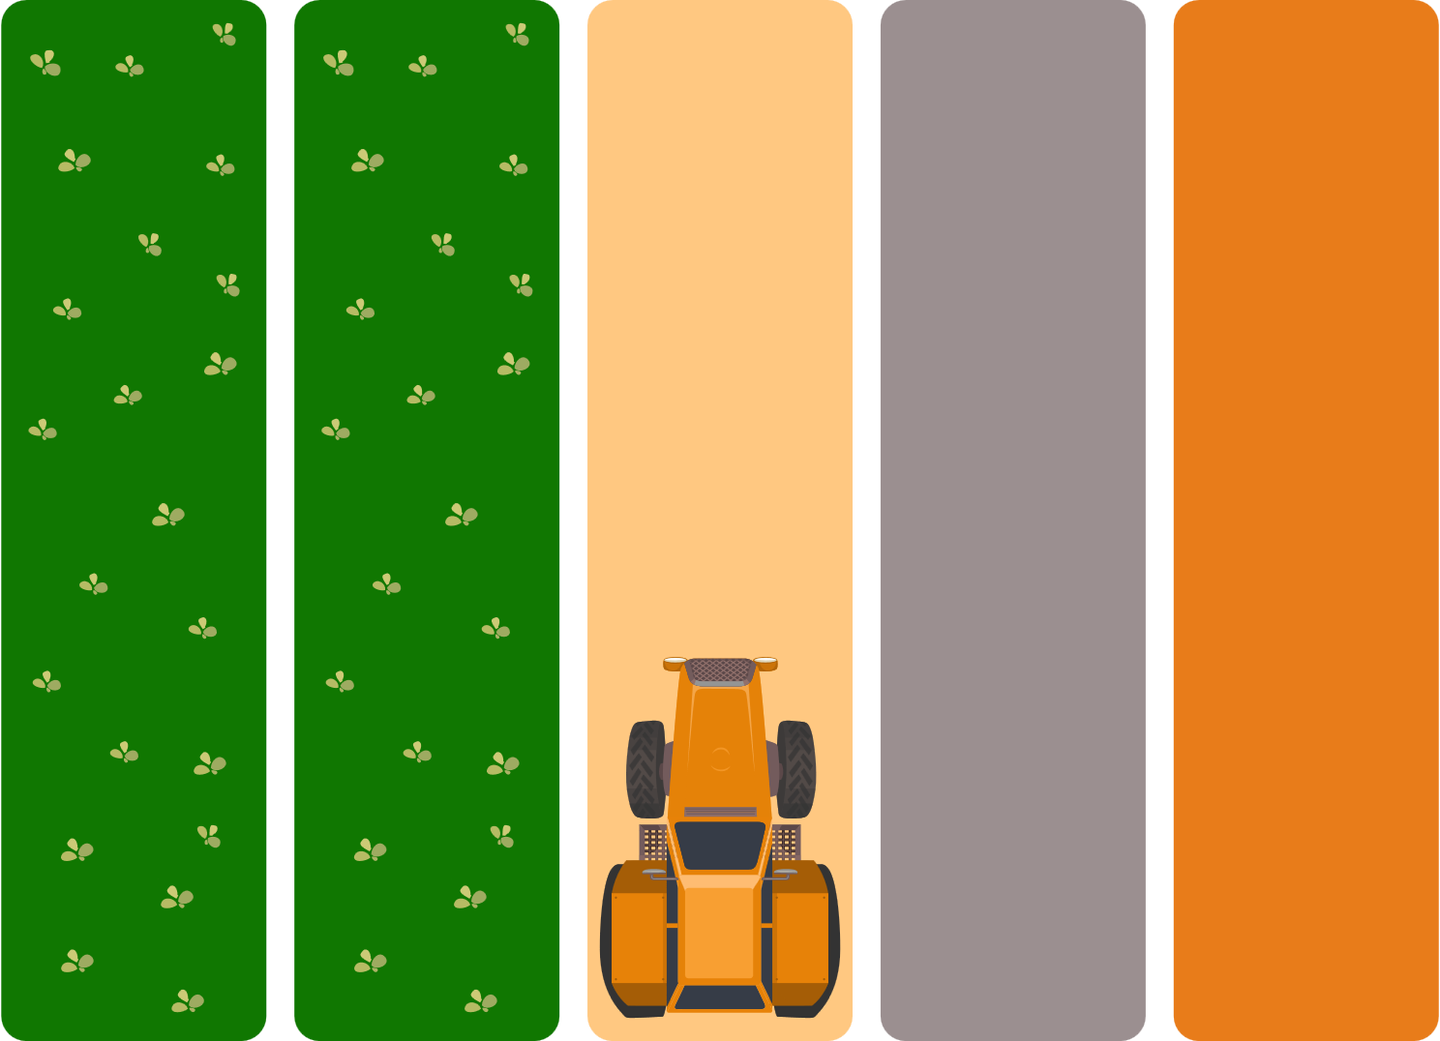
Our strategy 2030 is underpinned by
FIVE CORE PILLARS:
A key component
of our strategy is
the creation of
industrial clusters
for sustainable
food production.
Our goal is
to enhance local
production capabilities, reduce food shortages,
and ensure more
people have access to
high-quality, nutritious, locally-produced food.
Diversification
Sustainability
Digital & Automation
Expansion of current
business lines
Value creation for
our investors

Slide 5
SWOT Analysis
• Integrated Agribusiness Model
• Strong Position in Romanian
Dairy Market
• Technological Leadership
• Strategic Access to EU Funds
• Robust Strategic Roadmap
• Geographic Concentration Risk
• High Capital Intensity
• Dependency on EU Subsidies
• Limited Consumer
Brand Recognition
• Labor and Workforce Challenges
• Rising Demand for Sustainable Dairy
and Traceable Food Sources
• Expansion into Value-Added Commodity
• Land Value Appreciation and
Strategic Acquisitions
• Carbon Credit and Circular
Economy Opportunities
• Digital Transformation
and Smart Farming
• High-Value Greenhouse &
Vertical Farming
• Expansion in the Region
• Food Deficit
• Farm to Fork
• Commodity Price Volatility
• Climate Change and
Environmental Risks
• Regulatory and Political Risks
• Competitive Pressure
from Multinationals
• Biosecurity and Animal
Health Risks

Slide 6
Porter’s five forces analysis
FORCE
INTENSITY / DEGREE
OF INFLUENCE
KEY GROWTH LEVER
Threat of New Entrants
Maintain tech edge and capital barriers
through vertical integration.
Bargaining Power of Suppliers
Scale in-house inputs (feed, compost)
and build strategic supplier partnerships.
Bargaining Power of Buyers
Develop proprietary, value-added products and
branded verticals to reduce buyer leverage.
Threat of Substitutes
Invest in R&D and sustainability-driven differentiation
to defend against plant-based alternatives.
Competitive Rivalry
Drive innovation and pursue M&A to consolidate
regional market and reduce fragmentation.
LOW
MODERATE
HIGH

Slide 7
DN AGRAR
Strategy for 2030:
A Vision for
Growth,
Innovation,
and Value Creation
BUSINESS SEGMENTS:
1
MILK Production
2
COMPOST
3
4
VERTICAL FARMING
Production for
wheatgrass
GREEN ENERGY
5
ALTERNATIVES for
VALORIZING MILK
6
GREENHOUSES

Slide 8
1
MILK Production
5,000 dairy cows
150,000 liters of milk per day, approx. 50 million per year
Expanding
milk production capacity at the
APOLD Farm
Our objective is to expand the milk production capacity of the Apold Farm, aiming for a daily output of up to 100,000 liters of milk.
Investment
in CUT 2 Farm
Research & Development
for Straja 2 Farm
Straja 1
Farm Status
5,000 dairy cows
150,000 liters per day
Fully operational in 2028
5,000 dairy cows
50 million liters per year

Slide 9
Investment Plan:
The Development of the CUT 2 Farm
The farm will feature two state-of-the-art milking rotors, facilitating three milking sessions per day for optimal milk yield. Additionally, robotic systems will be installed in the milking parlors for automated udder dipping and cleaning, ensuring the highest standards of hygiene and animal welfare.
To enhance sustainability, between 20% and 30% of the livestock feed at the Cut 2 farm will be supplied by the wheatgrass produced at the new vertical farm, located on the Cut 2 premises. Furthermore, the manure will be valorized at the Biomethane facility.
In a bold move towards sustainability, the farm will integrate solar energy to supply its electricity needs, minimizing the environmental impact and contributing to its long-term cost-efficiency.
Overview:
DN AGRAR Group S.A.
is set to embark
on the development
of the CUT 2 Farm,
a cutting-edge dairy
farming facility that
will accommodate
5,000 dairy cows
and produce 150,000
liters of milk daily.
Estimated Investment:
Approx. EUR 13-15 million
CUT 1
CUT 2
Financing:
Bank loan (EUR 10 million)
and Own sources

Slide 10
CUT 2 FARM TIMELINE
Current Status
Land Acquisition
Construction Phase
Farm Development
Milking and Automation
Sustainability Integration
Vertical Farming for Feed
Manure Valorization
2025
Late 2025
Early 2026
Second Half
of 2026
2027
2029
2027
2029
2029
Permitting and
Planning Phase
Permitting Process
Building Permits
Livestock Procurement
and Gradual Population
Phase 1 (Late 2027)
Phase 2 (2028-2029)
Full Operational Launch
Three Milking Sessions/Day
Sustainability in Action

Slide 11
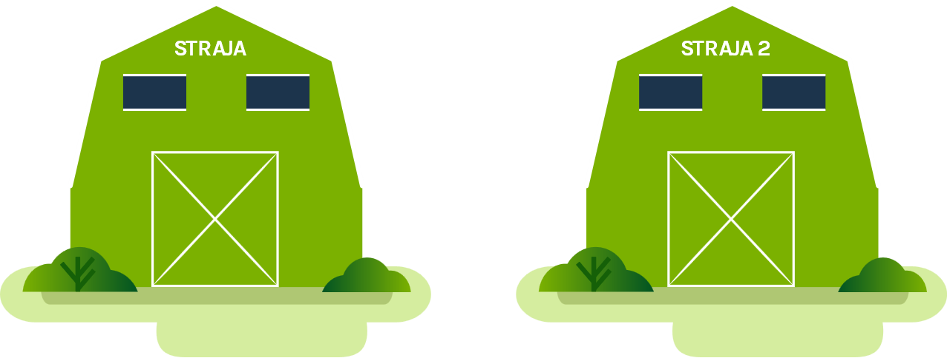
Research Plan:
Development of Straja 2 Farm
within DN AGRAR Group
This research plan
will guide the strategic investment decision
for the Straja 2 Farm,
with the final investment decision expected
in 2027-2028.
Furthermore, the Straja 1 and Straja 2 Farms combined will have the capacity for 11,000 cows and a total milk production capacity of 300,000 liters per day.
Overview of the Straja 2 Farm Development:
5,000 Dairy cows
2 Milking Rotors
Production of 150,000 liters of milk per day,
approximately 50 million annually
Acquisition of land and building permit
will be finalized in 2027
2 composting units,
capacity 14,000 tons of organic fertilizer per year

Slide 12
2
COMPOST
Expansion of Compost Factories
In line with our commitment to sustainability, DN AGRAR will invest in multiple compost factories, transforming organic waste into premium organic fertilizers. This circular economy approach will not only reduce waste but also create a new, high-margin revenue stream, contributing to the overall value proposition of the Group.
Voluntary Certificate
Obtaining Voluntary Certificates
for Carbon Emission Reduction
No-till
Production of
organic fertilizer
over 40,000 tons per year
100,000 certificates annually in 2030,
for 15 years
Units developing:
4 new compost factories
Decision to be made:
Adding 2 more units in 2030 (Straja Farm) 14,000 Tons

Slide 13
3
GREEN ENERGY
DN AGRAR Group Leads Romania’s Biomethane Revolution
Operational in 2027 /2028
15 – 20 MW
Not all manure is contracted, the possibility of increasing the number of tons of feedstock and revenue
DN AGRAR is responsible for feedstock delivery and transportation
Option of equity stake
Solar Panels
With this initiative, DN AGRAR aims to reduce with 80% the electricity power bills,
which translates to:
2026:
Estimated cost reduction ~ EUR 500K (solar panels on Apold, Cut, Lacto Agrar farms).
2027:
Estimated cost reduction of ~ EUR 700K (solar panels on Apold, Cut, Lacto Agrar, Straja farms).
2028:
Estimated cost reduction ~ EUR 900K (solar panels on Apold, Cut, Lacto Agrar, Straja, Cut 2 farms).
2026: reduction of EUR 500K
2027: reduction of EUR 700K
2028: reduction of EUR 900k
*estimations
Turnover:
€3.5-4 million/year
Completion Timeline:
Within two years of the final agreement

Slide 14
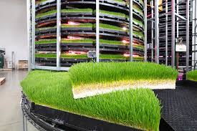
4
VERTICAL FARMING
Production for wheatgrass
Estimated Investment:
Between EUR 3-4 million
for 20 tons produced
Investment Plan:
Sustainable Wheatgrass Production
for Livestock Feed at DN AGRAR Group
Financing:
Bank loan
ROI:
Approx. 3 years
5 Units
Approx. 140 tons daily output
First unit operational in 2026 (Cut Farm 20 tons)

Slide 15
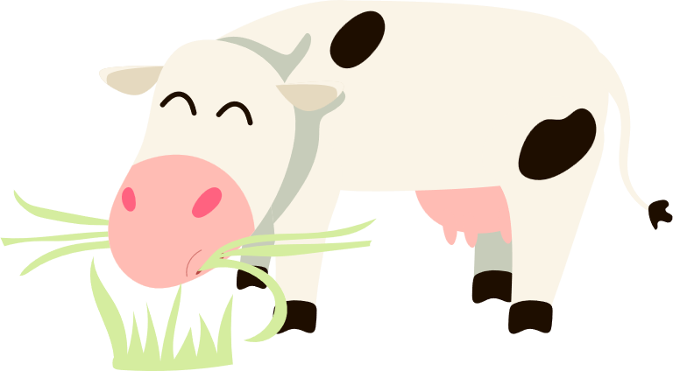
Why Wheatgrass for Livestock Feed?
Nutritional Profile
for Livestock
Healthier Cows,
Better Yields
Improved Milk Quality
Efficient Feed Conversion
Happy cows
Healthy milk
Satisfied customers
Resilient Food Supply

Slide 16
TIMELINE AND MILESTONES:
Pre-Launch
Phase
2025
Secure funding, finalize partnerships for land, technology,
Complete feasibility studies and develop financial and environmental
impact projections.
Construction
& Setup
2026
Build vertical farming,
Recruit and train staff to operate the new systems efficiently.
At end of 2026, we will begin the production of 20 tons/day, for the Cut 1 farm.
Initial Production Phase
2027
Begin the production of wheatgrass, integrating it into
the livestock
feeding system.
Monitor livestock health, feed quality, and operational performance to optimize production.
Full-Scale
Operation
2028
Reach full production capacity of 40 tons of wheatgrass per day.
Evaluate financial returns, operational efficiencies, and environmental impacts, adjusting
the system as
needed for maximum performance.
Integrating CO₂ capture systems.
At end of 2028, we will begin the vertical farm construction for Cut 2 farm, for a 20 tons/day production.
Doubled
Capacity
2029
The capacity is set
to be doubled, to
40 tons/day, at the
Cut 2 farm.

Slide 17
5
ALTERNATIVES for VALORIZING MILK
Increasing the Value of Raw Milk
We are conducting in-depth research on methods to increase the value of raw milk, including developing premium dairy products such as cream, fat, and milk-based supplements. This focus on value-added products will allow us to capture premium pricing, increase margins, and diversify into higher-value sectors, creating new revenue opportunities in both local and international markets.
RESEARCH KEY OBJECTIVES:
Milk Valorization and
Value-Added Products
Fat
Protein
Butter
Milk powder
Extract water from milk
to reduce transportation costs
Zero-emissions milk
GMO-Free milk

Slide 18
6
GREENHOUSES
STRATEGIC IMPACT
Why?
Because the market context & structural gaps offer opportunities
• Total vegetable production in Romania fell from its peak in 2021, driven by decreasing field yields and weather vulnerability.
• Vegetable consumption in Romania reached 8.72 kg/person/month in 2023—an all-time high.
• Romania cultivates only ~10% of vegetables under cover, representing roughly 4,600 ha—well below regional benchmarks such as Poland (~5,220 ha).
• The country’s leafy vegetable and brassica output is also modest and declining, while consumer demand remains strong and rising.
• Romania is a net importer of vegetables, particularly in the winter and early spring seasons. Key imports include lettuce, tomatoes, cucumbers, and brassicas—products that perform well in greenhouses.
• Strategic priorities for Romania include boosting yield efficiency, investing in protected cultivation, and targeting high-value crops to improve trade balance and reduce import reliance.
\\\\
Reduce Romania’s dependence
on imports during off-season
Deliver premium pricing
and high yield per m²
Diversify DN AGRAR’s
revenue beyond milk
Contribute to sustainability, composting, and ESG metrics
Position the company as a
first-mover in protected
vegetable farming in Romania
In 2028, we plan to start construction of the
first greenhouse
In 2030 is expected
to start the operations

Slide 19
STRATEGIC TIMELINE 2025 - 2030
2025 - FOUNDATION YEAR
KEY INITIATIVES
Capital Structure & Financing
Remaining loan facility: €5.5M
Direct capital contribution: 20% (cash)
Loan facility: €1.7M
Subsidized financing: €1.8M loan (60% government subsidy)
DN AGRAR STRAJA – Phase I
COMPOST FABRICATION FACILITY – Vaidei
SOLAR PANELS INSTALLATIONS - 3 Agricultural Sites
Strategic Notes
• Full financing secured for 2025 initiatives.
• Objective: establish energy and organic waste infrastructure
and initiate renewable integration

Slide 20
STRATEGIC TIMELINE 2025 - 2030
2026 – VERTICAL INTEGRATION & DIVERSIFICATION
KEY INITIATIVES
Capital Structure & Financing
Internal cash flow utilization
Loan: €3-4M (vertical farm)
Loan: €1.7M (compost facility)
DN AGRAR STRAJA – Completion
Capital injection for lagoon in Apold: €100K (own sources)
Facility financing for dary product line diversification: TBA
VERTICAL FARMING UNIT – Cut 1
COMPOST FABRICATION FACILITY – Cut 1
LAGUNA PROJECT – Apold
Strategic Notes
• Vertical Farm Cut 1 (20 tons/day wheatgrass): €3-4M CAPEX, with a 10-year payback period at €400K annually.
• Compost facility CAPEX: €1.7M, 10-year/€170K/year.
• Infrastructure investment in Apold lagoon: €100K.
DAIRY PRODUCT LINE DIVERSIFICATION
CONSTRUCTION OF DN CUT 2 (5,000 dairy cows)

Slide 21
STRATEGIC TIMELINE 2025 - 2030
2027 – BIOGAS ENTRY & OPERATIONAL SCALING
KEY INITIATIVES
Capital Structure & Financing
Capital requirement contingent on Biogas stake
(e.g., 20% share implies proportional equity contribution)
DN AGRAR Cut 2: €7M loan for construction
Solar Panels Straja: €800K
Lagoon infrastructure: €100K cash
DN BIOGAS FACILITY – Possibility to obtain between 10%-20% stake in the Biogas facility
DN AGRAR – Cut 2
(Land, Construction, Milking Infrastructure)
SOLAR PANELS EXPANSION – Straja
Strategic Notes
• Stakeholder alignment required for Biogas venture.
• DN AGRAR Cut 2 to anchor long-term livestock capacity expansion.
LAGUNA PROJECT – Cut 2

Slide 22
STRATEGIC TIMELINE 2025 - 2030
2028 – INFRASTRUCTURE CONSOLIDATION & AGRITECH EXPANSION
KEY INITIATIVES
Capital Structure & Financing
Total investment: €13-15M (includes construction of buildings and milking parlors, and €7.5M for lives stock procurement)
Loan: €4M (vertical farm)
CAPEX requirement: €1.7M (compost facility)
Capital contribution: €100K
DN AGRAR – Cut 2 (Animal Acquisition Phase)
VERTICAL FARMING UNIT – Cut 2
COMPOST FABRICATION FACILITY – Cut 2
LAGUNA PROJECT – Straja (Ohaba)
Strategic Notes
• Livestock procurement internally, from DN AGRAR farms:
5,000 animals @ €1,500/unit.
• Vertical Farm Cut 2 (20 tons/day): €3-4M investment to scale agri-output.
• Compost infrastructure reinforces circular economy objectives.
BIOGAS – First Full Year of Operations

Slide 23
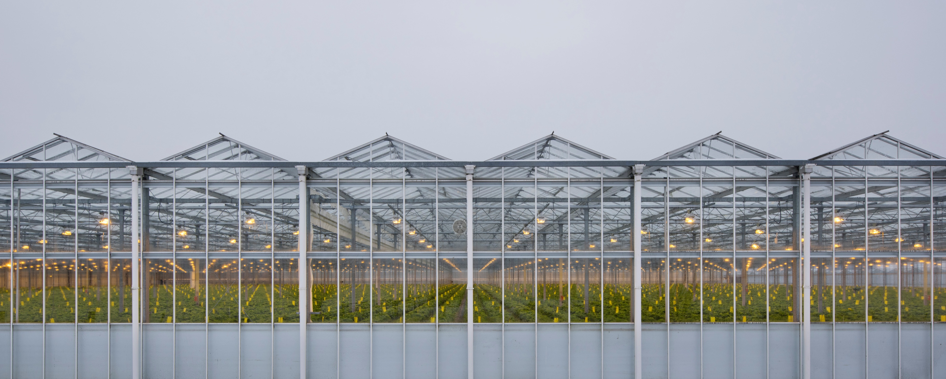
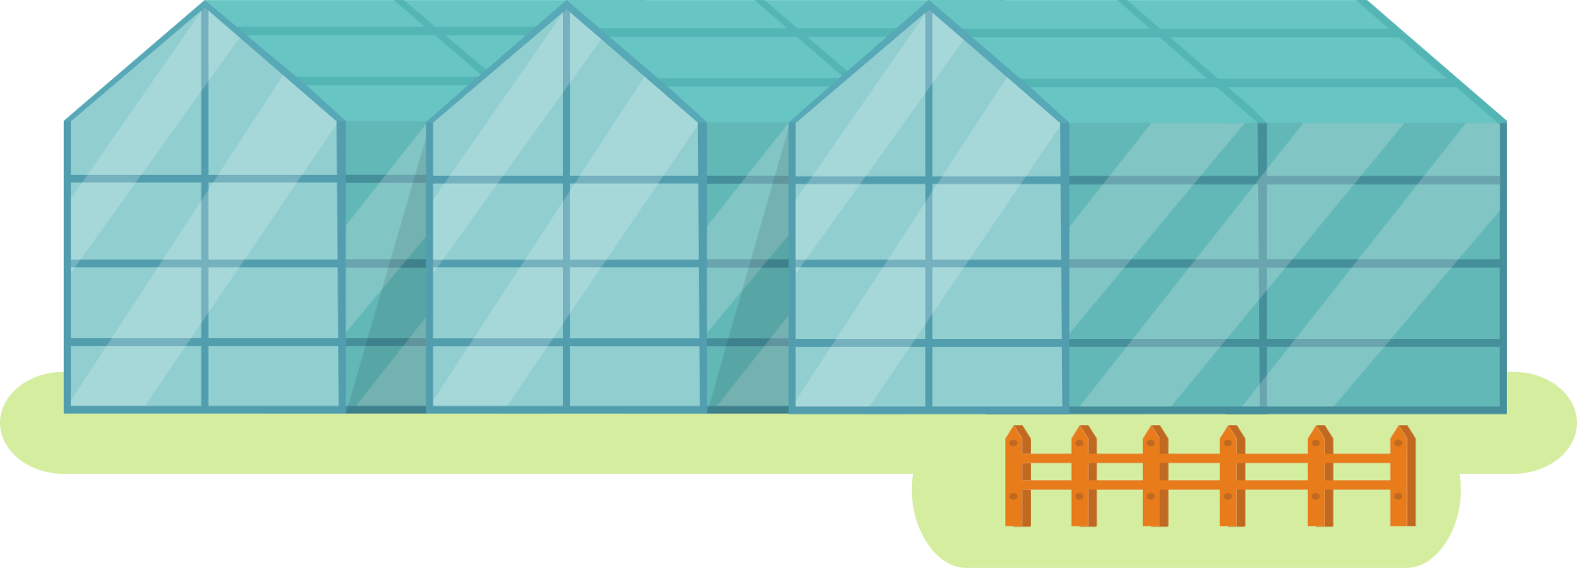
STRATEGIC TIMELINE 2025 - 2030
2029 – GREENHOUSE CONSUMER - ORIENTED
KEY INITIATIVES
Capital Structure & Financing
Expected financing: a combination of more sources
(subsidies, own sources and capital increase).
Estimated CAPEX: €3-4M (Lacto Agrar)
GREENHOUSE COMPLEX – Phase I
VERTICAL FARM – Vaidei (Lacto Agrar)
Strategic Notes
• Consumer-oriented vertical farm (culture-specific):
CAPEX flexible.
• Wheatgrass production target:
30 tons/day, estimated investment €5-6M.

Slide 24
STRATEGIC TIMELINE 2025 - 2030
2030 – MARKET PENETRATION & FINAL VERTICAL INTEGRATION
KEY INITIATIVES
Capital Structure & Financing
Expected financing: a combination of more sources (subsidies, own sources and capital increase).
Estimated CAPEX: €6M
GREENHOUSE COMPLEX – Phase II
VERTICAL FARM – Apold
Strategic Notes
• The final stage of the vertical farming ecosystem:
30 tons/day production unit, approx. €5-6M investment.
• Enhances direct-to-consumer supply chain control and operational efficiency.

Slide 25
STRATEGIC TIMELINE 2025 - 2030
Vertical Integration
& diversification
Vertical Farming (Cut 1) Compost (Cut 1)
Laguna (Apold)
Cut 2 Farm (Construction)
Infrastructure Consolidation
& Agritech Expansion
Cut 2 Farm (Animal Acquisition)
Vertical Farming (Cut 2)
Compost (Cut 2)
Laguna (Straja - Ohaba)
Straja 2 Farm (Potential Construction)
Market Penetration
& Final Vertical Integration
Greenhouses (Phase 2) Vertical Farming (Apold)
2 Composting Units (Straja)
2025
2027
2029
2026
2028
2030
Foundation Year
Straja Farm Phase 1 Compost (Vaidei) Solar Panels
Biogas Entry & Operational Scaling
Straja 1 Farm Completed
Biogas Facilty (end of 2027)
Cut 2 Farm (Milking Infrastructure) Solar Panels (Expansion)
Laguna (Cut 2)
Greenhouse
consumer – oriented
Greenhouses (Phase 1) Vertical Farming (Vaidei)

Slide 26
DN AGRAR in 2030:
A Vision of Scaled Growth,
Sustainability, and Value Creation
150 - 200 million liters of milk annually
Close to 30,000 animals
6 composting units producing
over 40,000 tons of organic fertilizer annually
Obtaining approx. 100,000 voluntary certificates
annually for 15 years
5 wheatgrass production units
25% - 30 % feedstock cows
2 industrial Greenhouses for
consumer-based vegetable production
DN AGRAR is listed for several years on
the Main Market of the BVB
Produces milk close to Net-Zero
Reduces emissions by 90% and adds to its revenues
EUR 3.5 – 4 million due to the biomethane plant.

Slide 27
DN AGRAR in 2030:
A Vision of Scaled Growth,
Sustainability, and Value Creation
DN AGRAR in 2030:
Resilient.
Profitable.
Sustainable.
Ready for the future.
By the end of 2030,
DN AGRAR will stand as a national and regional
leader in sustainable food production,
an integrated agribusiness group built
on innovation, operational excellence, and long-term value creation for shareholders
and stakeholders alike.

Slide 28
THE FOUR SCENARIOS:
What’s included in the
financial scenarios
up to 2030
• Current operations
• Straja farm
• Cut 2 farm
• 28,000 tons organic fertilizer
• Biometehane production (from 2028)
• Solar in Straja, Apold, Cut and Lacto
What’s not included
in the scenarios,
will be included
in the coming years
when all details
are known:
• Straja 2
• 14,000 tons of organic fertilizer
• 2 greenhouses for vegetables production
• Solar in Cut 2 and Straja 2
• Wheatgrass production ass feedstock for animals
• Different valorization of the commodity milk
• Approximately 100,000 voluntary carbon certificates annually for a period
of 15 years, with a current value of approximately Euro 20 per certificate
• Certificates obtained due to the implementation of no-till

Slide 29
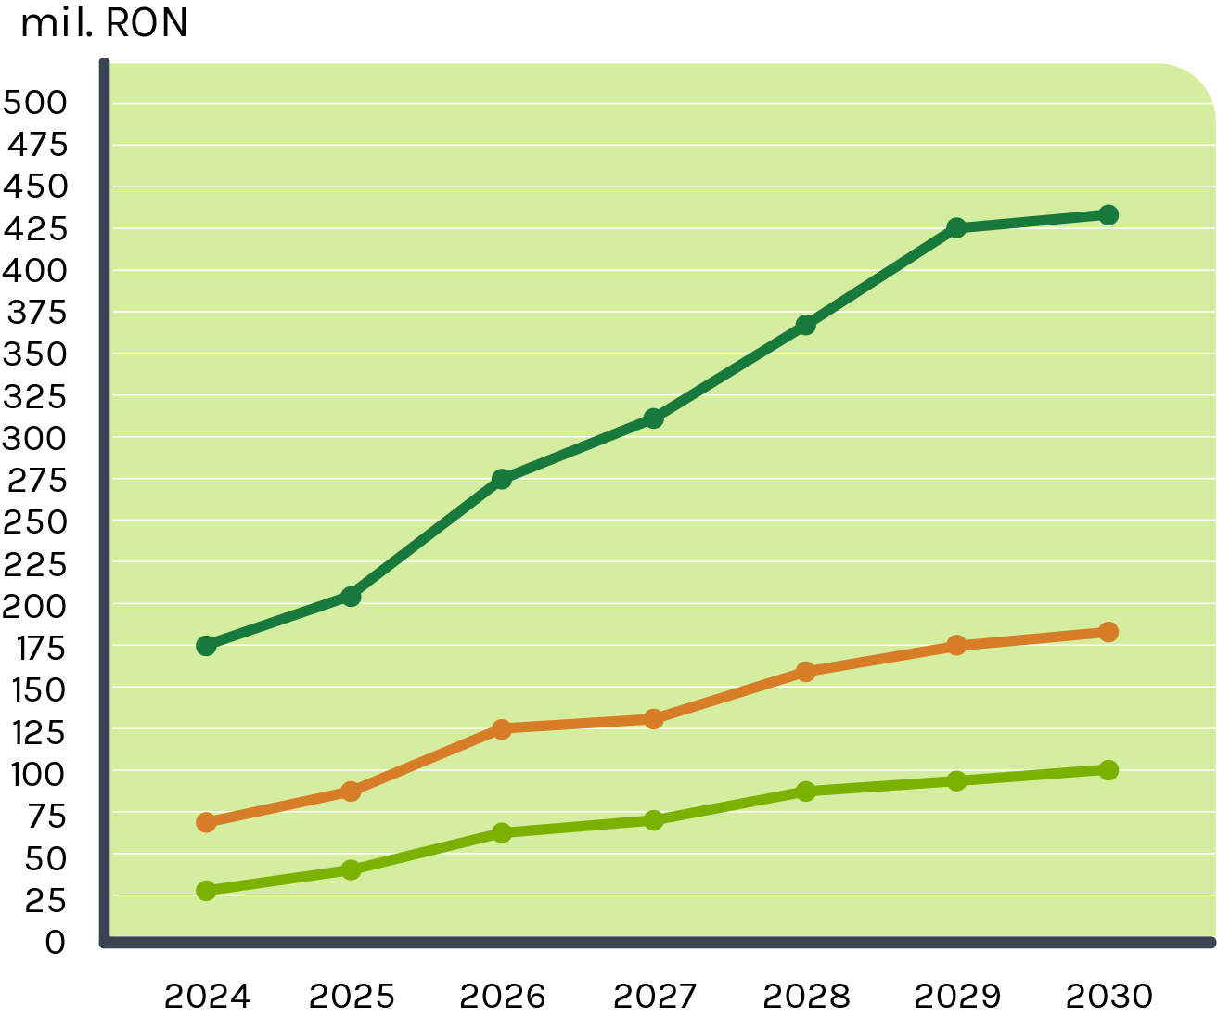
THE FOUR SCENARIOS:
SCENARIO 1
In scenario 1, the milk price is considered based on the average milk price in 2023.
SCENARIO 2
In scenario 2, the milk price is considered based on the average milk price in 2024.

Slide 30
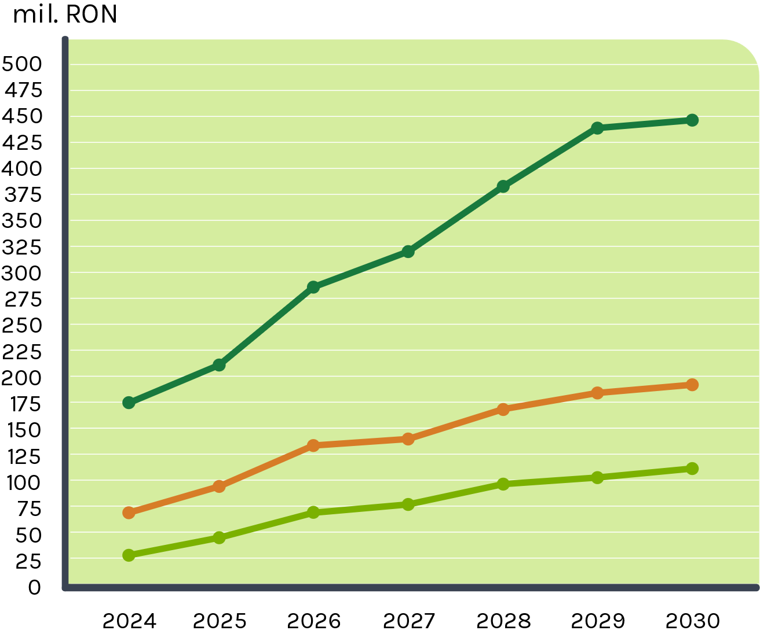
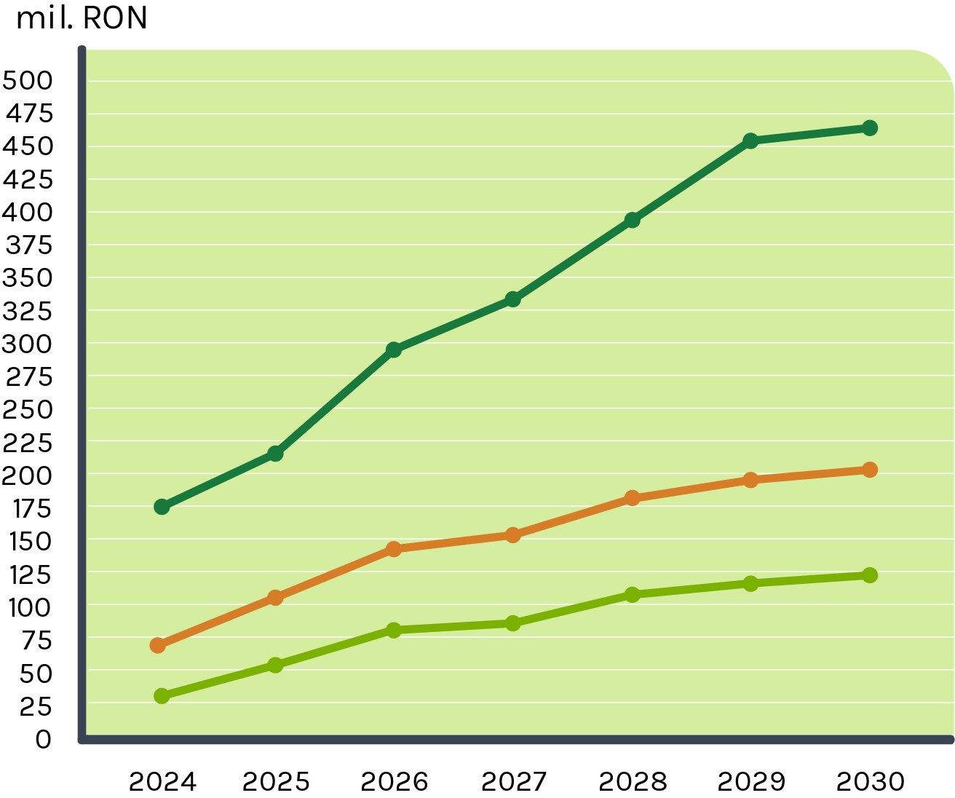
THE FOUR SCENARIOS:
SCENARIO 3
In scenario 3, the milk price is considered based on the average milk price at the end of 2024.
SCENARIO 4
In scenario 4, the milk price is considered based on the average milk price in 2025, until now.

Slide 31
MAIN MARKET & Dividends
Strategic Roadmap for Main Market
DN AGRAR, a high-growth agricultural company that was successfully listed on the Bucharest Stock Exchange in 2022, is pleased to announce its strategic roadmap towards upgrading to the Main Market in the coming years.
Our objective is to adopt IFRS reporting starting in 2026.
DN AGRAR GROUP S.A.
Sets Course for Main Market Upgrade
and Announces Dividend Plans
Following Biomethane
Plant Launch
Main Market BVB
Estimation 2028
IFRS starting from 2026
Dividend Plans
Dividend starting from 2028
Free shares
Buy-back-program
The Company
will continue to update shareholders as it progresses towards these
key milestones.

Slide 32
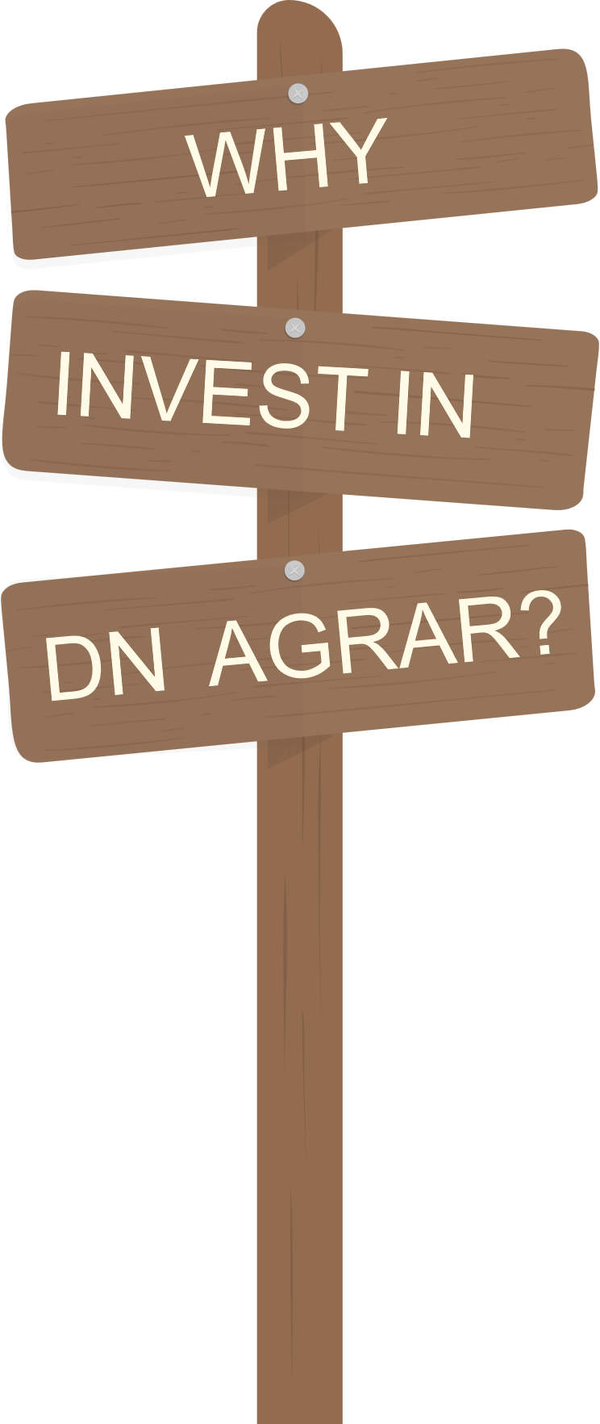
High-Return Growth Strategy:
DN AGRAR’s Strategy 2025-2030 presents exceptional investment opportunities across a diversified range of agricultural sectors. Our focus on sustainability, technological innovation, and strategic M&A ensures a clear path to strong, long-term financial performance.
Sustainability and Efficiency:
Through investments in solar energy, wheatgrass production, composting, and biomethanization, DN AGRAR is pioneering a more sustainable and cost-effective model that will reduce operational risks and maximize profits.
Market Leadership in Dairy and Beyond:
With a commitment to enhancing our dairy operations and expanding into value-added products, DN AGRAR is well-positioned to become a leader in the dairy and agricultural industries, generating superior margins and establishing a strong market presence.
Geographic Expansion:
The Group’s expansion into key European markets like Hungary, Poland, and Bulgaria offers a high-growth opportunity to scale our operations, increase revenue, and capture new market share in some of the most dynamic agricultural regions.
Innovation-Driven Growth:
With a strong focus on R&D, DN AGRAR is continually innovating in areas such as milk valorization, sustainable production, and advanced farming technologies. This commitment to innovation will not only improve operational efficiency but also drive higher returns and business resilience.
Diversified Investment Opportunities:
DN AGRAR’s diversified investment approach, including M&A activity, strategic farm expansions, and entry into the fruit and vegetable sectors, offers investors a broad spectrum of high-return opportunities across multiple industries.

Slide 33
Industrial Clusters
2025 – 2027,
decision
2027
DN AGRAR
is embarking on
an exciting journey
to explore
the potential
of developing
industrial clusters
within its current operations
This initiative aims to enhance the company’s
agri-food production by integrating key elements such as solar energy, organic fertilizers, and advanced agricultural practices into a unified cluster model.

Slide 34
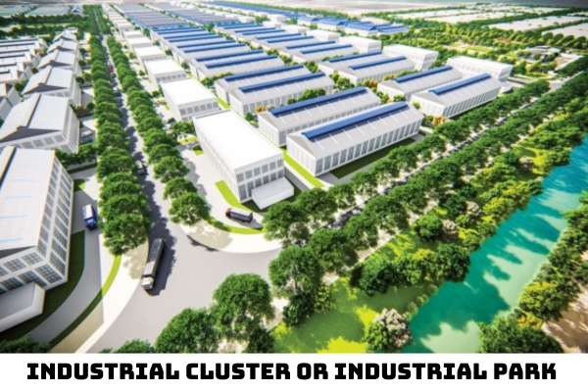
Industrial Clusters
Environmental factors
Demand
condition
Geographical focus
Establishment and Developement of Industry Cluster
Strategy and structure
Relation of enterprises
Infrastructure
Below are the main advantages of developing industrial clusters for raw material production in Romania:
1
Economies of Scale
5
Job Creation and Economic Growth
2
Increased Productivity and Efficiency
6
Sustainability and Environmental Impact
3
Improved Innovation and Knowledge Sharing
7
Resilience to External Shocks
4
Enhanced Market Access and Competitive Advantage
8
Cluster Development as a Long-Term Strategy

Slide 35
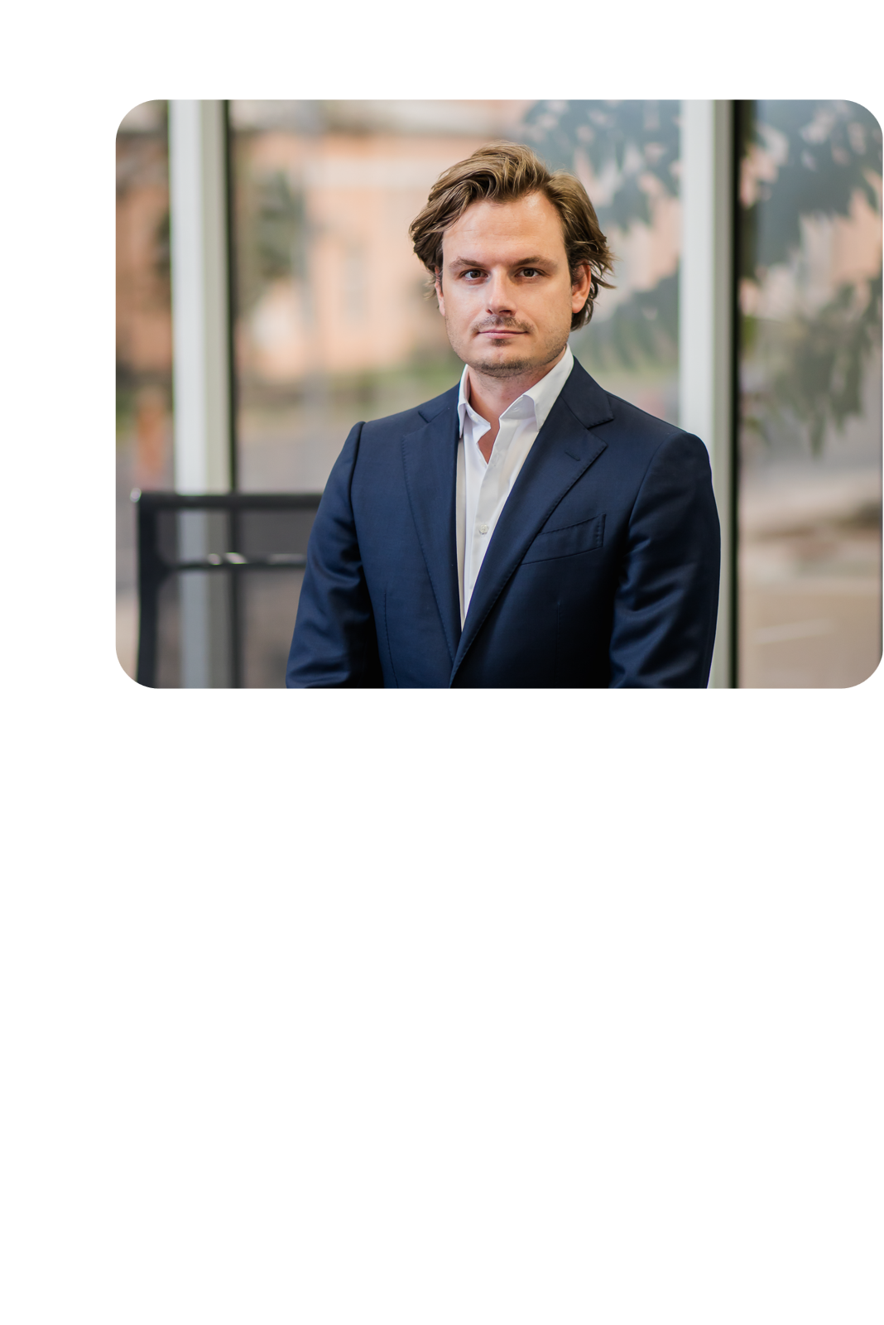
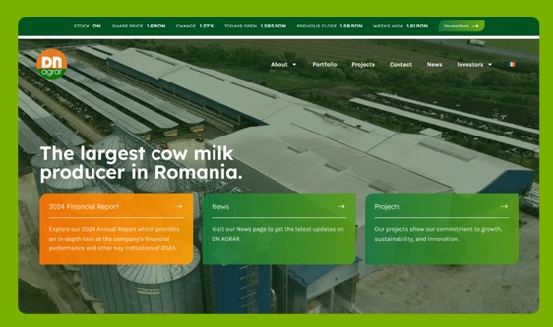
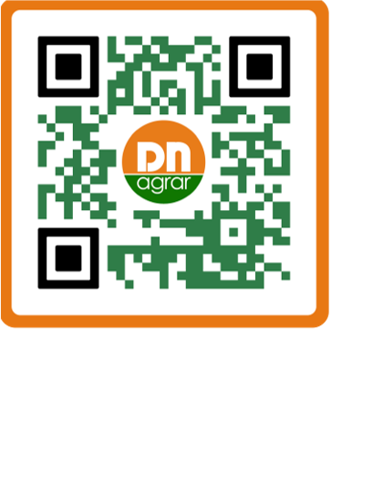
CONTACT
Website: www.dn-agrar.eu
On the DN AGRAR company website, you can find press releases, financial reports, annual reports, presentations, the financial calendar, and other relevant information for shareholders, accessible through the Euroland interactive tool.
How do you contact us?
Peter de Boer, CEO & BoD Member
DN AGRAR Group
Visit our page and
subscribe to our newsletter
to keep up to date with our work.
General information
Piața Iuliu Maniu Street, No. 1, Alba-Iulia Alba County, Romania
(+)40 258 818 114
(+)40 258 818 115
office@dn-agrar.eu
investors@dn-agrar.eu

