Slide 1
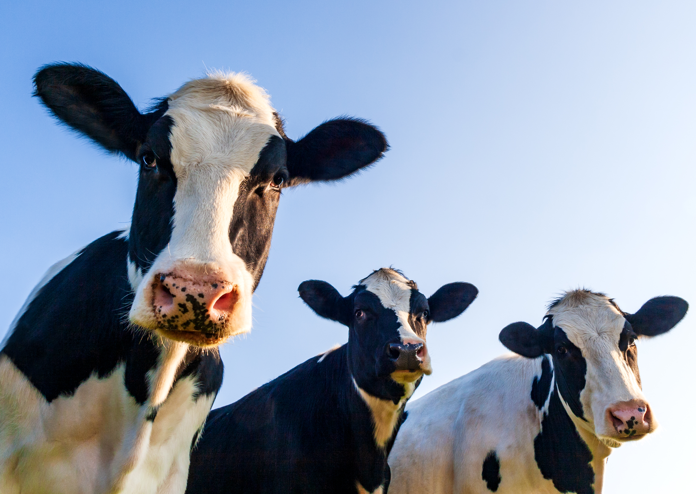
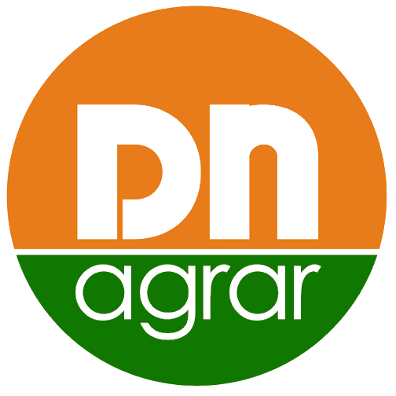
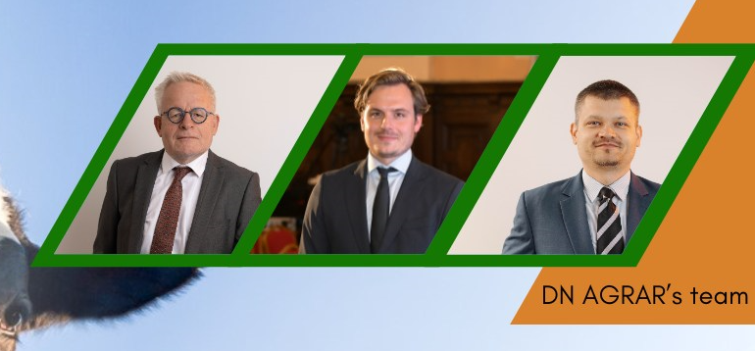
Presentation
Preliminary Financial Results 2024

Slide 2
CONTENT
ABOUT DN AGRAR
2024 PRELIMINARY FINANCIAL RESULTS
OPERATIONAL ACTIVITY
DN AGRAR PROJECTS AND OUTLOOK

Slide 3
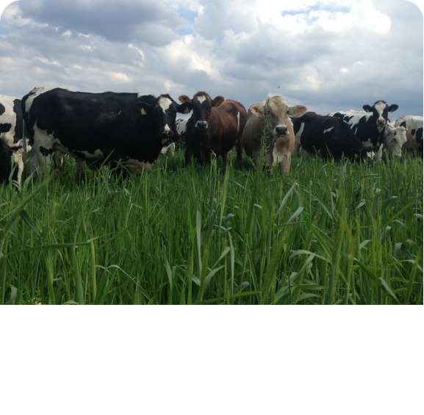
DN AGRAR - AN OUTSTANDING GROWTH STORY
Tripled the business since listing
Consistent Growth in EBITDA
Approx. 63 million liters of milk delivered in 2024
Track
Record
Focus on sustainable, regenerative agriculture practices that maximize productivity, reduce environmental impact, and ensure long-term profitability.
Sustainable
Agriculture
Current Strategy
One of Europe’s leading milk producers and the largest integrated zootechnical farm in Romania, with cow milk production and vegetable production.
To double again the business by 2027 supported by operation efficiencies and the development of Straja farm.
Target 2028: over 100 million liters of milk produced and delivered annually.
An update of the strategy will follow this year.
Market
Position
3

Slide 4
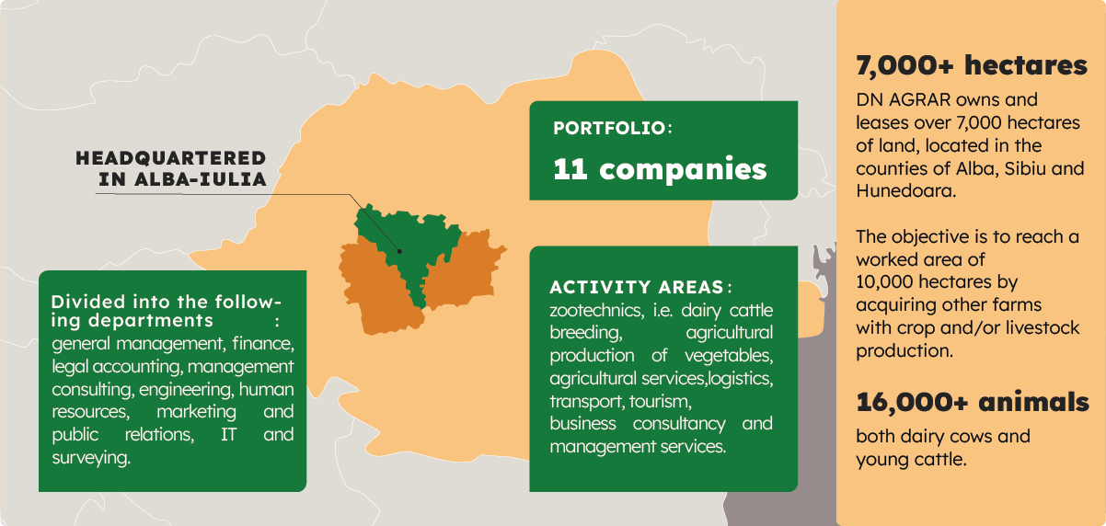
DN AGRAR ACTIVITY – INTEGRATED DAIRY PRODUCTION
Zootechnics
Vegetal agricultural production
Agricultural services
Logistics
Transport
Tourism
Business and management consulting services

Slide 5
DN AGRAR FARMS LEADING ROMANIAN MILK PRODUCTION
~ 63 million liters of milk
were delivered in 2024
APOLD FARM
CUT FARM
8,300 dairy cattle & young stock
75,000 liters/day
400 cows milked/hour
2,000 dairy cattle
49,000 liters/day
300 cows milked/hour
PRODLACT FARM
LACTO AGRAR FARM
1,000 young stock animals
Raising young cattle for Apold, Cut and Straja farms
4,100 dairy cattle & young stock
60,000 liters/day
350 cows milked/hour
STRAJA FARM
650 Animals

Slide 6
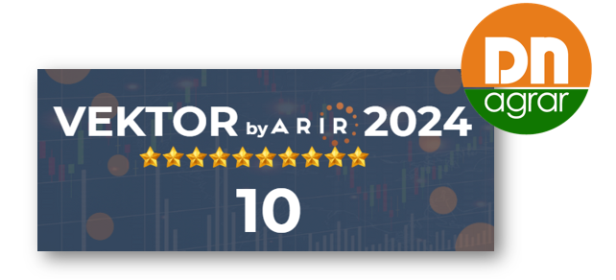
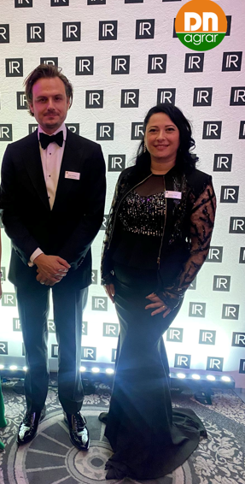
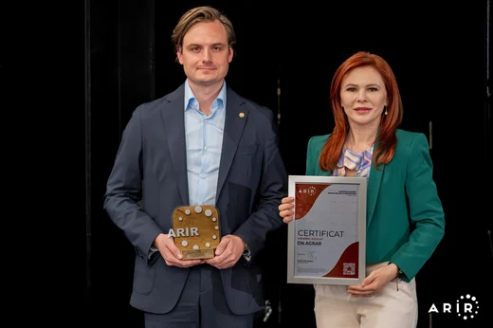
ACTIVITY IN THE CAPITAL MARKET RECOGNIZED INTERNATIONALLY
Listed on the Bucharest Stock Exchange, AeRO market since February 2, 2022
Market capitalization of EUR ~50 mil, liquidity at the level of Main Market companies
The company with the largest weight in the BETAeRO index at the end of 2024
Shares included in the MSCI Frontier Small Cap and MSCI Romania Small Cap indices
2 analysts covering the share, both highlighting an upside
10 at VEKTOR by ARIR 2024 evaluation
DN AGRAR has been nominated for IR Magazine Europe Awards 2024
DN AGRAR became ARIR's Associate Member
Performance recognized at GALA BY ARIR 2024 with the following awards:
Best IR Department
Best Annual Report
Best Company Representative in the Capital Market
Best ESG Performance & Communication
Recognition
Analysts covering DN share – latest updates
Prime Transaction – June 24th, updated target price 1.8074 RON and October 21st, updated target price 1.7683 RON
BRK Financial Group – August 7, updated target price 1.746 RON, BUY recommendation

Slide 7
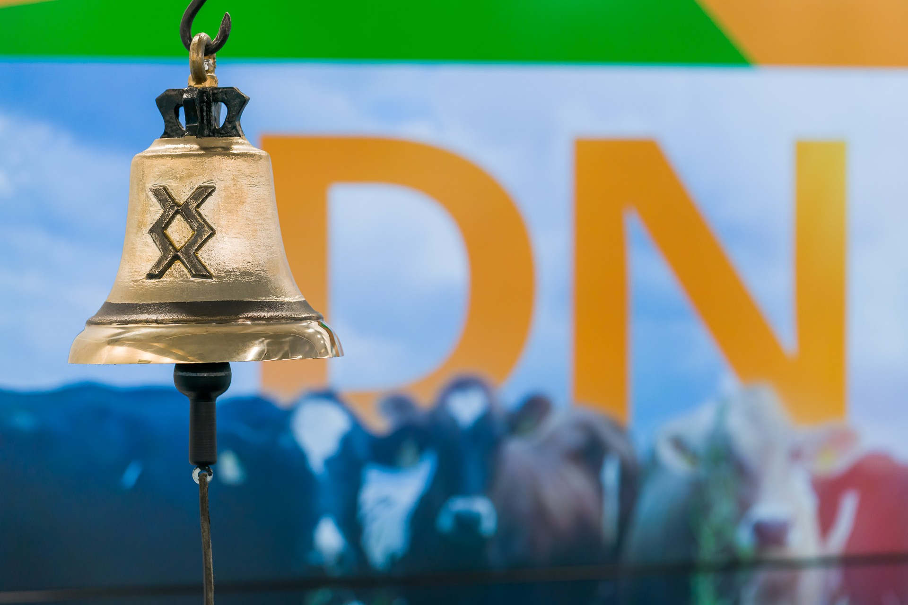
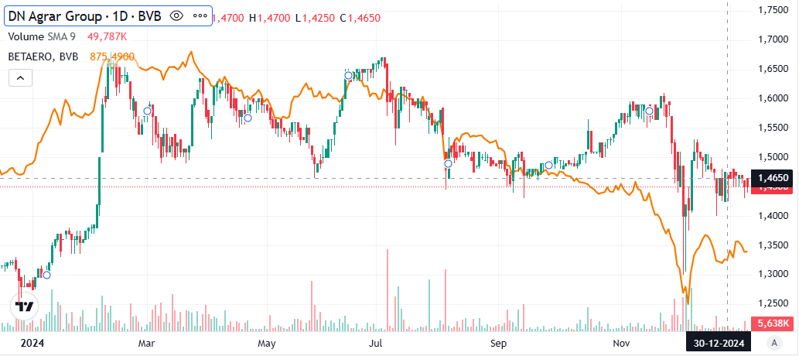
STRONG PERFORMANCE IN THE CAPITAL MARKET
Strong Share Performance
The share price performance compared to the listing has doubled.*
+14.45% share price performance YOY** (Dec 2024 vs Dec 2023)
In the top performances YOY**
The value traded - DN AGRAR shares doubled to RON 54.2 million in 2024, compared to RON 25.5 million
Shareholders Evolution
117
shareholders
3,000
shareholders
2022
2024
60% increase in the number of shareholders
*considering the closing price from 30.12.2024
**Dec 2024 vs Dec 2023

Slide 8
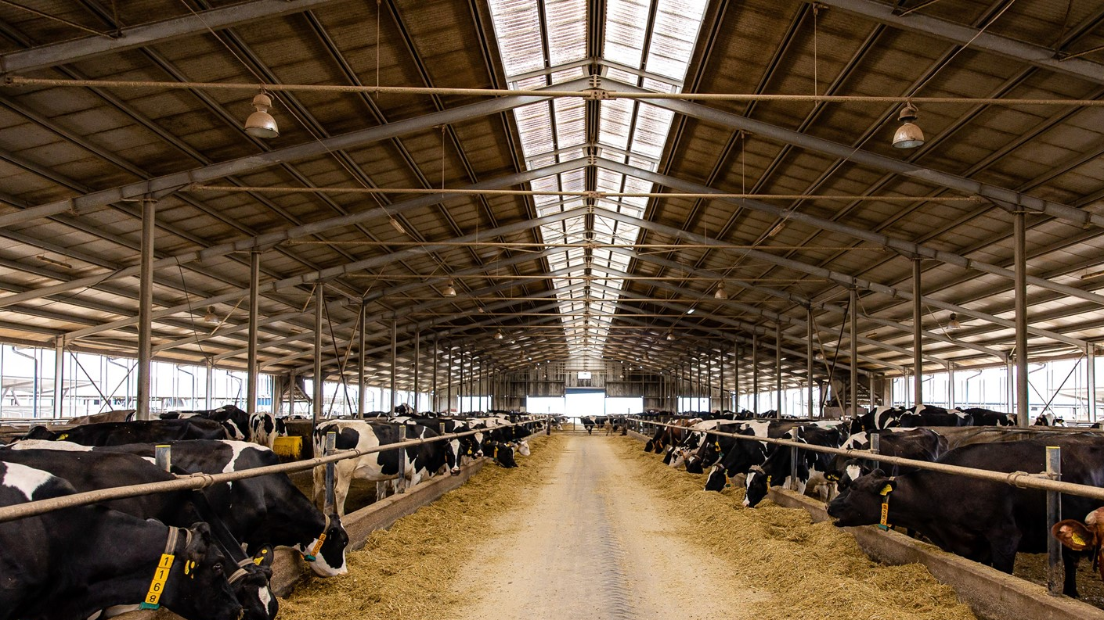
2024 RESULTS & OUTLOOK

Slide 9
RECORD RESULTS IN 2024, TURNOVER +16%, NET PROFIT +40%
TURNOVER
NET ASSETS
RON 175.70 mil.
+16.44%
vs 2023
RON 277.39 mil.
+19.95%
vs 31.12.2023
NET PROFIT
TOTAL ASSETS
RON 31.75 mil.
+40.02%
vs 2023
RON 361.66 mil.
+17.44%
vs 31.12.2023
EBITDA
EQUITY
RON 70.72 mil.
+31.02%
vs 2023
RON 164.99 mil.
+23.73%
vs 31.12.2023

Slide 10
FACTORS THAT INFLUENCED THE 2024 RESULTS
Increase in turnover by 16%
Decrease in production costs for crops by approximately 4.4%.
Income from subsidies decreased by 13%
The increase in depreciation by 21%
Increase in raw materials
and consumables by 8%
expenses
The increase of personnel expenses by 7%
The evolution of investments
Value adjustments regarding current assets (stocks of crops)
The increase in corporate income tax expenses by 71%
10

Slide 11
CONTINOUS FINANCIAL GROWTH PERFORMANCE
2024 Results were above the budgeted figures
TURNOVER, mil. RON
EBITDA, mil. RON
NET PROFIT, mil. RON

Slide 12
PRELIMINARY FINANCIAL RESULTS HIGHLIGHTS 2024
PROFIT AND LOSS ACCOUNT (RON) | 31/12/2024 | 31/12/2023 | ∆%
OPERATING INCOME – TOTAL | 264,319,815 | 234,724,747 | 12.61%
OPERATING EXPENSES – TOTAL | 218,862,630 | 200,188,600 | 9.33%
OPERATING PROFIT OR LOSS | 45,457,185 | 34,536,147 | 31.62%
FINANCIAL INCOME – TOTAL | 1,132,716 | 2,781,307 | (59.27)%
FINANCIAL EXPENSES – TOTAL | 8,473,501 | 10,519,474 | (19.45)%
FINANCIAL PROFIT OR LOSS | (7,340,785) | (7,738,167) | (5.14)%
GROSS PROFIT OR LOSS | 38,116,400 | 26,797,980 | 42.24%
GROUP NET PROFIT OR LOSS | 31,747,240 | 22,672,945 | 40.02%
Operating revenues amounted to RON 264 million, an increase of 13% compared to the same period last year.
Operating expenses increased by 9% in 2024 compared to 2023, reaching RON 219 million. The main contribution came from expenses related to value adjustments for tangible and intangible assets, which reached RON 25 million, a 21% increase compared to the same period last year.
Revenues from the production of tangible fixed assets increased by 139%, reaching RON 20 million, due to the registration as fixed assets of young dairy cows that have entered the milk production process.

Slide 13
THE MAIN ELEMENTS OF THE BALANCE SHEET
Equity increased by 24% compared to December 31, 2023, reaching RON 165 million. The evolution was determined by the recording of a net profit of RON 32 million as of December 31, 2024.
Long-term liabilities increased by 15% compared to the end of 2023, so as of December 31, 2024, the balance of long-term liabilities reached RON 110 million.
Provisions for the year 2024 remained at the same level as at the end of 2023, at RON 386 thousand.
Compared to the end of 2023, there was an increase in long-term loans contracted from Exim Bank by RON 35 million, representing a 319% increase, as a result of contracting a financing of EUR 9.2 million in April 2024 for the construction project of the DN AGRAR Straja farm, as well as a refinancing carried out for the loans from ING Bank.
BALANCE SHEET INDICATORS (RON) | 31/12/2024 | 31/12/2023 | ∆%
FIXED ASSETS - TOTAL | 243,511,009 | 212,141,058 | 14.79%
CURRENT ASSETS - TOTAL | 115,784,991 | 94,362,606 | 22.70%
DEFERRED EXPENSES | 2,369,930 | 1,441,310 | 64.43%
TOTAL ASSETS | 361,665,930 | 307,944,974 | 17.44%
DEBTS: AMOUNTS TO BE PAID WITHIN UP TO ONE YEAR | 84,131,609 | 76,397,539 | 10.12%
DEBTS: AMOUNTS TO BE PAID IN MORE THAN ONE YEAR | 110,433,346 | 95,954,744 | 15.09%
PROVISIONS | 386,046 | 385,892 | 0.04%
DEFERRED REVENUES | 1,727,746 | 1,867,001 | (7.46)%
DEBT - TOTAL | 194,564,955 | 172,352,283 | 12.89 %
EQUITY - TOTAL | 164,987,183 | 133,339,798 | 23.73%
TOTAL EQUITY AND DEBT | 361,665,930 | 307,944,974 | 17.44%

Slide 14
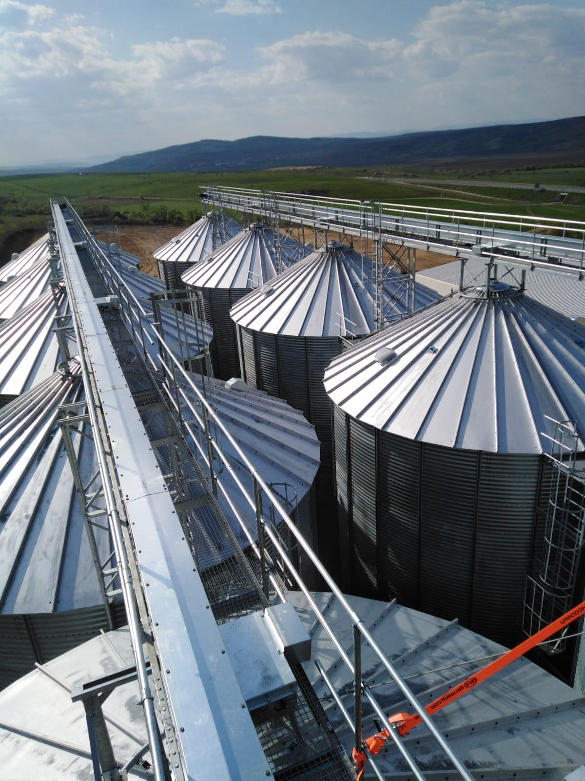
OPERATIONAL
ACTIVITY

Slide 15
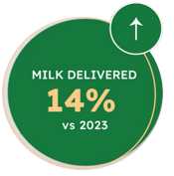
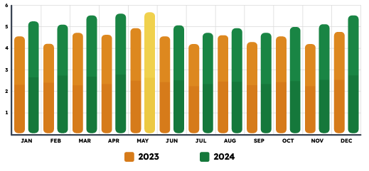
CONSISTENT GROWTH IN MILK DELIVERIES
🐄 Milk production has maintained an upward trend with a monthly average of over 5 million liters.
🐄 Approximately 63 million liters of milk were delivered in 2024, exceeding the target of 60 million liters for 2024.
15

Slide 16
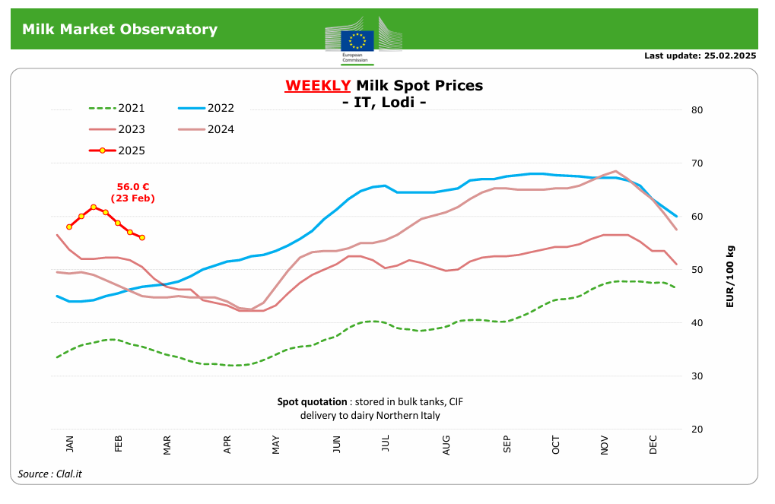
EUROPEAN MILK MARKET & OUTLOOK 2024
European milk market
as of Dec 2024
as of Dec 2024
*https://agriculture.ec.europa.eu/data-and-analysis/markets/price-data/price-monitoring-sector/milk-and-dairy-products_en
*Source: https://agriculture.ec.europa.eu/

Slide 17
DN AGRAR
PROJECTS AND OUTLOOK

Slide 18
DN AGRAR STRATEGIC VIEW BY 2027/ 2028
A Clear and Achievable Vision
Over 300.000 liters per day
The 5 farms will produce over 100 million liters of milk annually
A herd of approx. 20.000 dairy cows and young stock
Building a Major European Milk Producer
Straja farm project
to be finalized in 2027
Compost factory started operations in 2024
Biomethane facility planned, with a total capacity up to 20MW
Strategic Projects

Slide 19
DN AGRAR FARMS 2027/2028
AQUISITION FARM
~ 100 million liters of milk will be delivered annually, starting 2028
………. dairy cattle
………. liters/day
………. cows milked/hour
APOLD FARM
STRAJA FARM
6,000 dairy cattle + young stock
100,000 liters/day
400 cows milked/hour
5,000 dairy cattle + young stock
100,000 liters/day
600 cows milked/hour
CUT FARM
2,200 dairy cattle
50,000 liters/day
300 cows milked/hour
LACTO AGRAR FARM
4,000 dairy cattle + young stock
63,000 liters/day
350 cows milked/hour
PRODLACT FARM
Over 3,000 young stock animals
Raising young cattle for Apold and Cut farms

Slide 20
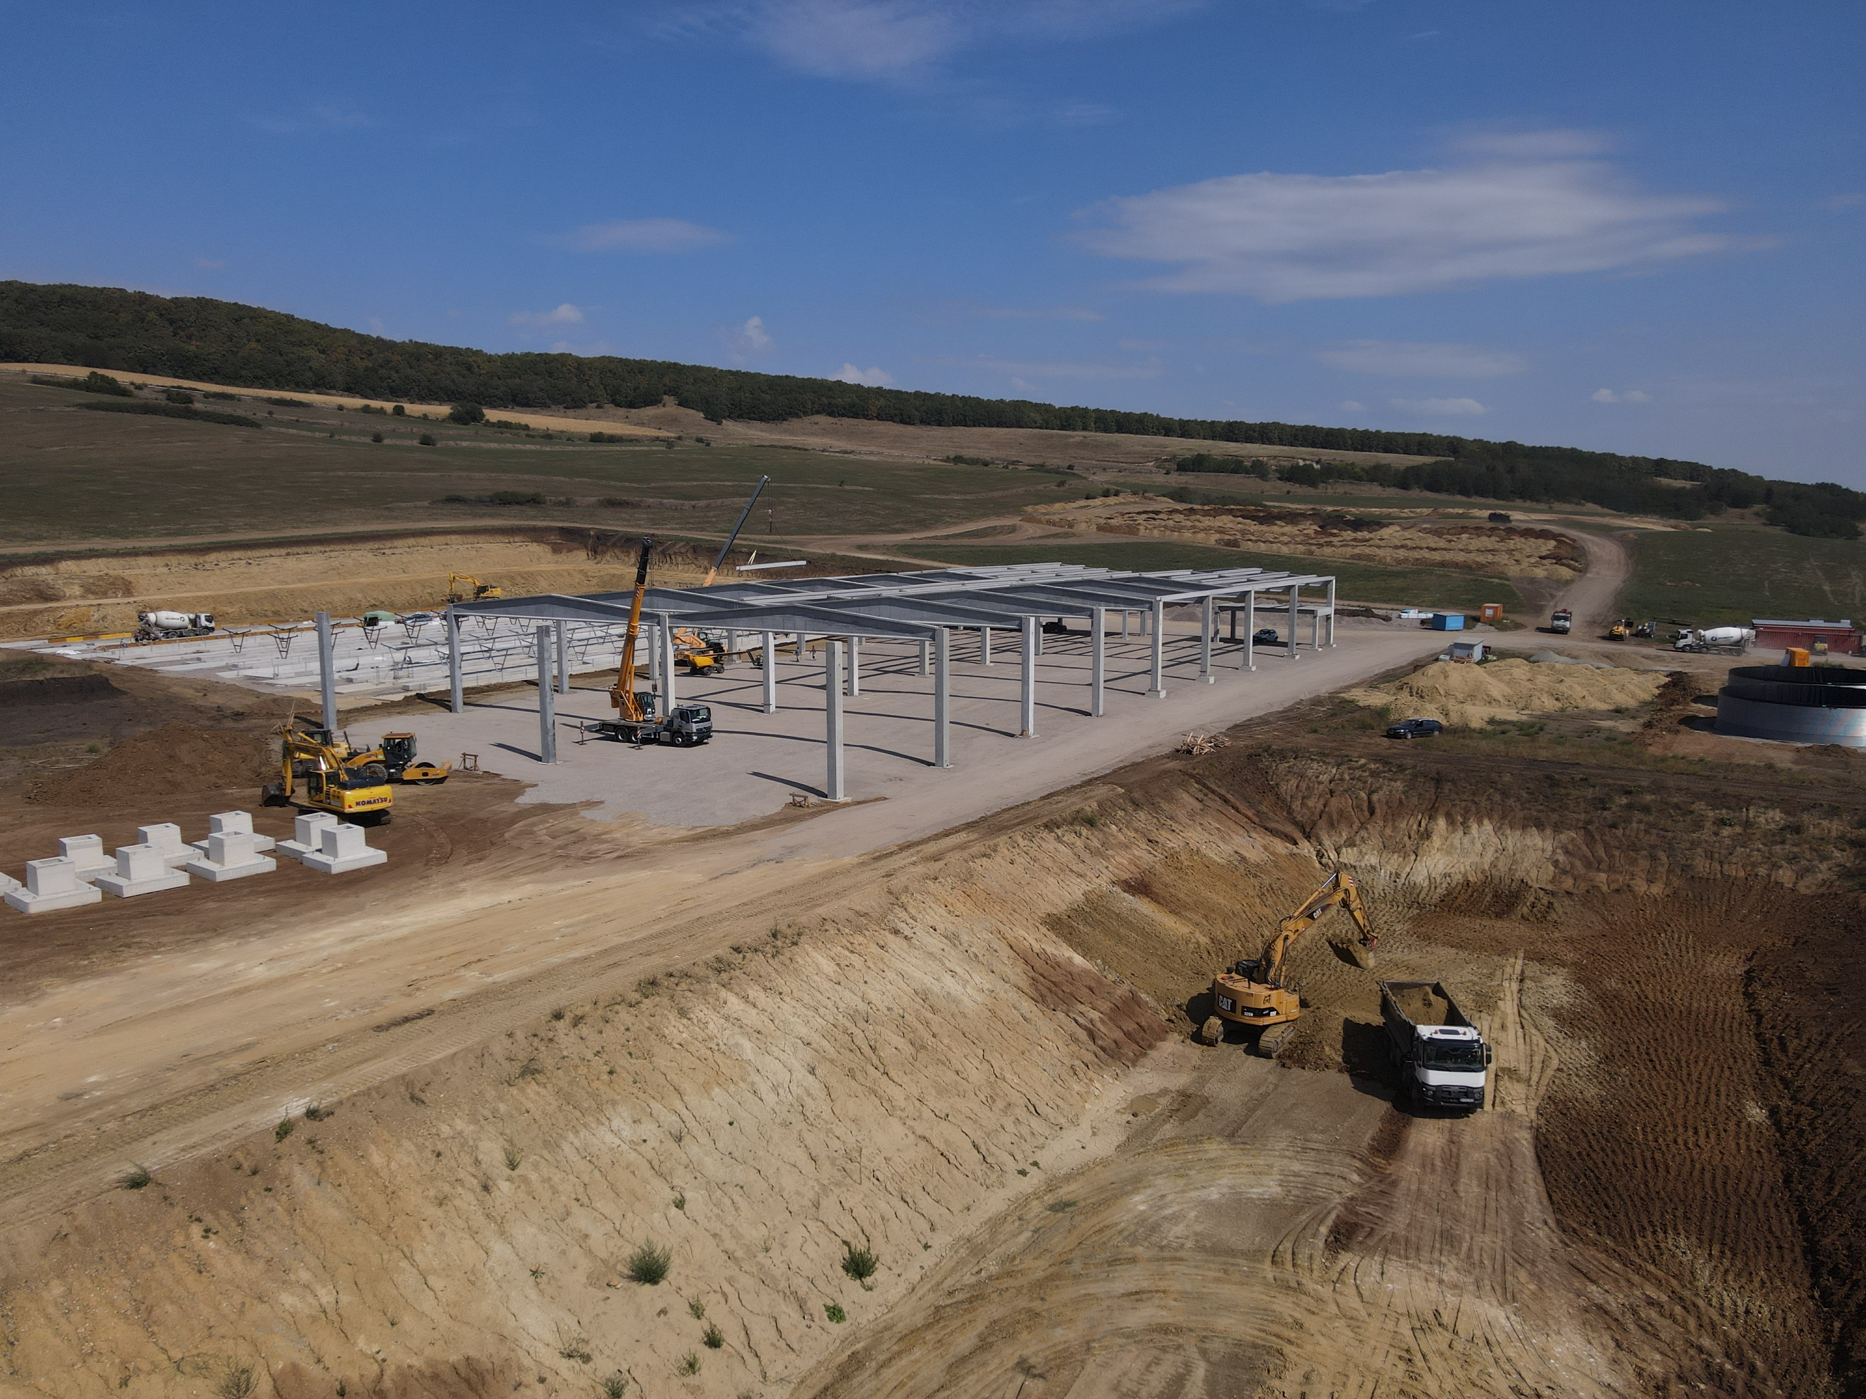
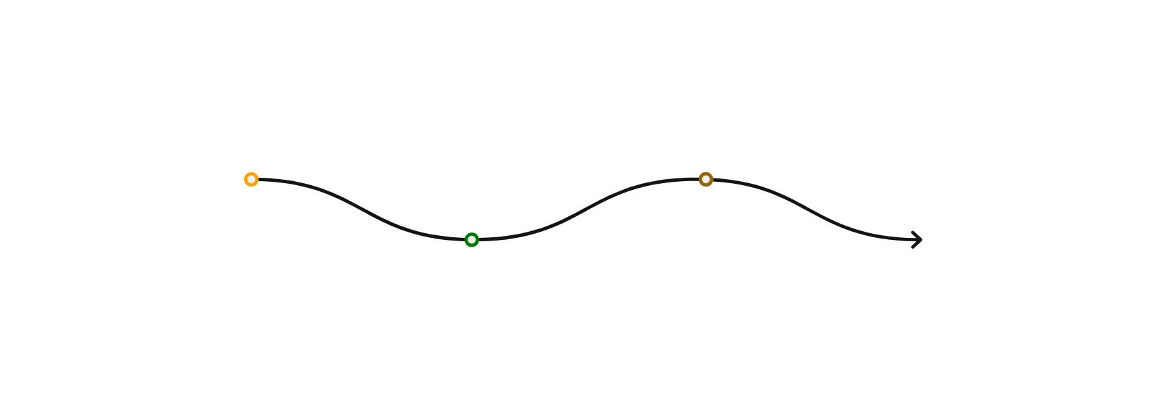
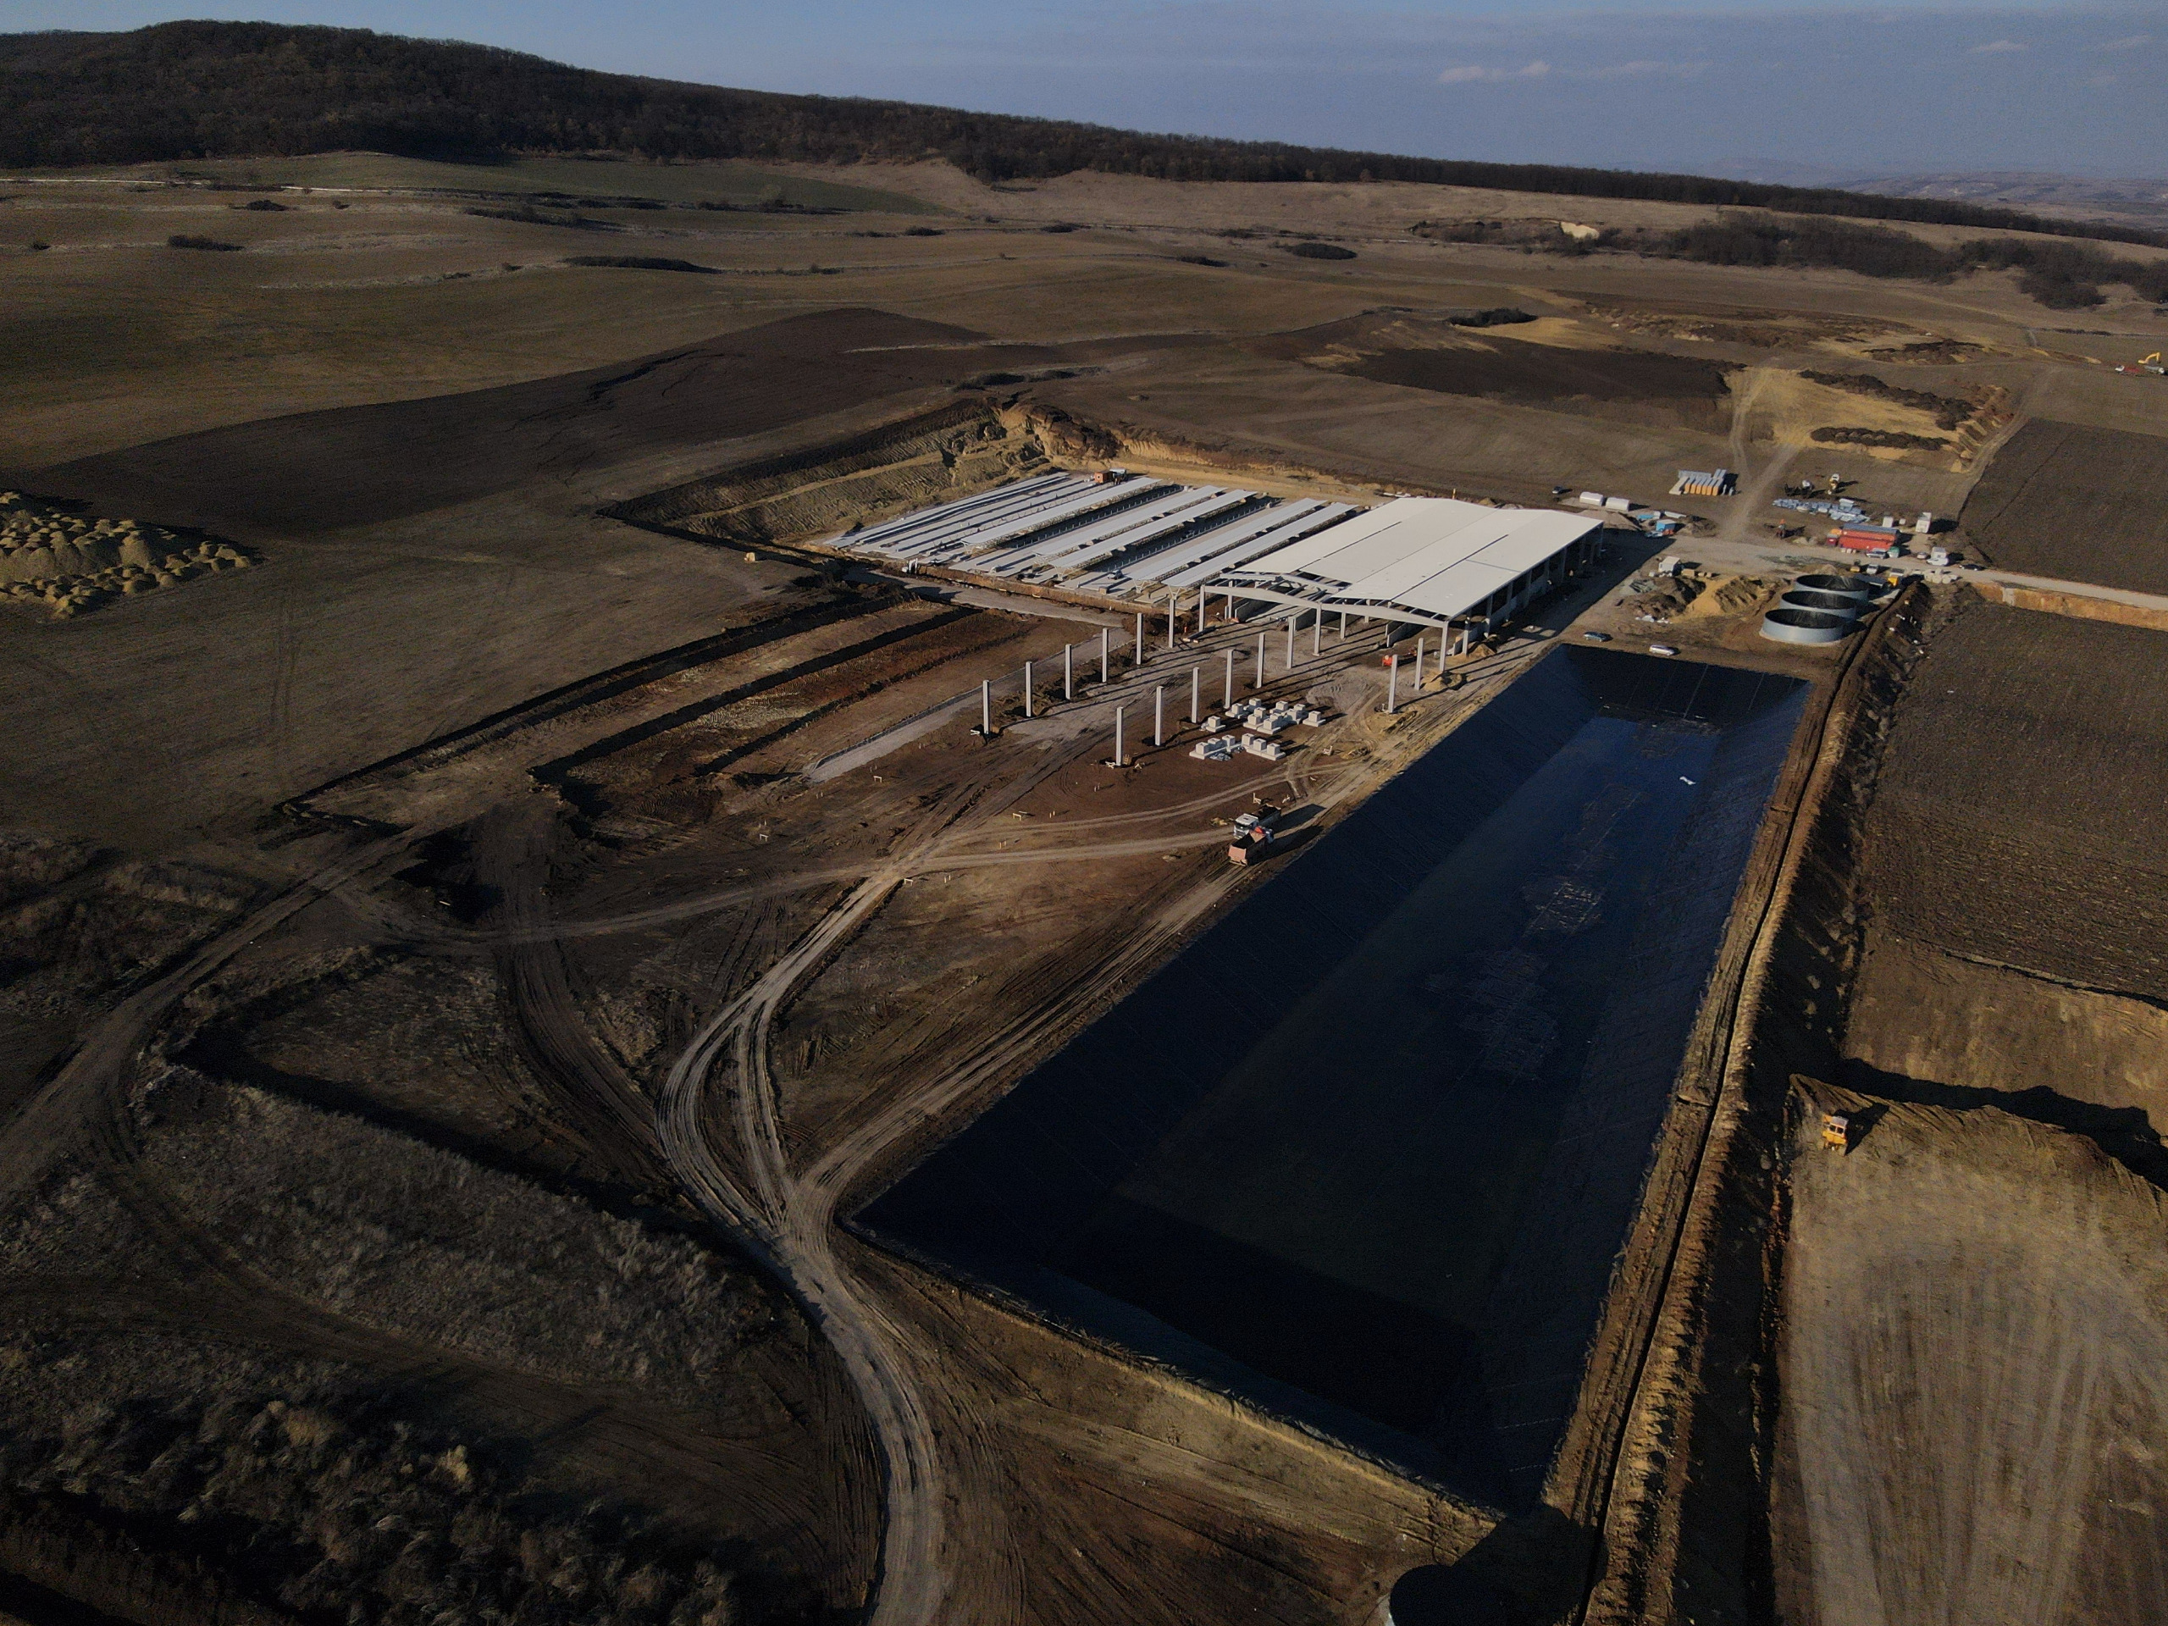
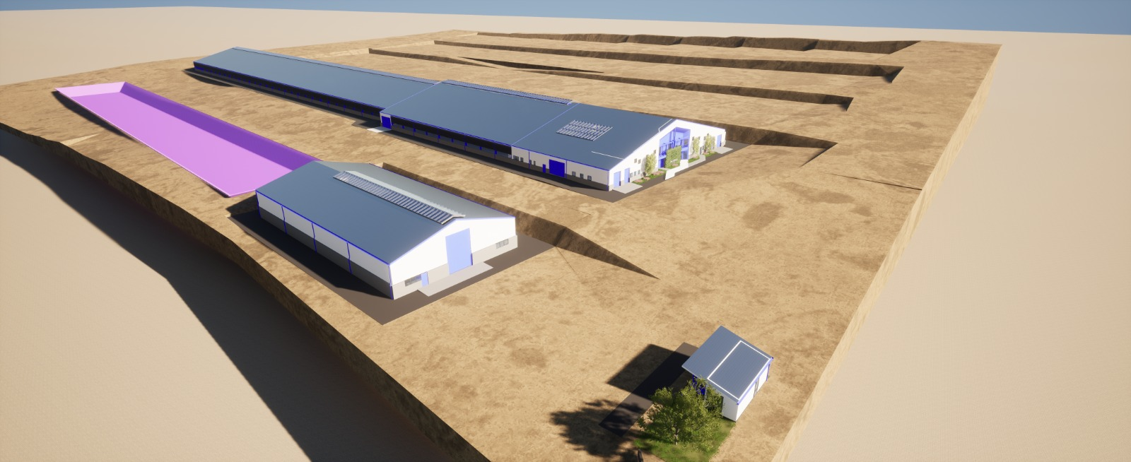
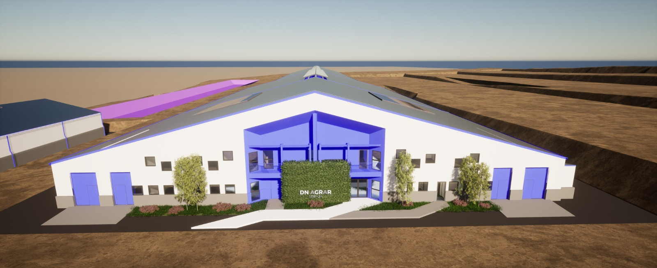
STRAJA PROJECT - A SIGNIFICANT EXPANSION IN PRODUCTION
Key Highlights
2024:
The foundation works were completed
Part of the main hall, finalized
Waste storage lagoon, finalized
Started in 2023, and planned to be completed in 2027.
Capacity of 5,000 cows (4,000 dairy cows and 1,000 young stock).
Financed through credit facility and own sources.
The first milking operations at Straja farm are scheduled for March 2025.
Gradual increase of the dairy cow herd, reaching 1,800 heads by the end of 2025.
The installation of the first rotor has already been completed, and the second is expected to be completed by the end of March. Currently, the farm is prepared to accommodate a herd of 1,100 dairy cows
2025:
Beg. March – Start milk production
April– finalizing the 2nd milking parlor
End of 2025: 1,800 cows
2026:
Approx. 3,400 cows in production & pregnancy
Robots to be installed
End of 2027: 5,000 Animals

Slide 21
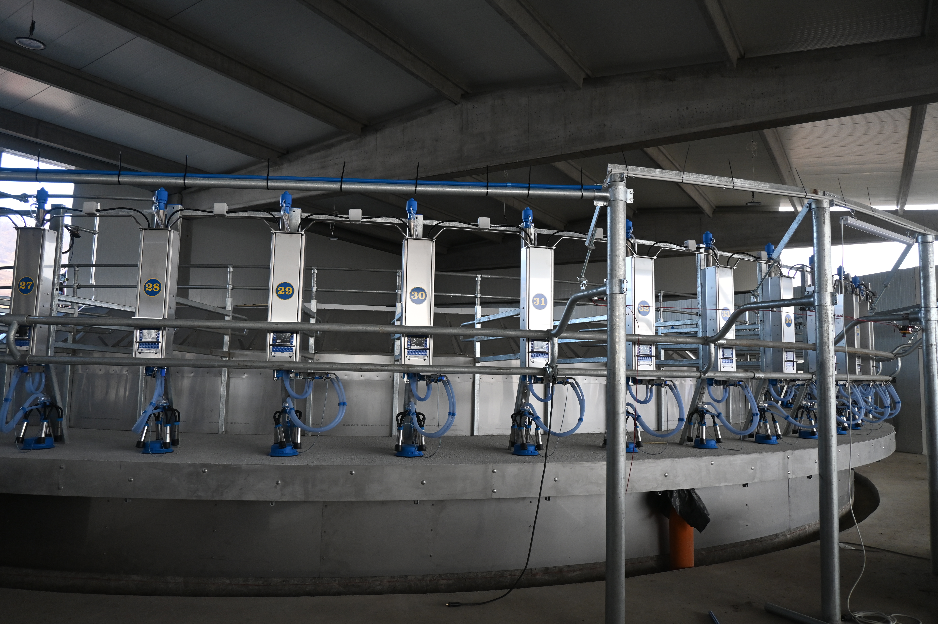
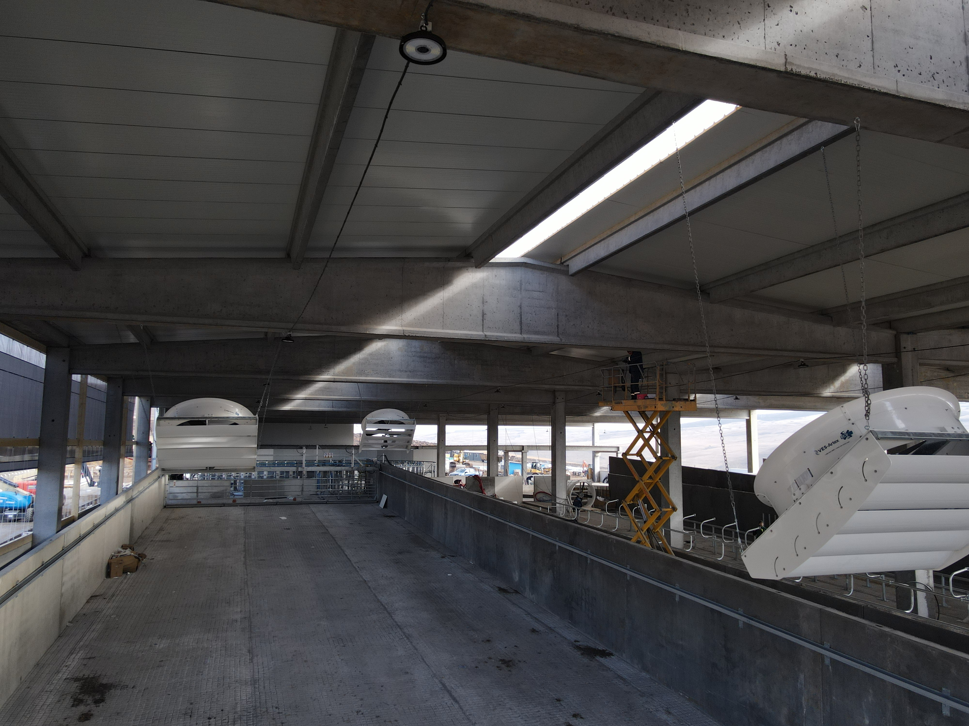
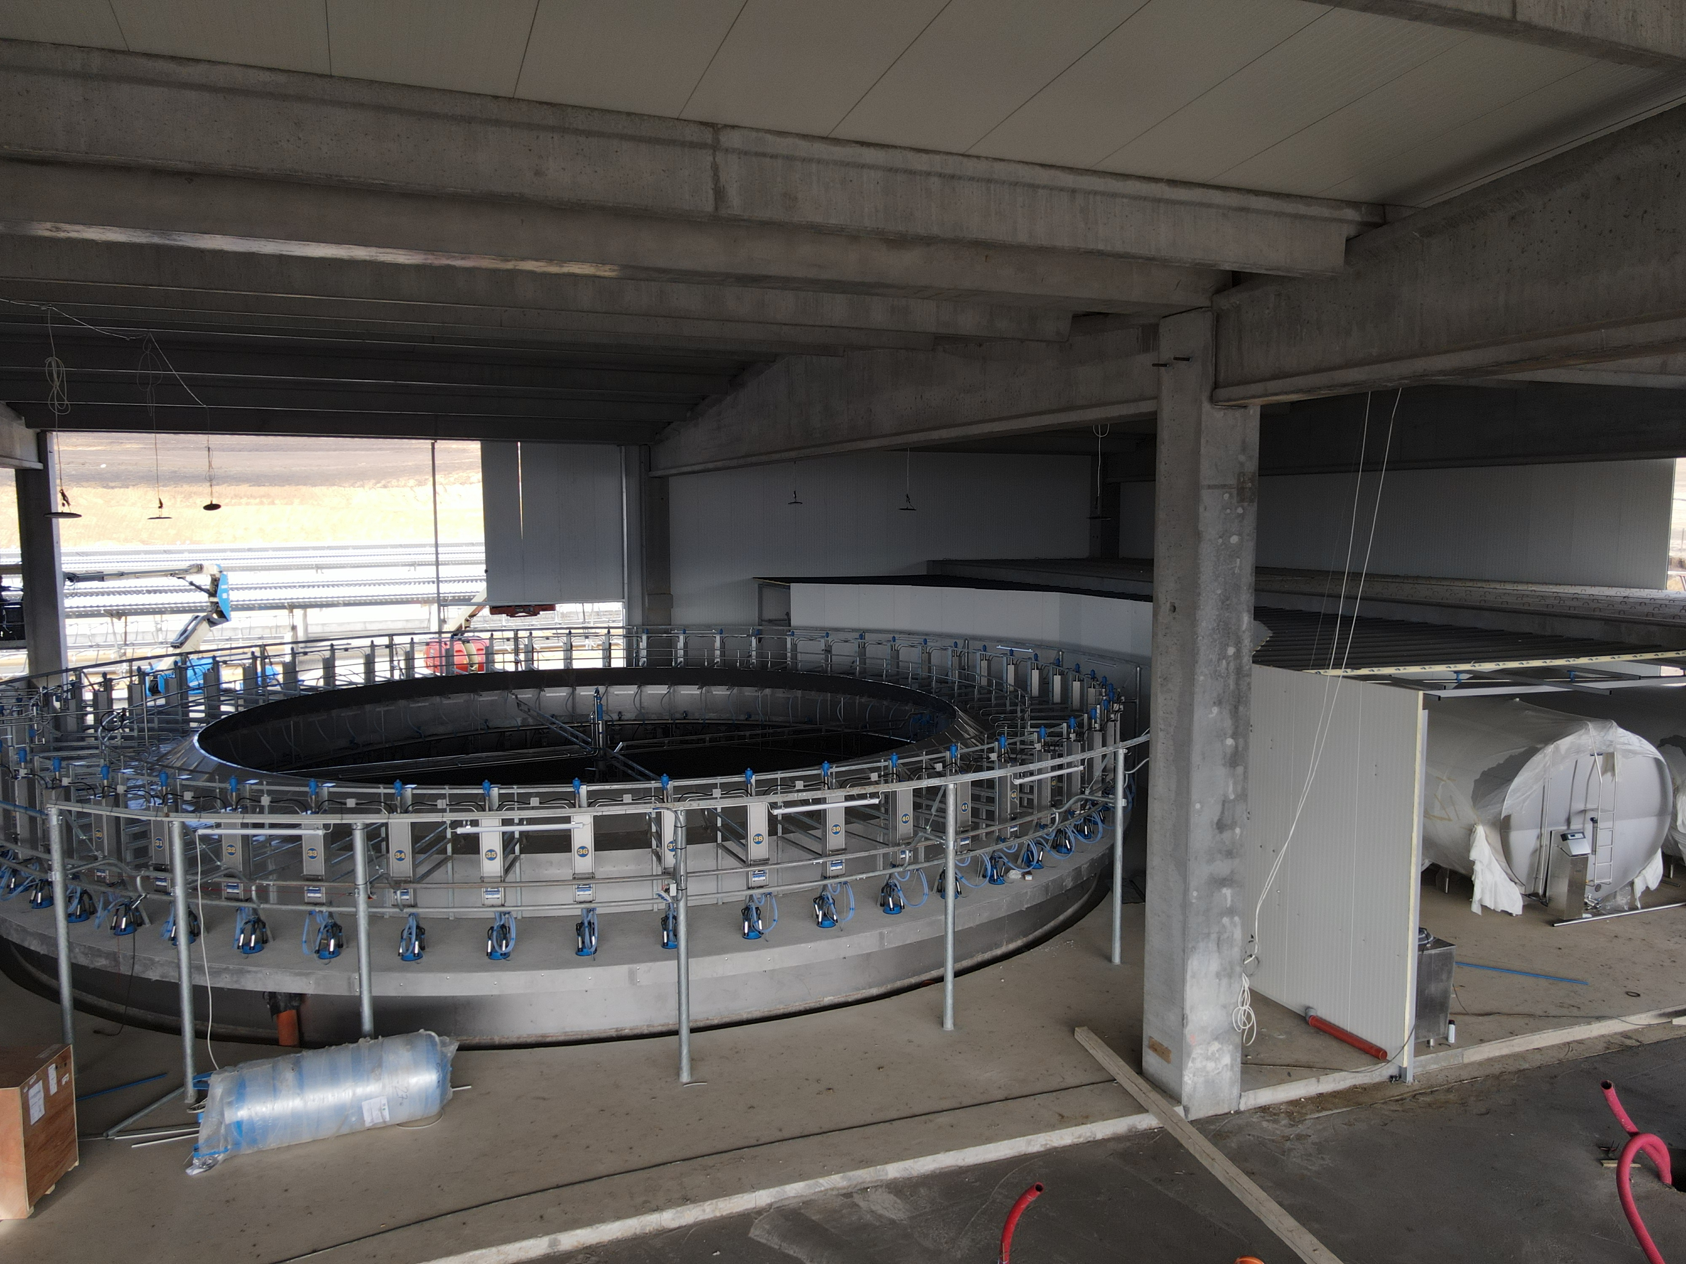
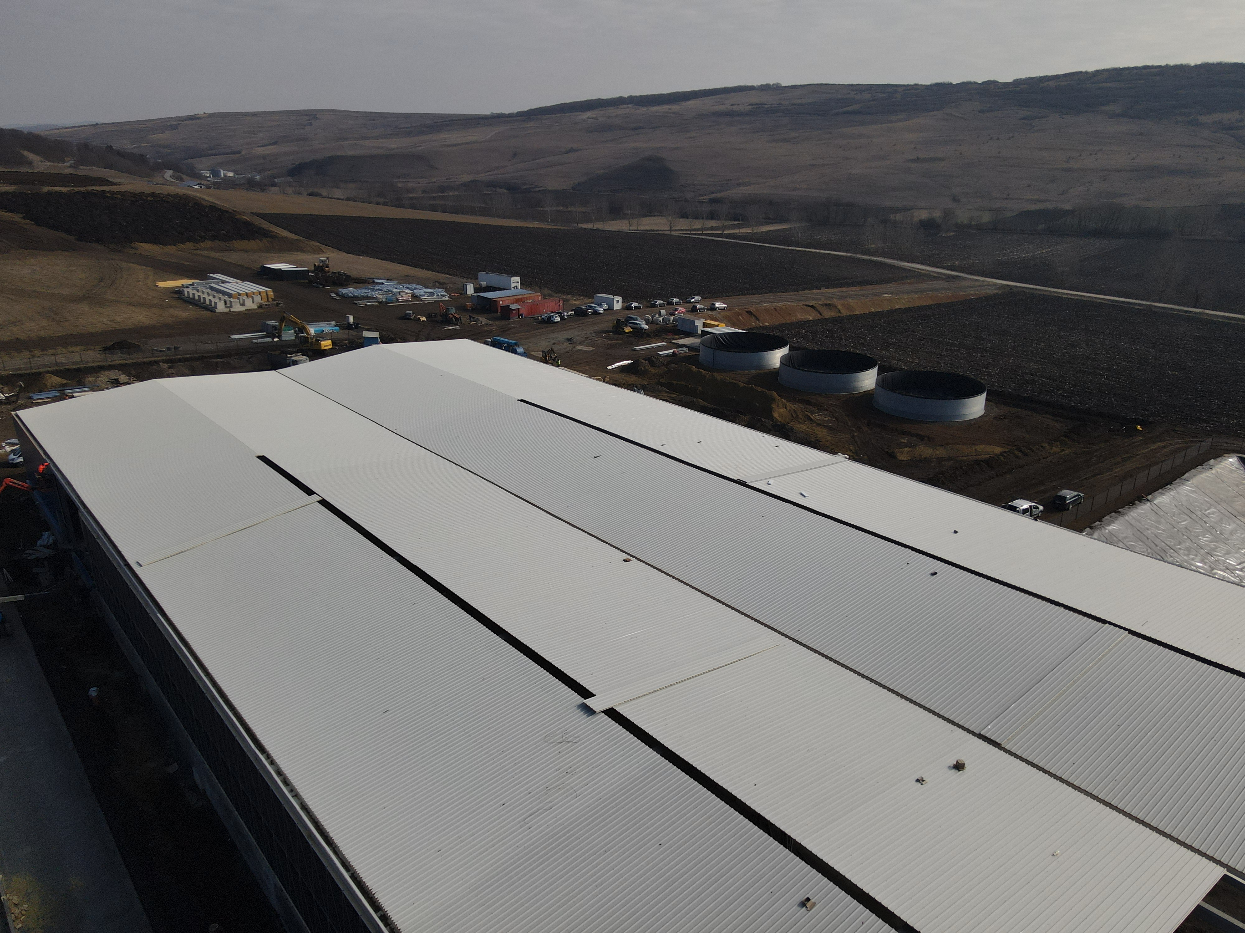
STRAJA PROJECT CURRENT STATUS

Slide 22
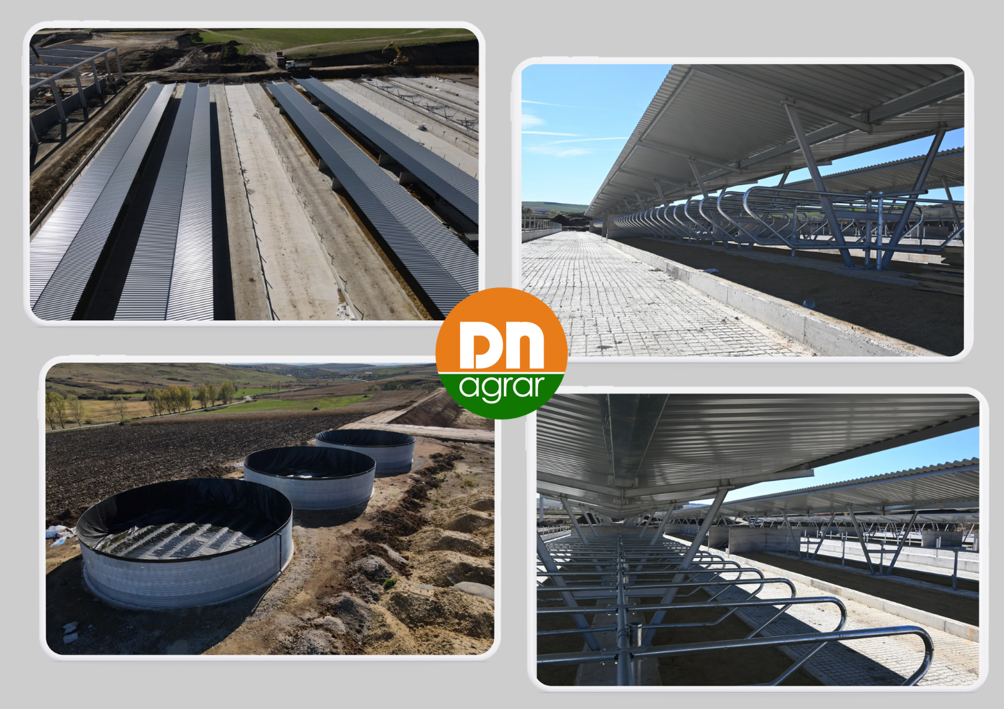
STRAJA PROJECT CURRENT STATUS

Slide 23
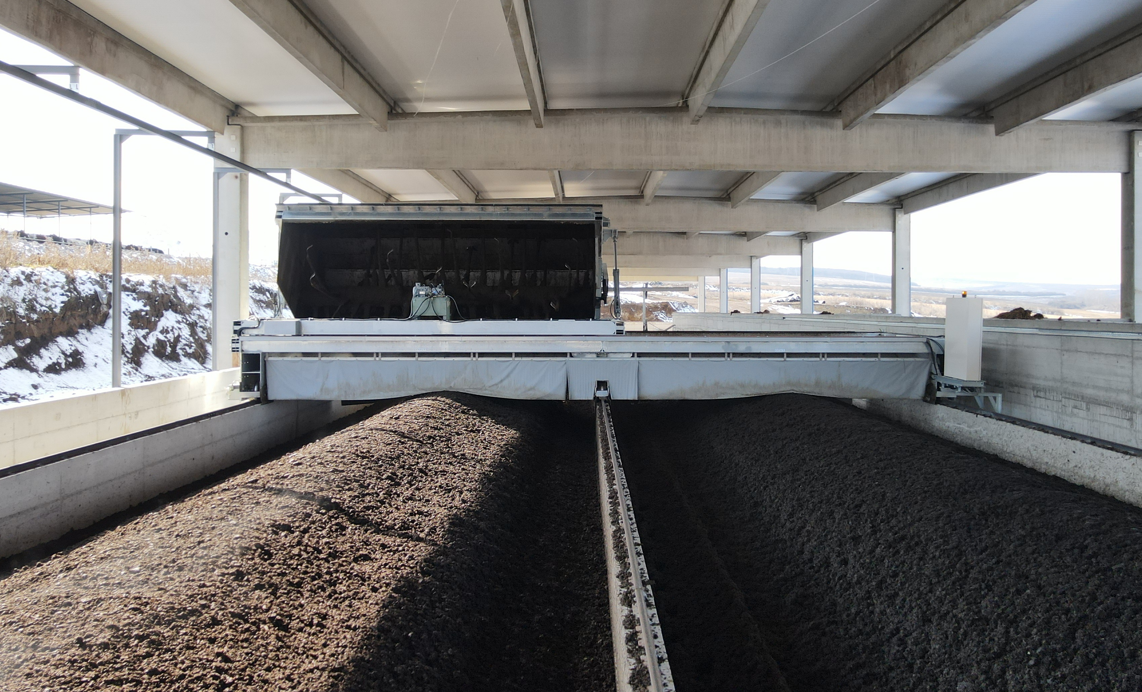
COMPOST FACTORY TO STRENGTHEN THE CIRCULAR ECONOMIC MODEL
Operational Highlights
Integrated organic waste management system
Operations started in November 2024
21,000 tons of manure processed annually
Production of over 7,000 tons of organic fertilizer
Use the organic fertilizers produced for internal needs and to sell outside the Group
The process of certifying fertilizers as organic typically takes 3 - 6 months
Investment of EUR 1.8 million
The project addresses two major challenges:
1. efficient manure management and improved soil fertility
2. contribution to the reduction of greenhouse gas emissions
Further Developments
In parallel with the start of operations, the process of obtaining voluntary carbon certification for the produced compost has been initiated
It is estimated that by the end of 2026, the first carbon credits will be obtained
Build the sales channel to develop the business line
Advance with the certification process to achieve the international "Gold Standard" accreditation for carbon credit
23

Slide 24
BIOMETHANE PRODUCTION FOR AN INTEGRATED SUSTAINABLE STRATEGY
Operational Highlights
Production facility with a total capacity of up to 20 MW
DN AGRAR will supply the raw material for the biomethane production
BSOG Energy will develop the production facility
Cooperation agreement for the largest biomethane production facility in Romania with BSOG Energy
This project aligns with DN AGRAR’s mission
to lead sustainable agriculture.
Further Developments
Project execution is expected to take over 2 years from the signing of the final agreement
The overall investment in the facility is estimated to around EUR 30 million
Based on a 15-year contract of approx. 50 million EURO, the expected yearly revenues for DN AGRAR will be between EUR 3 - 3.5 million
By implementing biomethane, composting, and solar panel sustainability projects, DN AGRAR aims to significantly reduce its carbon footprint and be close to net-zero emissions in 2030.
Project initiated at the beginning of 2024
24

Slide 25
STATUS OF CURRENT PROJECTS
Automation and Energy Diversification
Obtaining voluntary certification
for the compost produced
In parallel with the start-up of the compost plant, we have embarked on an ambitious project to obtain voluntary certification for the compost produced.
This process will be carried out in a 5-year period.
After 2 years, the certificates can be traded.
Obtaining voluntary
carbon reduction
Allowances
The project aims to cover a significant area of land, and contracts
will be signed for the land
included in the program to achieve this goal.
Estimates indicate a carbon reduction of
approximately 5,000 tons of carbon emissions per year, a remarkable performance achieved through the
implementation of modern technologies and sustainable
farming practices.
In 2025, the produced fertilizer will be used both for testing and optimizing the certification as organic fertilizer, as well as to selling it outside the group.

Slide 26
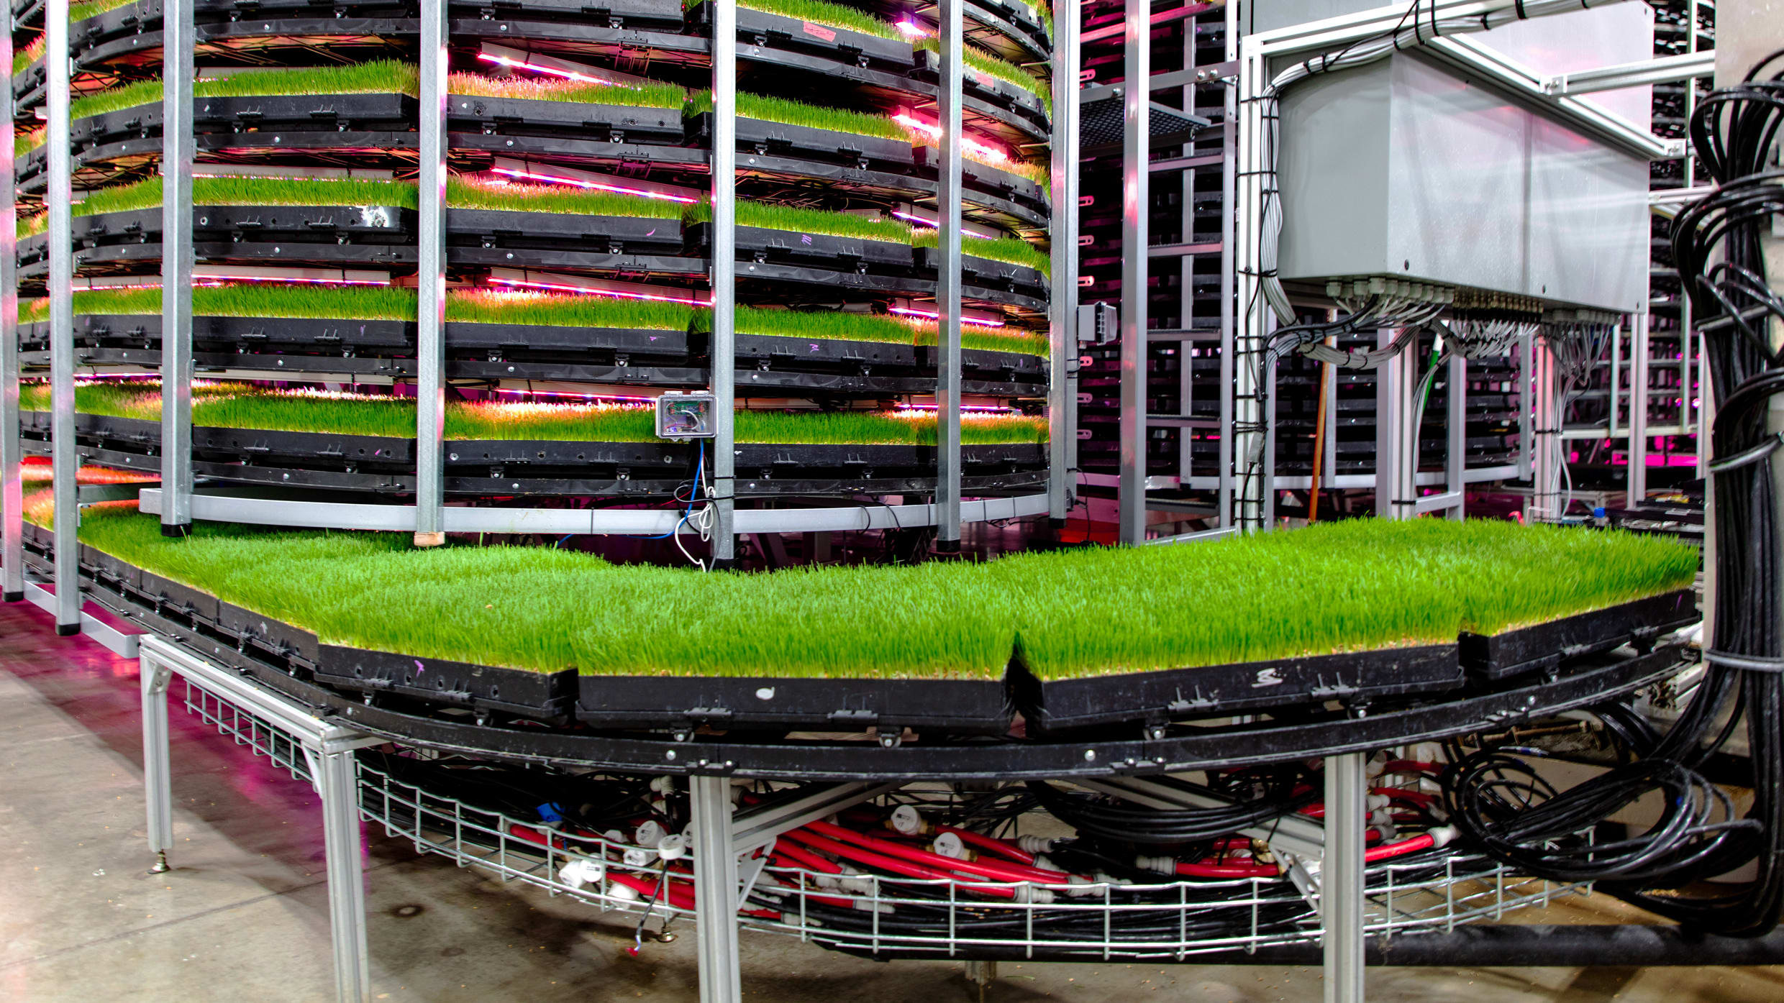
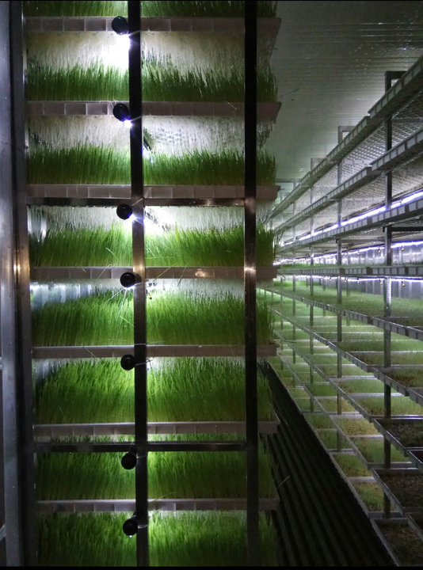
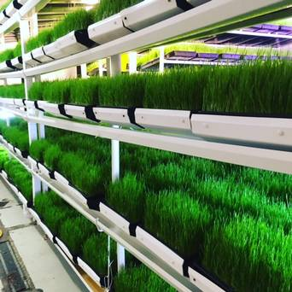
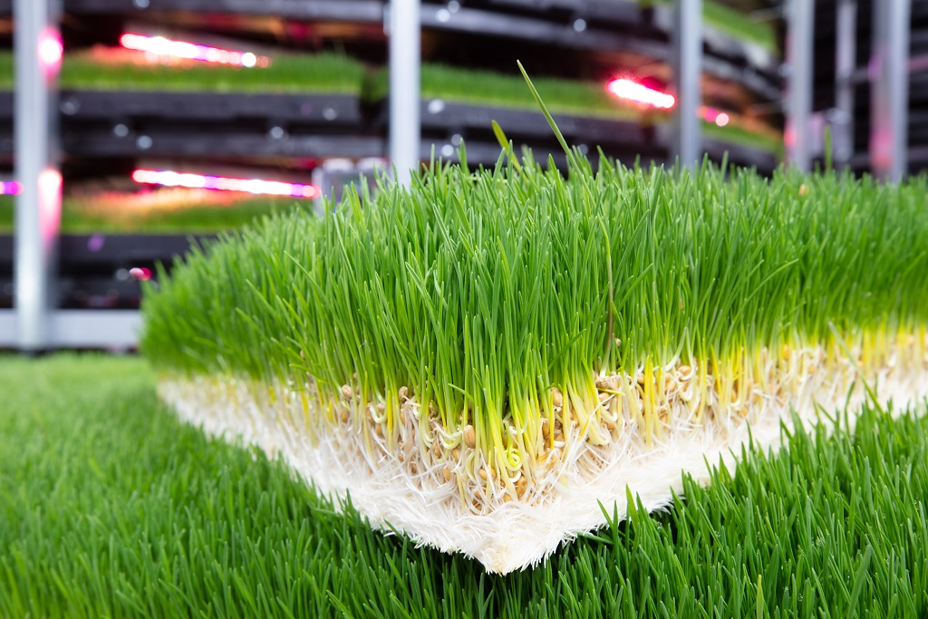
FUTURE PLANS under analysis
Vertical Farming
Under analysis
Advantages:
Year-round production
Climate and weather agnostic
More efficient use of space
Urban farming
Lower labor costs
Minimal water use
No soil degradation
No usage of pesticides or herbicides
The two leading challenges of vertical farming include:
Energy Dependency
Advanced, Technical Knowledge Needed

Slide 27
NEW STRATEGIC INVESTMENTS PLANNED FOR 2025
New Compost Factory at Lacto Agrar Farm
Solar panels with an installed capacity of 2,218 kW
Investment of EUR 1.7 million
Investment of approx. EUR 1.7 million
Second composting unit within the Group
Start in 2025, operational by Q4 2025
Annual capacity: 7,000 tons of organic fertilizer
Total production increase to 14,000 tons annually from 2026
Organic certification and carbon emissions reduction (32,000 carbon credits annually)
The investment aims to install solar panels on the rooftops of farms located at Apold, Lacto Agrar, and Cut (DN AGRAR Service)
Planned to be made in 2025, the installation is scheduled for Q2 2025
In the second phase, the farms will also be equipped with storage batteries to enhance further the efficiency brought
We estimate that through this project we will become completely energy independent for our Lacto Agrar, Cut and Apold farms
These projects will be financed through a combination of European funds and bank loans.
Subject to the approval of the EGMS from March 25th.

Slide 28
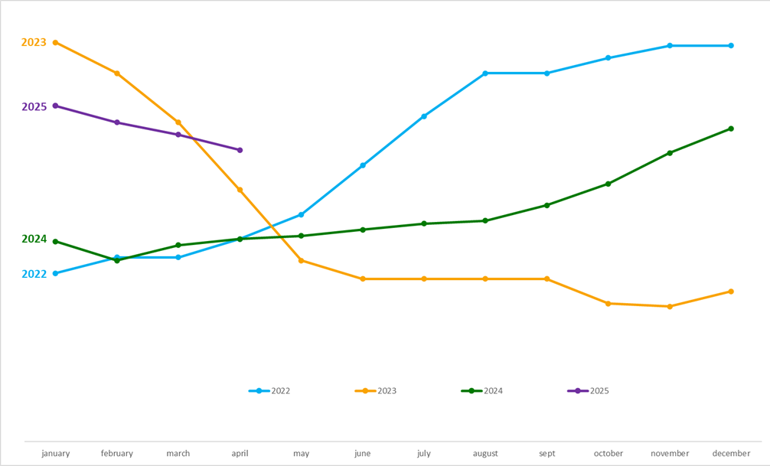
Q1 2025 OUTLOOK ON MILK MARKET EVOLUTION
DN’s milk price evolution
In the context of the evolution of the milk market, in the first quarter of 2025, DN AGRAR benefited from a significant increase in the price of the milk sold, compared with the similar period of 2024.

Slide 29
RAINFALL 1ST OCTOBER – 1ST MARCH

Slide 30
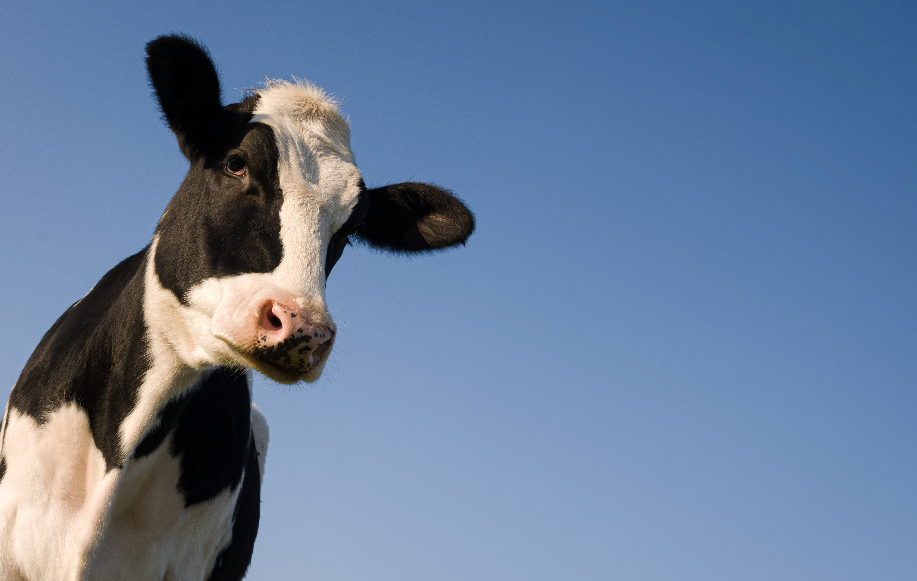
CONTACT INVESTOR RELATIONS
Peter de Boer,
BoD Member & Investor Relations Manager
investors@dn-agrar.eu , +40 258 818114

Slide 31
QUESTIONS
Are there plans to transition to the main market and attract institutional investors and pension funds?
Do you intend to build a dairy products factory?

Slide 32
STRATEGY 2030
New significant investments that will become operational until 2030
Updated scenarios
Strategy Presentation will be announced

Slide 33
FUTURE EVENTS
25th of March
EGMS
Beginning of April
Presentation of the Strategy by 2030
Approval for the financing of new investments
DN AGRAR will publish the updated strategy, including the working scenarios
29th of April
Annual GMS
30th of
April
2024 Annual Report
publication
Beginning of
May
2024 ESG Report
publication
22nd of May
Q1 2025 Results
26th of May
Q1 2025 Results
Teleconference

