Slide 1
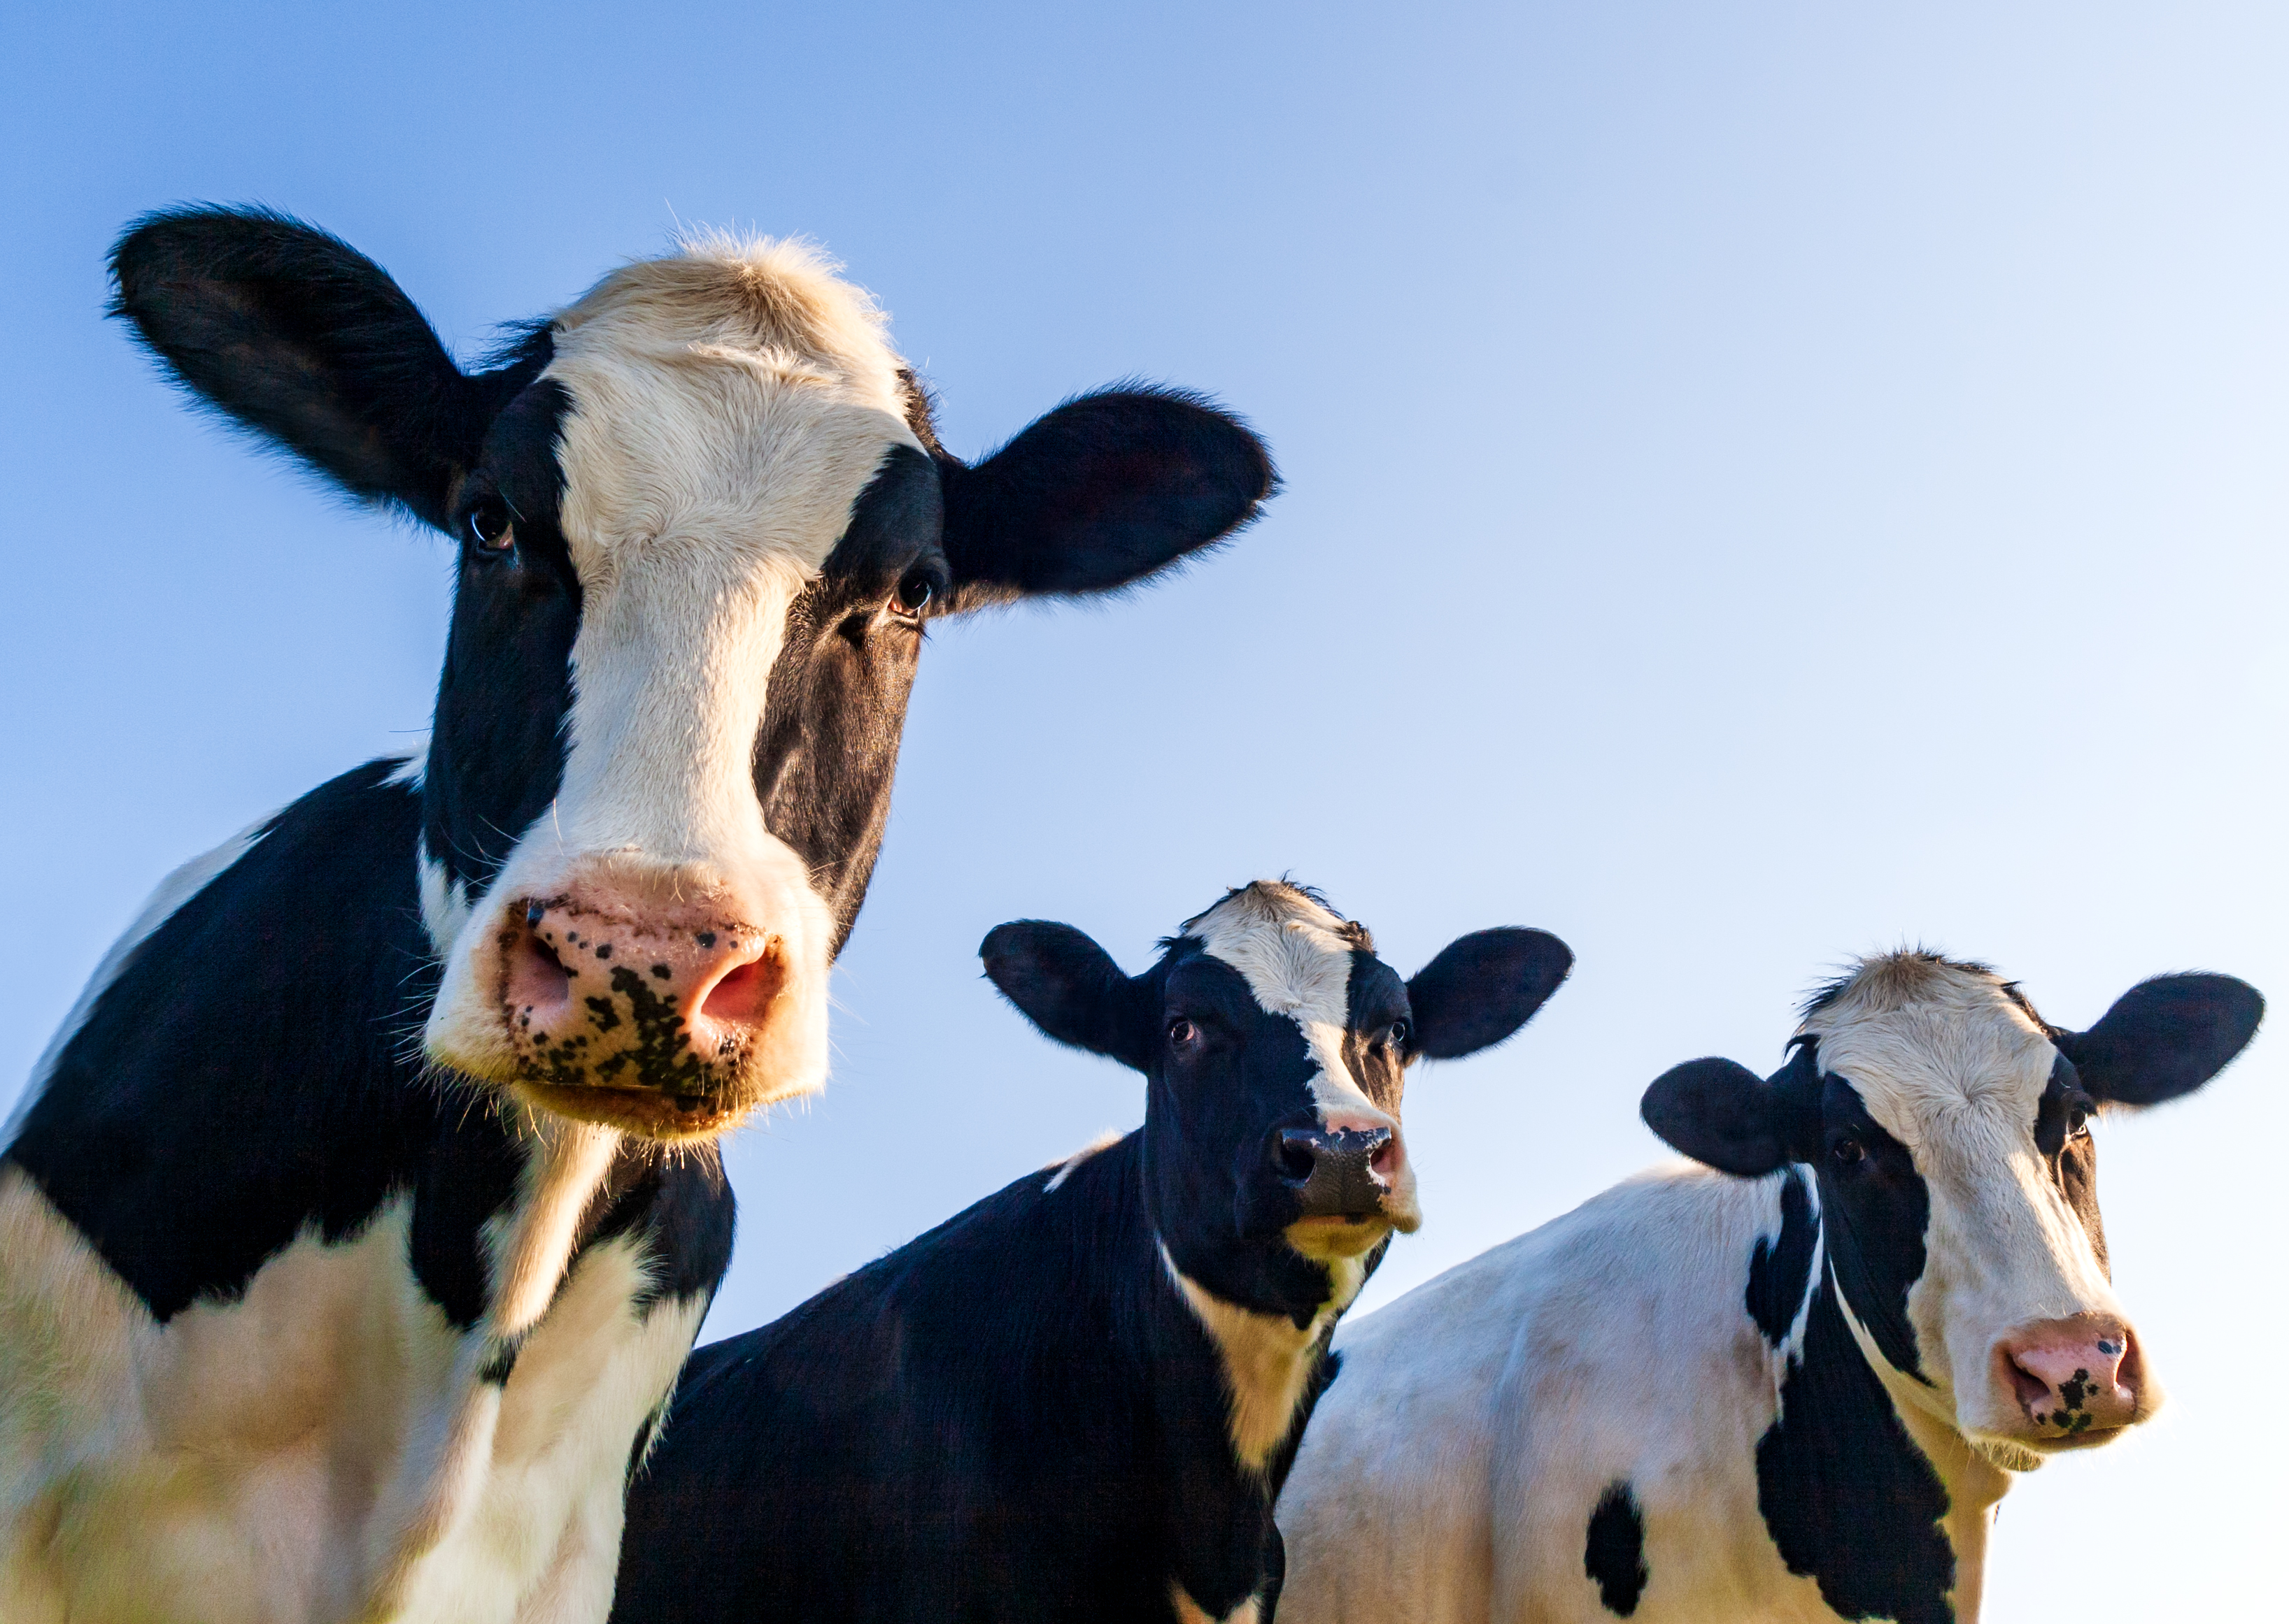
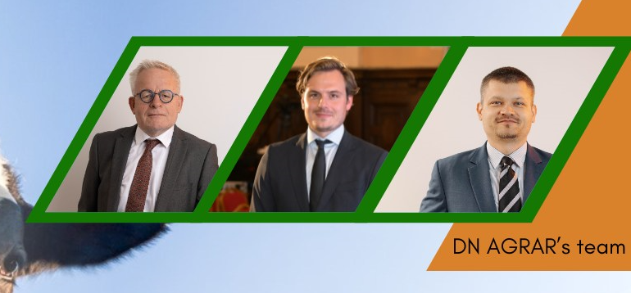
Presentation Financial Results
9M 2024
- November 2024 -

Slide 2
CONTENT
ABOUT DN AGRAR
9M 2024 FINANCIAL RESULTS
OPERATIONAL ACTIVITY
DN AGRAR STRATEGY & PROJECTS

Slide 3
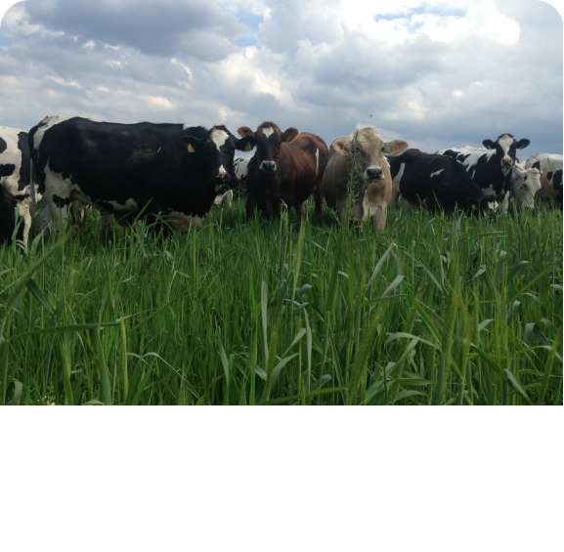
DN AGRAR - AN OUTSTANDING GROWTH STORY
One of Europe’s leading milk producers and the largest integrated zootechnical farm in Romania, with cow milk production and vegetable production.
Market
Position
Tripled its business since listing
Consistent Growth in EBITDA
~ 60 million liters of milk delivered annually
Track
Record
Strategy
To double again the business by 2027 supported by operation efficiencies and the development of a new farm.
Target 2028: over 100 million liters of milk produced and delivered annually.
Focus on sustainable, regenerative agriculture practices that maximize productivity, reduce environmental impact, and ensure long-term profitability.
Sustainable
Agriculture
3

Slide 4
DN AGRAR FARMS LEADING ROMANIAN MILK PRODUCTION
~ 60 million liters of milk are delivered annually
APOLD FARM
CUT FARM
6,100 dairy cattle & young stock
63,000 liters/day
400 cows milked/hour
2,200 dairy cattle
45,000 liters/day
300 cows milked/hour
LACTO AGRAR FARM
PRODLACT FARM
4,000 dairy cattle & young stock
53,000 liters/day
350 cows milked/hour
2,400 young stock animals
Raising young cattle for Apold and Cut farms
4

Slide 5
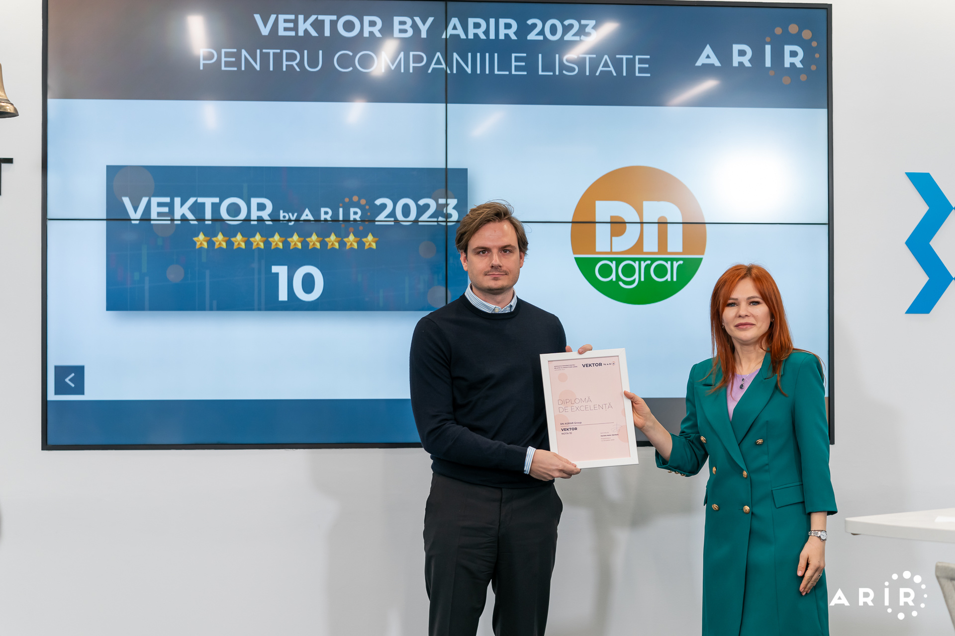
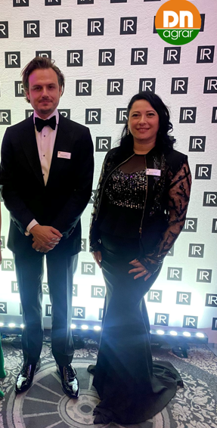
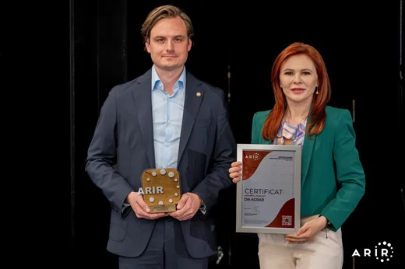
ACTIVITY IN THE CAPITAL MARKET RECOGNIZED INTERNATIONALLY
Listed on the Bucharest Stock Exchange, AeRO market since February 2, 2022
Market capitalization of EUR ~50 mil
The company with the largest weight in the BETAeRO index
Shares included in the MSCI Frontier Small Cap and MSCI Romania Small Cap indices
2 analysts covering the share, both highlighting an upside
10 at VEKTOR by ARIR evaluation
DN AGRAR has been nominated for IR Magazine Europe Awards 2024
DN AGRAR became ARIR's Associate Member
Performance recognized at GALA BY ARIR 2024 with the following awards:
Best IR Department
Best Annual Report
Best Company Representative in the Capital Market
Best ESG Performance & Communication
Recognition
Analysts covering DN share – latest updates
Prime Transaction – October 21, updated target price 1.7683 RON
BRK Financial Group – August 7, updated target price 1.746 RON, BUY recommendation

Slide 6
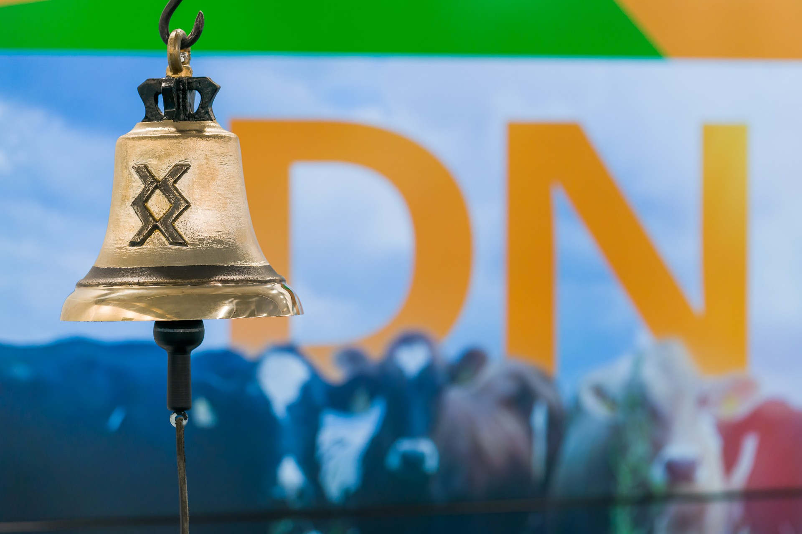
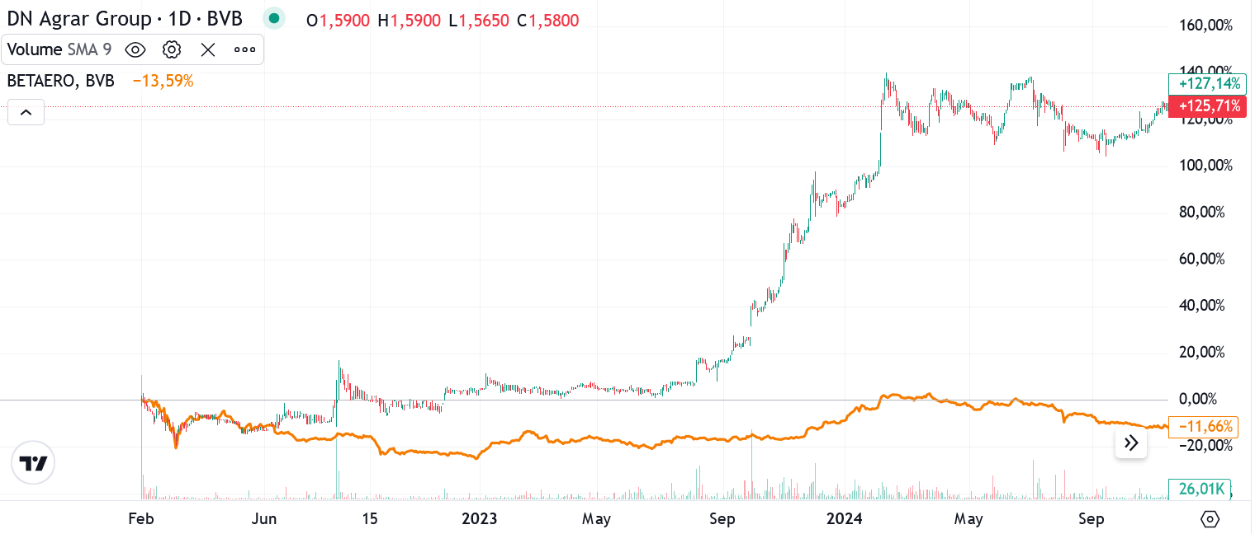
STRONG PERFORMANCE IN THE CAPITAL MARKET
Strong Share Performance
+125% share price performance vs listing*
+53% share price performance YOY** (Sept 2024 vs Sept 2023)
Top 3 performances YOY**
Shareholders Evolution
117
shareholders
3,000
shareholders
2022
2024
*considering the closing price from 18.11.2024
**Sept 2024 vs Sept 2023

Slide 7
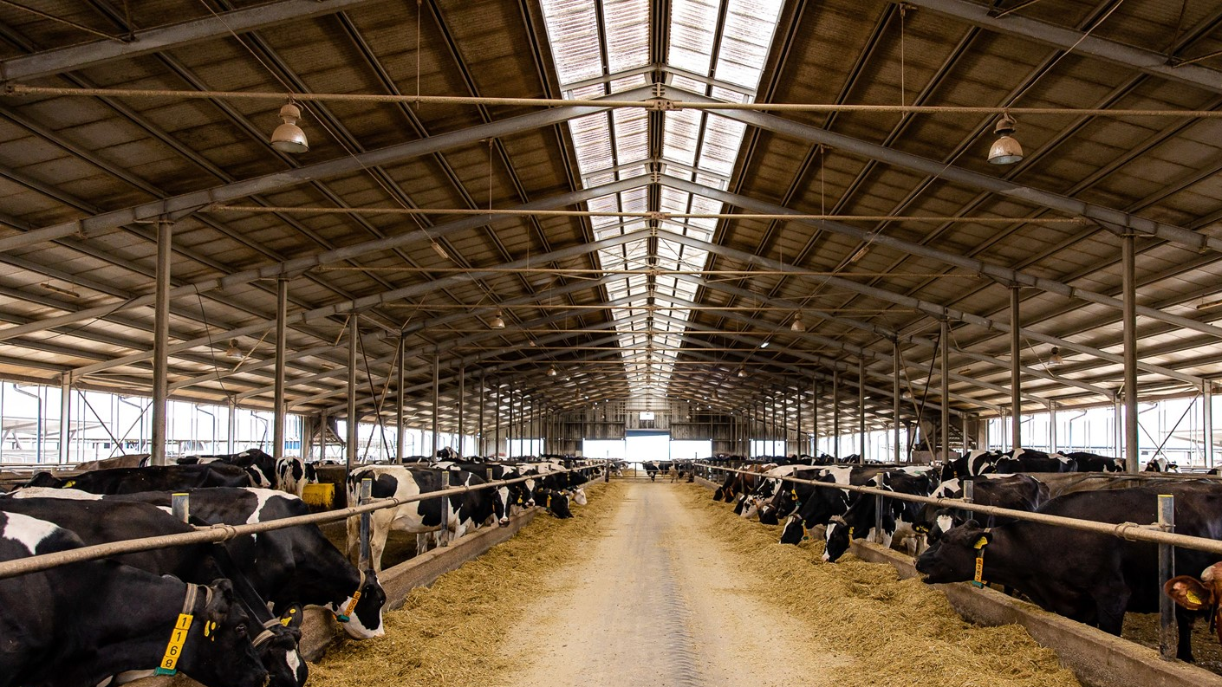
9M 2024 RESULTS & OUTLOOK

Slide 8
9 MONTHS RESULTS – CONTINUED STRENGTHENING OF EBITDA
TURNOVER
NET PROFIT
EBITDA
RON 126.79 mil.
+9.32%
Vs 9M 2023
RON 21.08 mil.
-5.65%
Vs 9M 2023
RON 50.02 mil.
+7.59%
Vs 9M 2023
NET ASSETS
TOTAL ASSETS
EQUITY
RON 258.39 mil.
+11.73%
Vs 31.12.2023
RON 343.78 mil.
+11.64%
Vs 31.12.2023
RON 154.22 mil.
+15.66%
Vs 31.12.2023

Slide 9
FACTORS THAT INFLUENCED THE 9 MONTHS RESULTS
Increase in turnover by 9%
The increase of expenses related to raw materials by 5%
Current result adjustments
Granting subsidies that decreased by 8%
The increase of personnel expenses by 10%
The increase in corporate income tax expenses by 23%
Increase in revenue from production of tangible fixed assets
The increase in depreciation by 20%
9

Slide 10
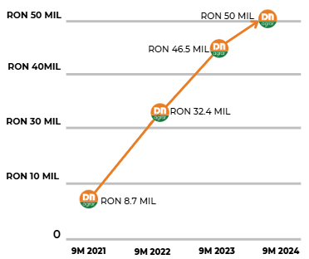
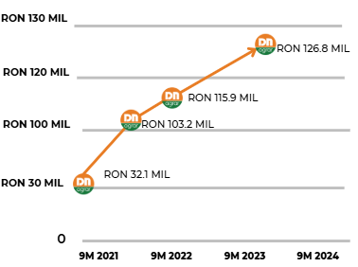
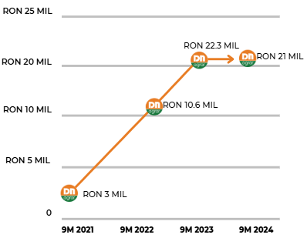
KEY PERFORMANCE INDICATORS EVOLUTION - CONTINUED GOWING
TURNOVER
EBITDA
NET PROFIT

Slide 11
FINANCIAL RESULTS HIGHLIGHTS 9 MONTHS 2024
PROFIT AND LOSS ACCOUNT (RON) | 30/09/2024 | 30/09/2023 | ∆%
OPERATING INCOME – TOTAL | 193,492,036 | 180,897,789 | 6.96%
OPERATING EXPENSES – TOTAL | 161,949,913 | 147,741,472 | 9.62%
OPERATING PROFIT OR LOSS | 31,542,122 | 33,156,316 | (4.87)%
FINANCIAL INCOME – TOTAL | 864,875 | 1,714,238 | (49.55)%
FINANCIAL EXPENSES – TOTAL | 6,556,988 | 8,329,025 | (21.28)%
FINANCIAL PROFIT OR LOSS | (5,692,113) | (6,614,787) | (13.95)%
GROSS PROFIT OR LOSS | 25,850,009 | 26,541,529 | (2.61)%
GROUP NET PROFIT OR LOSS | 21,077,699 | 22,339,132 | (5.65)%
Operating revenues amounted to RON 193 million, an increase of 7% compared to the same period last year.
Operating expenses increased by 10% as of September 30, 2024, reaching RON 162 million. The main contribution came from expenses related to value adjustments for tangible and intangible assets, which amounted to RON 19 million, a 20% increase compared to the same period last year.
Revenues from the production of tangible fixed assets saw a 136% increase, reaching RON 14 million. This growth occurred as a result of the registration of young dairy cows, which entered the milk production process, as fixed assets.

Slide 12
THE MAIN ELEMENTS OF THE BALANCE SHEET
Equity increased by 16% compared to December 31, 2023, reaching RON 154 million. This increase was driven by the recording of a net profit of RON 21 million as of September 30, 2024.
Long-term liabilities registered an increase compared to the end of 2023, so as of September 30, 2024, the balance of long-term liabilities reached RON 103 million.
Provisions decreased by 96% compared to the end of 2023, reaching RON 17 thousand as of September 30, 2024.
Compared to the end of 2023, there was an increase in long-term loans contracted from Exim Bank by RON 25 million, a 226% rise, as a result of a financing agreement of EUR 9.2 million, contracted in April 2024 for the construction project of the DN AGRAR Straja farm, as well as a refinancing carried out for the loans from ING Bank.
BALANCE SHEET INDICATORS (RON) | 30/09/2024 | 31/12/2023 | ∆%
FIXED ASSETS - TOTAL | 235,554,061 | 212,141,058 | 11.04%
CURRENT ASSETS - TOTAL | 105,722,073 | 94,362,606 | 12.04%
DEFERRED EXPENSES | 2,507,418 | 1,441,310 | 73.97%
TOTAL ASSETS | 343,783,552 | 307,944,974 | 11.64%
DEBTS: AMOUNTS TO BE PAID WITHIN UP TO ONE YEAR | 85,248,150 | 76,397,539 | 11.58%
DEBTS: AMOUNTS TO BE PAID IN MORE THAN ONE YEAR | 102,538,384 | 95,954,744 | 6.86%
PROVISIONS | 16,815 | 385,892 | (95.64)%
DEFERRED REVENUES | 1,762,560 | 1,867,001 | (5.59)%
DEBT - TOTAL | 187,786,534 | 172,352,283 | 8.96 %
EQUITY - TOTAL | 154,217,643 | 133,339,798 | 15.66%
TOTAL EQUITY AND DEBT | 343,783,552 | 307,944,974 | 11.64%

Slide 13
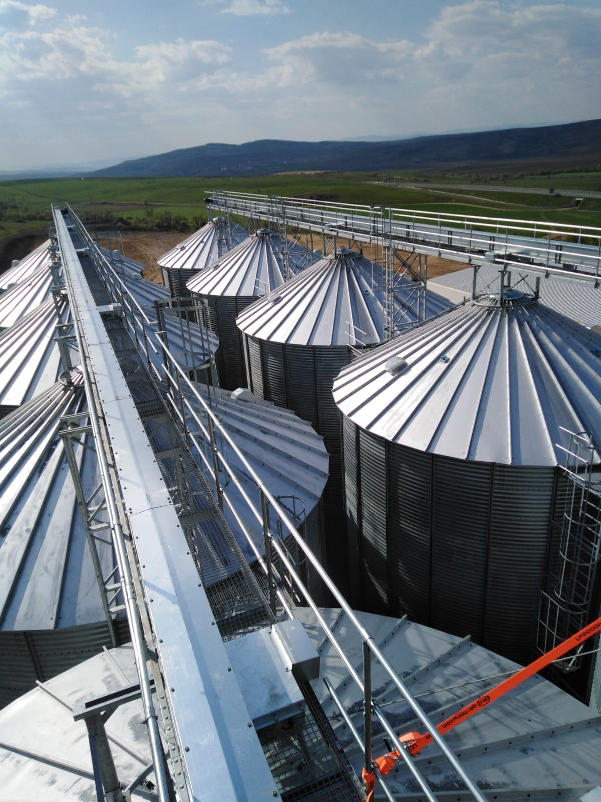
OPERATIONAL
ACTIVITY

Slide 14
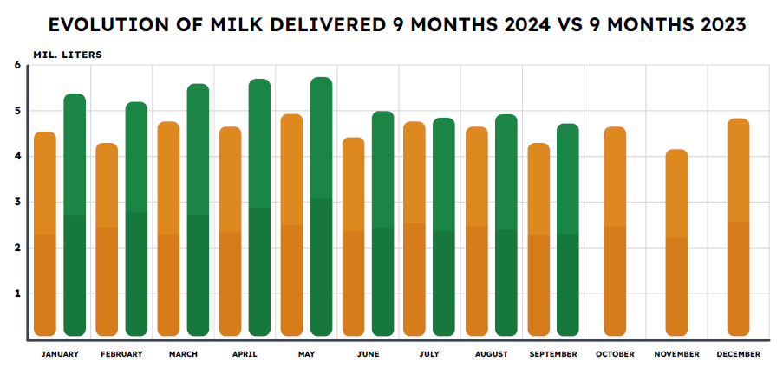
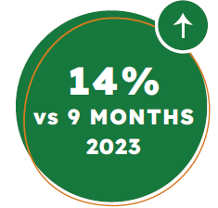
CONSISTENT GROWTH IN MILK DELIVERIES
🐄 By maintaining a sustained pace of production and delivery, we recorded a monthly average of 5 million liters of milk deliveries in the first 9 months of this year.
🐄 60 million liters of milk to be delivered in 2024.
14

Slide 15
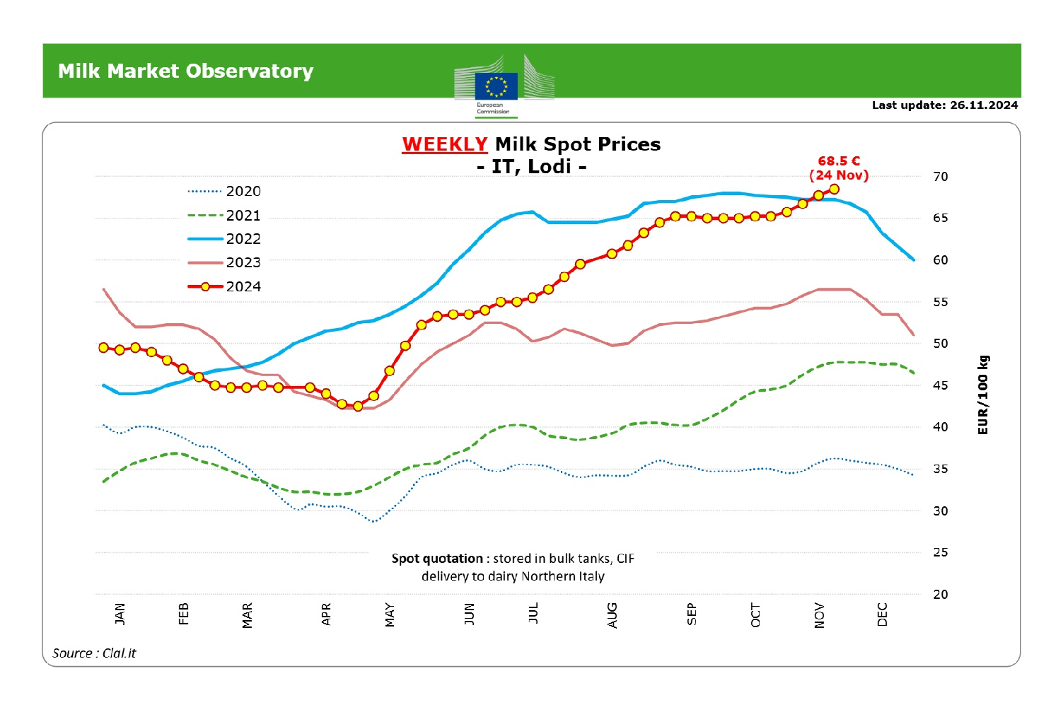
EUROPEAN MILK MARKET & OUTLOOK 9M 2024
European milk market
as of Aug 2024
as of Sept 2024
*https://agriculture.ec.europa.eu/data-and-analysis/markets/price-data/price-monitoring-sector/milk-and-dairy-products_en
*Source: https://agriculture.ec.europa.eu/

Slide 16
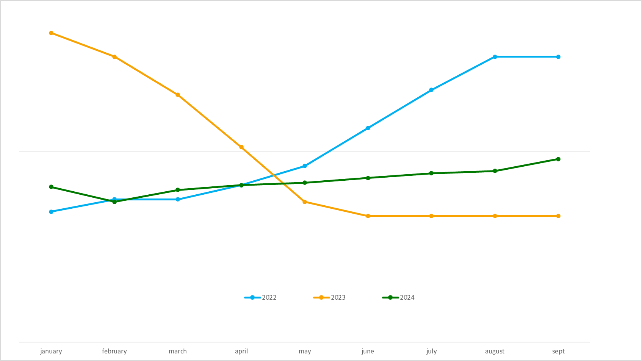
DN AGRAR MILK PRICE 9M EVOLUTION
Stabilization of prices as the market adjusts and stable demand

Slide 17
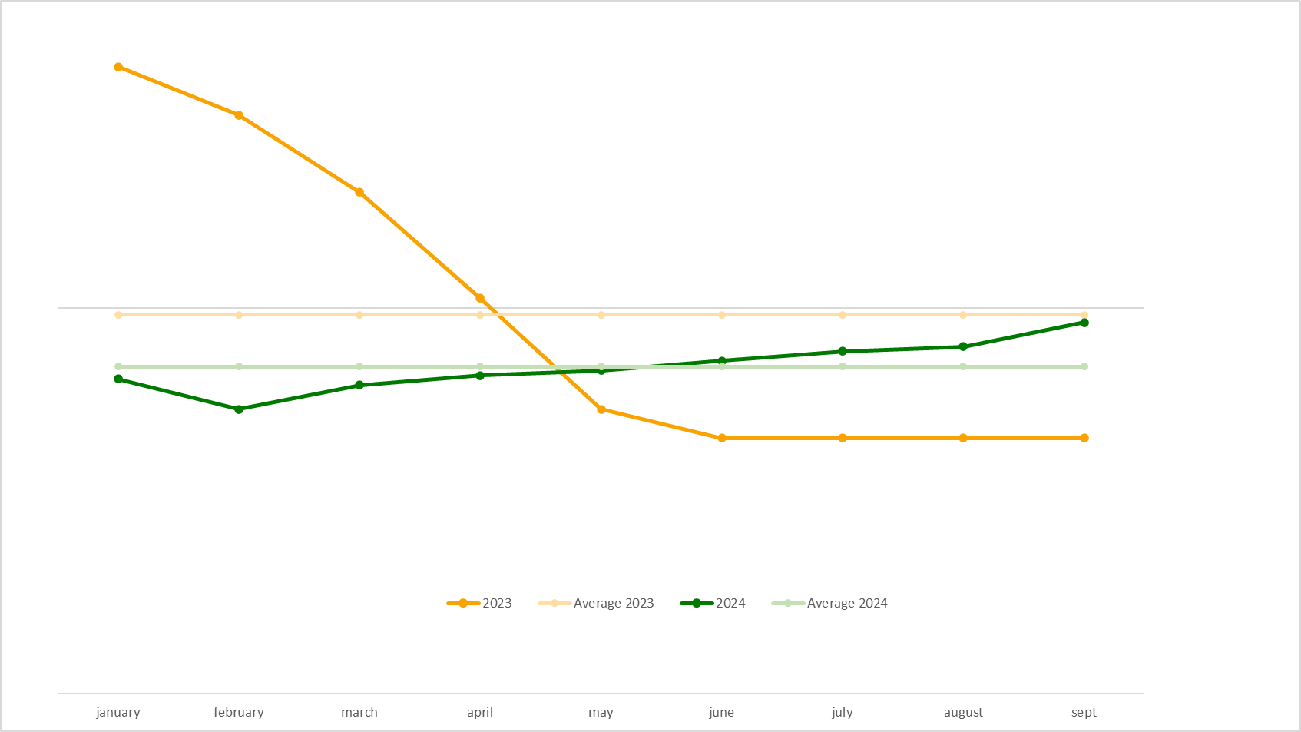
DN AGRAR MILK PRICE 9M EVOLUTION
Stabilization of prices as the market adjusts and stable demand

Slide 18
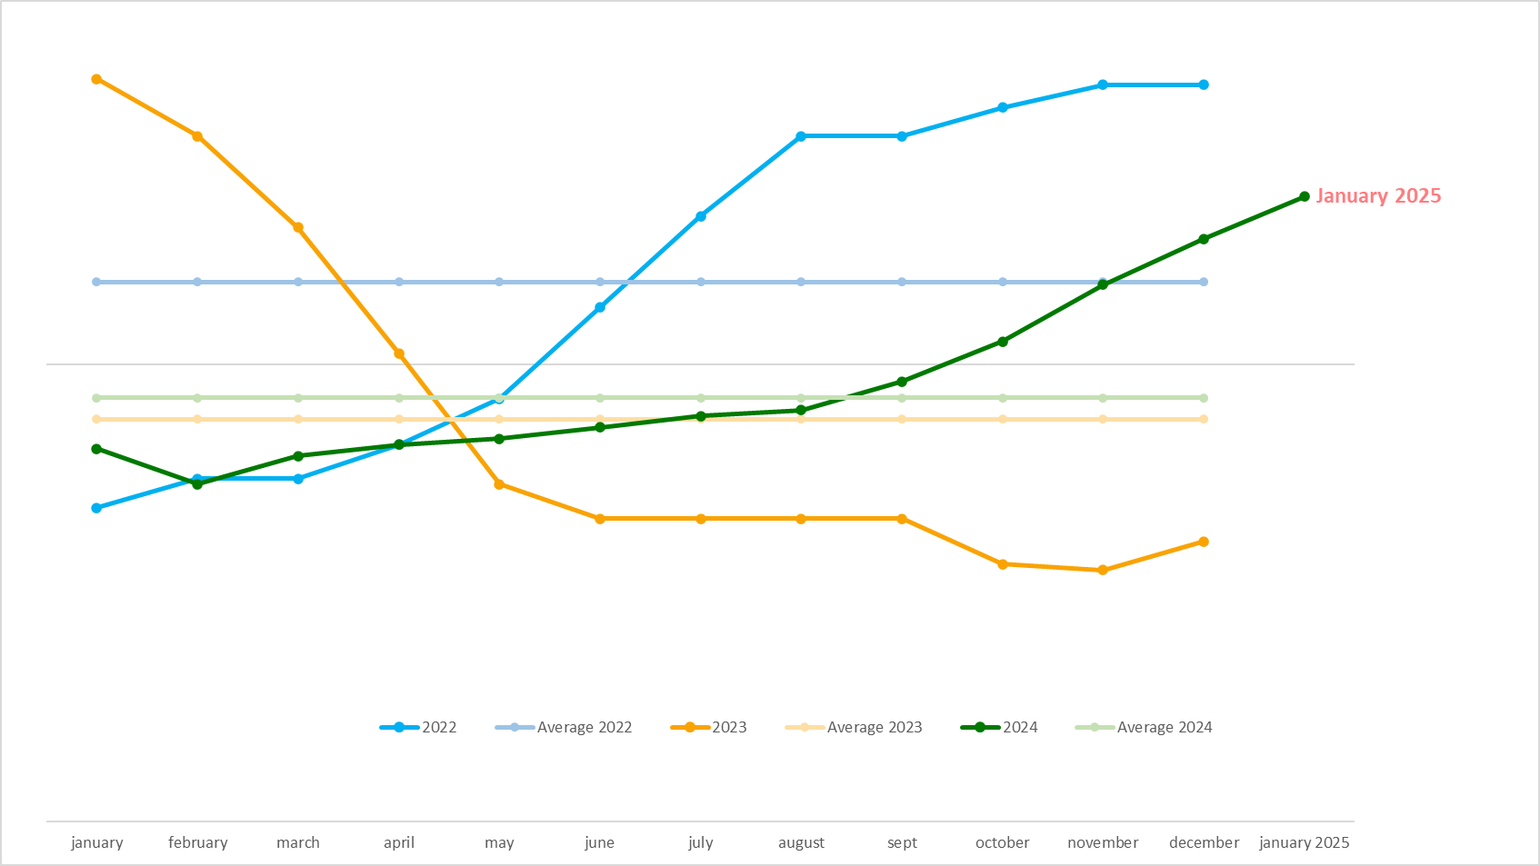
OUTLOOK OF DN AGRAR MILK PRICE
Stabilization of prices as the market adjusts and stable demand

Slide 19
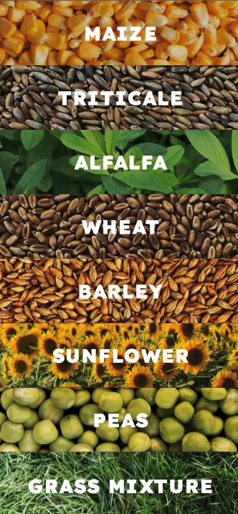
DN AGRAR CEREAL PRODUCTION EVOLUTION – SUSTAINABLE GROWTH
Lucerne:
580 ha harvested
4 harvests, with a production of 22,33 tons/ha
Triticale silage (main crop):
1500 ha harvested
Production of 31,27 tons/ha vs. 22,74 tons/ha in 2023 - increase of 38%
Maize silage (main crop):
1900 ha harvested
Production of 29 tons/ha vs. 24 tons/ha in 2023 - increase of 21%
The use of
No-tillage technology in the cultivation
process and its benefits
Protects the soil and
reduces erosion
Produces better quality soil
Saves insects and
Microorganisms
Contributes to the battle
against the climate changes

Slide 20
DN AGRAR
PROJECTS

Slide 21
DN AGRAR STRATEGIC VIEW BY 2027/ 2028
A Clear and Achievable Vision
Over 300.000 liters per day
The 4 farms will produce over 100 million liters of milk annually
A herd of approx. 20.000 dairy cows and young stock
Building a Major European Milk Producer
Straja farm project
to be finalized in 2027
Compost plant started operations in 2024
Biomethane facility planned
Strategic Projects

Slide 22
DN AGRAR FARMS 2027/2028
~ 100 million liters of milk will be delivered annually
STRAJA FARM
Acquisition FARM
3,800 dairy cattle
1,200 young stock
100,000 liters/day
600 cows milked/hour
………. dairy cattle
………. liters/day
………. cows milked/hour
APOLD FARM
CUT FARM
5,500 dairy cattle + young stock
100,000 liters/day
400 cows milked/hour
2,200 dairy cattle
50,000 liters/day
300 cows milked/hour
LACTO AGRAR FARM
PRODLACT FARM
4,000 dairy cattle + young stock
63,000 liters/day
350 cows milked/hour
Over 3,300 young stock animals
Raising young cattle for Apold and Cut farms

Slide 23
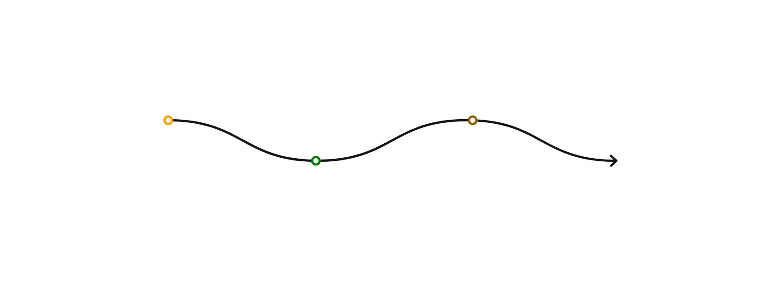
STRAJA PROJECT - A SIGNIFICANT EXPANSION IN PRODUCTION
2024: The foundation works were completed and part of the main hall, along with the waste storage lagoon
Key Highlights:
Started in 2023, planned to be completed in 2027
Capacity of 5,000 cows (3,800 dairy cows and 1,200 young stock)
Financed through credit facility and own sources
The first milking operations at the Straja farm are scheduled for the beginning of 2025
By this time, the farm will have 1,120 productive cows, and the first milking parlor will be fully operational
The foundation for the first rotary parlor was poured,
with installation scheduled for early December, and
progress has been made on the construction of
barns to hold 1,120 animals, which will be equipped
as work progresses.
This phase represents one-third of the total project.
2025: Approx. 1,700 cows in production & pregnancy
2026: Approx. 3,400 cows in production & pregnancy
2027: Approx. 5,000 cows in production & pregnancy

Slide 24
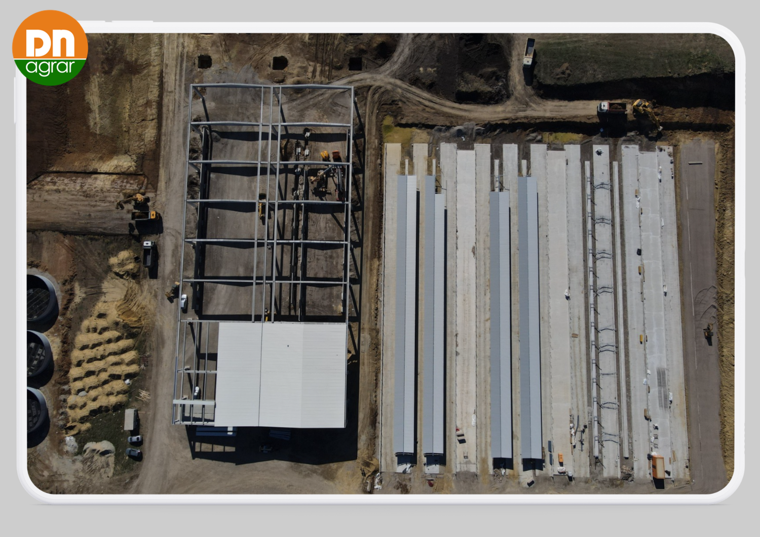
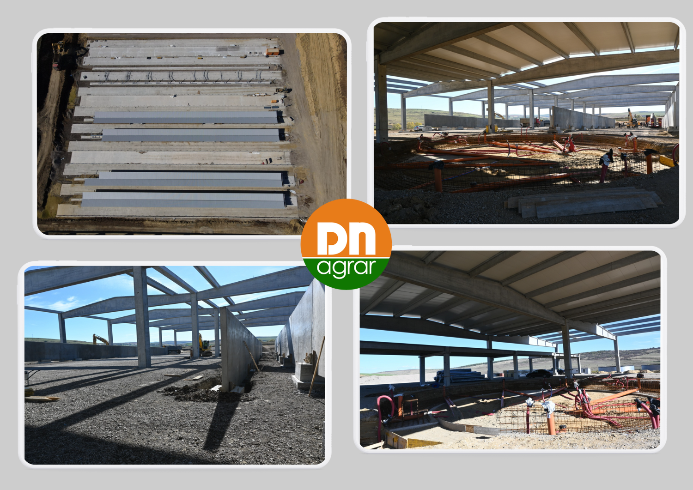
STRAJA PROJECT CURRENT STATUS

Slide 25
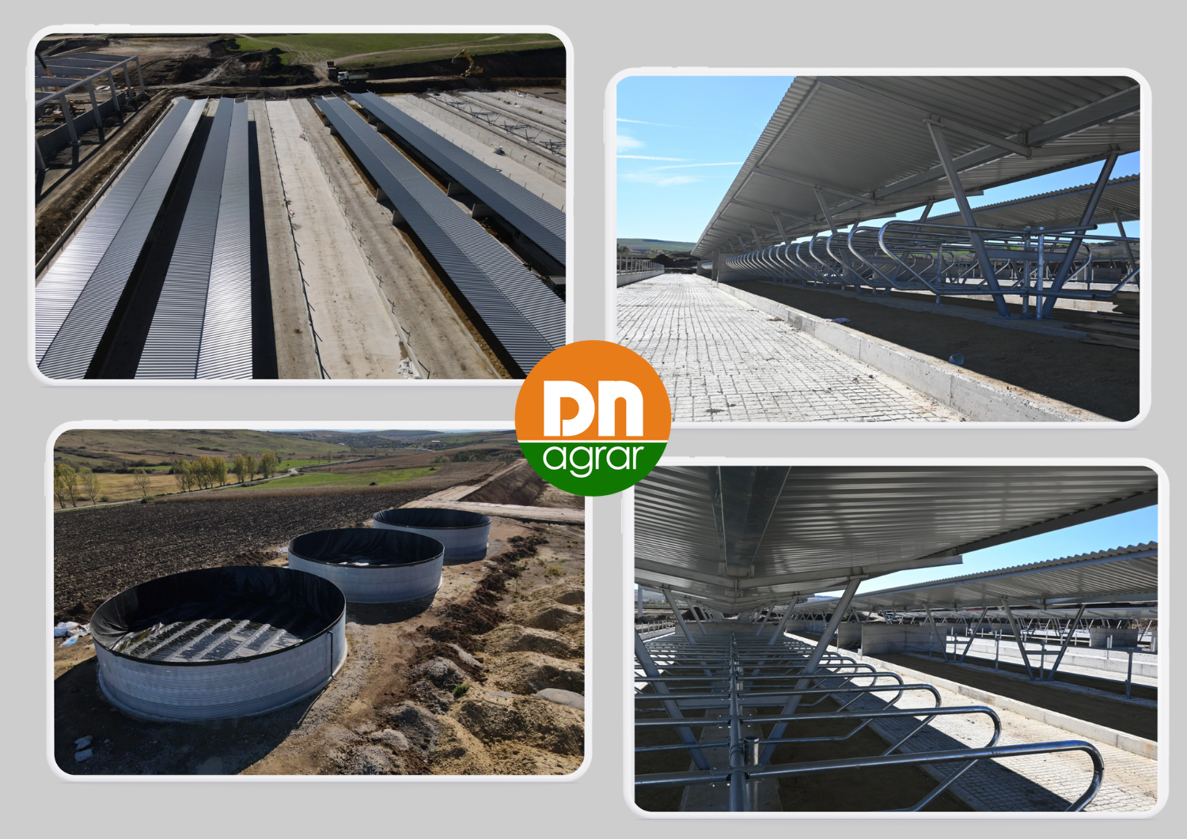
STRAJA PROJECT CURRENT STATUS

Slide 26
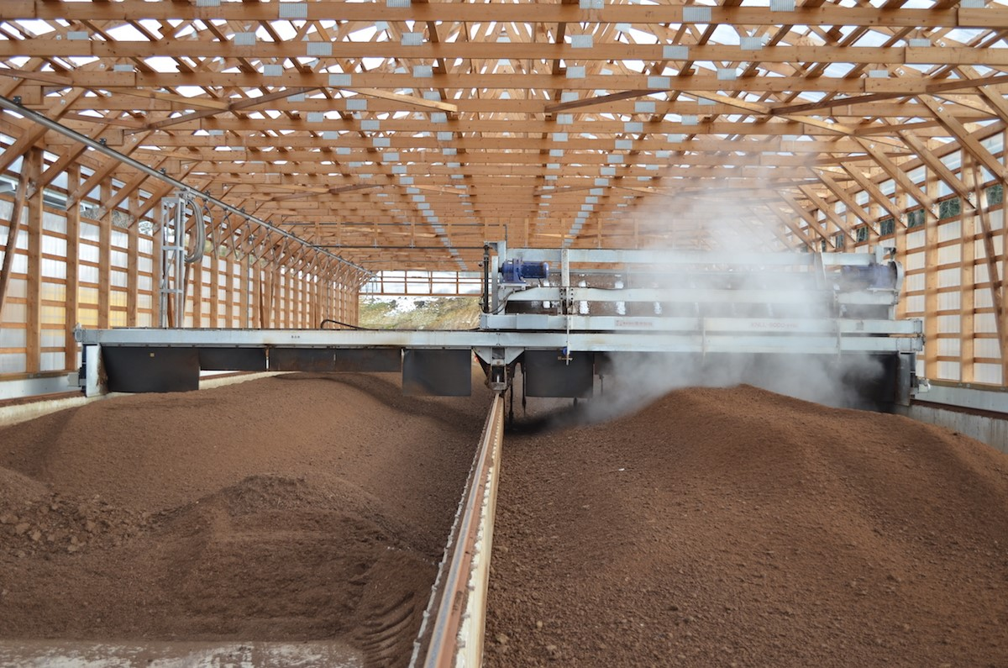
COMPOST FACTORY TO STRENGTHEN THE CIRCULAR ECONOMIC MODEL
Operational Highlights
Integrated organic waste management system
Operations started in November 2024
21,000 tons of manure processed annually
Production of over 7,000 tons of organic fertilizer
Use the organic fertilizers produced for internal needs and to sell outside the Group
The process of certifying fertilizers as organic typically takes 3 - 6 months
Investment of EUR 1.8 million
The project addresses two major challenges:
1. efficient manure management and improved soil fertility
2. contribution to the reduction of greenhouse gas emissions
Further Developments
The process of obtaining voluntary carbon certificates started
Build the sales channel to develop the business line
Advance with the certification process to achieve the international "Gold Standard" accreditation for carbon credit
26

Slide 27
BIOMETHANE PRODUCTION FOR AN INTEGRATED SUSTAINABLE STRATEGY
Operational Highlights
Production facility with a total capacity of up to 15 MW
DN AGRAR will supply the raw material for the biomethane production
BSOG Energy will develop the production facility
Cooperation agreement for the largest biomethane production facility in Romania with BSOG Energy
This project aligns with DN AGRAR’s mission
to lead sustainable agriculture.
Further Developments
Project execution is expected to take over 2 years from the signing of the final agreement
The overall investment in the facility is estimated to around EUR 30 million
Based on a 15-year contract of approx. 50 million EURO, the expected yearly revenues for DN AGRAR will be between EUR 3 - 3.5 million

Slide 28
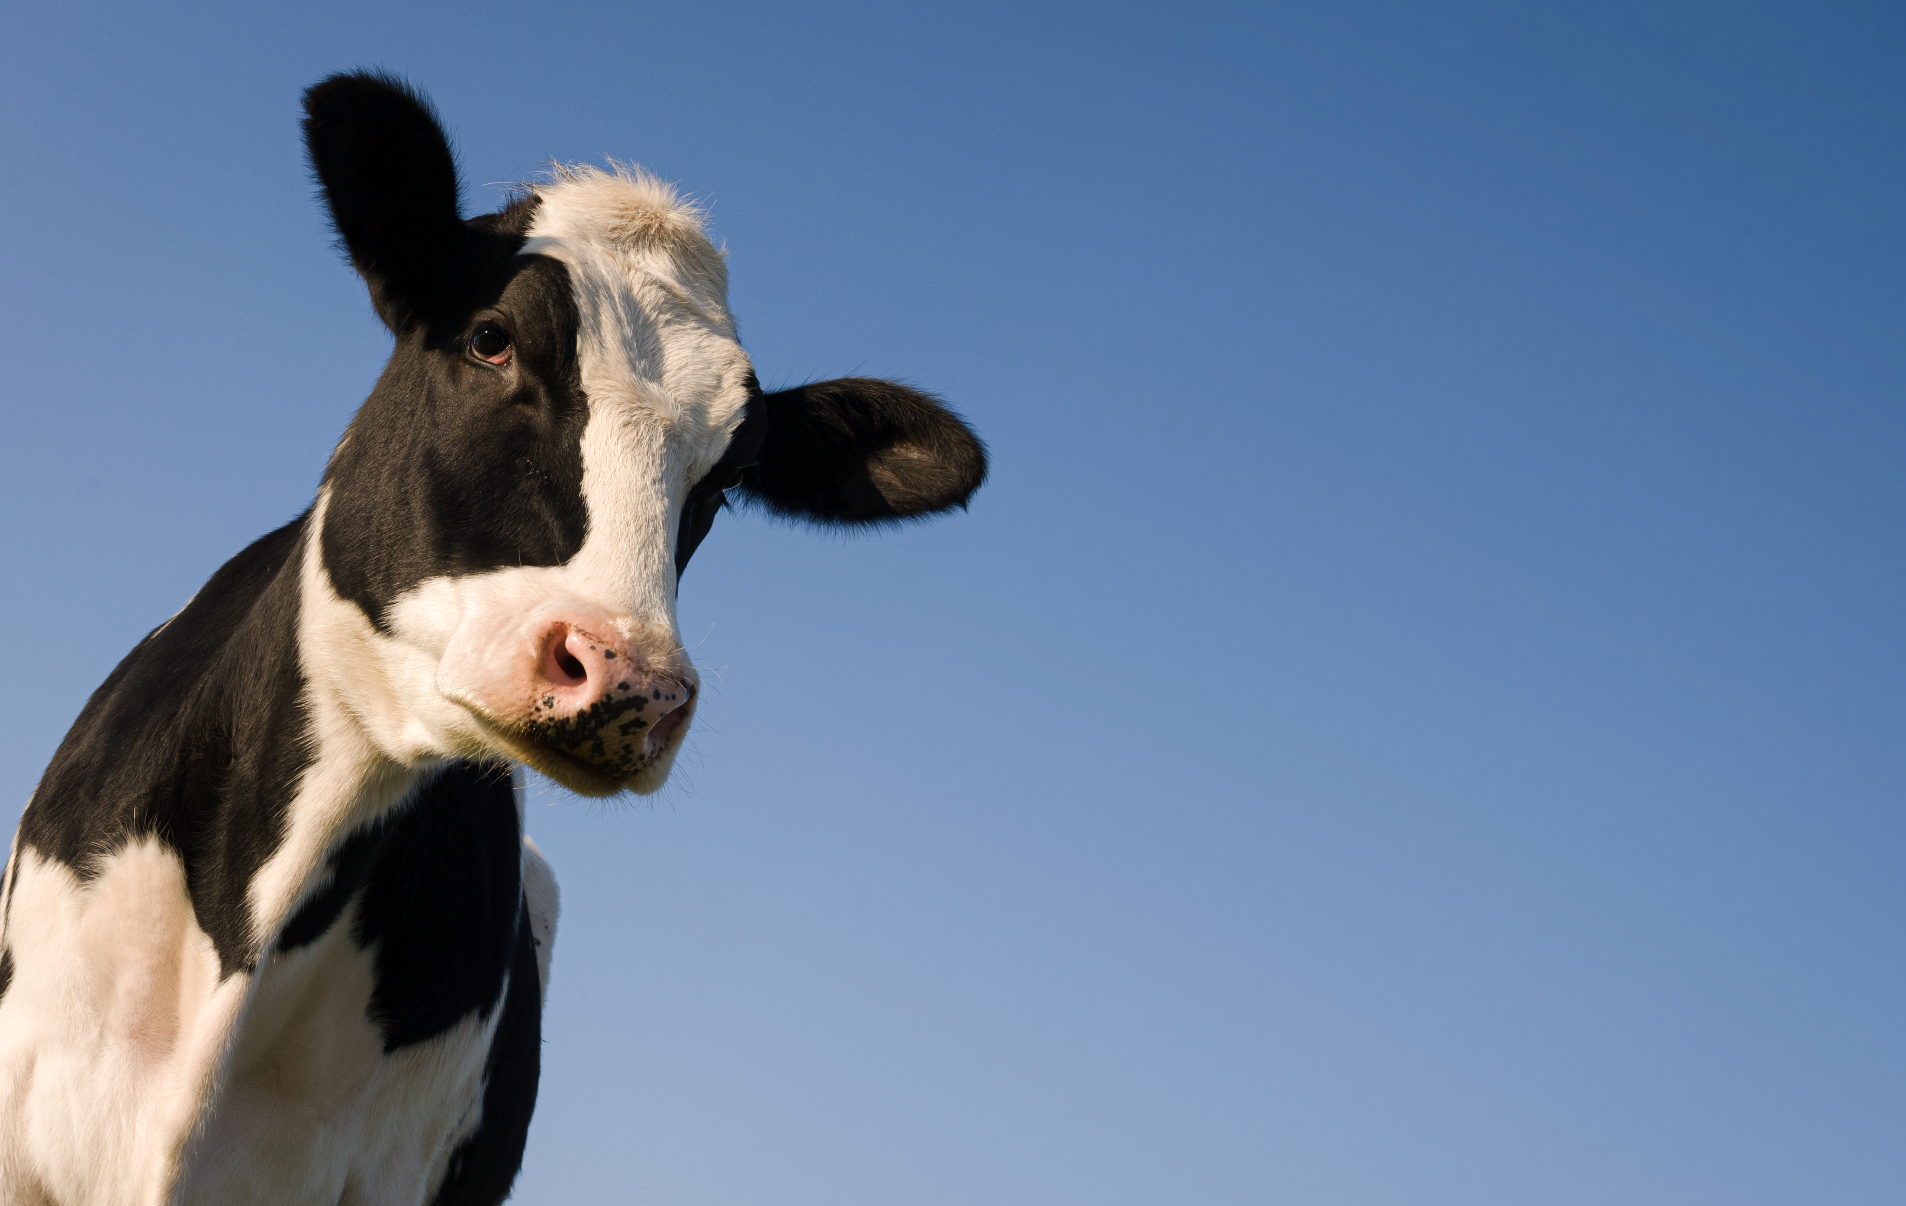
CONTACT INVESTOR RELATIONS
Peter de Boer,
BoD Member and Strategic & IR Director
investors@dn-agrar.eu , +40 258 818114

Slide 29
QUESTIONS
When will the Straja farm be fully populated so that it can operate at maximum production parameters?
When does the activity in Straja farm start?

