Slide 1
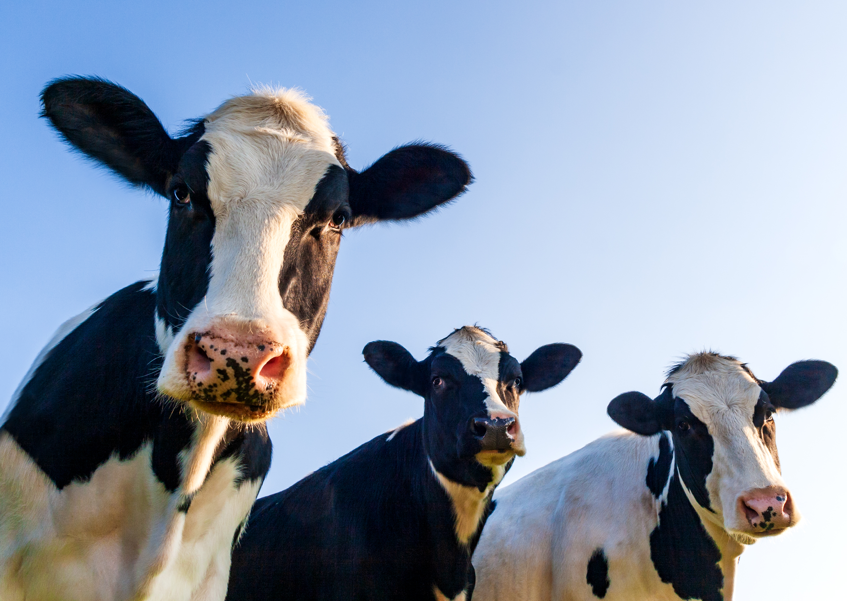
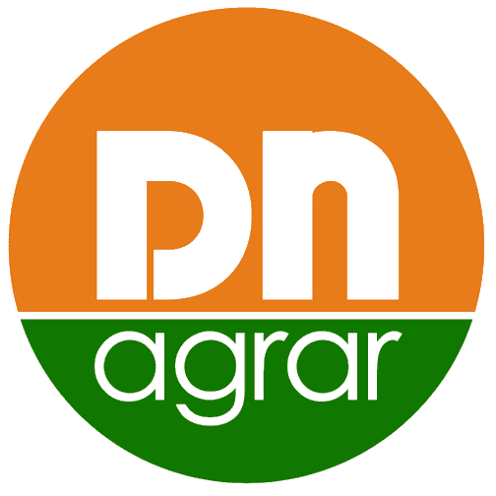
Financial Results
1st half of 2024
- August 2024 -

Slide 2
CONTENT
ABOUT DN AGRAR
6M 2024 FINANCIAL RESULTS
OPERATIONAL ACTIVITY
DN AGRAR PROJECTS

Slide 3
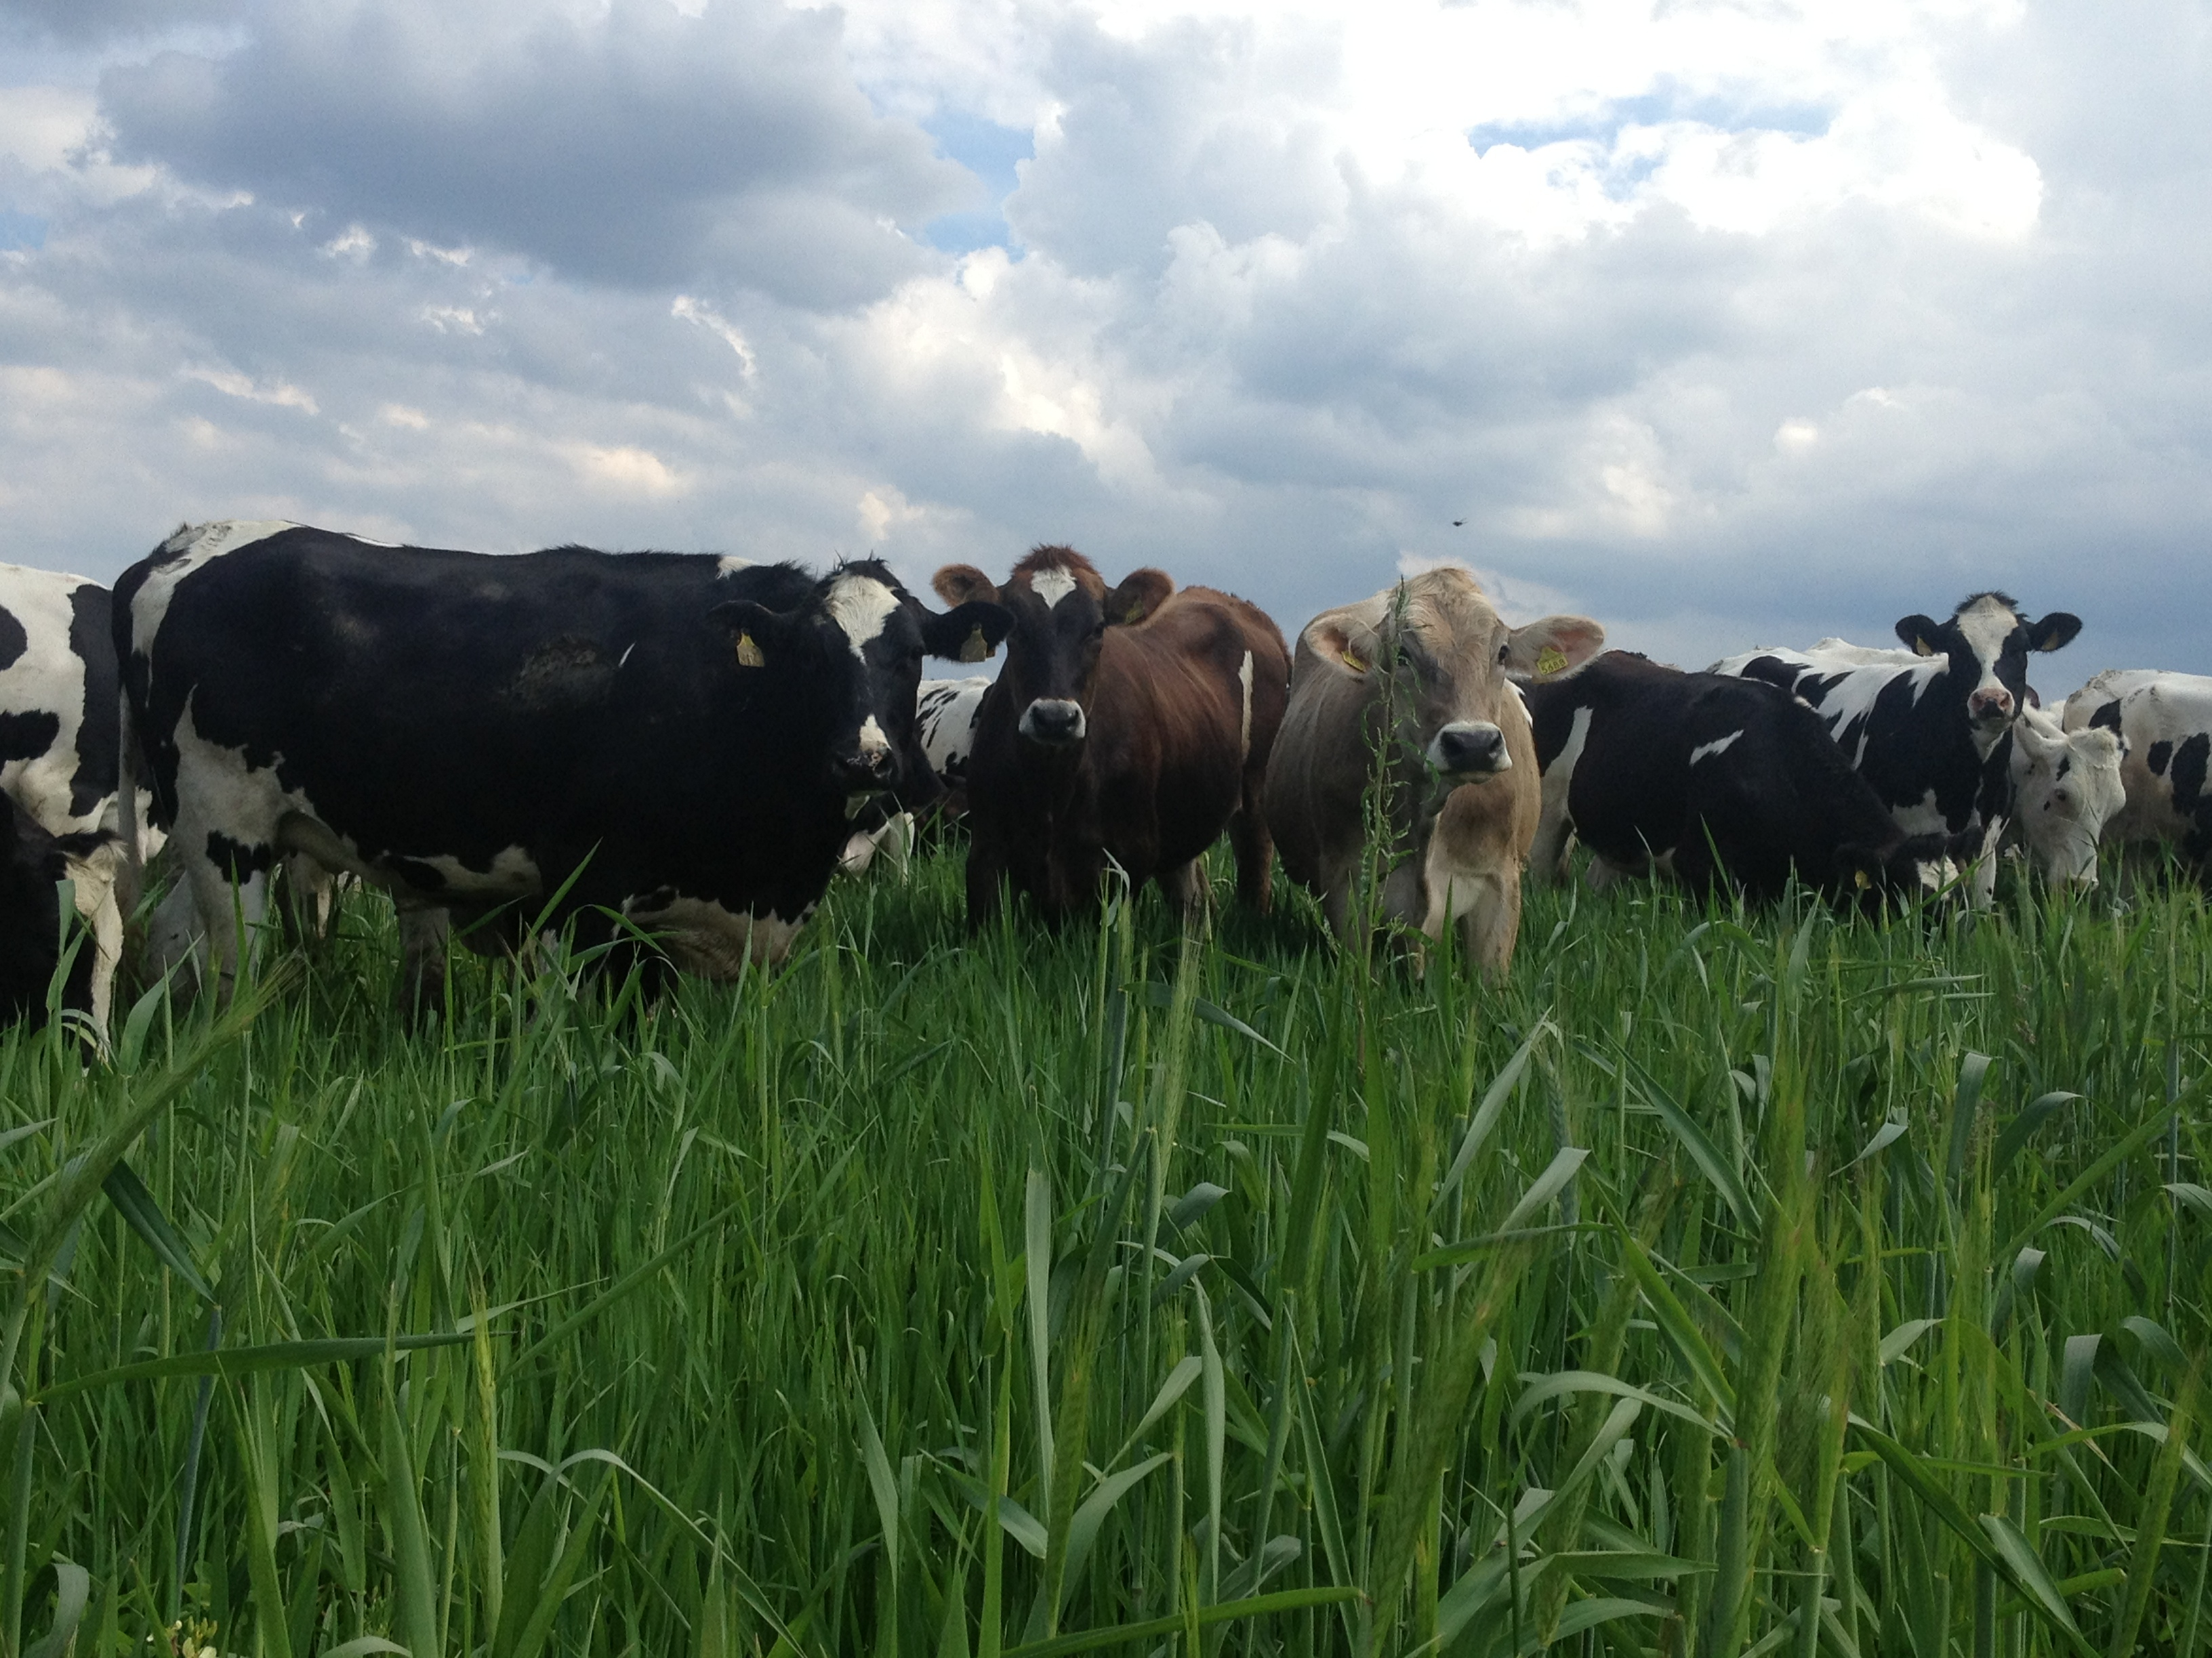
DN AGRAR - AN OUTSTANDING GROWTH STORY
Tripled its business since listing.
Consistent Growth in EBITDA
~ 60 million liters of milk delivered annually.
Track
Record
Focus on sustainable, regenerative agriculture practices that maximize productivity, reduce environmental impact, and ensure long-term profitability.
Sustainable
Agriculture
Strategy
One of Europe’s leading milk producers and the largest integrated zootechnical farm in Romania, with cow milk production and vegetable production.
To double again the business by 2027 supported by operation efficiencies and the development of a new farm.
Target 2028: production of over 100 million liters of milk delivered annually
Market
Position

Slide 4
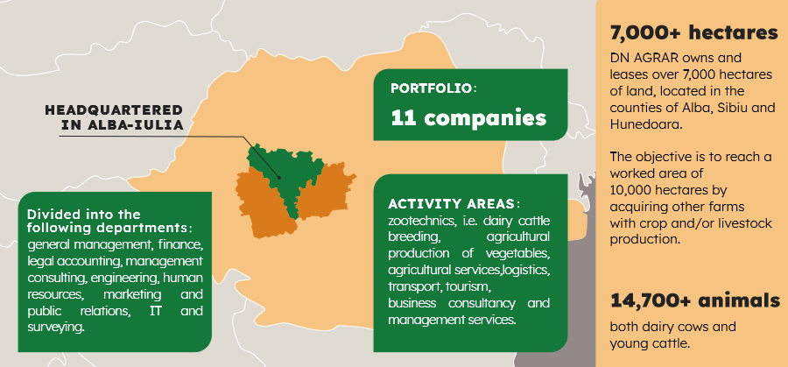
DN AGRAR ACTIVITY – INTEGRATED DAIRY PRODUCTION
Zootechnics
Vegetal agricultural production
Agricultural services
Logistics
Transport
Tourism
Business and management consulting services

Slide 5
DN AGRAR FARMS TODAY - Leading Romanian Milk Production
APOLD FARM
CUT FARM
6,100 dairy cattle & young stock
63,000 liters/day
400 cows milked/hour
2,200 dairy cattle
45,000 liters/day
300 cows milked/hour
LACTO AGRAR FARM
PRODLACT FARM
4,000 dairy cattle & young stock
53,000 liters/day
350 cows milked/hour
2,400 young stock animals
Raising young cattle for Apold and Cut farms

Slide 6
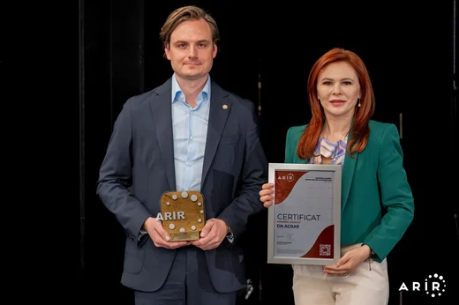
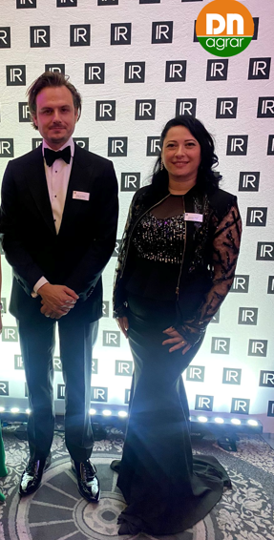
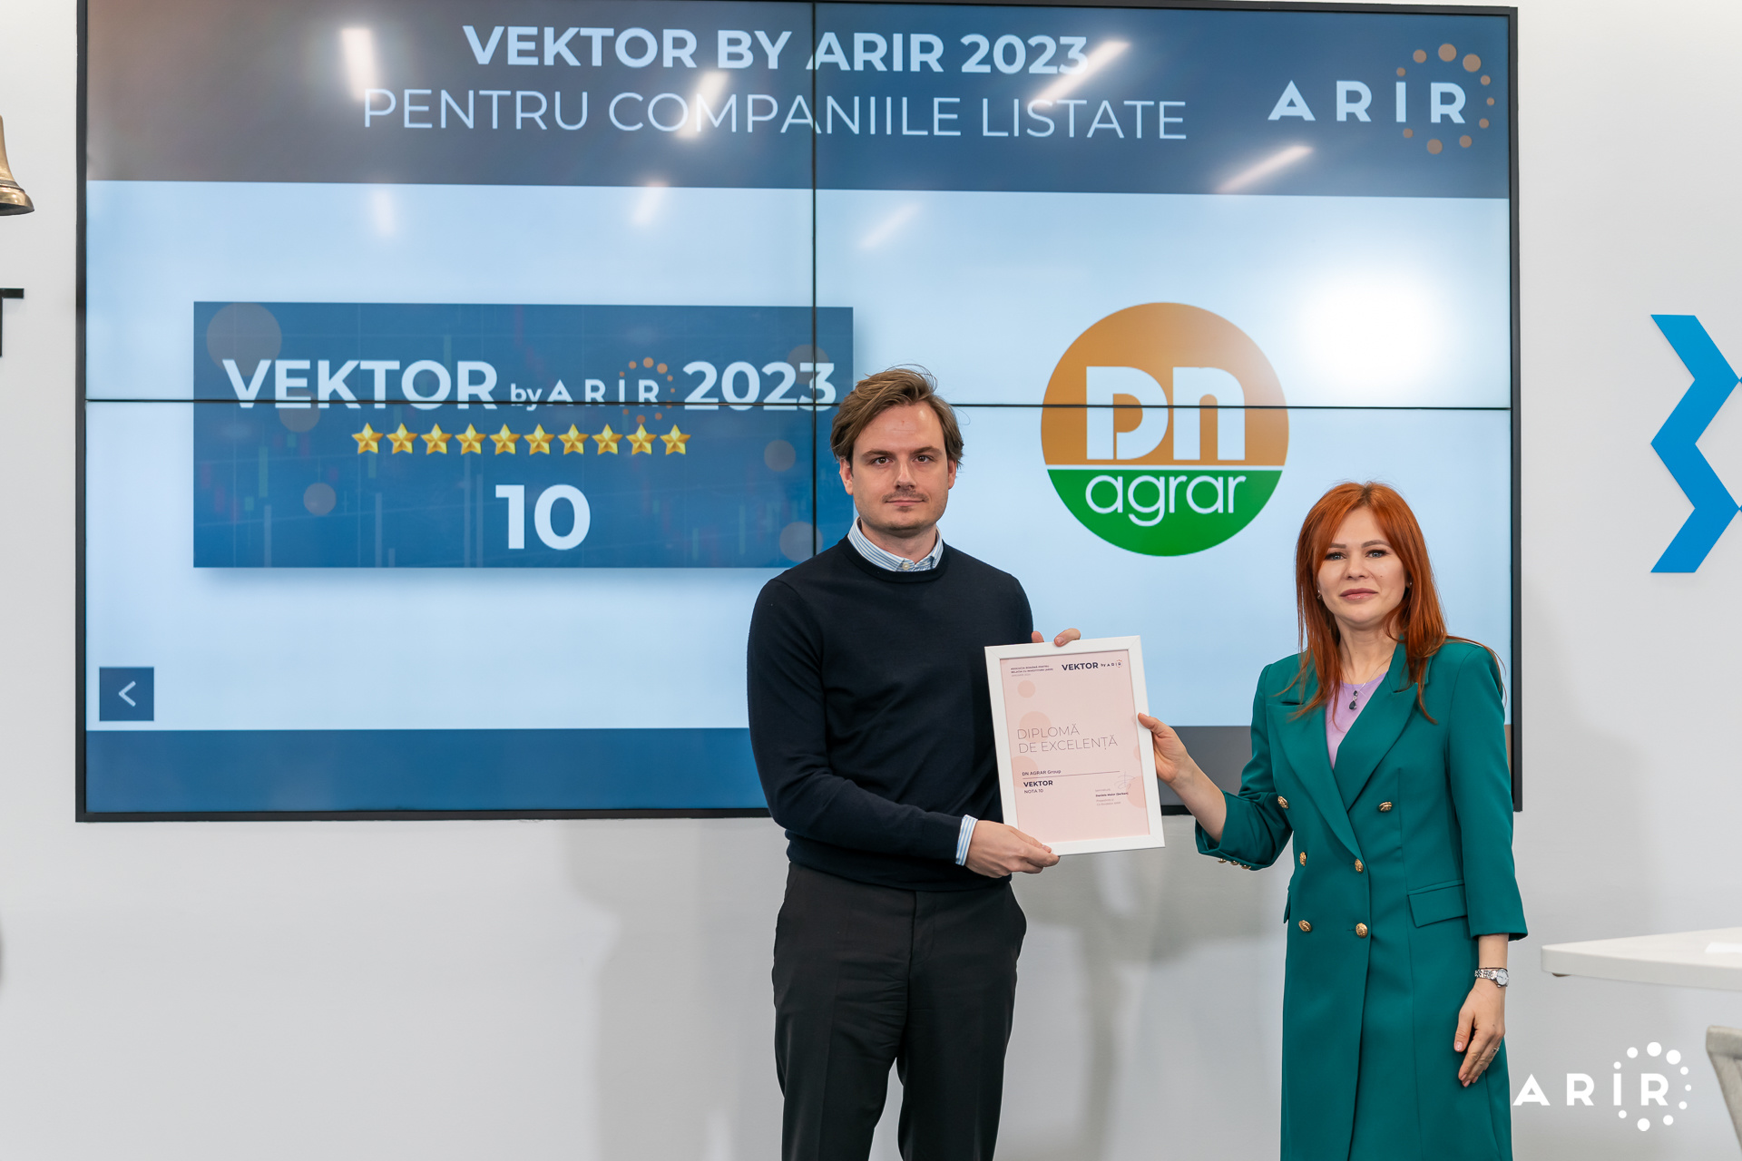
DN AGRAR IN THE CAPITAL MARKET - Activity Recognised Internationally
Listed on the Bucharest Stock Exchange, AeRO market since February 2, 2022
+131% share price performance on June 28, 2024, compared to June 30, 2023
Shares included in the BETAeRO and MSCI Frontier Small Cap and MSCI Romania Small Cap indices
Over 2.500 shareholders
Market-Making services provided by BRK Financial Group
Analysts covering DN share
BRK Financial Group – August 7th, updated target to 1.8460, up from RON 0.9100 estimated in June 2023 report.
Prime Transaction – June 24th, updated target price to 1.8074 RON, up from RON 1.6922 estimated in the December 2023 report.
Recognition
10 in the second VEKTOR by ARIR evaluation
DN AGRAR has been nominated for IR Magazine Europe Awards 2024
DN AGRAR becomes ARIR's Associate Member

Slide 7
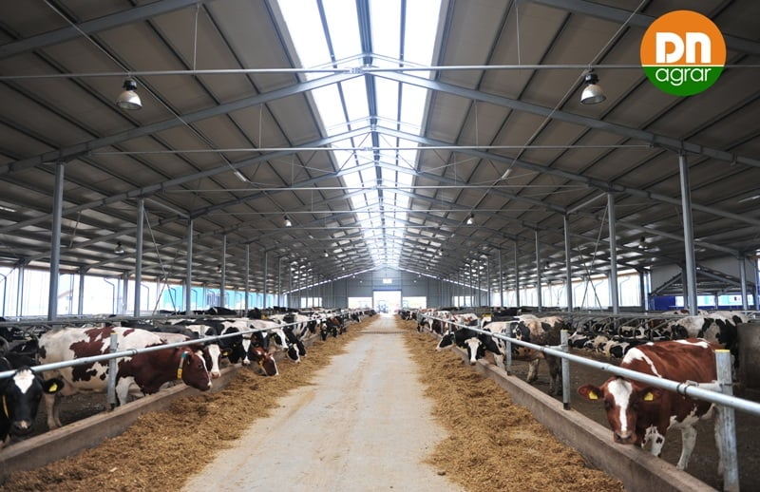
6M 2024 FINANCIAL
RESULTS

Slide 8
KEY PERFORMANCE INDICATORS
Continued Strengthening of EBITDA
TURNOVER
NET PROFIT
EBITDA
RON 83.25 mil.
+4%
Vs H1 2023
RON 15.08 mil.
(0.6)%
Vs H1 2023
RON 34.74 mil.
+10%
Vs H1 2023
NET ASSETS
TOTAL ASSETS
EQUITY
RON 250.46 mil.
+8%
Vs 31.12.2023
RON 328.75 mil.
+7%
Vs 31.12.2023
RON 148.12 mil.
+11%
Vs 31.12.2023

Slide 9
KEY PERFORMANCE INDICATORS -Turnover Growing, Slight Fall in Net Profit
TURNOVER
EBITDA
NET PROFIT

Slide 10
KEY PERFORMANCE INDICATORS EVOLUTION - Continued Growing
TURNOVER
EBITDA
NET PROFIT

Slide 11
FINANCIAL RESULTS HIGHLIGHTS
H1 Trends Reflected in Increased Expenses
PROFIT AND LOSS ACCOUNT (RON) | 30/06/2024 | 30/06/2023 | ∆%
OPERATING INCOME – TOTAL | 131,737,012 | 124,299,059 | 5.98%
OPERATING EXPENSES – TOTAL | 109,139,557 | 100,999,572 | 8.06%
OPERATING PROFIT OR LOSS | 22,597,455 | 23,299,487 | (3.01)%
FINANCIAL INCOME – TOTAL | 722,747 | 791,093 | (8.64)%
FINANCIAL EXPENSES – TOTAL | 4,592,687 | 5,670,999 | (19.01)%
FINANCIAL PROFIT OR LOSS | (3,869,940) | (4,879,906) | (20.70)%
GROSS PROFIT OR LOSS | 18,727,515 | 18,419,581 | 1.67%
GROUP NET PROFIT OR LOSS | 15,077,972 | 15,175,641 | (0.64)%
Operating expenses increased by 8% as of June 30, 2024, reaching RON 109.14 million.
The main contribution came from expenses related to adjustments in the
value of tangible and intangible assets,
which reached RON 12 million, an increase of 20% compared to the same period of last year.
This evolution is related to the revaluation of fixed assets in DN AGRAR’s farms, which increased by 7% compared to 2023.

Slide 12
THE MAIN ELEMENTS OF THE BALANCE SHEET
Increases in Assets and Equity
Equity increased by 11.08% compared to December 31, 2023, reaching RON 148.11 million. This increase was driven by the recording of a net profit of RON 15 million as of June 30, 2024.
Long-term liabilities registered an increase compared to the end of 2023, so as of June 30, 2024, the balance of long-term liabilities reached RON 100.63 million.
Provisions decreased by 85.34% compared to the end of 2023, reaching RON 56.58 thousand as of June 30, 2024.
ING investment loan Euribor 1M (3.58%) + 2.2% (approx. 5.78%)
Exim Bank investment loan Euribor 6M (3,38%) + 2.7% (approx. 6.08%)
BALANCE SHEET INDICATORS (RON) | 30/06/2024 | 31/12/2023 | ∆%
FIXED ASSETS - TOTAL | 227,390,073 | 212,141,058 | 7.19%
CURRENT ASSETS - TOTAL | 98,758,891 | 94,362,606 | 4.66%
DEFERRED EXPENSES | 2,603,972 | 1,441,310 | 80.67%
TOTAL ASSETS | 328,752,936 | 307,944,974 | 6.76%
DEBTS: AMOUNTS TO BE PAID WITHIN UP TO ONE YEAR | 78,148,498 | 76,397,539 | 2.29%
DEBTS: AMOUNTS TO BE PAID IN MORE THAN ONE YEAR | 100,632,559 | 95,954,744 | 4.88%
PROVISIONS | 56,589 | 385,892 | (85.34)%
DEFERRED REVENUES | 1,797,374 | 1,867,001 | (3.73)%
DEBT - TOTAL | 178,781,057 | 172,352,283 | 3.37 %
EQUITY - TOTAL | 148,117,916 | 133,339,798 | 11.08%
TOTAL EQUITY AND DEBT | 328,752,936 | 307,944,974 | 6.76%
Compared with Q1 2024, the interest rates decreased with 5%-8% due to the changes of the EURIBOR

Slide 13
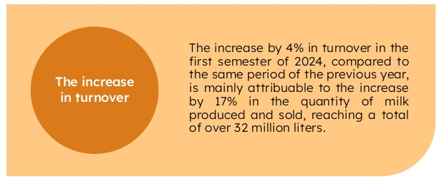
MAIN FACTORS INFLUENCING 6M 2024 RESULTS
Strong Performance in Period of Falling Prices

Slide 14
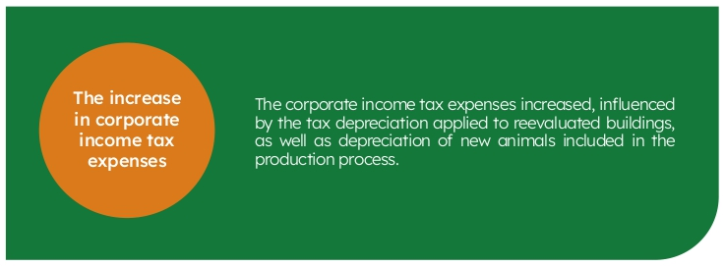
MAIN FACTORS INFLUENCING 6M 2024 RESULTS
Strong Performance in Period of Falling Prices

Slide 15
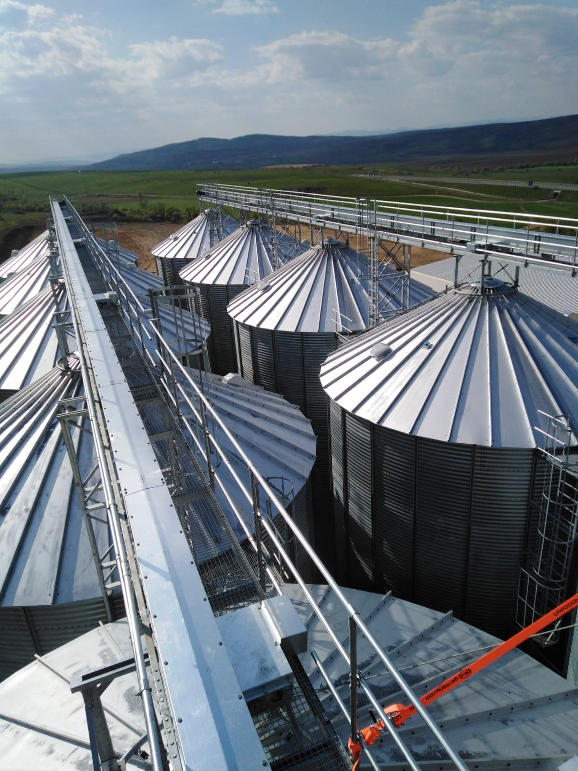
OPERATIONAL
ACTIVITY

Slide 16
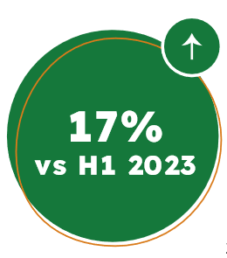
MILK PRODUCTION
Consistent Growth in Milk Deliveries
DN AGRAR recorded a 17% increase in H1 2024 compared to the same period of last year.
There were registered increases in milk delivered each month in 2024 compared to the same period in 2023, delivering over 5 million liters of milk per month.
For the next semester of this year, we aim to maintain the same pace in terms of
operational activity, namely milk production, considering the extremely high temperatures recorded in July and August.
By the end of this year, we expect a constant evolution of milk deliveries,
respectively to maintain the threshold of 5 million liters delivered monthly.

Slide 17
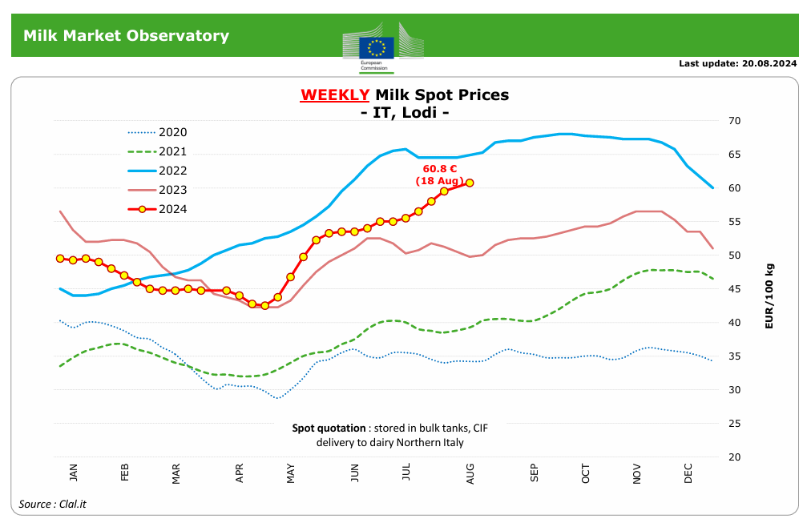
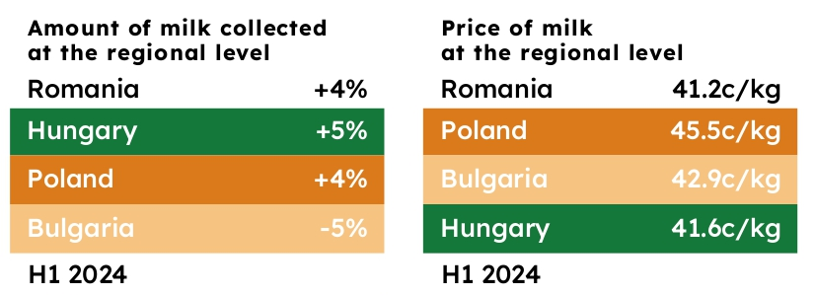
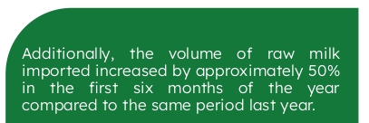
EUROPEAN MILK MARKET & OUTLOOK Q3 2024
European milk market
*Source: https://insse.ro/cms/ro/
*https://agriculture.ec.europa.eu/data-and-analysis/markets/price-data/price-monitoring-sector/milk-and-dairy-products_en

Slide 18
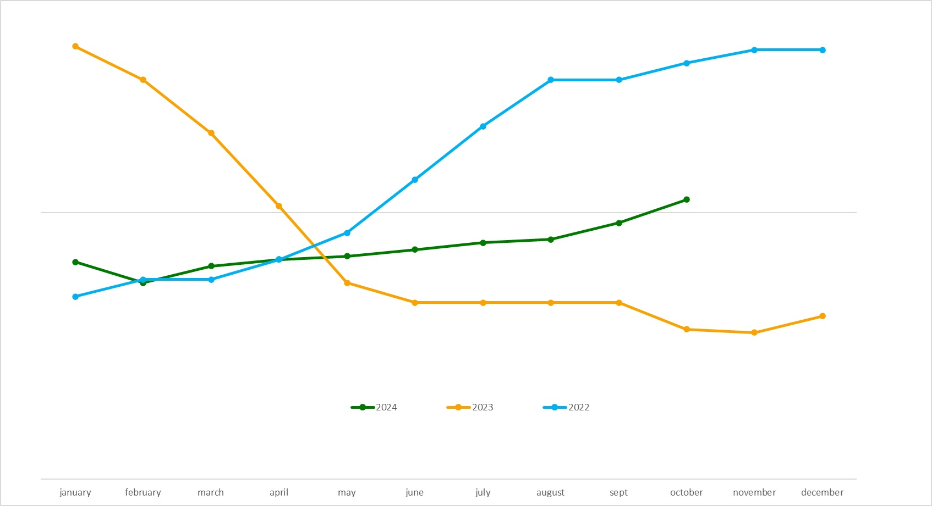
OUTLOOK OF DN AGRAR MILK PRICE
Stabilization of prices as the market adjusts and stable demand

Slide 19
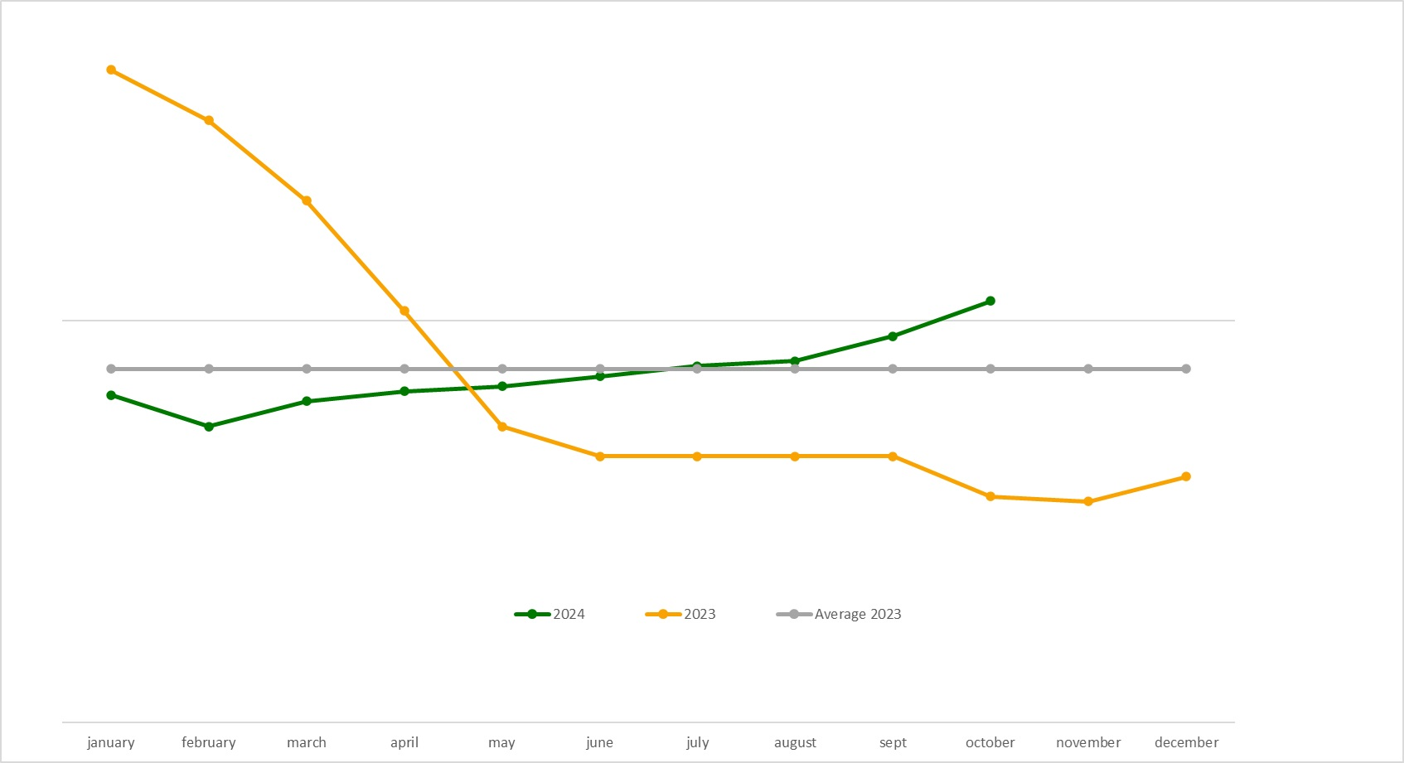
OUTLOOK OF DN AGRAR MILK PRICE
Stabilization of prices as the market adjusts and stable demand

Slide 20
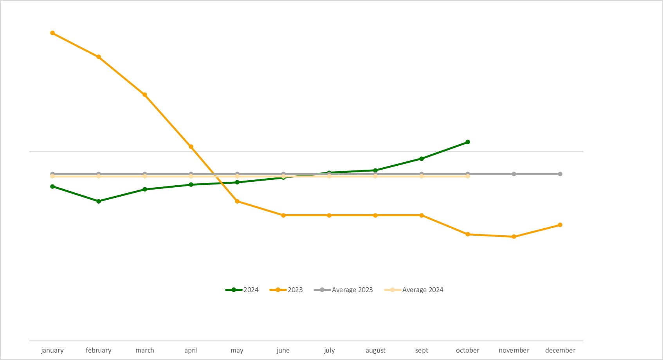
OUTLOOK OF DN AGRAR MILK PRICE
Stabilization of prices as the market adjusts and stable demand

Slide 21
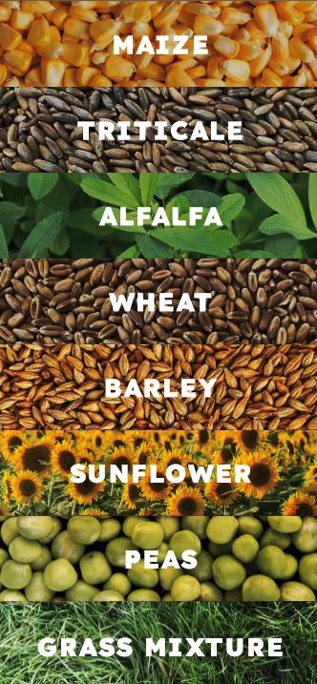
CEREAL PRODUCTION EVOLUTION
Sustainable Growth
Lucerne:
3 harvests, with a production of 20 tons/ha
We will have extra 1 or 2 harvests
Triticale:
1200 ha harvested
Production of 31 tons/ha
In 2023, we had a production of 23 tons/ha
Corn silage:
So far, the partial results indicate better production than last year
Production of 31 tons/ha, in 2024
In 2023, we had a production of 24 tons/ha
The use of
No-tillage technology in the cultivation
process and its benefits
Protects the soil and
reduces erosion
Produces better quality soil
Saves insects and
Microorganisms
Contributes to the battle
against the climate changes

Slide 22
DN AGRAR
PROJECTS

Slide 23
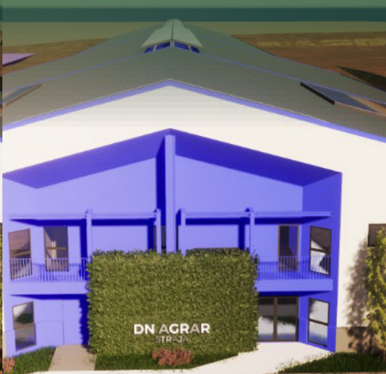
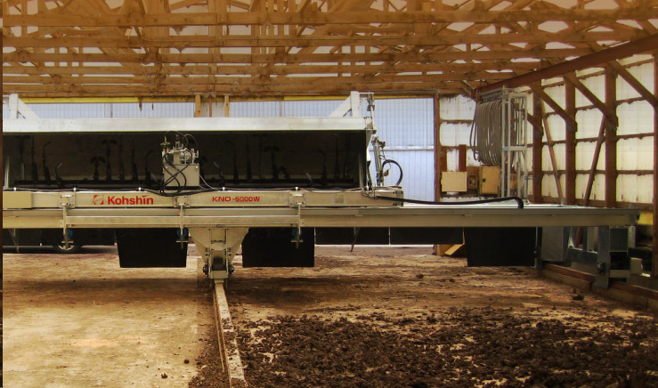
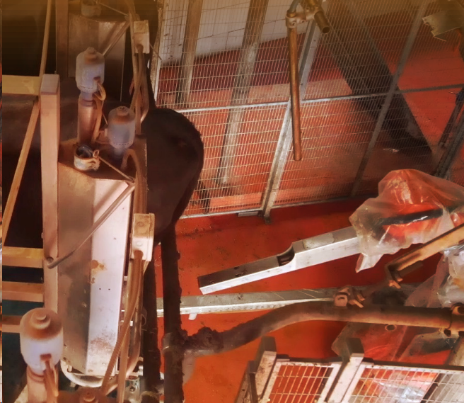
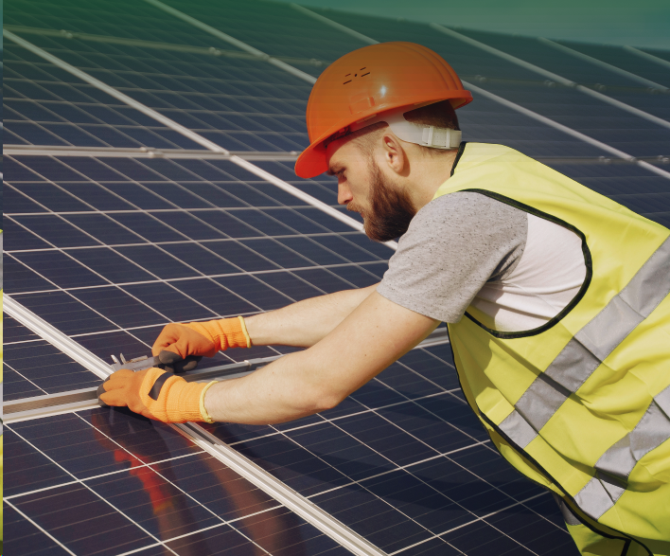
STATUS OF CURRENT PROJECTS
Automation and Energy Diversification
Compost Factory
In 2023, we completed the first 3 phases of this project. In the next phase, we will start the installation of the necessary equipment and machinery. The factory is expected to become operational in the third quarter of this year, marking a new phase in the development of DN AGRAR.
Straja project
A part of the main hall, all foundation work and
the lagoon for collecting manure, have been completed.
Solar panels on the roofs of the buildings of the farms
Accessed funds through PNRR and The submitted projects total an installed
power of 2,218 kW for the 3 farms, for a total area of 9,900 square meters, and their total eligible value for funding is EUR 900,000.
The projects were approved in July 2024, with the equipment installation phase scheduled to begin in October of the current year.
Robots for farms
The project, initiated in 2023, was completed in the first half of 2024 with the installation of the second type of robot, designed for pre-cleaning and stimulating the udder and milking, in the two DN AGRAR farms.

Slide 24
STATUS OF CURRENT PROJECTS
Automation and Energy Diversification
Obtaining voluntary certification
for the compost produced
In parallel with the start-up of the compost plant, we have embarked on an ambitious project to obtain voluntary certification for the compost produced.
This process will be carried out in a 5-year period.
After 2 years, the certificates can be traded.
Obtaining voluntary
carbon reduction
Allowances
The project aims to cover a significant area of land, and contracts
will be signed for the land
included in the program to achieve this goal.
Estimates indicate a carbon reduction of
approximately 5000 tons of carbon emissions per year, a remarkable performance achieved through the
implementation of modern technologies and sustainable
farming practices.

Slide 25
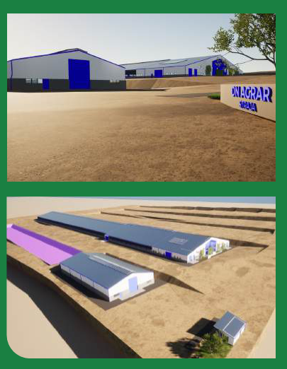
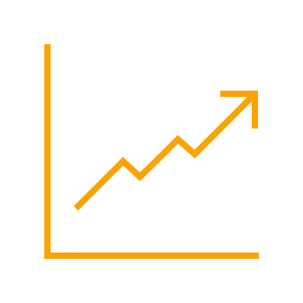
STRAJA PROJECT STATUS
A Significant Expansion in Production
Project planned to be completed in 2027
Capacity of 5,000 cows (3,800 dairy cows & 1,200 young stock)
Timeline
2024: Construction works start, 900 cows in production by the end of the year
2025: Approx. 1,700 cows in production & pregnancy
2026: Approx. 3,400 cows in production & pregnancy
2027: Approx. 4,000 cows in production & pregnancy
Impact
Straja Project will be an engine to our company’s growth, being estimated to double DN AGRAR’s business
Financing
A credit facility of 9.2 million euros to develop the farm, for equipment and the purchase of animals.
For this project, DN AGRAR will provide 20.78% by own sources.

Slide 26
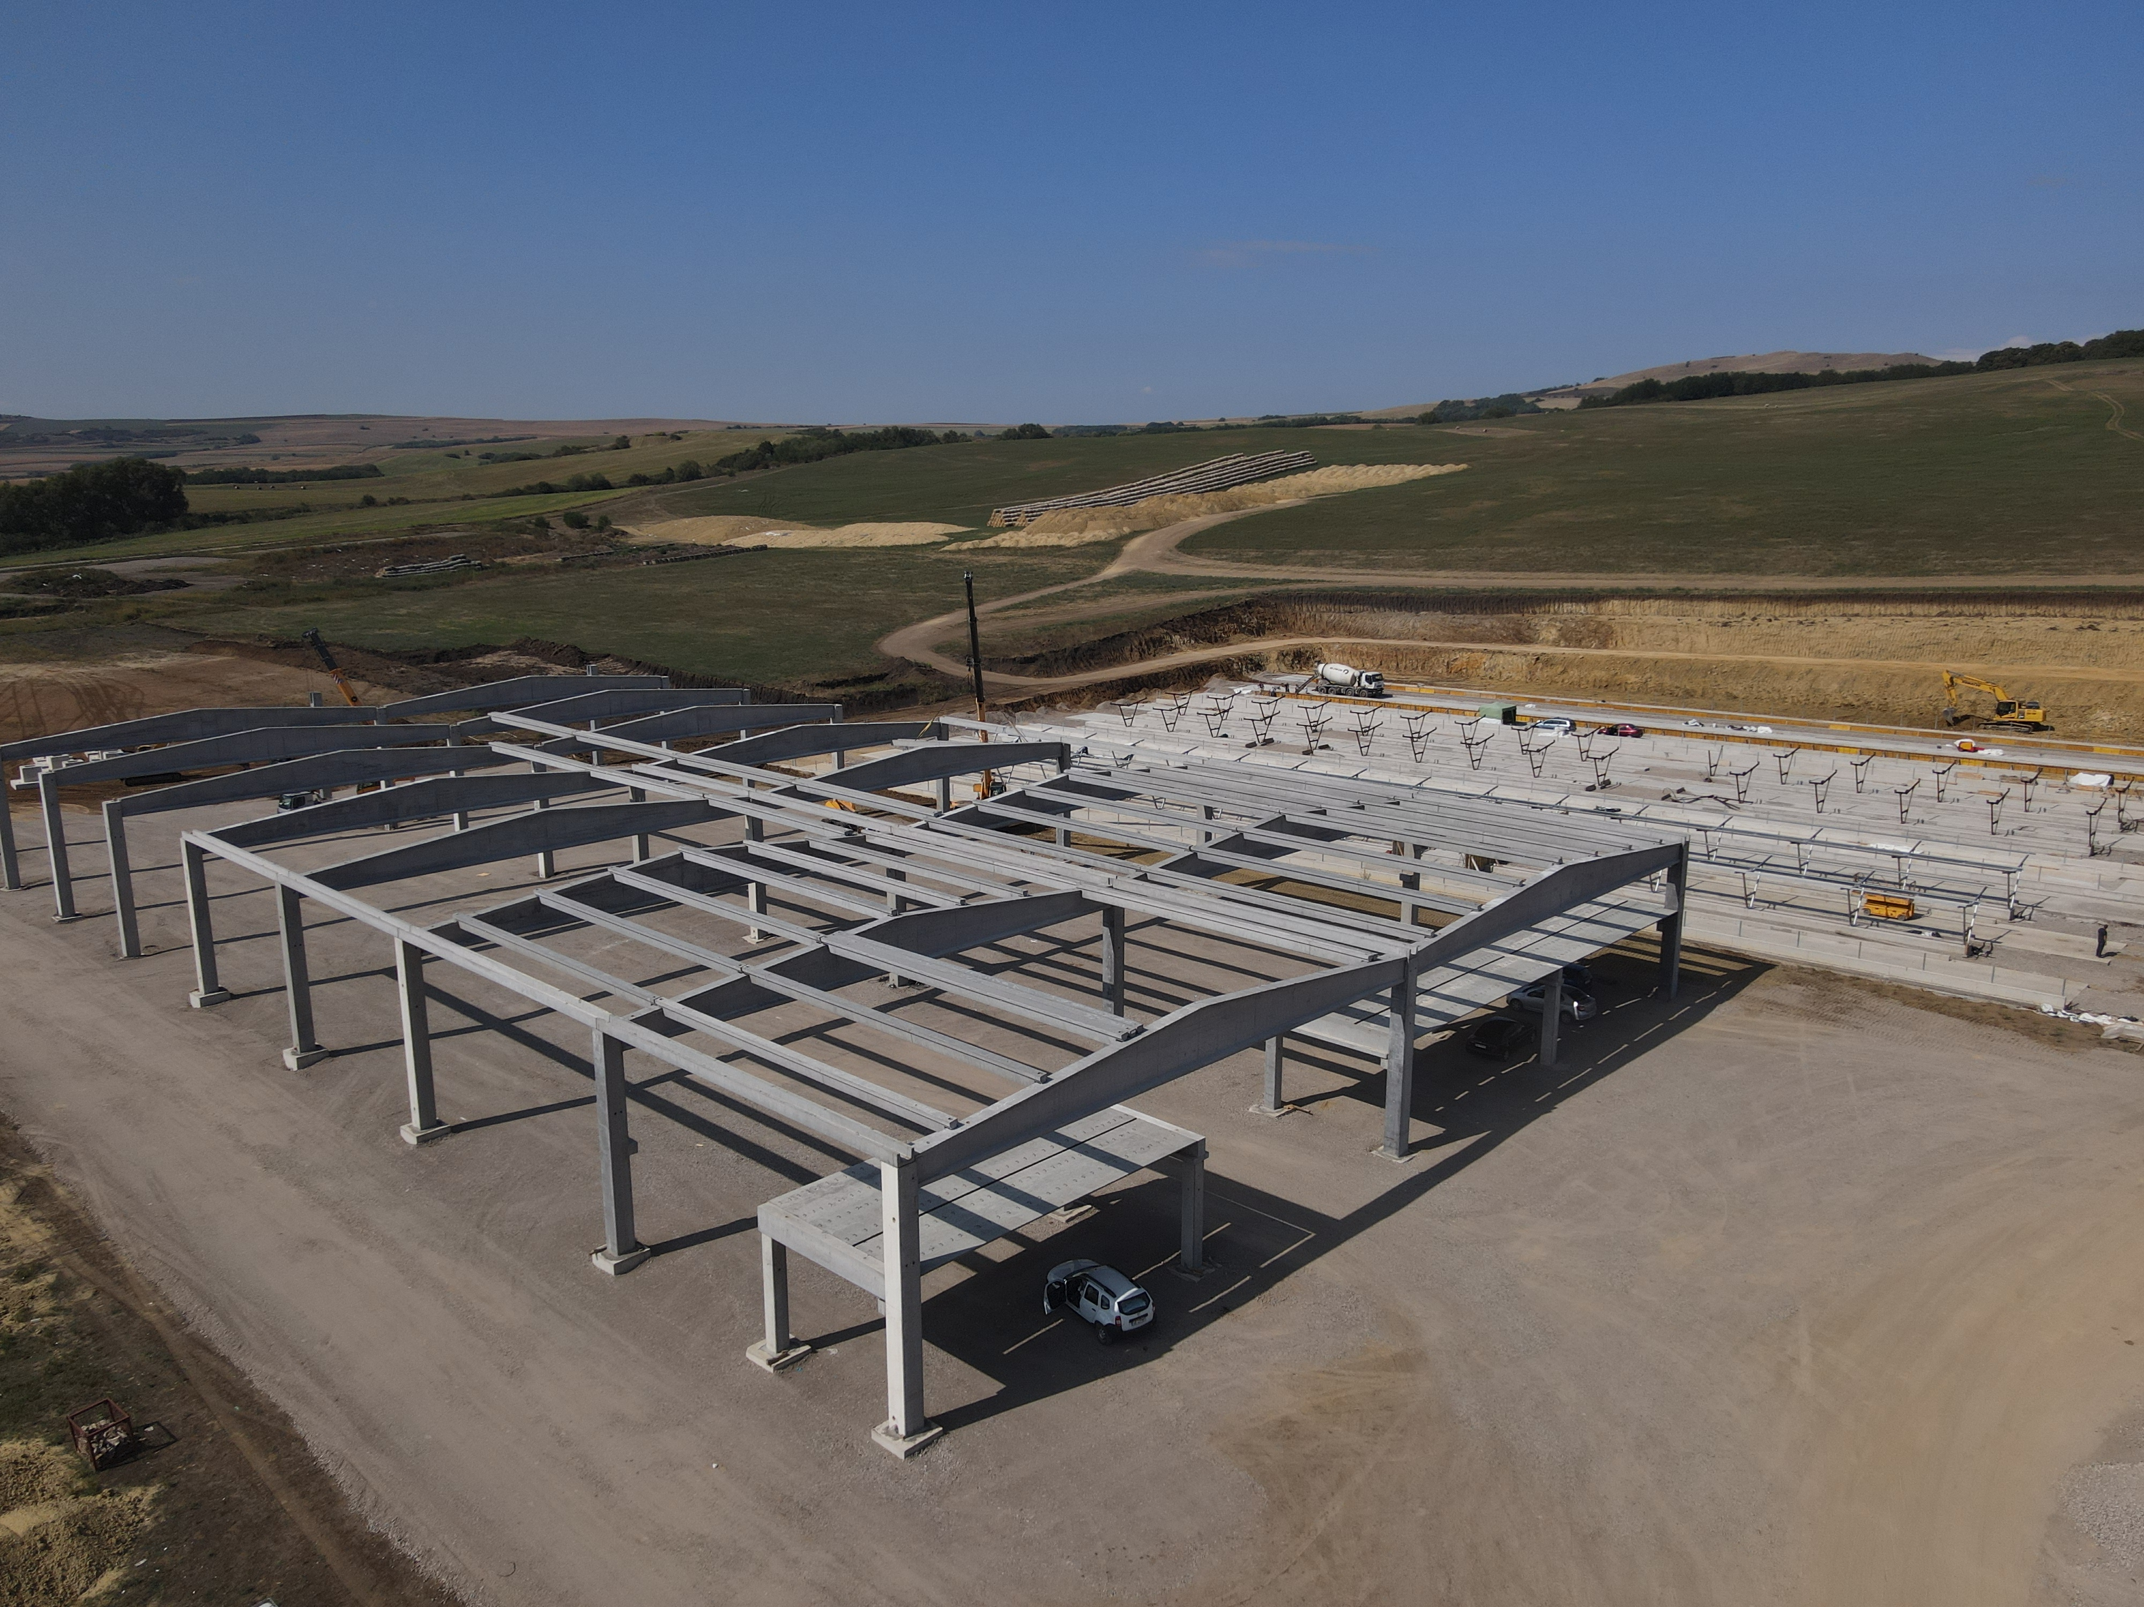
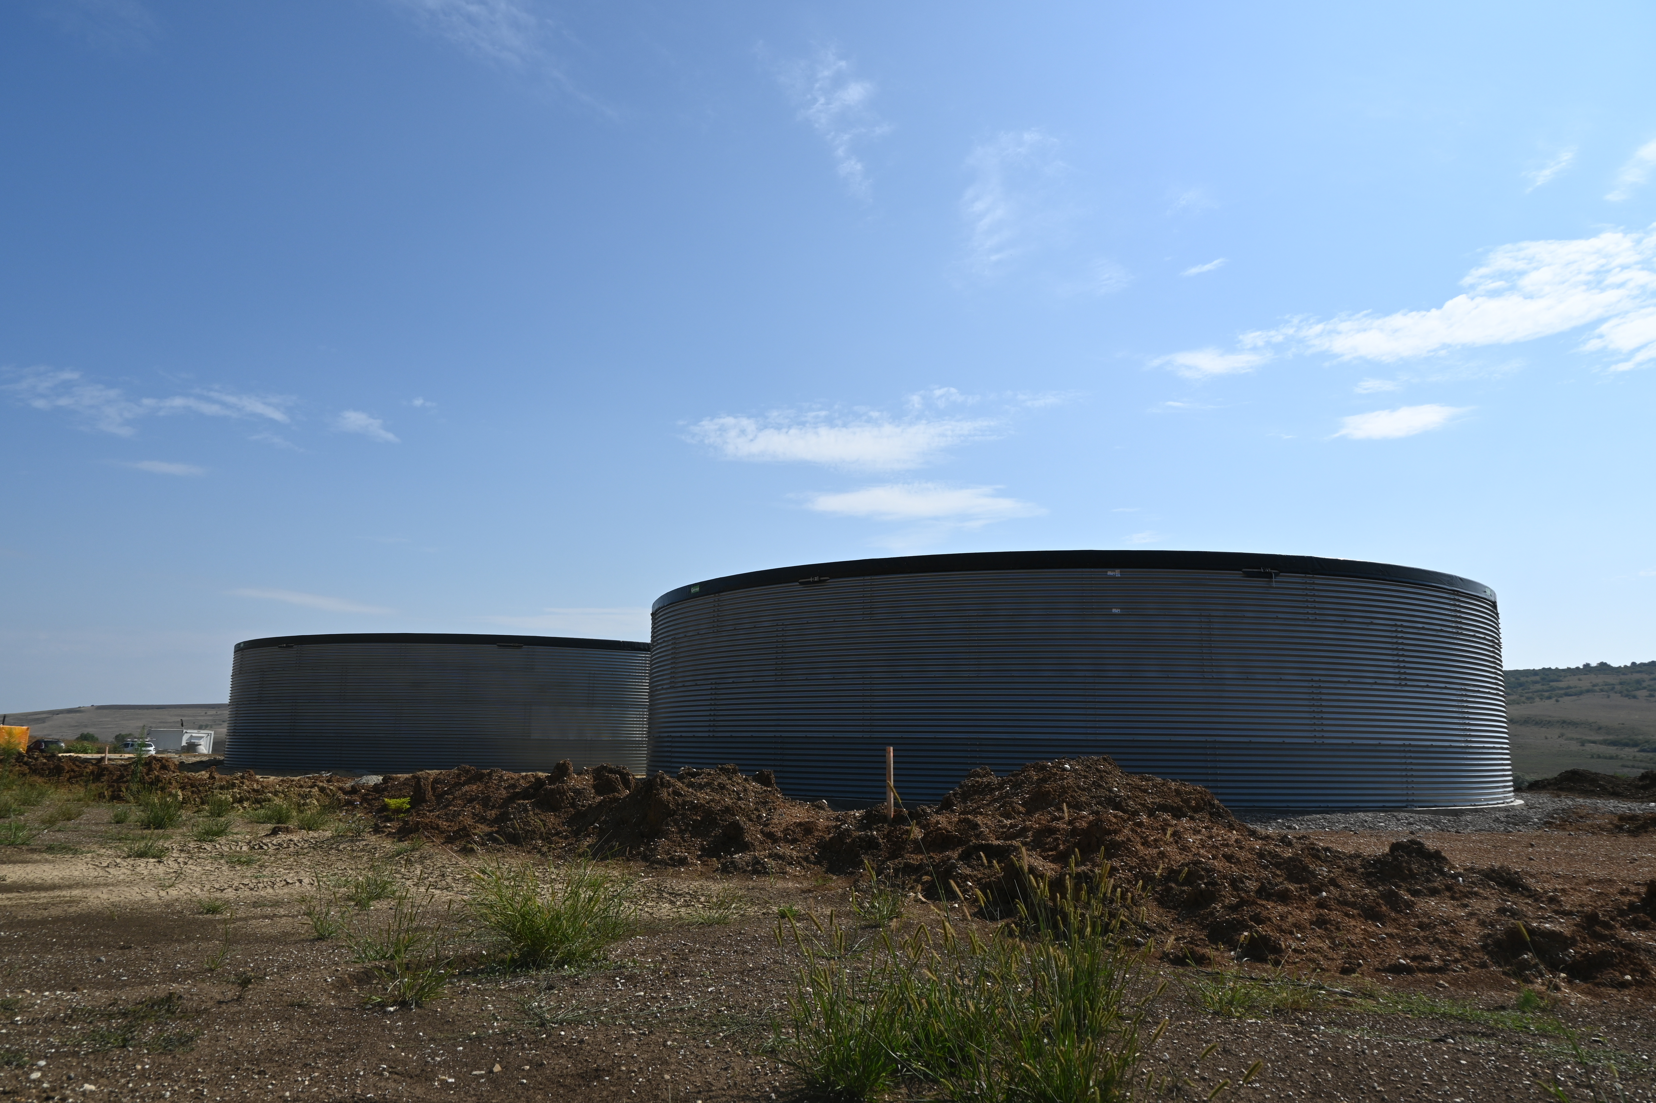
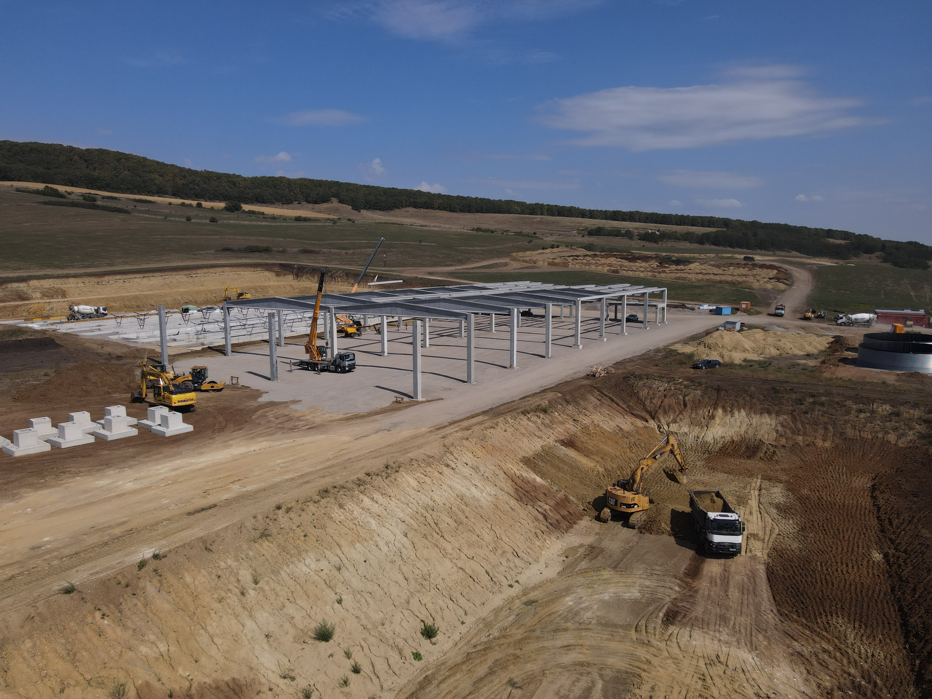
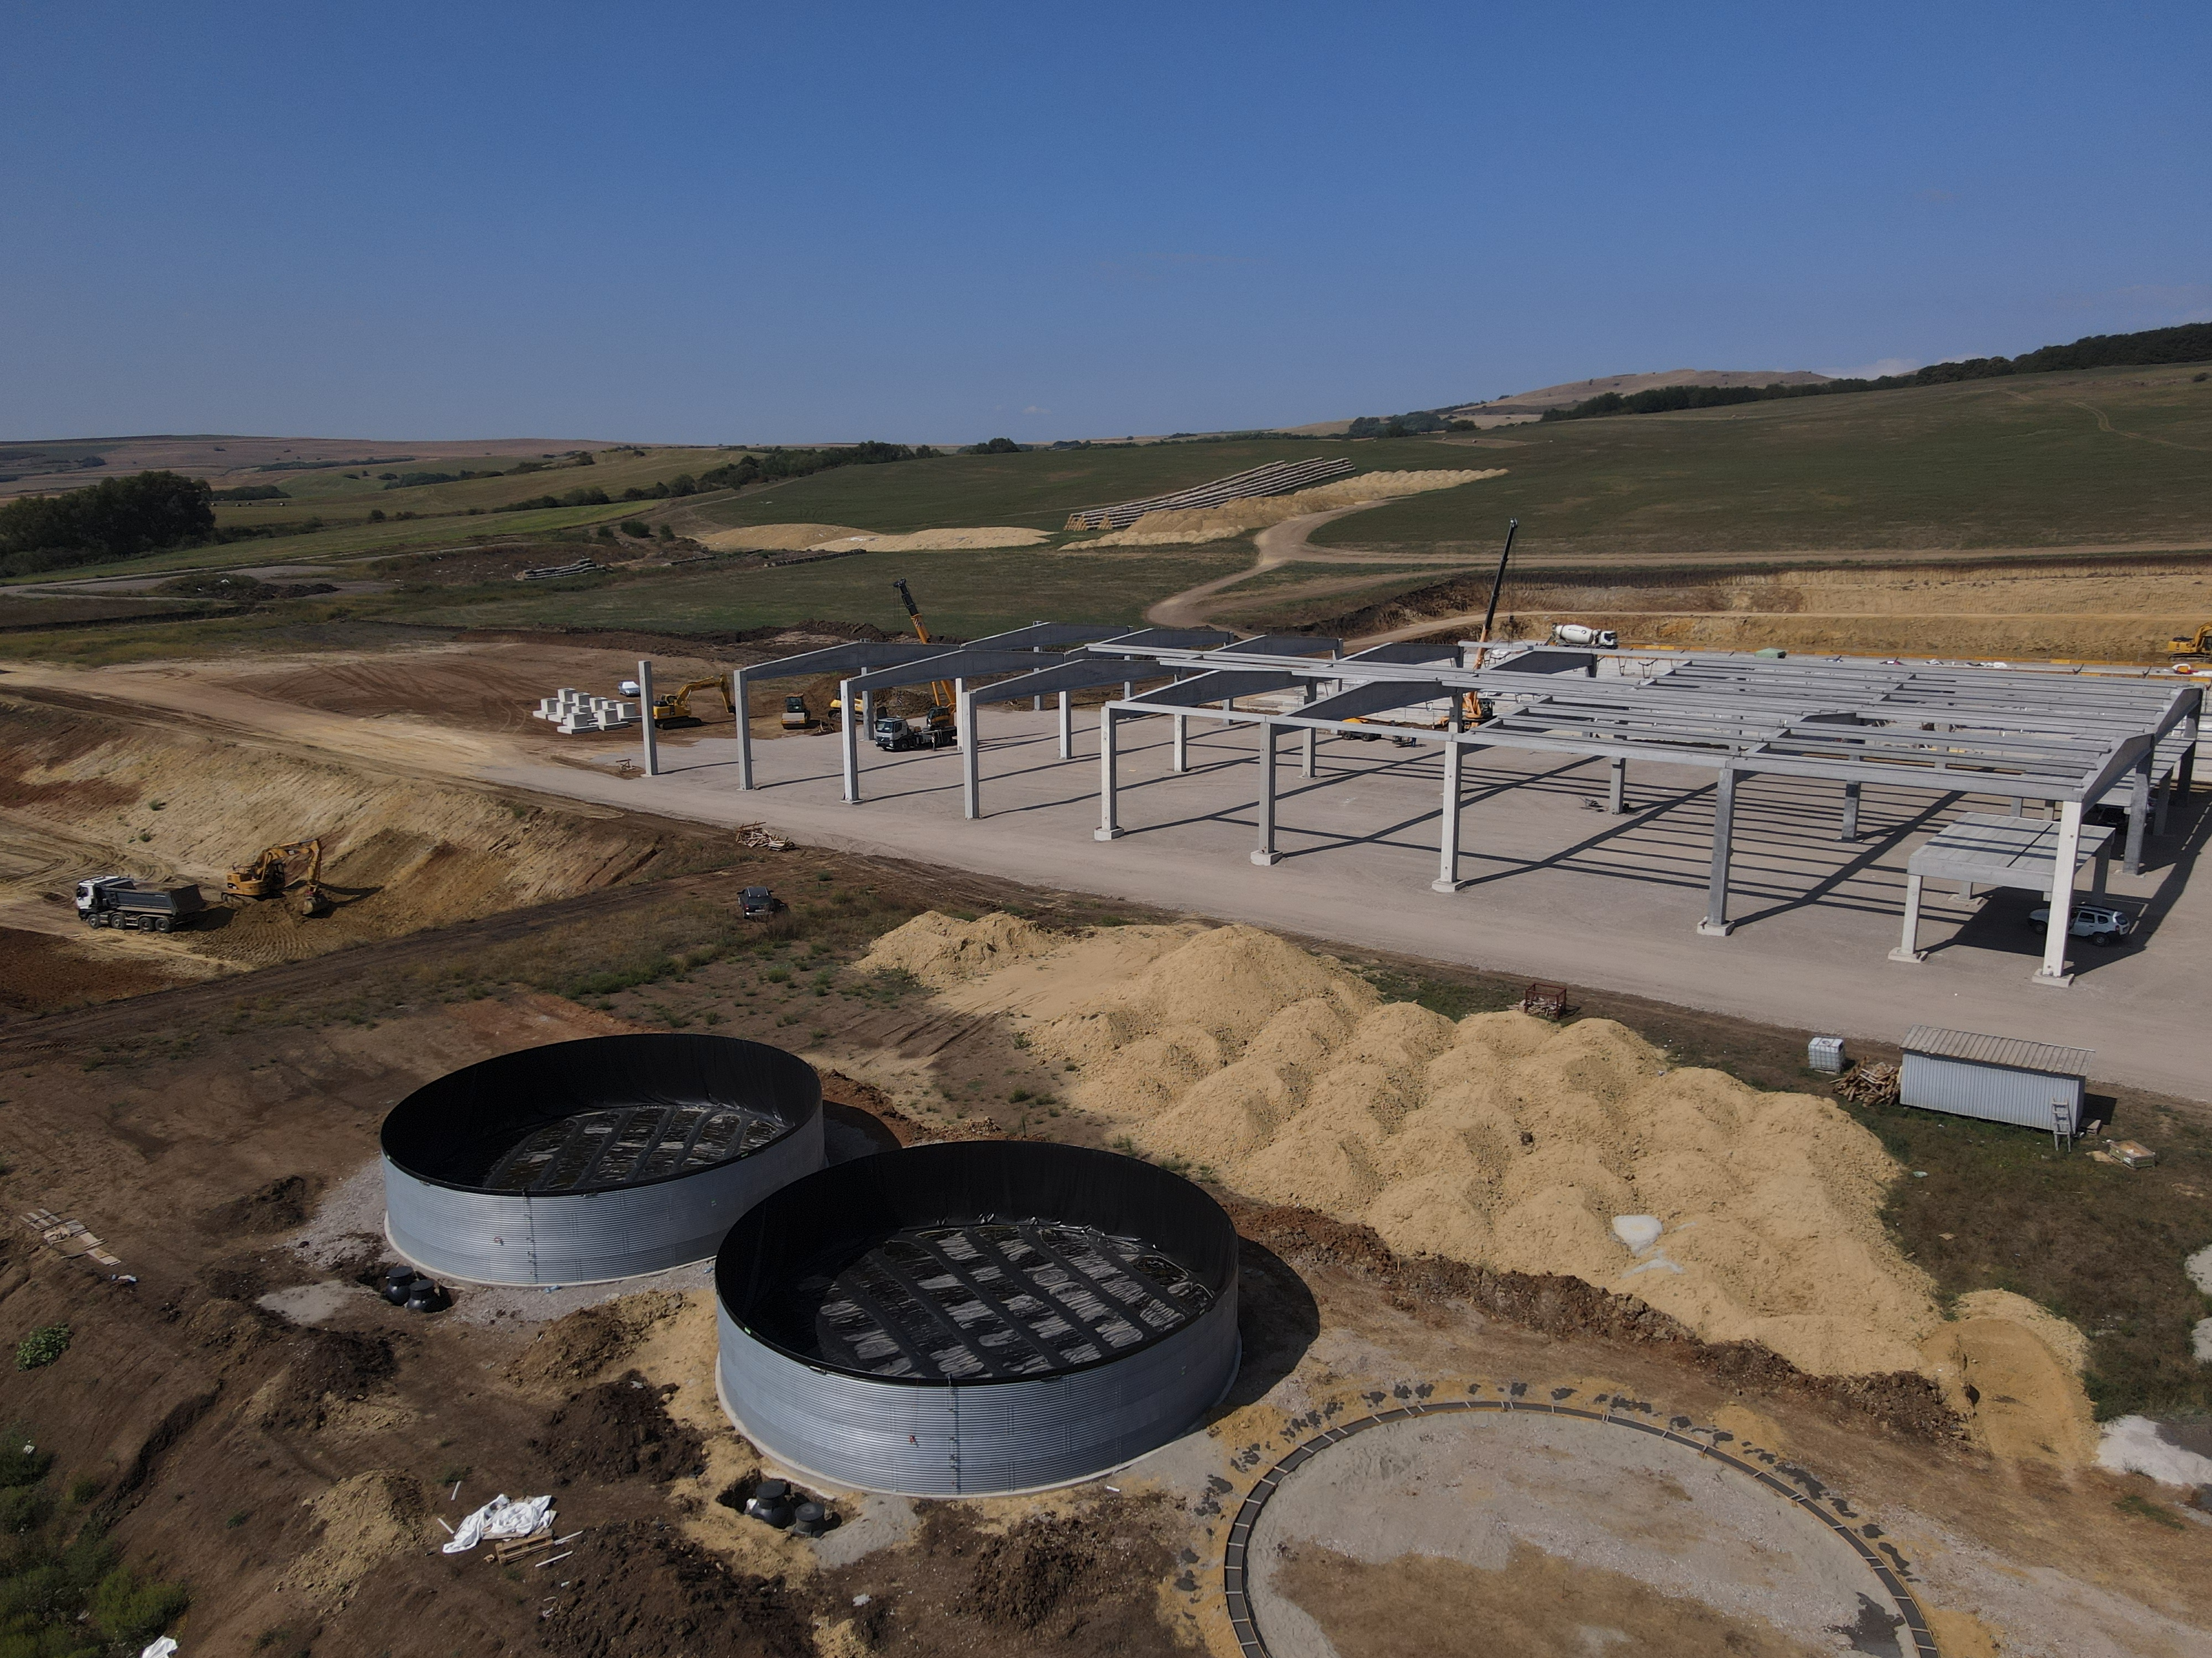
STRAJA PROJECT STATUS
A Significant Expansion in Production

Slide 27
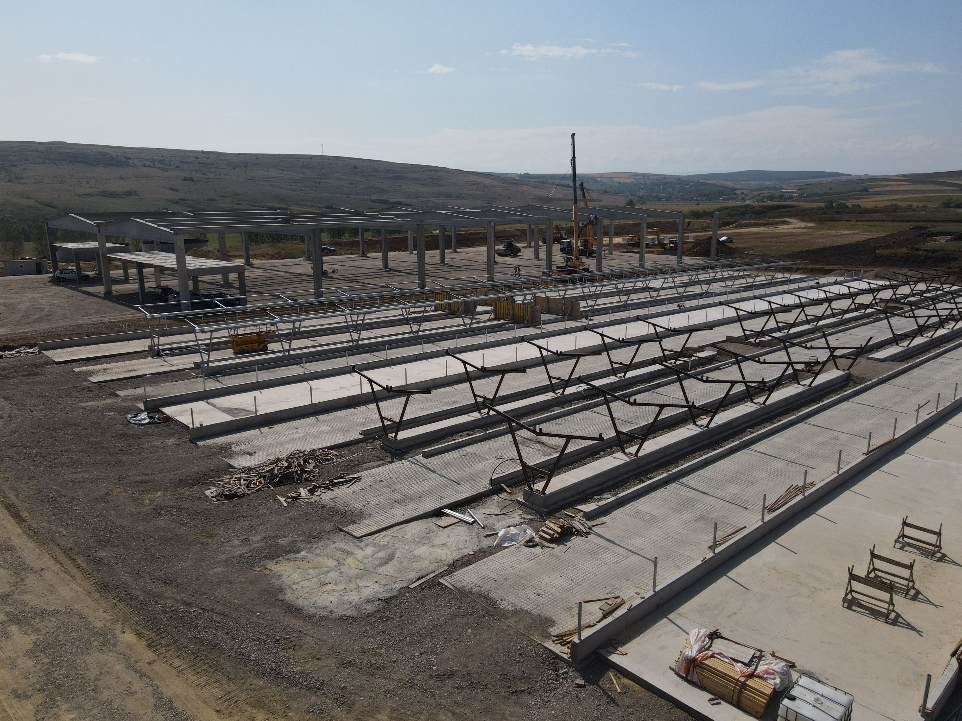
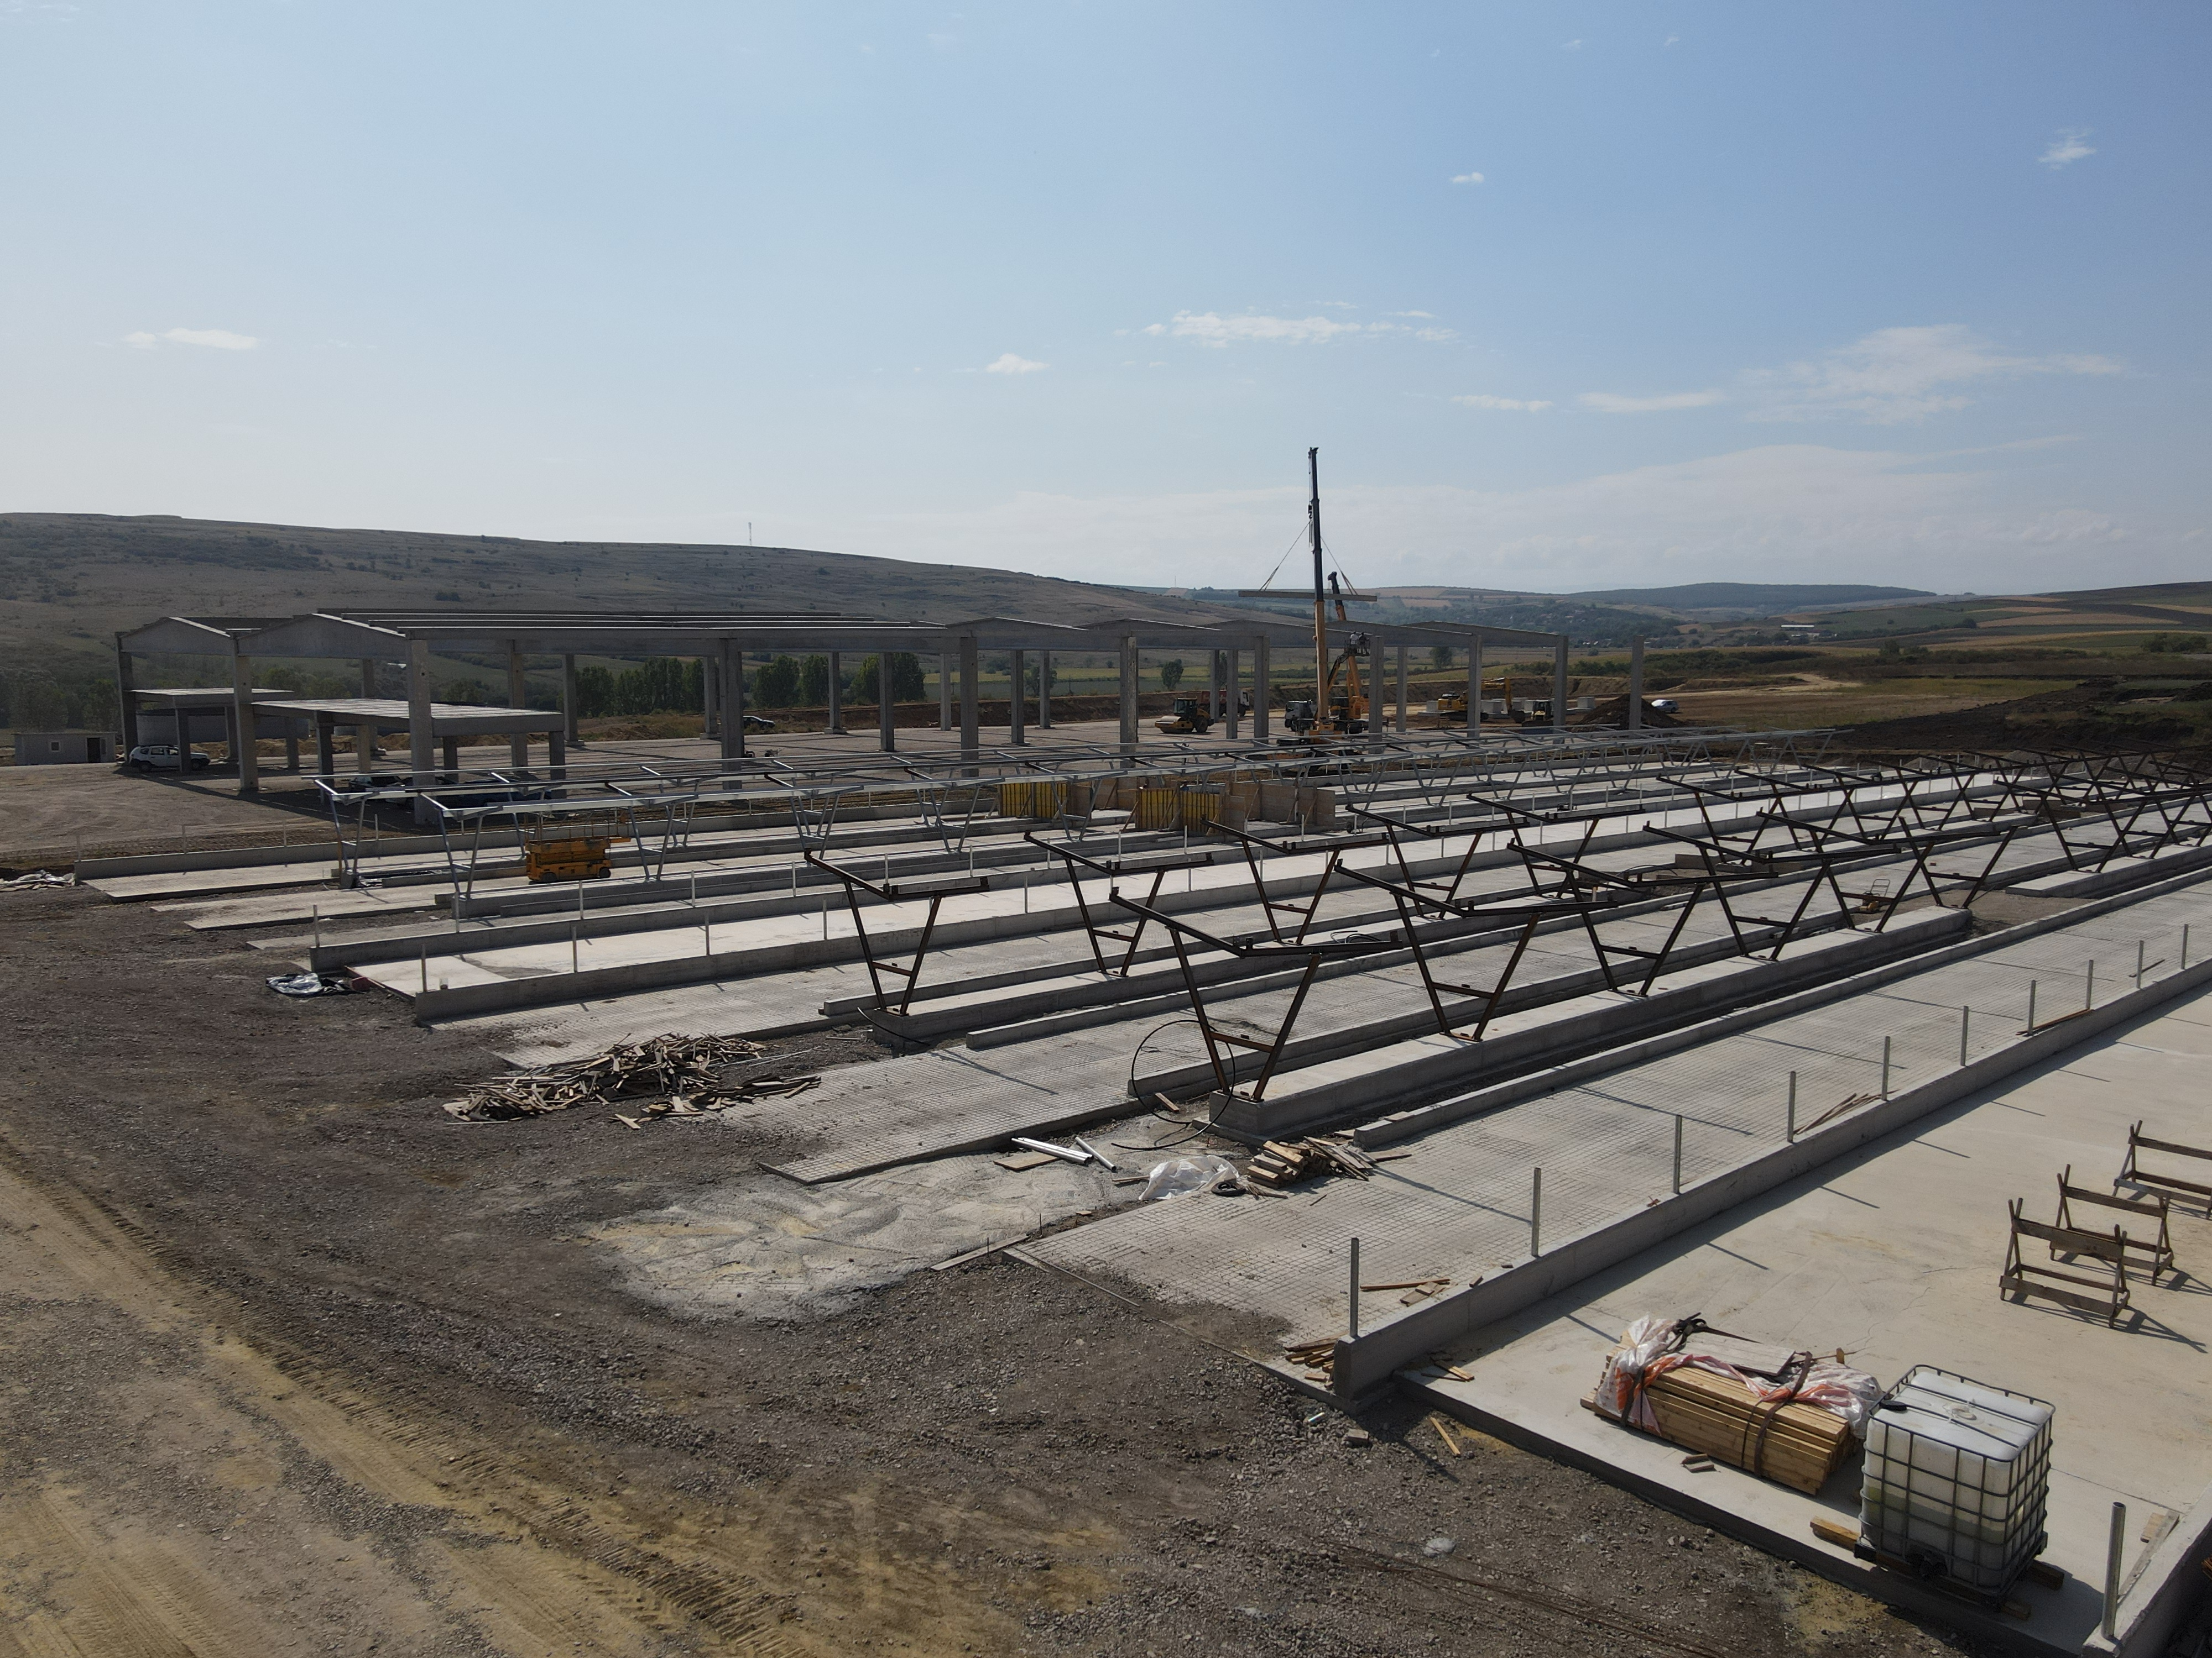
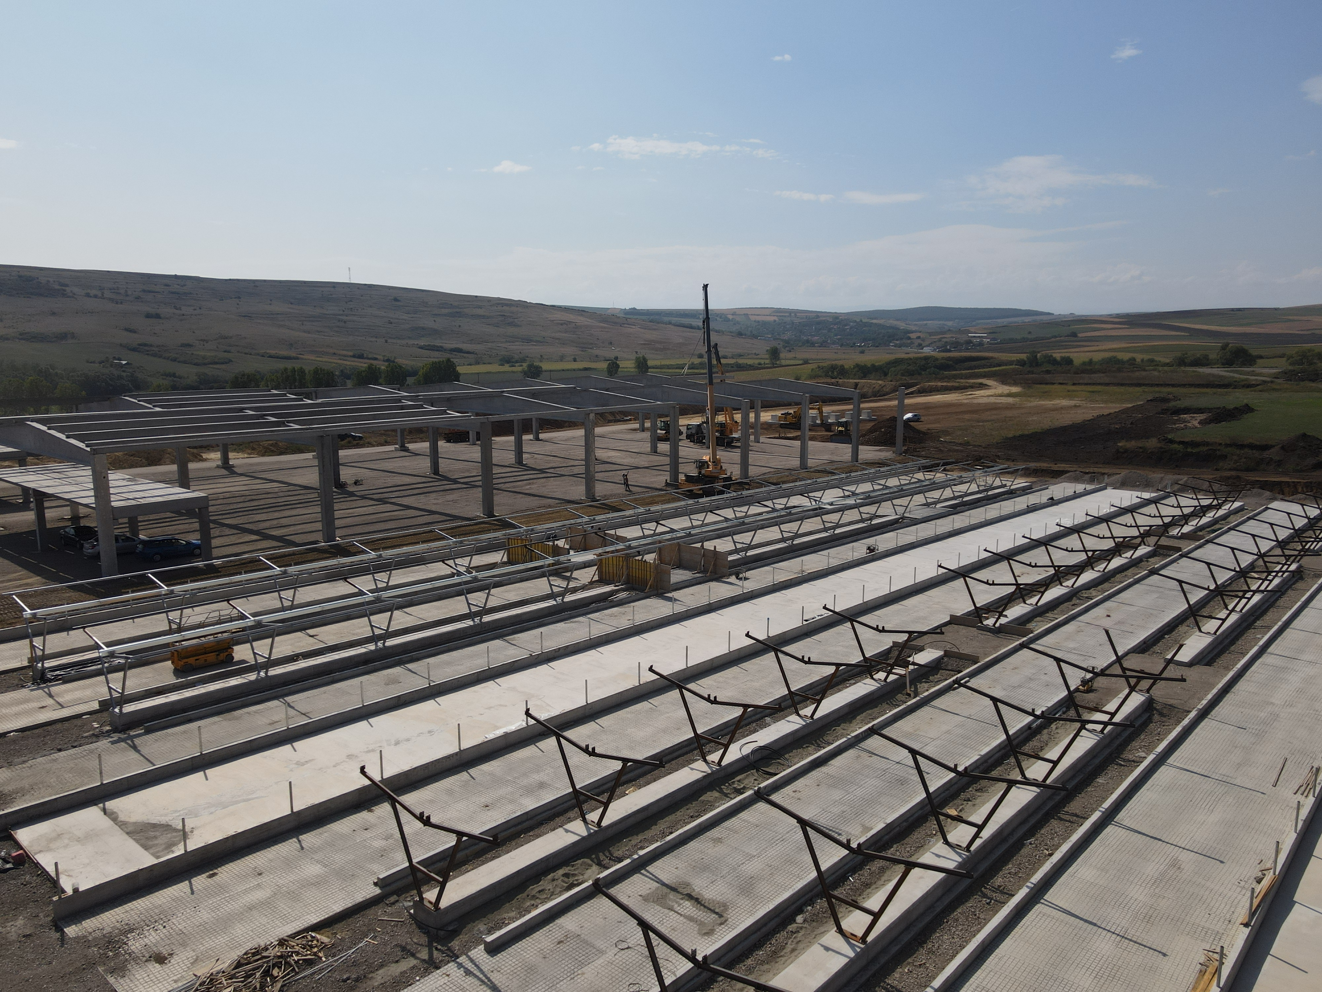
STRAJA PROJECT STATUS
A Significant Expansion in Production

Slide 28
DN AGRAR DAIRY FARMS 2027/2028
Building a Major European Milk Producer
OVER 300.000 LITERS PER DAY
THE 4 DAIRY FARMS WILL PRODUCE OVER 100 MILLION LITERS OF MILK ANNUALLY
A HERD OF APPROX 20.000 DAIRY COWS AND YOUNG STOCK

Slide 29
DN AGRAR FARMS 2027/2028
A Clear and Achievable Vision
STRAJA FARM
Acquisition FARM
3,800 dairy cattle
1,200 young stock
100,000 liters/day
600 cows milked/hour
………. dairy cattle
………. liters/day
………. cows milked/hour
APOLD FARM
CUT FARM
5,500 dairy cattle + young stock
100,000 liters/day
400 cows milked/hour
2,200 dairy cattle
50,000 liters/day
300 cows milked/hour
LACTO AGRAR FARM
PRODLACT FARM
4,000 dairy cattle + young stock
63,000 liters/day
350 cows milked/hour
Over 3,300 young stock animals
Raising young cattle for Apold and Cut farms

Slide 30
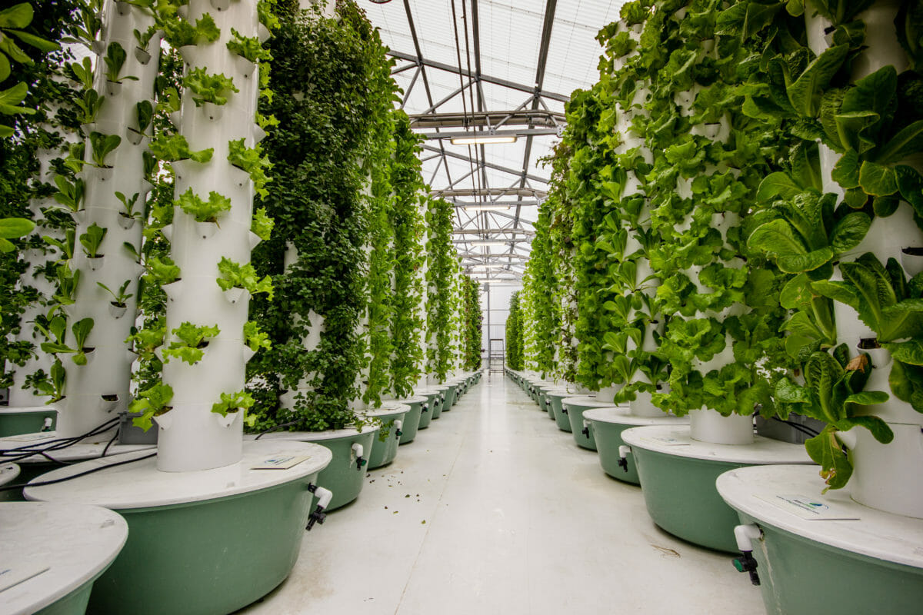
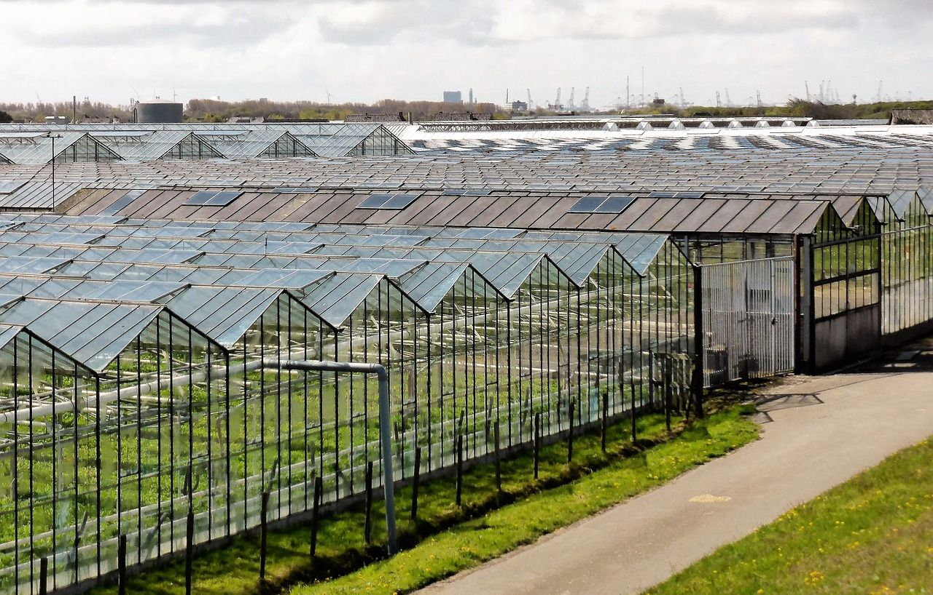
FUTURE PROJECTS
Identifying Innovative Opportunities
Production of Biogas
Under final negotiations
Currently at the stage of
discussions and internal analysis of the
offers of collaboration
By using manure from own farms in biogas production,
DN AGRAR will reduce its carbon emissions by 90%.
1
2
Vertical Farming / Greenhouse
Under analysis
Finalizing the pre-feasibility study
conducted on several Central and Eastern European Markets

Slide 31
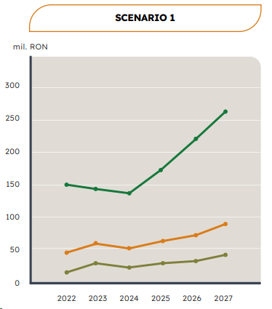
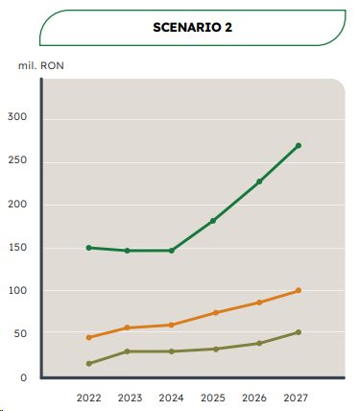
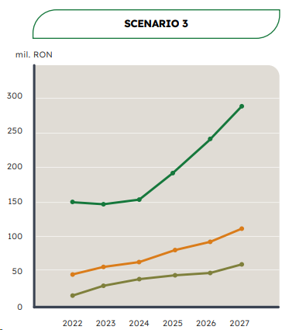
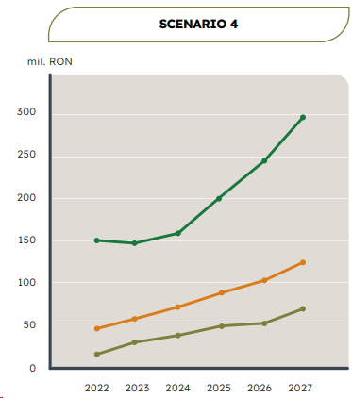
WORKING SCENARIOS until 2027
Robust Profitability Stress Tested
Net Profit
Net Turnover
EBITDA
The selling price of milk is considered to be close to 2023's lowest selling price.
The milk price at the average price level we achieved from the sale of production in November 2023.
The price of milk is considered to be at the level of the annual average at which we sold milk in 2023.
Takes into account a positive evolution in the milk price, higher than the average selling price in 2023, but at a significantly lower level than the sales price from the first quarter of 2023.

Slide 32
FUTURE EVENTS
11th of September
Financial Intelligence Capital Market Forum
26th of
November
Q3 Report
Speaker Peter de Boer, BoD Member & IR Manager
DN AGRAR will publish the 3rd Quarter Report
September
Profit TV
28th of
November
Teleconference Q3 Report
Company documentary & Interview Peter de Boer, BoD Member & IR Manager
DN AGRAR will organize the teleconference for presenting Q3 2024 results

Slide 33
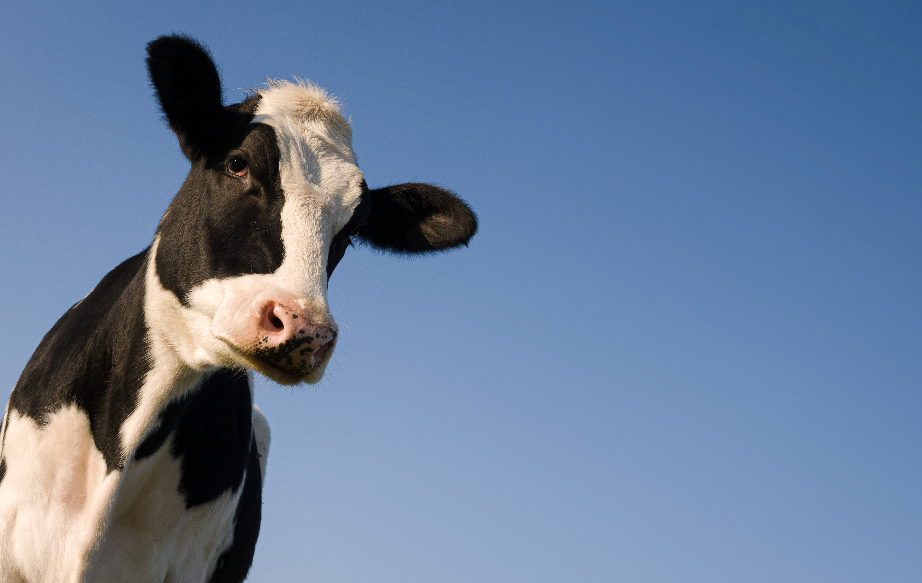
CONTACT INVESTOR RELATIONS
Peter de Boer,
BoD Member & Investor Relations Manager
investors@dn-agrar.eu , +40 258 818114

Slide 34
QUESTIONS
Can you provide the status of the new and ongoing business development projects?
Which are the main clients to whom you sell the milk?
What events could determine a more pessimistic scenario than the most pessimistic scenario presented by you? (the 4 scenarios)

