Slide 1
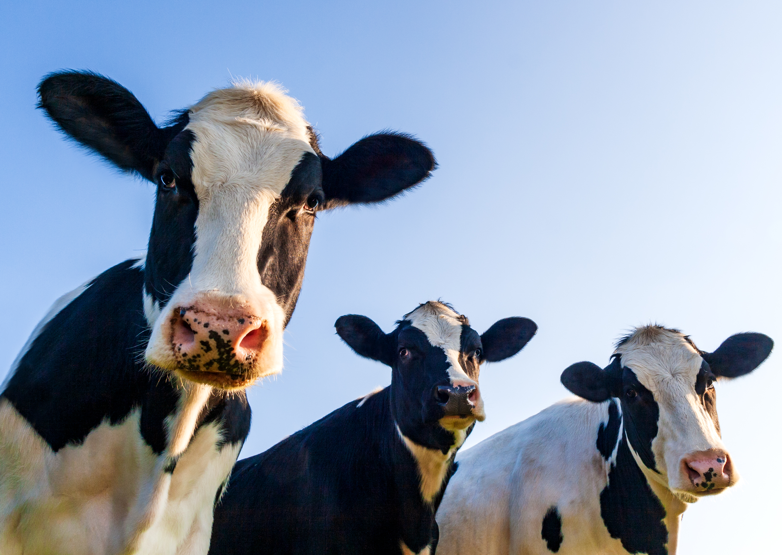
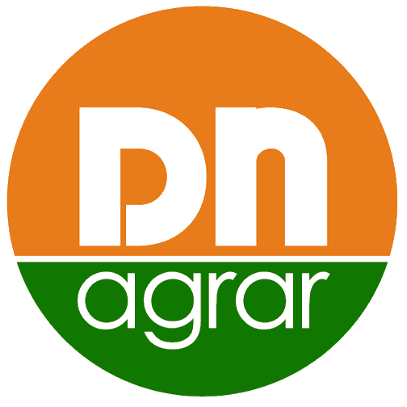
Presentation Financial Results
Q1 2024
- May 2024 -

Slide 2
CONTENT
ABOUT DN AGRAR
Q1 2024 RESULTS & OUTLOOK
DN AGRAR STRATEGY

Slide 3
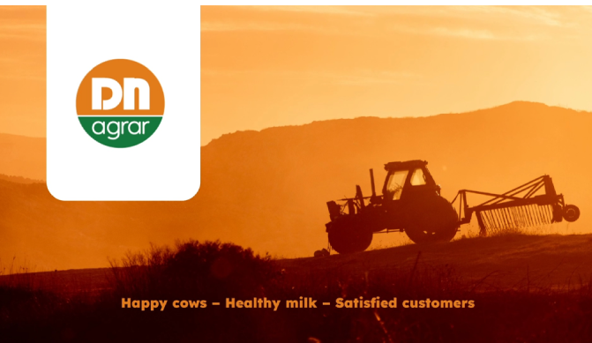
DN AGRAR INVESTMENT PROPOSITION
Leading milk producers in Europe and the largest integrated zootechnical farm in Romania, with cow milk production and vegetable production.
Market
Position
Focus on sustainable, regenerative agriculture practices that maximize productivity, reduce environmental impact, and ensure long-term profitability.
Sustainable
Agriculture
Strategy
Tripled its business since listing.
To double the business by 2027 supported by operation efficiencies and the development of a new farm.
Target 2027: production of over 100 million liters of milk delivered annually
Track
Record
~ 60 million liters of milk delivered annually.
Notes:
With a clear vision for expansion and development, DN AGRAR aims to capitalize on emerging opportunities in the agricultural market while mitigating risks through prudent financial management and strategic planning

Slide 4
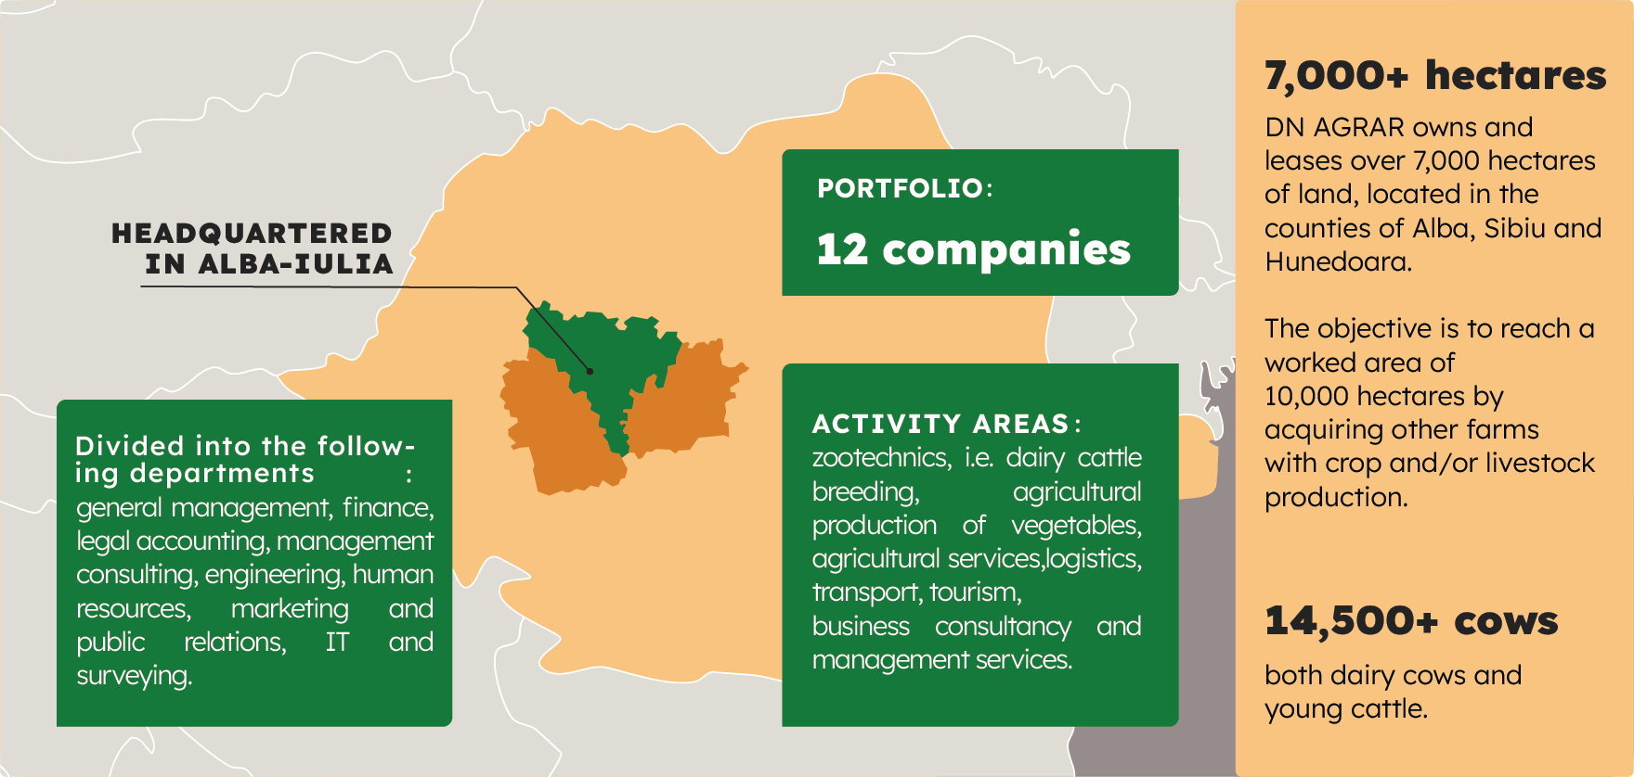
DN AGRAR ACTIVITY
Zootechnics
Vegetal agricultural production
Agricultural services
Logistics
Transport
Tourism
Business and management consulting services

Slide 5
DN AGRAR FARMS TODAY
APOLD FARM
CUT FARM
5,500 dairy cattle & young stock
70,000 liters/day
400 cows milked/hour
2,200 dairy cattle
50,000 liters/day
300 cows milked/hour
LACTO AGRAR FARM
PRODLACT FARM
4,000 dairy cattle & young stock
63,000 liters/day
350 cows milked/hour
Over 3,000 young stock animals
Raising young cattle for Apold and Cut farms

Slide 6
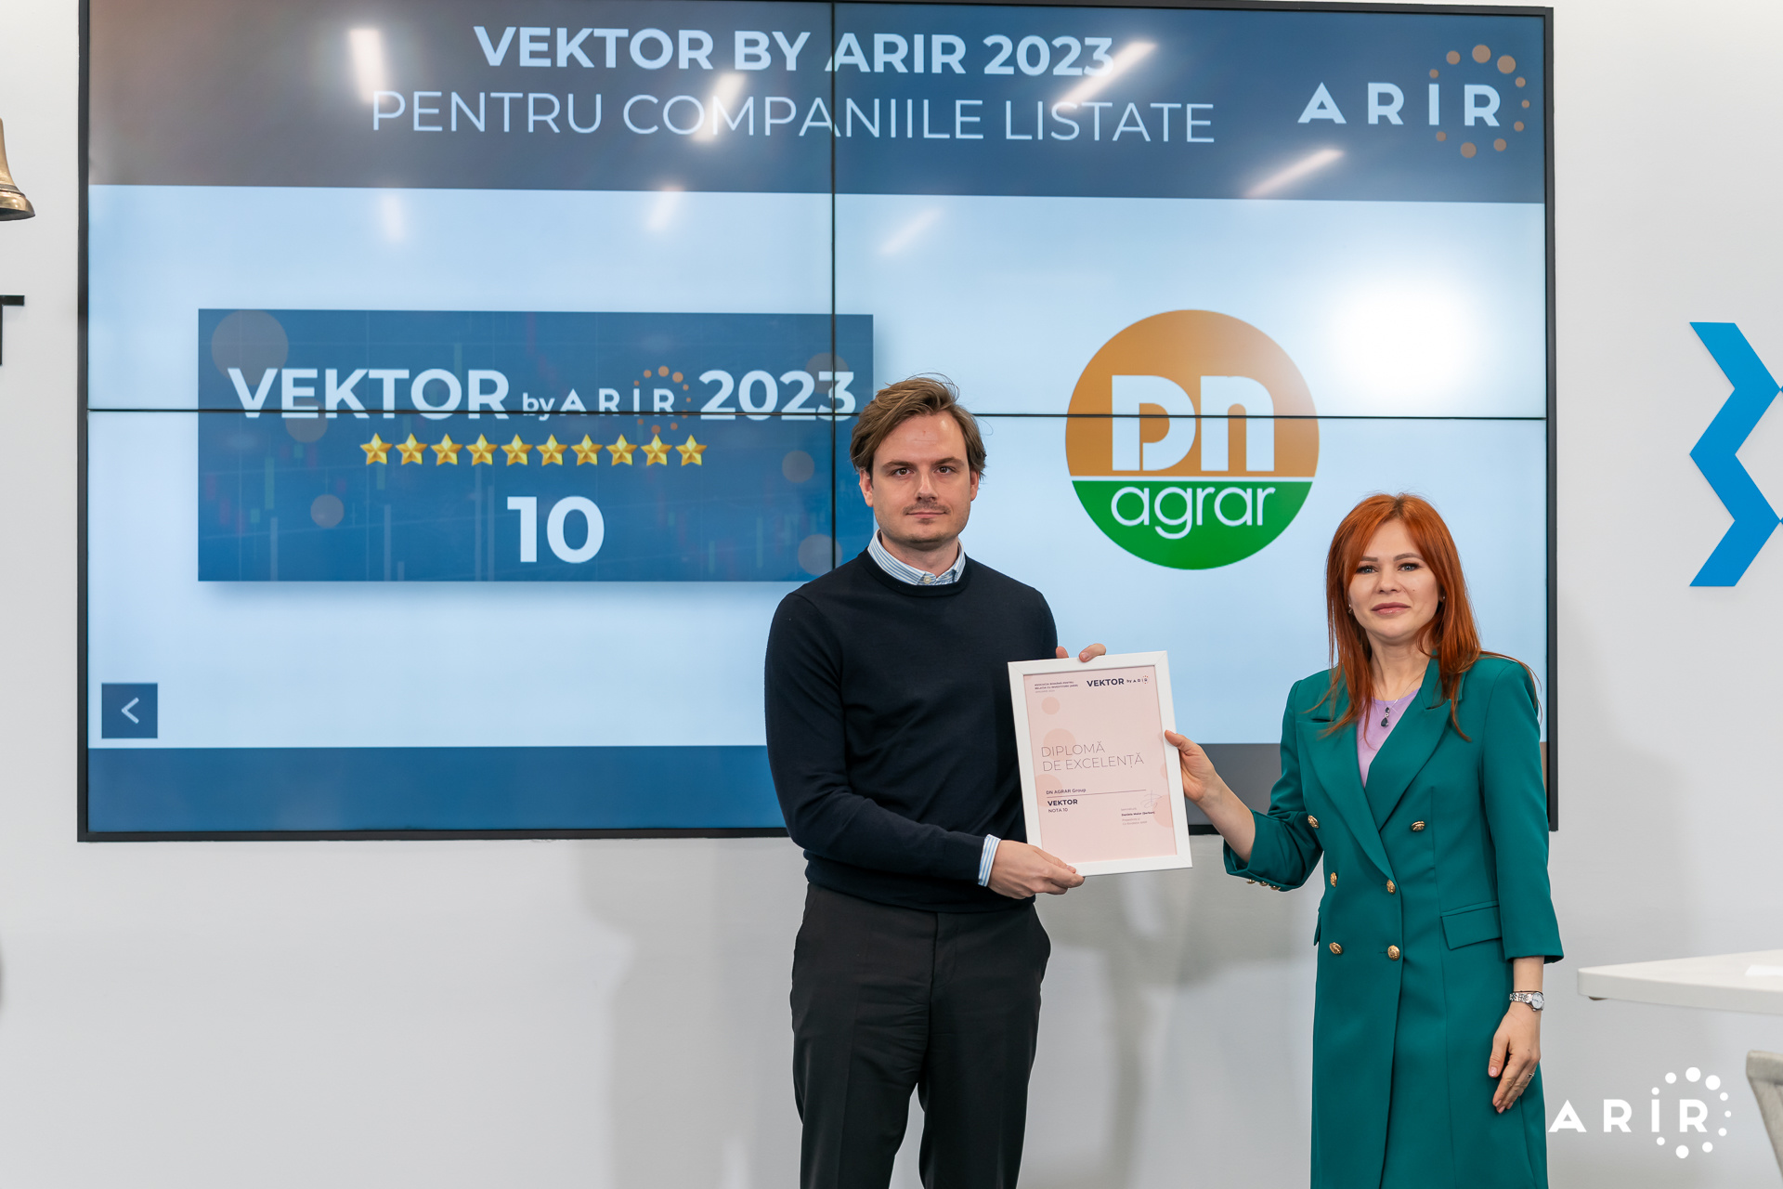
DN AGRAR IN THE CAPITAL MARKET
Listed on the Bucharest Stock Exchange, AeRO market since February 2, 2022
+123% share price performance on March 29, 2024, compared to March 31, 2023
Shares included in the BETAeRO and MSCI Frontier Small Cap and MSCI Romania Small Cap indices
Over 2.500 shareholders
Market-Making services provided by BRK Financial Group
Analysts covering DN share
Prime Transaction – December 18, updated target price 1.6922 RON
Prime Transaction – November 22, target price 1.5954 RON
BRK Financial Group – June 30, target price 0.91 RON
Recognition
10 in the second VEKTOR by ARIR 2023 evaluation
Best Company in IR – AeRO Market, awarded by ARIR after being voted by individual investors

Slide 7
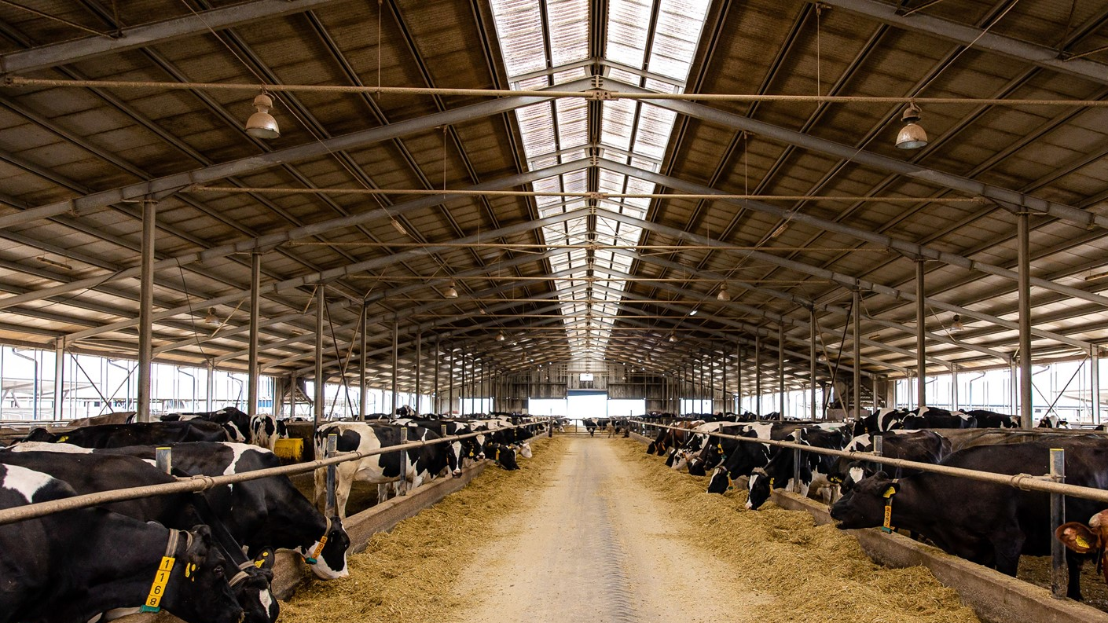
Q1 2024 RESULTS & OUTLOOK

Slide 8
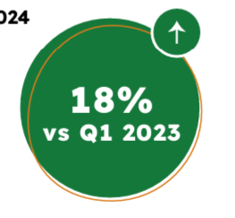
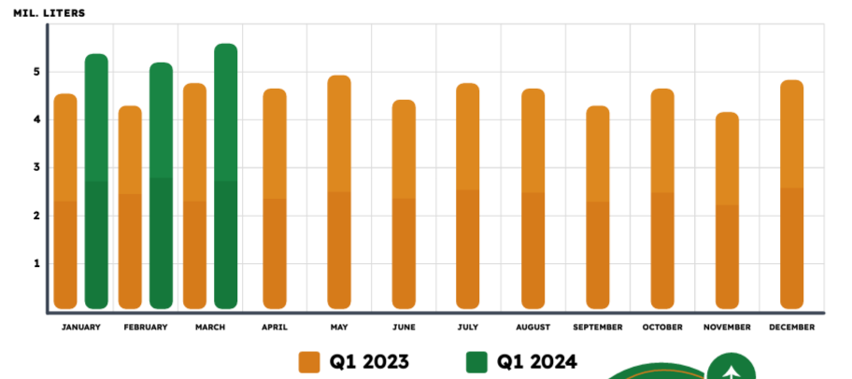
MILK PRODUCTION EVOLUTION
DN AGRAR recorded an 18% increase in the first quarter of 2024 compared to the same period of last year.
DN AGRAR exceeded the threshold of 5 million liters delivered monthly, in each month of the current year's first quarter. In March 2024, the quantity of milk delivered increased by 18% compared to March 2023.
For the next quarters of this year, we expect to maintain the current pace of our operational activity, including milk production, thereby consolidating the growth of milk deliveries to our customers.

Slide 9
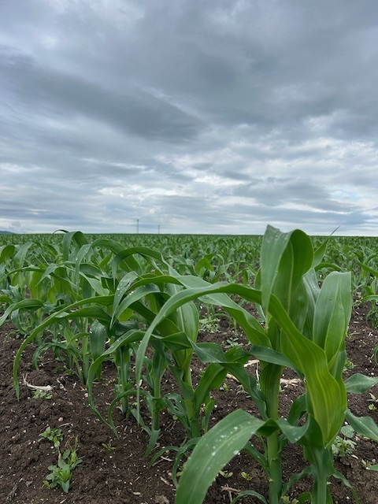
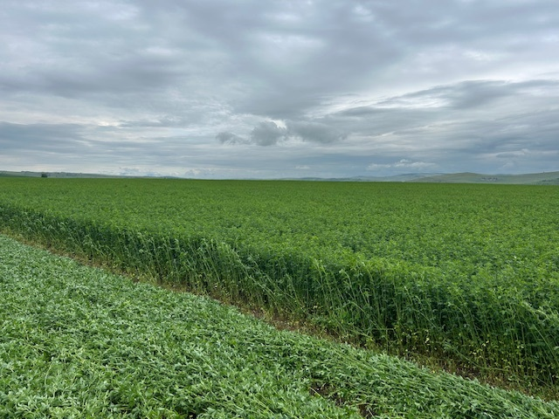
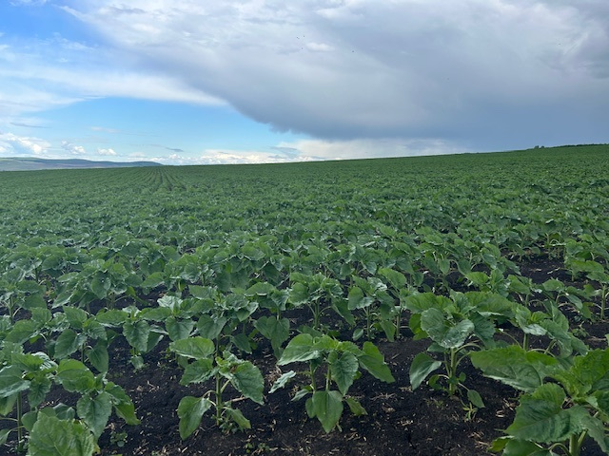
CEREAL PRODUCTION EVOLUTION
Lucerne:
2 harvests, with a production of 13 tons/ha
Triticale
800 ha harvested
Production of 30 tons/ha
In 2023, we had a production of 23 tons/ha
Still need to harvest 400 ha
After the harvest, seeding corn as a
second crop

Slide 10
KEY PERFORMANCE INDICATORS
TURNOVER
NET PROFIT
EBITDA
RON 40.28 mil.
-9.02%
Vs Q1 2023
RON 7.89 mil.
-4.53%
Vs Q1 2023
RON 17.70 mil.
+3.35%
Vs Q1 2023
NET ASSETS
TOTAL ASSETS
EQUITY
RON 239.13 mil.
+3.40%
Vs 31.12.2023
RON 316.38 mil.
+2.74%
Vs 31.12.2023
RON 141.36 mil.
+6.02%
Vs 31.12.2023

Slide 11
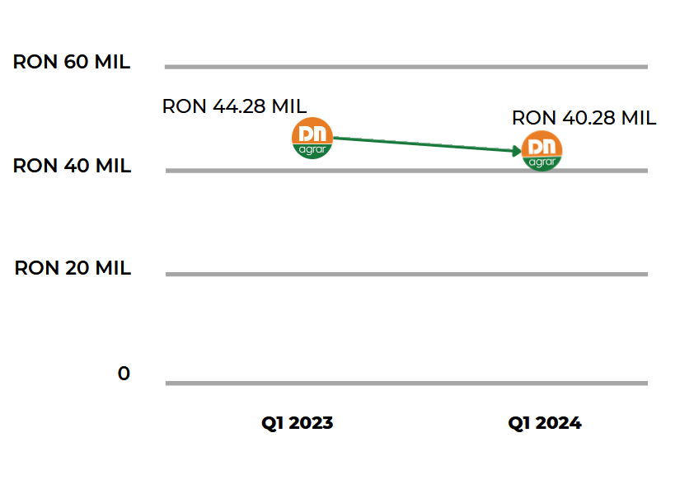
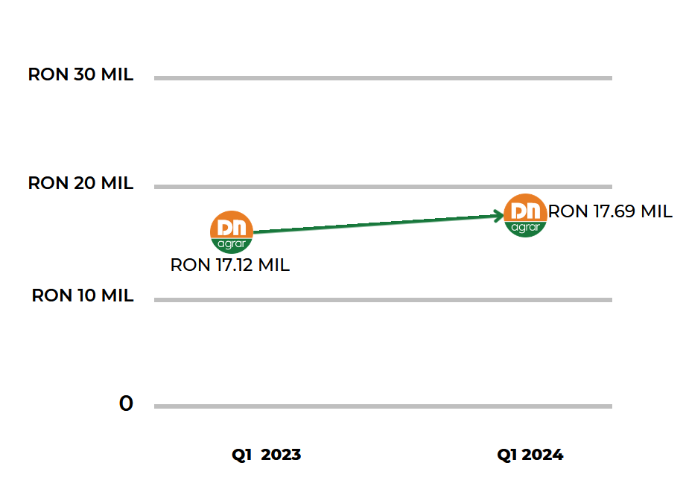
KEY PERFORMANCE INDICATORS
EVOLUTION TURNOVER
EVOLUTION EBITDA

Slide 12
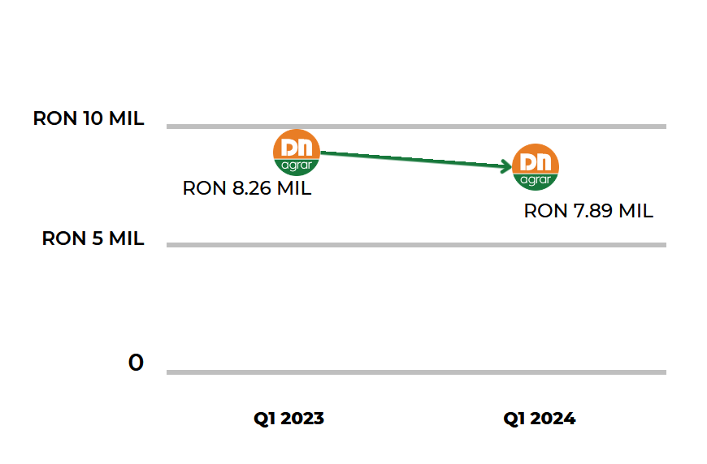
KEY PERFORMANCE INDICATORS
EVOLUTION NET PROFIT
Decreased by 5% compared to T1 2023, primarily impacted by the decrease of 25% in milk prices.

Slide 13
FINANCIAL RESULTS HIGHLIGHTS
Operating expenses increased by 3.27% as of March 31, 2024, reaching RON 49 million.
The main contribution came from expenses related to adjustments for tangible and intangible assets, which reached RON 6 million, representing an increase of 17% compared to the same period last year.
This evolution is linked to the revaluation of fixed assets in DN AGRAR farms. Specifically, negative differences from revaluation were recorded, largely stemming from the revaluation of agricultural land.
PROFIT AND LOSS ACCOUNT (RON) | 31/03/2024 | 31/03/2023 | ∆%
OPERATING INCOME – TOTAL | 60,152,441 | 60,406,670 | (0.42)%
OPERATING EXPENSES – TOTAL | 48,559,094 | 47,022,493 | 3.27%
OPERATING PROFIT OR LOSS | 11,593,346 | 13,384,178 | (13.38)%
FINANCIAL INCOME – TOTAL | 260,094 | 227,894 | 14.13%
FINANCIAL EXPENSES – TOTAL | 2,034,111 | 3,232,949 | (37.08)%
FINANCIAL PROFIT OR LOSS | (1,774,017) | (3,005,055) | (40.97)%
GROSS PROFIT OR LOSS | 9.819.329 | 10.379.123 | (5.39)%
NET PROFIT OR LOSS | 7,889,460 | 8,263,505 | (4.53)%

Slide 14
THE MAIN ELEMENTS OF THE BALANCE SHEET
BALANCE SHEET INDICATORS (RON) | 31/03/2024 | 31/12/2023 | ∆%
FIXED ASSETS - TOTAL | 213,534,017 | 212,141,058 | 0.66%
CURRENT ASSETS - TOTAL | 100,027,969 | 94,362,606 | 6%
DEFERRED EXPENSES | 2,820,633 | 1,441,310 | 95.70%
TOTAL ASSETS | 316,382,619 | 307,944,974 | 2.74%
DEBTS: AMOUNTS TO BE PAID WITHIN UP TO ONE YEAR | 77,111,558 | 76,397,539 | 0.93%
DEBTS: AMOUNTS TO BE PAID IN MORE THAN ONE YEAR | 95,924,935 | 95,954,744 | (0.03)%
PROVISIONS | 151,345 | 385,892 | (60.78)%
DEFERRED REVENUES | 1,832,188 | 1,867,001 | (1.86)%
DEBT - TOTAL | 173,036,494 | 172,352,283 | 0.40%
EQUITY – TOTAL | 141,362,592 | 133,339,798 | 6.02%
TOTAL EQUITY AND DEBT | 316,382,619 | 307,944,974 | 2.74%
Equity increased by 6% compared to December 31, 2023, reaching RON 141 million, a rise driven by the recording of a net profit of 8 million lei on March 31, 2024.
Long-term liabilities remained approximately at the same level as at the end of 2023, thus as of March 31, 2024, the balance of long-term liabilities reached RON 96 million.
Provisions decreased by 61% in the first quarter of 2024 compared to the end of 2023, reaching RON 151 thousand.

Slide 15
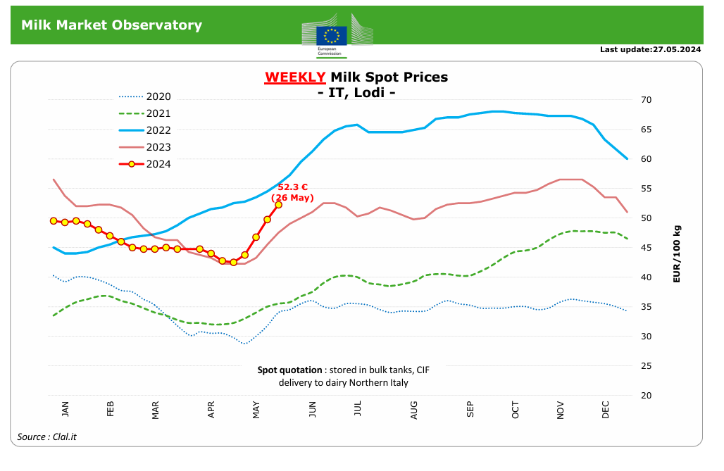
OUTLOOK Q2 2024
Key highlights of the European milk market
IT spot milk price still rising, now at 52.3 c/kg (26.05.2024)
EU butter prices: 609€/100 kg, +4.3% in the last 4 weeks
EU SMP prices: 244€/100 kg, +1.8% in the last 4 weeks
EU WMP prices: 373€/100 kg, +2.3% in the last 4 weeks
EU cheddar prices: 390€/100kg, -0.6% in the last 4 weeks
*https://agriculture.ec.europa.eu/data-and-analysis/markets/price-data/price-monitoring-sector/milk-and-dairy-products_en

Slide 16
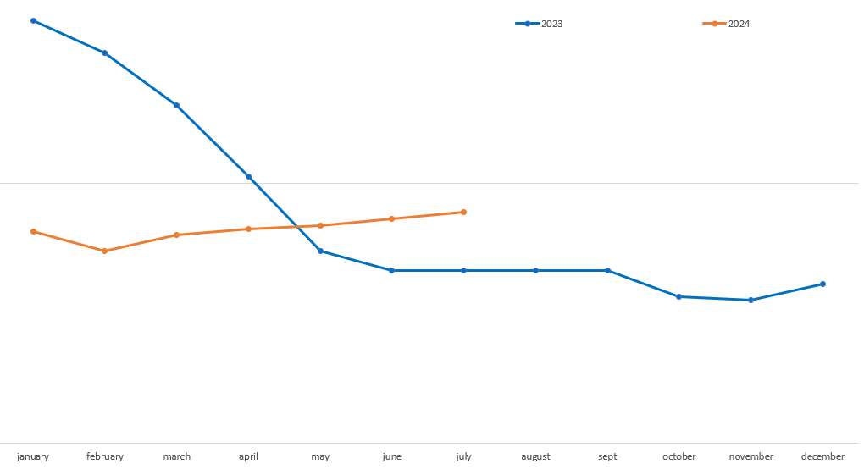
OUTLOOK OF DN AGRAR MILK PRICE

Slide 17
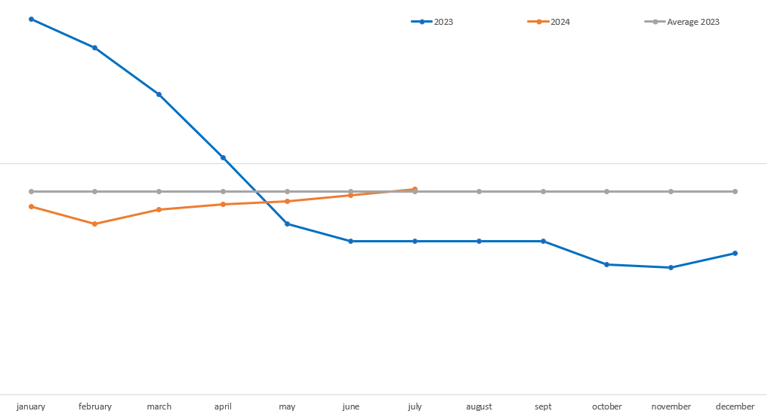
OUTLOOK OF DN AGRAR MILK PRICE

Slide 18
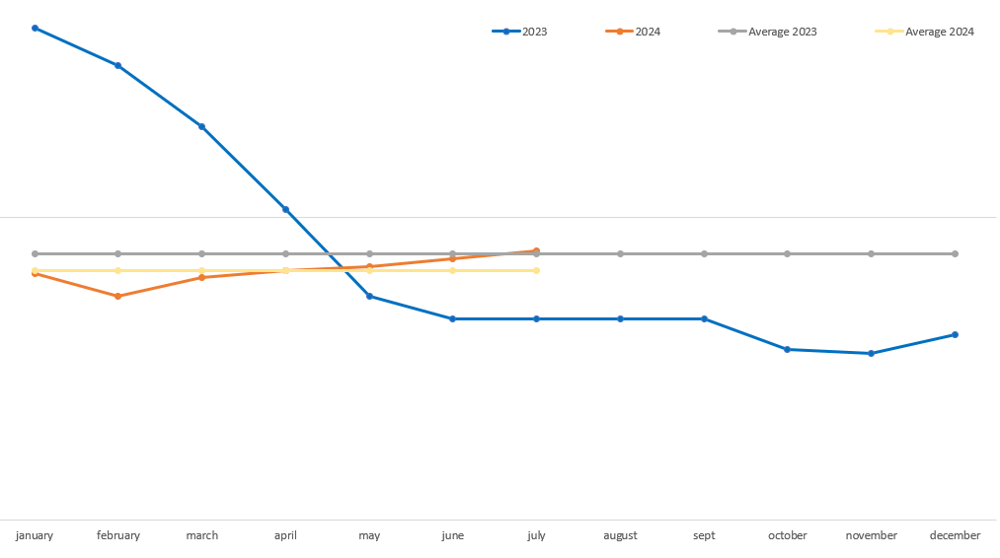
OUTLOOK OF DN AGRAR MILK PRICE

Slide 19
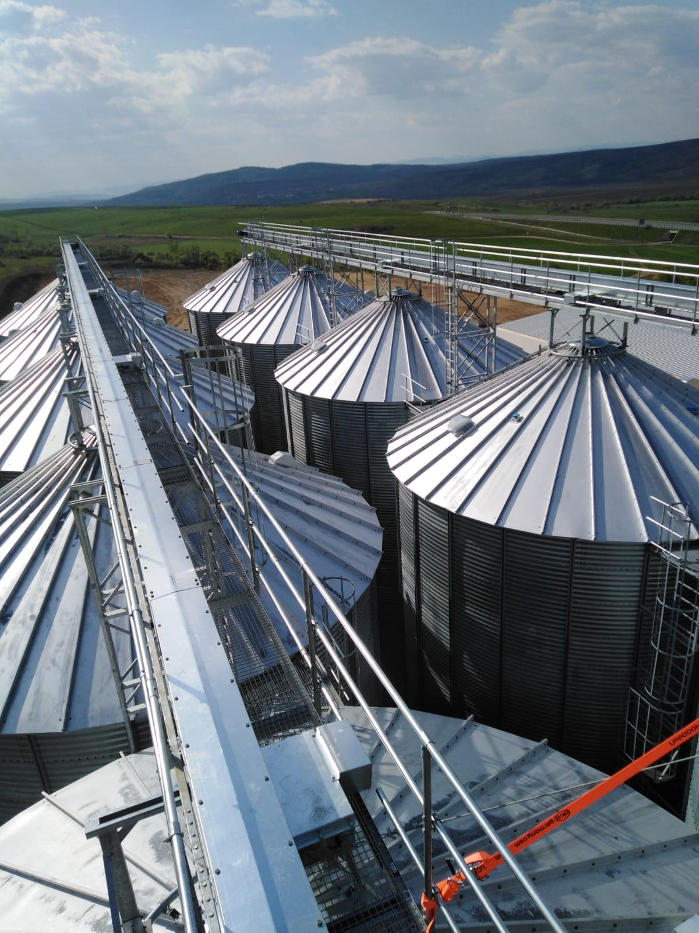
DN AGRAR
PROJECTS

Slide 20
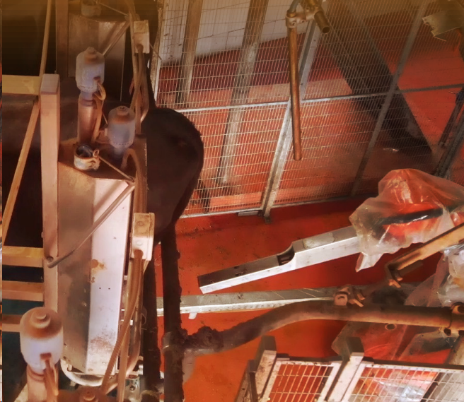
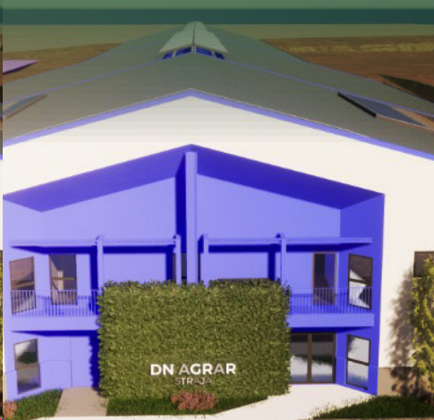
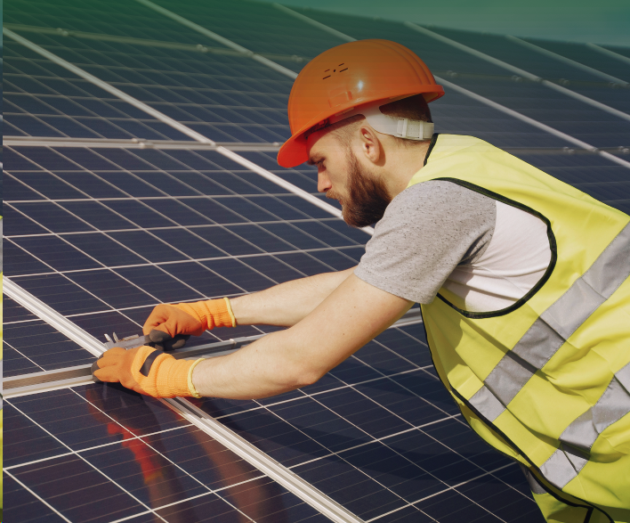
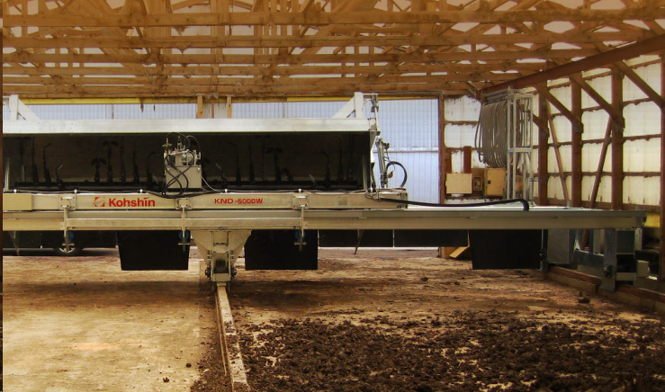
CURRENT PROJECTS AND PERSPECTIVES
Robots for farms
Installation of 2nd robot for the milking parlors of the DN AGRAR Cut and Lacto Agrar farms continued in the first quarter and the finalization was in May 2024.
Solar panels on the roof of the buildings of the DN AGRAR Apold, DN AGRAR Cut and Lacto Agrar farms.
Straja project
In the first part of 2024, DN AGRAR shareholders approved the financing for Straja farm.
The construction phase started for the first milking parlor, and in September 2024, we expect that milk production will begin at the Straja farm with 600 dairy cows, and gradually increase the number of dairy cows to 900, by the end of 2024.
Compost Factory Construction
In 2023, we completed the first 3 phases of this project, with the completion of the construction of the composting building, where we will place the composting unit.
In the next phase, we will start the installation of necessary equipment and machinery, including the composting machine, packaging and wrapping line, and associated auxiliary equipment

Slide 21
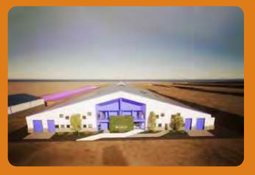
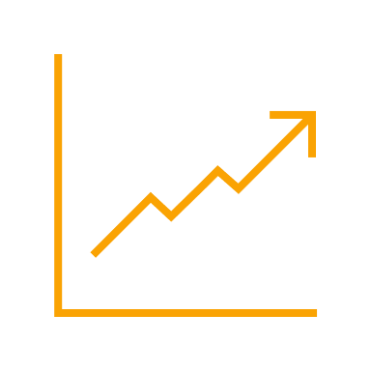
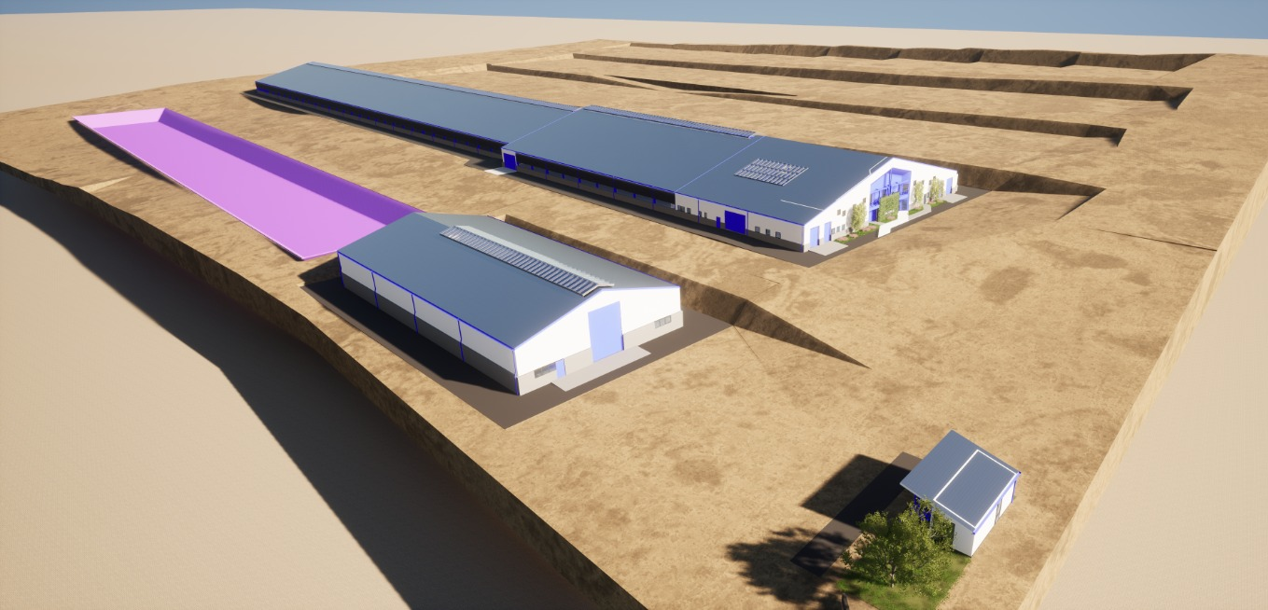
STRAJA PROJECT
Project planned to be completed in 2027
Capacity of 5,000 cows (3,800 dairy cows & 1,200 young stock)
Timeline
2024: Construction works start, approx. 1,000 cows in production
2025: Approx. 1,700 cows in production & pregnancy
2026: Approx. 3,400 cows in production & pregnancy
2027: Approx. 4,000 cows in production & pregnancy
Impact
Straja Project will be an engine to our company’s growth, being estimated to double DN AGRAR’s business
Financing
A credit facility of 9.2 million euros to develop the farm, for equipment and the purchase of animals.
For this project, DN AGRAR will provide 20.78% by own sources.

Slide 22
DN AGRAR DAIRY FARMS 2027/2028
OVER 300.000 LITERS PER DAY
THE 4 DAIRY FARMS WILL PRODUCE OVER 100 MILLION LITERS OF MILK ANNUALLY
A HERD OF APPROX 20.000 DAIRY COWS AND YOUNG STOCK

Slide 23
DN AGRAR FARMS 2027/2028
STRAJA FARM
Acquisition FARM
3,800 dairy cattle
1,200 young stock
100,000 liters/day
600 cows milked/hour
………. dairy cattle
……….liters/day
………. cows milked/hour
APOLD FARM
CUT FARM
5,500 dairy cattle + young stock
100,000 liters/day
400 cows milked/hour
2,200 dairy cattle
50,000 liters/day
300 cows milked/hour
LACTO AGRAR FARM
PRODLACT FARM
4,000 dairy cattle + young stock
63,000 liters/day
350 cows milked/hour
Over 3,300 young stock animals
Raising young cattle for Apold and Cut farms

Slide 24
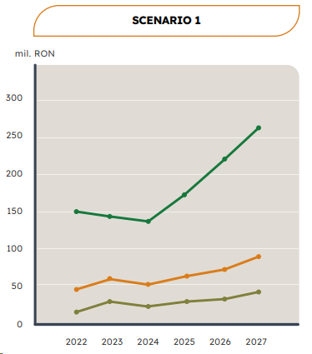
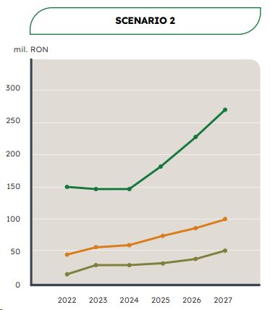
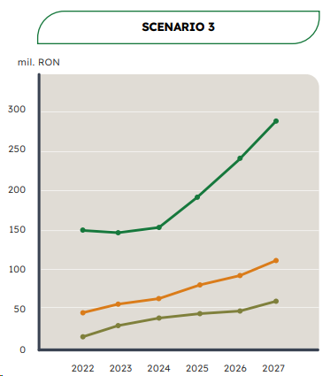
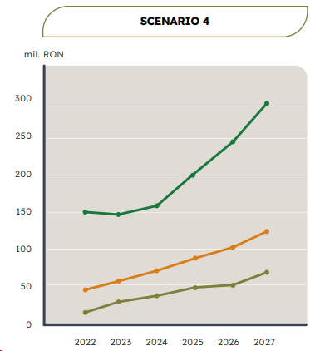
WORKING SCENARIOS until 2027
Net Profit
Net Turnover
EBITDA
The selling price of milk is considered to be close to 2023's lowest selling price.
The milk price at the average price level we achieved from the sale of production in November 2023.
The price of milk is considered to be at the level of the annual average at which we sold milk in 2023.
Takes into account a positive evolution in the milk price, higher than the average selling price in 2023, but at a significantly lower level than the sales price from the first quarter of 2023.

Slide 25
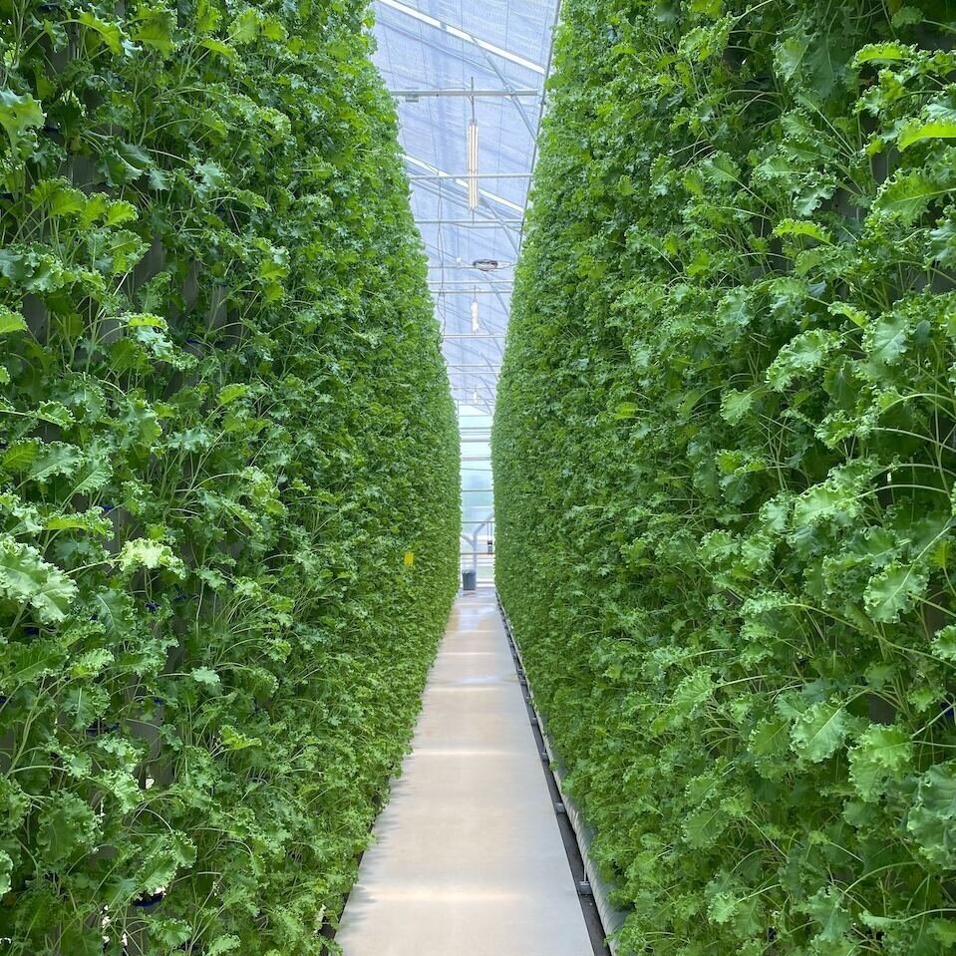
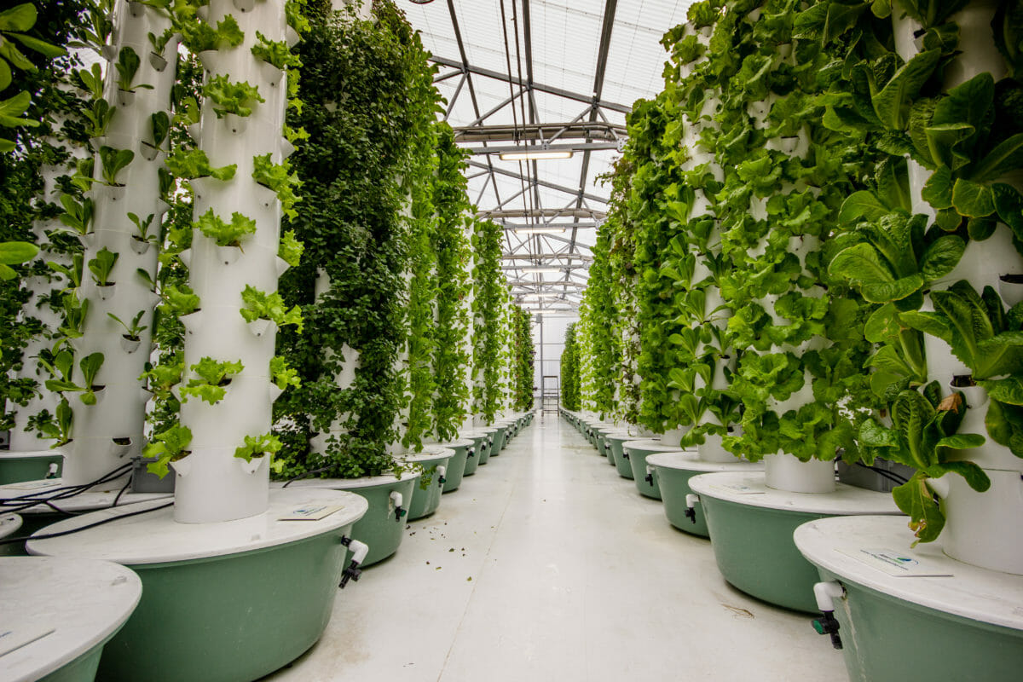
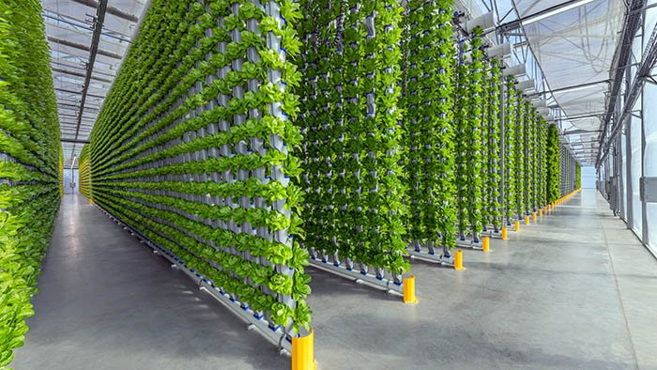
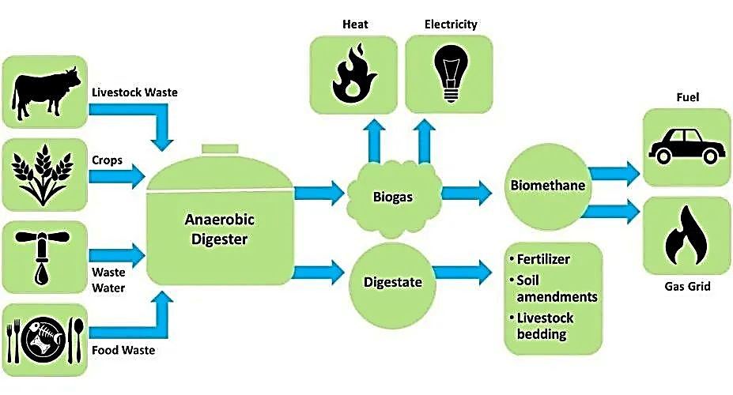
FUTURE PLANS under analysis
Vertical Farming
Under analysis
Advantges:
Year-round production
Climate and weather agnostic
More efficient use of space
Urban farming
Lower labor costs
Minimal water use
No soil degradation
No usage pesticides or herbicides
Production of Liquefied
or Compressed Biogas
Under analysis
By using manure from own farms in biogas production,
DN AGRAR will reduce its carbon emissions by 90%.
The three leading challenges of vertical farming include:
Energy Dependency
Advanced, Technical Knowledge Needed
Susceptibility to Water-Borne Diseases/Pests

Slide 26
FUTURE EVENTS
7th of June
ARIR Forum
June/July
ESG Report
Speaker Peter de Boer, BoD Member & IR Manager
DN AGRAR will publish 2023 ESG Report
12th of June
Quarterly Report by Tradeville
27th of August
H1 Report
Speaker Peter de Boer, BoD Member & IR Manager
DN AGRAR will publish H1 2024 Report
20th of June
29th of August
Teleconference H1 2024
IR Magazine Europe Awards London
Best retail IR Strategy nomination
DN AGRAR will organize the teleconference for presenting H1 2024 results

Slide 27
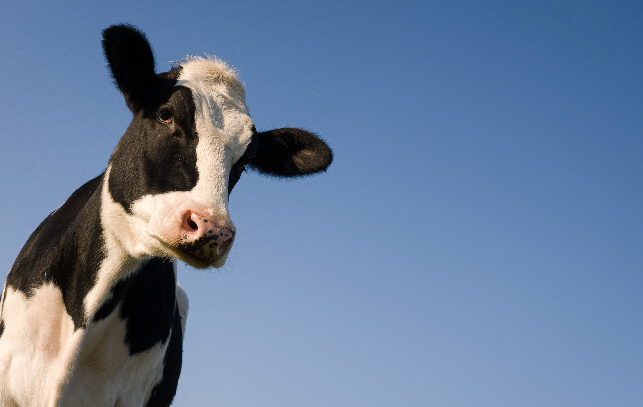
CONTACT INVESTOR RELATIONS
Peter de Boer,
BoD Member & Investor Relations Manager
investors@dn-agrar.eu , +40 258 818114

Slide 28
QUESTIONS
When you estimate you will give dividends to the shareholders?
I am interested to find out more about the status of implementation of the strategic initiatives.
Milk prices started growing again in April, and it looks that at least for Q2, the prices are 9-10% higher than Q2 last year. If the price trend stays the same, can the budget be exceeded?
Grain prices are increasing 15-20% in 2 months. What is the net impact for DN Agrar, and how does the productivity forecast look for DN Agrar farm at the moment?
What are the management costs of approx 153 k eur?
Any news on potential acquisition of other farms this year?
Compost factory: if operational from September this year, how will it contribute to the business in Q4 this year? Some numbers to share?

